Slide 1
Unit 2 Marine Biomes
Exam Review

Slide 2
Marine Ecology
The interdependence of all organisms living in the ocean, shallow coastal waters and on the seashore.
The marine environment for all organisms consists of
non-living (abiotic factors)
living (biotic factors)

Slide 3
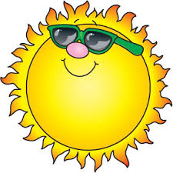
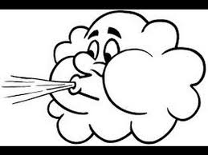
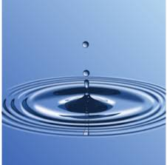
Abiotic Factors
The physical, chemical and geological variables that have a bearing on the type of life that can exist in an area.
They include:
water, light, temperature, pH, salinity, substratum, nutrient supply, dissolved gases, pressure
tides, currents, waves, exposure to air.

Slide 4
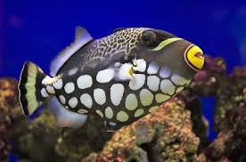
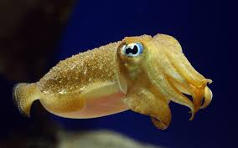
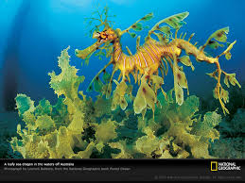
Biotic Factors
Living components of an ecosystem.
Interactions among living organisms
Adjust to salinity and temperature changes; Inhabit coastal areas which fit their adaptations.

Slide 5
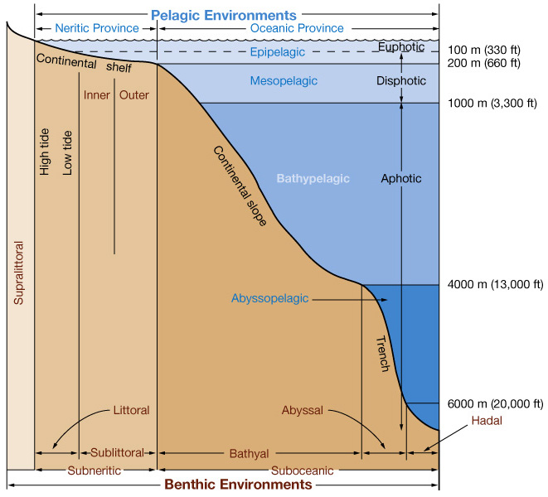
Zones of the Ocean
The ocean is divided into Zones:
Pelagic Zone:
“Open water”
Part of the ocean that is not near the coast or the sea floor.
Benthic Zone:
Lowest ecological region
Includes the sediment surface and some sub-surface layers.
Organisms generally live in close relationship with the substrate bottom and many are permanently attached to the bottom.

Slide 6
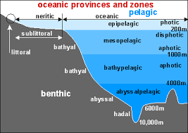
Photic and Aphotic Zones
Euphotic Zone:
Good light.
2/3 of all photosynthesis of all photosynthetic activity on Earth occurs in this zone.
Disphotic Zone:
Bad light
Only 1% of sunlight is able to penetrate into this layer.
Aphotic Zone:
Without light
No light is able to penetrate down to this level.

Slide 7
Zones of the Oceans
Zones of Surface Layers:
Neritic zone: the surface waters of the coastal areas until a continental slope
Contains: plant plankton, fish larva, invertebrate larva.
Epipelagic zone: the surface waters of the open ocean
Less productive, less life than Neritic zone.

Slide 8
Pelagic Zones: Water Column
Oceanic – beyond shelf break
Neritic – area that lies over shelf
Divided vertically by depth depending on level of sunlight:
Epipelagic
Mesopelagic
Bathypelagic
Abyssopelagic
Hadopelagic

Slide 9
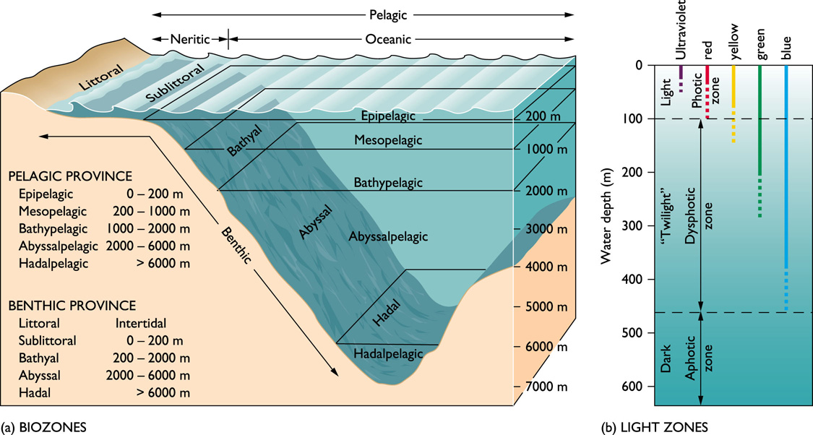
Zones of the Ocean
Epipelagic Zone: Surface to 200m.
Mesopelagic Zone: 200m-1000m
Bathypelagic Zone: deep sea layer 1000-4000m
Abyssopelagic Zone: below 4000m has limited food supplies. Some bacterica have been found to make their own food.
Hadopelagic Zone: Trench zone, depths of approximately 6000 m.

Slide 11
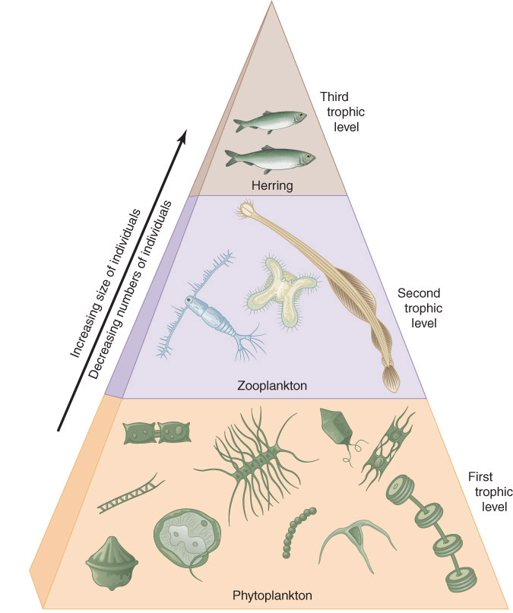
Feeding in the ocean
Trophic = feeding
Food Pyramid: the higher in the pyramid, the larger the animal but the fewer the animal

Slide 12
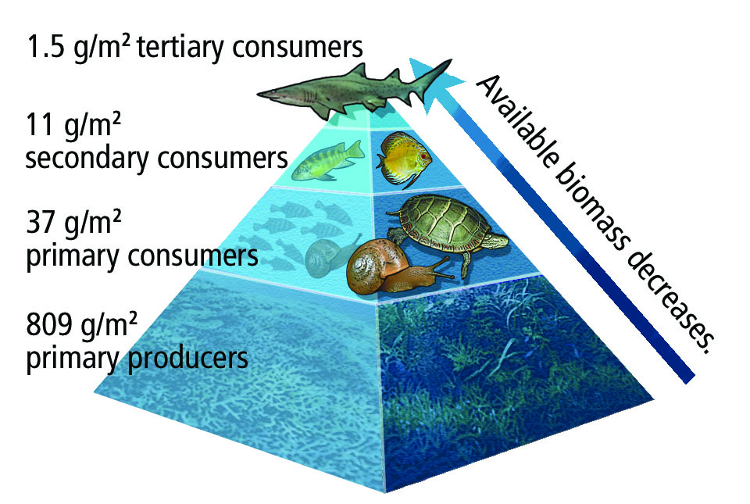
Autotrophs
Autotrophs:
absorb sunlight and transfer inorganic mineral nutrients into organic molecules
In surface waters: flowering plants such as sea grass, algae
In the deep ocean: chemosynthetic bacteria that take the inorganic energy to make organic matter for organisms that can’t absorb sunlight
https://www.youtube.com/watch?v=EN1Yxq8KMsw

Slide 13
Heterotrophs
Heterotrophs = consumers of energy that must rely on primary producers
Food Chain = series of step of consumers being eaten and eating
Trophic level = Each step of the food chain

Slide 14
Food Web
Includes all of the interactions within the trophic levels.

Slide 15
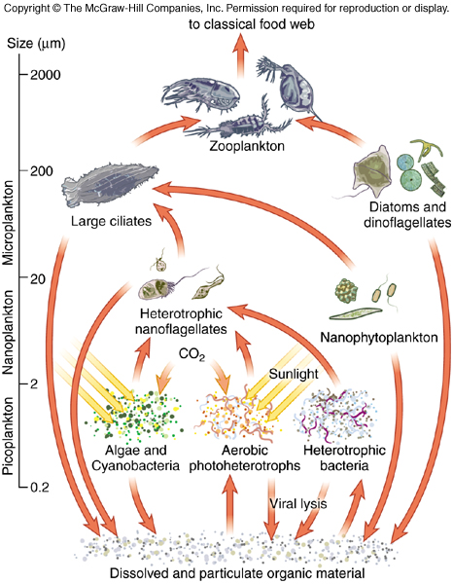
Decomposers
Decomposers:
live off of dead plant and animal material plus waste products. Their job gives the essential ingredients back to the autotrophs to continue the cycle.

Slide 16
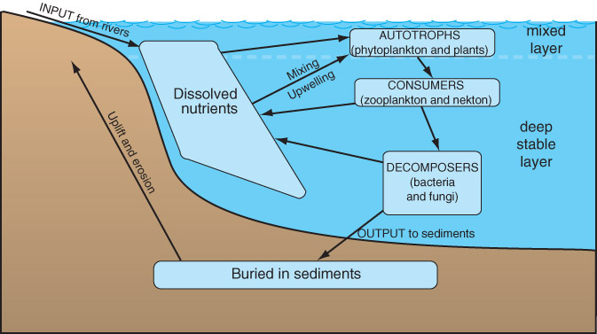
Decomposer Cycle

Slide 17
Energy Transfer in Marine Environments
Energy pyramid:
Energy distribution at each trophic level as it passes from producers to consumers
Some energy is lost by:
Consumers because they don’t usually consume the entire organism
Energy is used to capture food
Energy is lost to keep animal alive

Slide 18
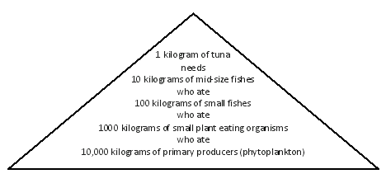

Slide 19
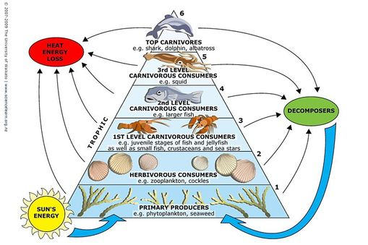

Slide 20
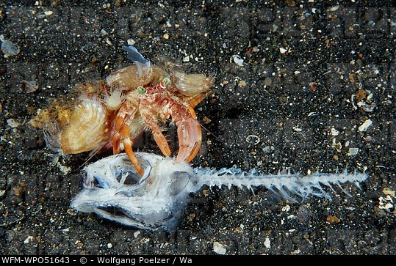
Scavengers
feed on dead plants and animals that they have NOT killed
Examples: crabs ripping chunks of flesh from fish on the beach

Slide 21
Symbiotic Relationship
refers to close nutritional relationship between two different species
Commensalism
Mutualism
Parasitism

Slide 22
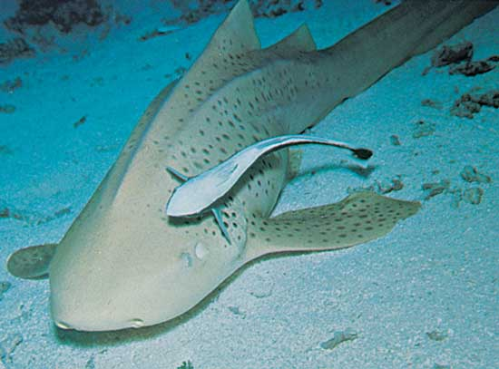
Commensalism relationship
One benefits the other is unaffected
Remora fish attaches itself to the leopard shark to hitch a ride. This allows the remora to save it’s energy to get to other places and the shark is unharmed.

Slide 23
Mutualism Relationship
Both benefit
The clownfish feeds on small invertebrates that otherwise have potential to harm the sea anemone

Slide 24
Parasitism
One benefits at the hosts expense
Loggerhead turtle can have leeches attached to its exposed body parts. The leeches use the turtle as a source of food and a place to lay eggs.
If the turtle becomes to infested, it could die.

Slide 25
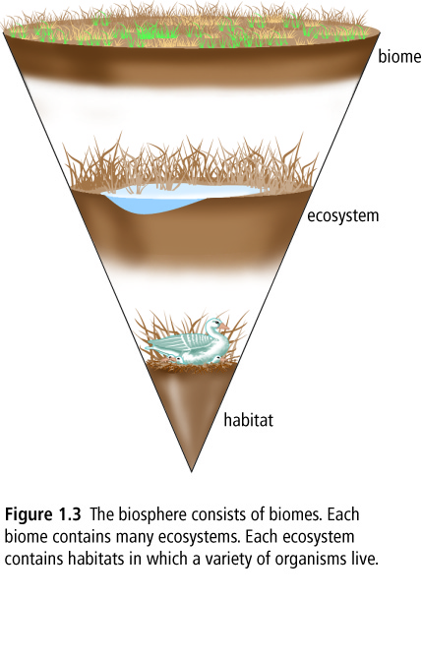
Biomes
A biome is a major, geographically extensive ecosystem, structurally characterized by its dominant life forms.
Most of the oceans are considered part of a single biome, although areas with particularly unusual or unique physical characteristics or inhabitants may be considered as separate ecosystems within the biomes.

Slide 26
World Oceans

Slide 27
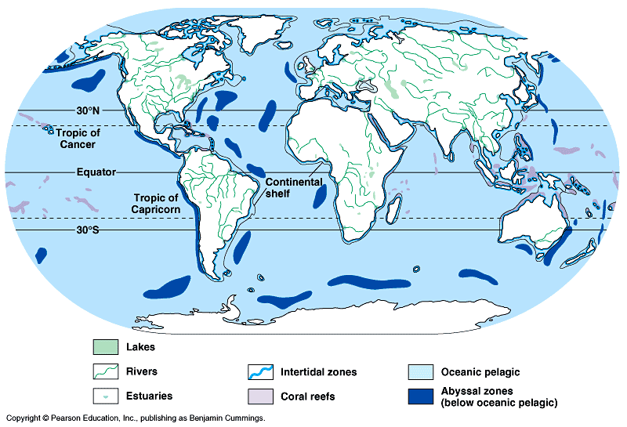

Slide 28
Importance of Marine Biomes
Oceans represent the largest and most diverse of the ecosystems.
Salt water evaporates and turns to rain which falls on the land regions, while most of the oxygen in our atmosphere is generated by algae.
Algae is also responsible for the absorption of large amounts of carbon dioxide from our atmosphere.

Slide 29
Marine Biomes
The marine regions are divided between:
Coral reefs
Estuaries
Oceans

Slide 30
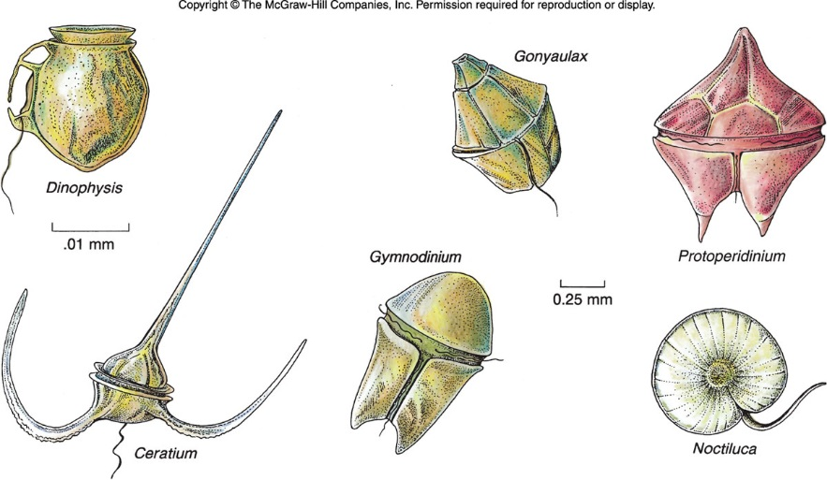
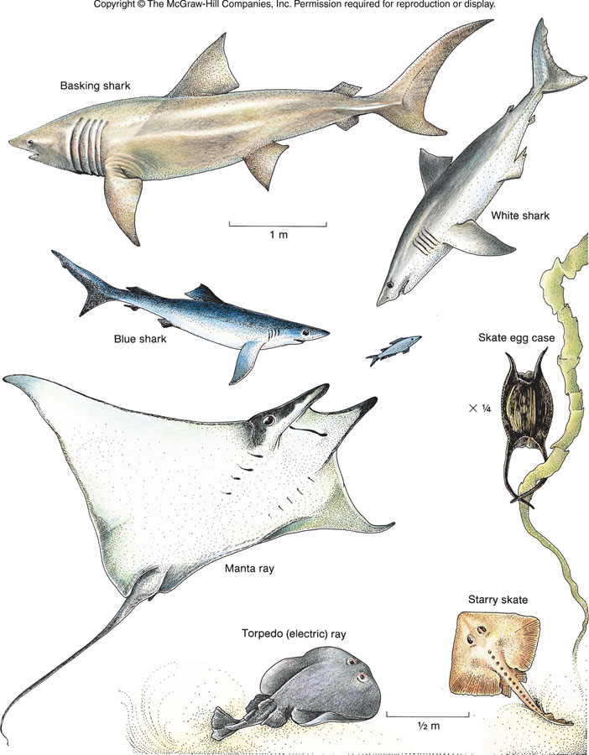
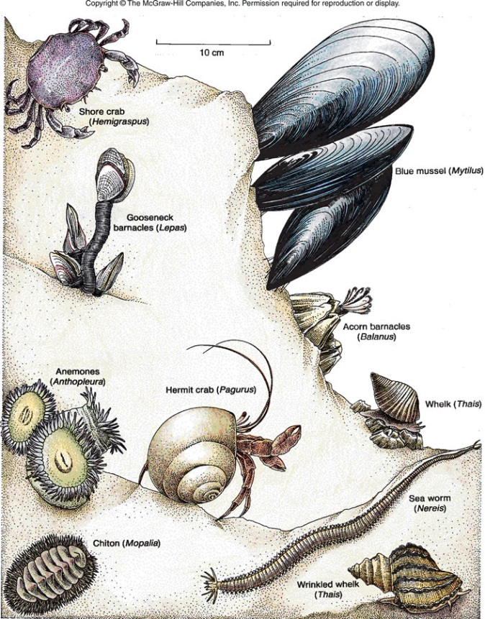
Classification of Marine Organisms
Plankton (floaters) [P]
Nekton (swimmers)[N]
Benthos (bottom dwellers)[B]

Slide 31
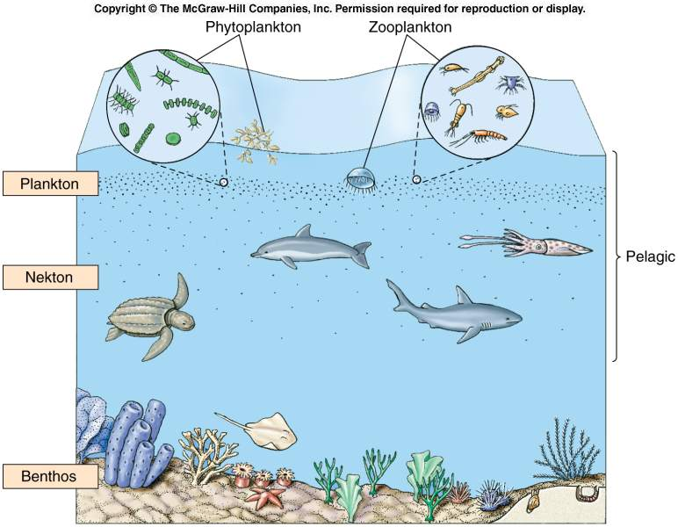

Slide 32
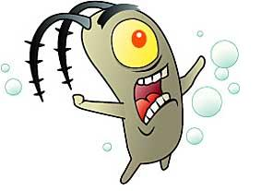
Plankton
Greek for “drifters”
Plankton is all plants or animals that drift with the ocean currents as inhabitant of the open waters of the ocean or sea
limited ability to move and can migrate vertically through the water from day to night.
Very diverse
http://www.ted.com/talks/the_secret_life_of_plankton?utm_source=newsletter_weekly_2012-04-03&utm_campaign=newsletter_weekly&utm_medium=email

Slide 33
Importance of Plankton
Plankton is very important as it occupies the first two or three links in the marine food chains.
Zooplankton are the animal members of the plankton ranging in size from bacteria size to 15 m jellyfish.
Phytoplankton are plant plankton and are the trees of the ocean.
They float near the surface to make the most of the sunlight for photosynthesis.
Their small size slows sinking,
Structure and shape slows sinking rate
Density decrease by storing droplets of oil in the cytoplasm.

Slide 34
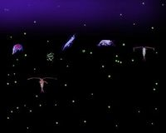
Plankton: Functional Groups
Phytoplankton
-autotrophic algae
-live near the surface…..why?
-diatoms, cyanobacteria, dinoflagellites
Zooplankton
-small crustations or other animals that feed on other plankton
-include eggs and larvae of larger animals
Bacterioplankton
-bacteria re-mineralize and decompose other plankton
AN ENTIRE COMMUNITY OF PLANKTON!

Slide 35
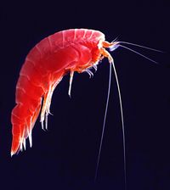
How much Plankton is there? And where is it?
Varies horizontally, vertically, seasonally
Light
-“All plankton ecosystems are driven by the input of solar energy”
-Geographic regions and seasons where light is abundant
-Surface Waters
Nutrients
-ocean circulation and stratification
-nutrients tend to be in deeper waters
Highest in Spring & Fall

Slide 36
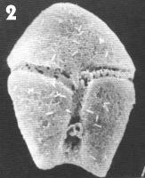
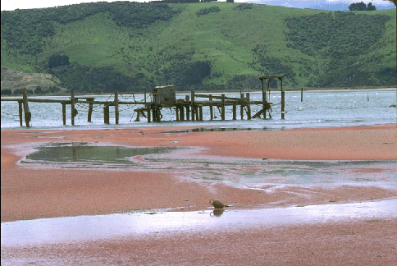
Dinoflagellates
Some Dinoflagellates cause “red tide” – they bloom so extensively that the water looks red
Some release a neurotoxin that is stored in certain shellfish and causes Paralytic Shellfish Poisoning (PSP) in humans when shellfish are eaten
Red tide

Slide 37
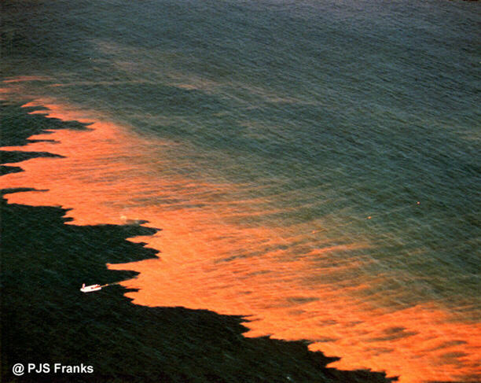
Red Tides
An algae “bloom” of dinoflagellites

Slide 38
Benthic
Organisms resides primarily in or on the bottom of the ocean and don't swim or drift for extended periods of time.
They burrow, crawl, walk (motile) or are permanently affixed to the ocean bottom or each other.
Demersal organisms: flounder swimming and rest on the bottom
Epifauna: live all of the time on the bottom of the ocean
Infauna: live under or within the bottom of the ocean

Slide 40
Nekton
Cephalopods (squids), fishes, marine mammals, sea turtles and marine birds
Many are carnivores or herbivores without natural predators.
Planktivorous nektons: are animals that feed directly on plankton such as baleen whales and some fish.
Herbivorous nektons are ones that feed on large seaweeds and sea grasses (turtles and manatees).
Carnivorous nekton are the dominant carnivorous animals of the pelagic environment and generally these animals migrate great distances in search of food. Use fins, jets of water, strong flippers, flukes and flippers to swim through the water.

Slide 42
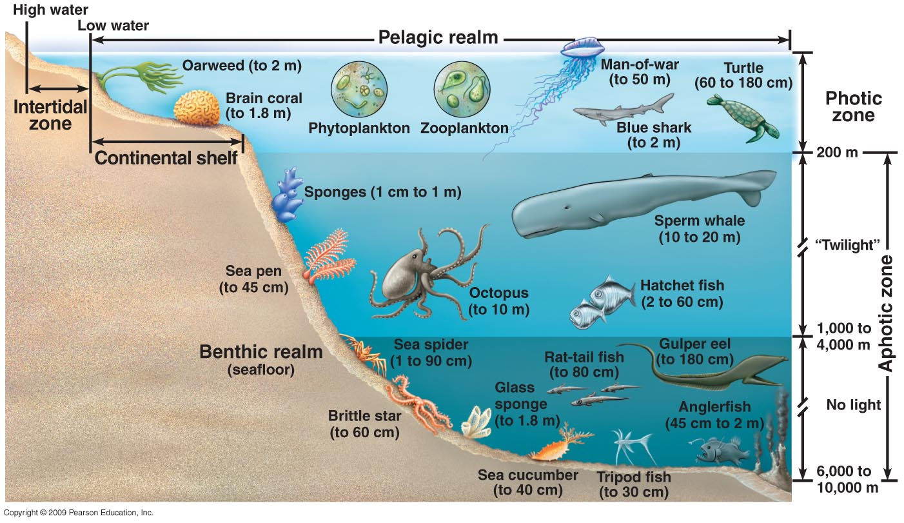

Slide 43
HABs: Harmful Algal Blooms
Harmful algal blooms, sometimes referred to as “red tides,” are mostly caused by single celled algae called phytoplankton (not all are red, and not all red blooms are harmful!)
Harmful algae are a small subset of species that negatively affect human, animal, and ecosystem health and coastal resources through the production of potent chemical toxins (algal toxins) or the build up of excess biomass.

Slide 44
Impacts of HABs
Human Health Impacts:
Effects can range from neurological impairment to gastrointestinal distress to respiratory irritation, in some cases resulting in severe illness and even death.
Animal Health Impacts:
Massive fish kills are most common. Algal toxins have also been associated with deaths of whales, manatees, sea lions, dolphins, sea turtles, birds and invertebrates.
Environmental Impacts:
Degrades ecosystem health by forming large and dense blooms. These blooms alter habitat quality through overgrowth, shading, oxygen depletion, or accumulation on beaches.
Socioeconomic Impacts:
Can be very costly! Just one major HAB event can cost local coastal economies tens of millions of dollars, translating to a much larger nationwide impact.

Slide 45
Why Classify?
There are over 8.8 million different species known on Earth.
Scientist are still discovering new species.
thousands of new marine species are discovered every year!
Developed by scientists to bring order to the great diversity of life forms.
Provides a logical naming system.
Newly discovered organisms may be grouped.
Identify organisms
Represent relationships among organisms.

Slide 46
Classification of Living Things:
Taxonomy: The science that deals with the classification of living things.
Unity: Similar characteristics among organisms which group them together. (how organisms are similar)
Diversity: Different aspects between organisms that place them into different groups. (how organisms are different)
Species: A group of organisms, alike in many ways that can interbreed under natural conditions to produce fertile offspring.
Genus: A group of similar species.

Slide 47
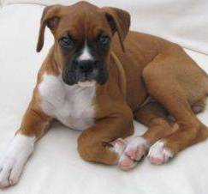
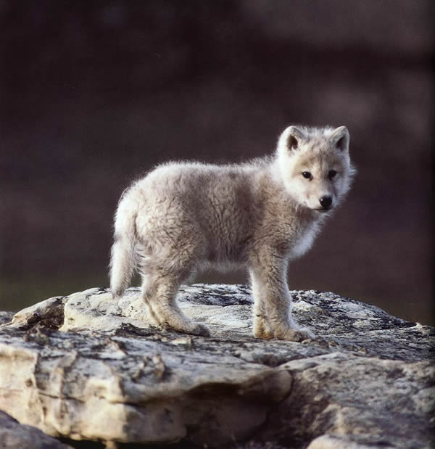
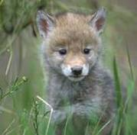
Binomial Nomenclature
Linnaeus used a two name system for assigning names to organisms.
This is known as binomial nomenclature.
Two word Latin name. Latin is a dead language (unchanging)
The first name is the genus (a noun)
Second name is the species (an adjective) within the genus.
Genus and species are given together to constitute the species name of an organism. Genus may be indicated with first initial, but only if it is understood.
Examples:
Canis familiaris (dog)
C. lupus (wolf)
C latrans (coyote)
Note that this system shows a connection between dogs, wolves, and coyotes.
Genus is capitalized. Species is lower case.
https://www.youtube.com/watch?v=F38BmgPcZ_I

Slide 48
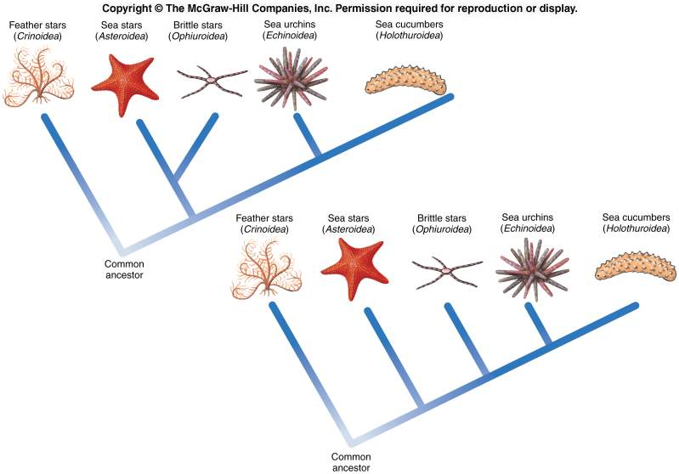
Classification
Is
Tricky…

Slide 49
Some organisms were named a long time ago. Since then more information has been gained and now we realize they were not named correctly.
Ex: Seahorse

Slide 50
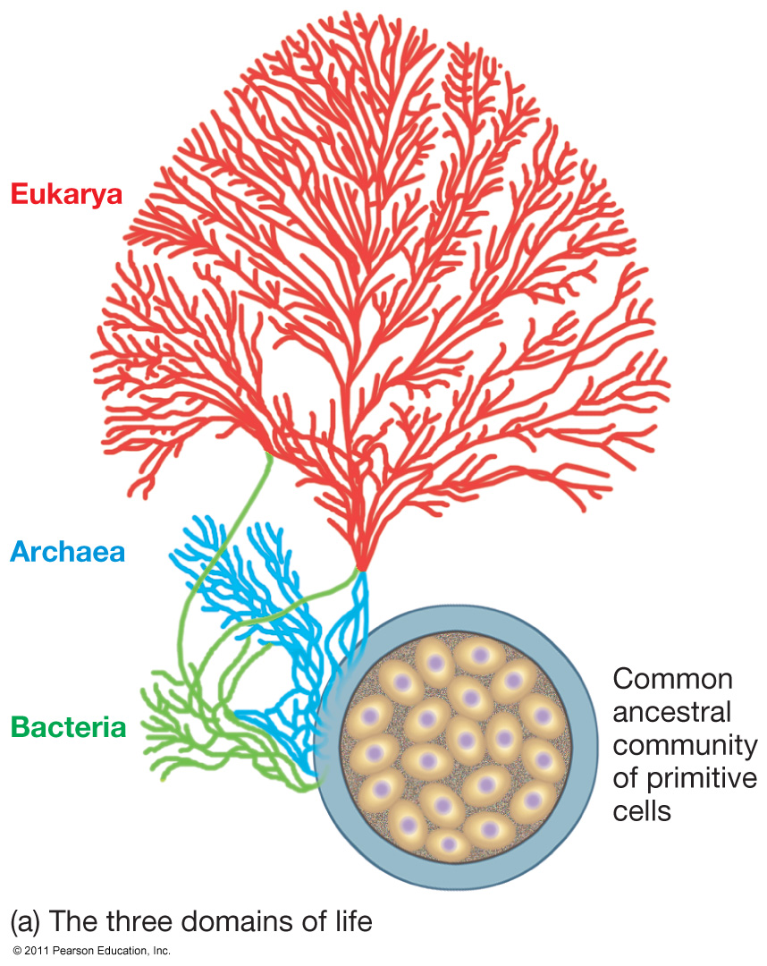
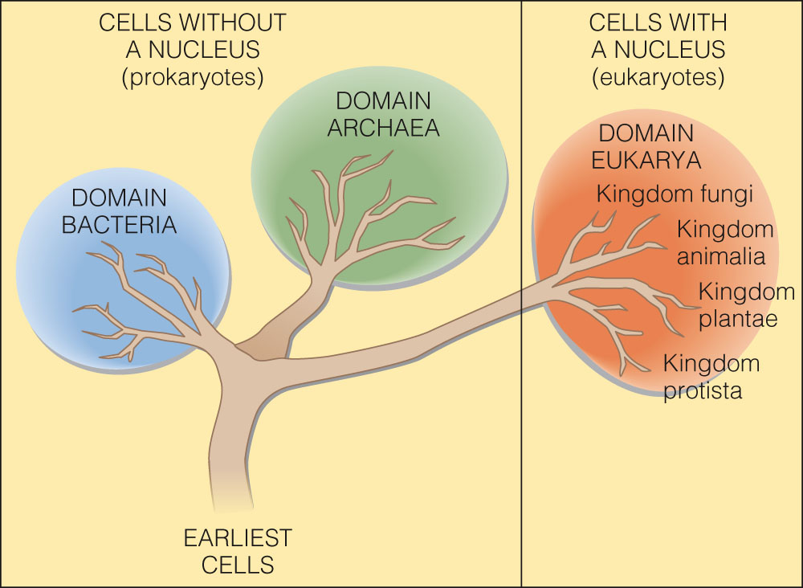
Classification of Life
Three domains
Archaea
Bacteria
Eukarya

Slide 51
Three Kingdom Classification System

Slide 52
Bacteria and Archaea
The Bacteria and Archaea contain single-celled organisms without nuclei or organelles; they are called prokaryotes.
Eukarya
The fungi, protists, animals, and plants contain organisms with cells having nuclei and organelles; they are called eukaryotes.

Slide 53
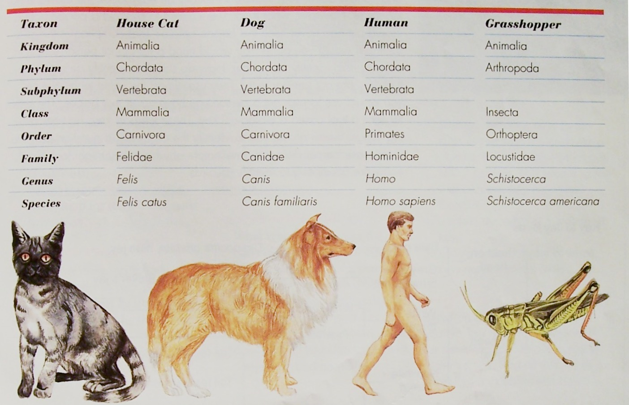
Classification of Sample Animals

Slide 54
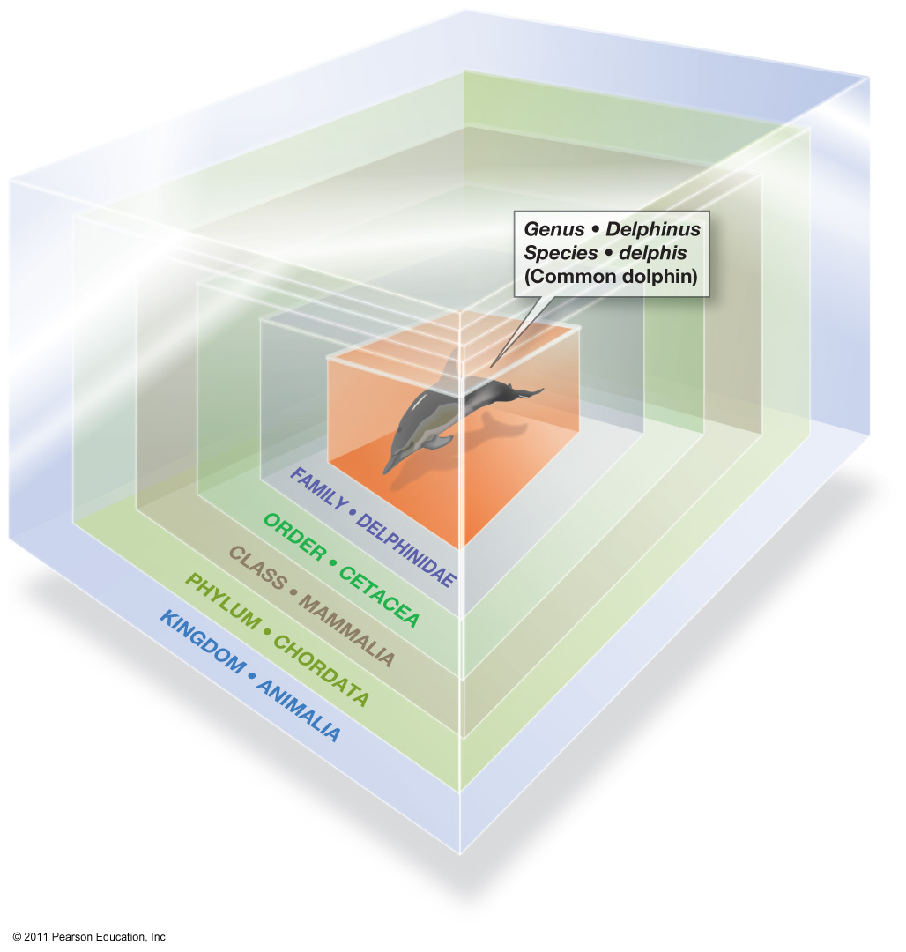
The Seven Taxa
Scientist place organisms into different taxa; the more taxa the organisms have in common the more closely related they are!
Kingdom
Phylum
Class
Order
Family
Genus
Species
Fundamental unit
Population of genetically similar,
interbreeding individuals

Slide 55
Classification Examples
Organism | Tulip | Amoeba | Giant Sea Kelp
Kingdom | Plantae | Protista | Protoctista
Phylum | Magnoliophyta | Protozoa | Phaeophyta
Class | Lilliopsida | Rhizopoda | Phaeophyceae
Order | Liliales | Amoebida | Laminariales
Family | Lilliaceae | Amoebidae | Lessoniaceae
Genus | Tulipa | Amoeba | Macrocystis
Species | primulina | proteus | pyrifera

Slide 56
Dichotomous Keys
A dichotomous key is a tool that allows the user to determine the identity of items in the natural world based on the items characteristics
"Dichotomous" means
“divided into two parts” Greek origin
dichotomous keys always give two distinct choices in each step, often they are opposites
Black/white; wings/no wings

Slide 57
Biodiversity
Biological diversity, or biodiversity, refers to the variety of species and ecosystems on Earth and the ecological processes that they are a part of.
The three components of biodiversity include ecosystem diversity, species diversity and genetic diversity.
High levels of biodiversity increase an ecosystem’s resilience and resistance to natural and human influenced disturbances.
Biodiversity also provides countless ways for life to adapt to changing environmental conditions.

Slide 58
Adaptations of Marine Organisms
Adaptation is an evolutionary process whereby an organism becomes increasingly well suited to living in a particular habitat.
It is not a quick process! Natural Selection over many generations results in helpful traits becoming more common in a population.
Adaptation is also a common term to describe these helpful or adaptive traits.
In other words, an adaptation is a feature of an organism that enables it to live in a particular habitat.

Slide 59
Types of Adaptations
Marine organisms have adapted to the great diversity of habitats and distinctive environmental conditions in the marine environment.
Adaptations are many and varied but they are generally grouped into 3 main categories:
Structural
Physiological
Behavioural

Slide 60
Structural Adaptations
Structural adaptations are the physical features of the organism.
These include things you can see, like its shape or body covering, as well as its internal organisation.
Example: Bivalves are filter feeders, they have adapted specialized siphon structures that filter the organisms from the surrounding water.

Slide 61
Physiological Adaptations
Physiological adaptations relate to how the organism’s metabolism works.
These adaptations enable the organism to regulate their bodily functions, such as breathing and temperature, and perform special functions like excreting chemicals as a defence mechanism.
Example: Whales migrate over large distances and may spend time in a combination of arctic, tropical and temperate waters.
To cope with these temperature changes, they are endothermic or ‘warm blooded’, meaning they are able to maintain a constant body temperature that is not dependent on the surrounding water.

Slide 62
Behavioural Adaptations
Behavioural adaptations are learned or inherited behaviours that help organisms to survive.
Example: Bryozoans are tiny animals that band together to aid in finding food and to survive predation.

Slide 63
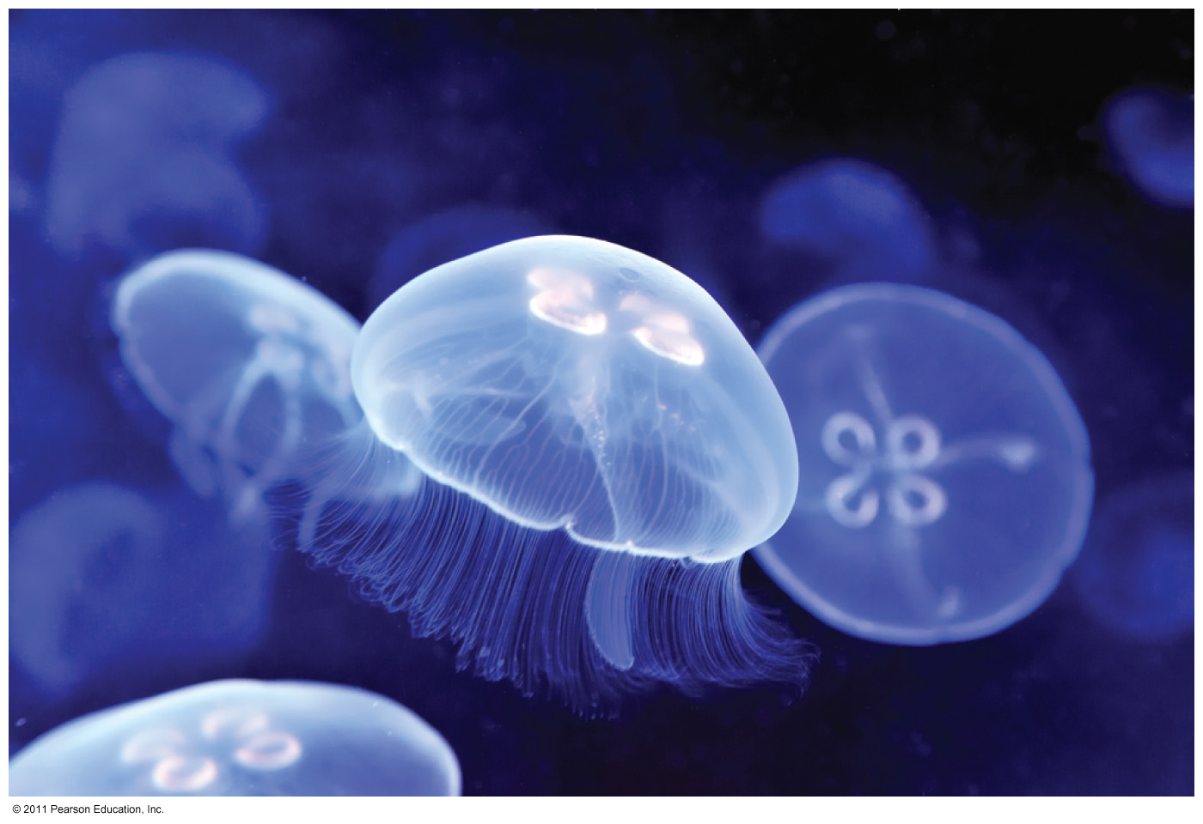
Water’s Transparency
Many marine organisms see well.
Some marine organisms are nearly transparent.
Elude predators
Stalk prey

Slide 64
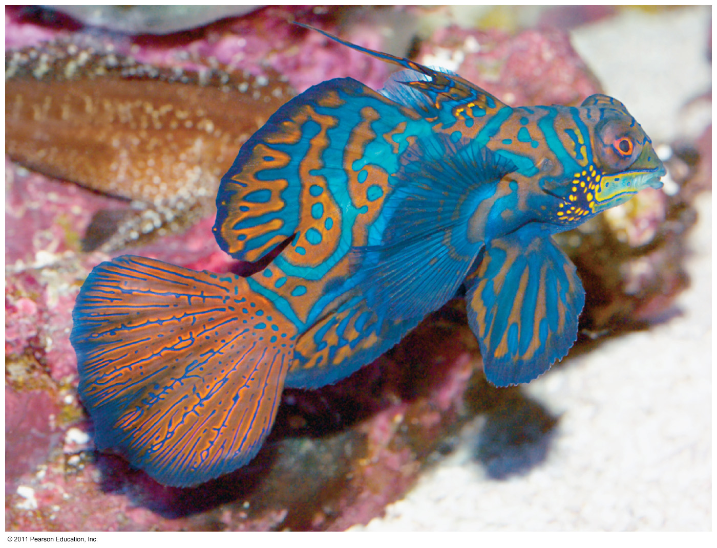
Adaptations to Marine Environment
Camouflage through colour patterns
Countershading – dark on top, light on bottom
Disruptive colouration – large bold patterns, contrasting colours make animal blend into background

Slide 65
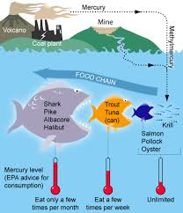
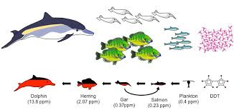
Bioaccumulation and Biomagnification

Slide 66
Bioaccumulation and Biomagnification
Bioaccumulation is a process in which materials, especially toxins, are ingested by an organism at a rate greater than they are eliminated.
Biomagnification is the increase in the concentration of a toxin as it moves from one trophic level to the next.

Slide 67
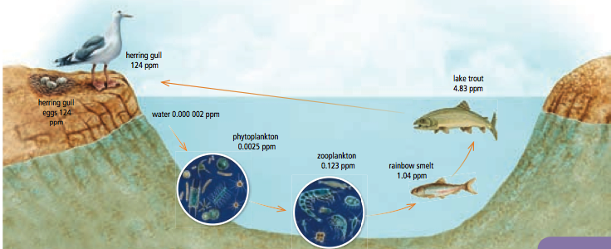
Biomagnification

Slide 68
Persistent Organic Pollutants (POP’s)
POP’s are a group of toxic chemicals sharing 4 common properties:
Highly toxic
Persistent in the environment
Travel long distances globally
Bioaccumulation in humans and wildlife

Slide 69
The Dirty Dozen

Slide 70
How does this affect us?
Greatest health problems at top
DDT → is an agricultural insecticide that was once used in North America
PCB → was previously used in industries.

Slide 71
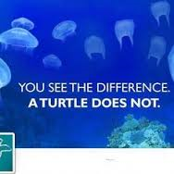
The Ocean: Toxic Soup
The ultimate destination for most persistent anthropogenic substances → THE OCEAN
Substances with long residence times can
cause serious harm to biota
(all living things in the ocean!!!)
Substances can interact:
Plastics are known to adsorb hydrophobic pollutants,
increasing toxicity.

Slide 72
Biomagnification occurs when contaminants that don’t easily degrade increase with each link of a food chain.
In seawater, these persistent molecules stick to small particles and phytoplankton. Small fish eat the phytoplankton, but the contaminants can’t be broken down and are absorbed, intact, by the fish. When small fish are eaten by larger predators, the process repeats again and again, up the food chain.
Each subsequent predator receives a higher dose than the previous one. Animals at the top of the food chain, such as dolphins, receive the most concentrated dose of these contaminants with every meal.

