Slide 1
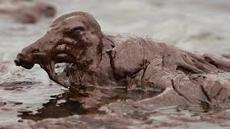
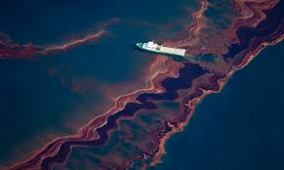
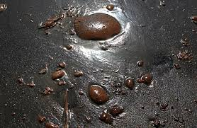
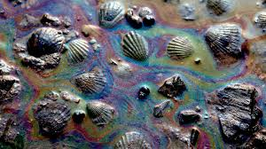
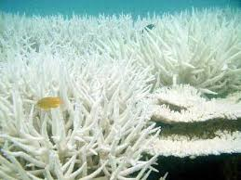
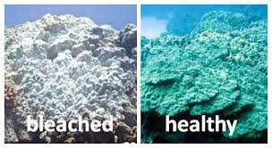
Marine Environments

Slide 2
Marine Environments
Due to the fluid nature of water, Marine organisms are highly sensitive to fluctuations in the environments.
Salinity
Temperature
CO2, O2 and other dissolved gases
Nutrient levels
Pollutants
Changes in marine environments can have dramatic effects on species distribution and survival.

Slide 3
Effects of Changing Species Distribution
Coastal areas are the most populated parts of the world (70 % of people live in coastal areas!)
Many of these areas are dependent on seafood for survival (Sea food serves as the primary source of dietary protein).
As ocean conditions change, species adjust by moving to areas that are more suitable for their survival.
Populations reliant on these species for food no longer have a sustainable food source → creating conditions of food scarcity.

Slide 4
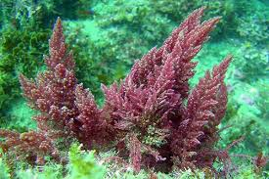
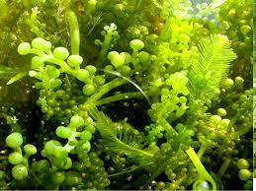
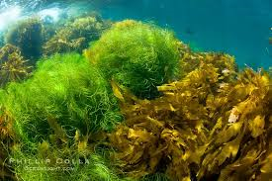
Primary Productivity
Primary productivity is the amount of carbon (organic material) produced by organisms.
Mainly through Photosynthesis, some through chemosynthesis

Slide 5
Oceanic Photosynthetic Productivity
Factors affecting photosynthetic productivity:
Availability of Nutrients
Nitrates
Phosphates
Iron
Availability of Sunlight
Varies Daily and Seasonally
Sunlight strong enough to support photosynthesis occurs only to a depth of 100m (Euphotic Zone)

Slide 6
Location of Maximum Productivity
Margins of the Ocean
Abundant supply of nutrients (Why?)
Shallow enough for sunlight to penetrate to bottom of ocean floor.
Upwelling Areas
Currents bring cool nutrient rich water to warmer sunlit surface

Slide 8
Seasonal Distribution

Slide 9
Phytoplankton Blooms
Spring brings warmer temperatures and increased sunlight, creating a thermocline that traps nutrients at the ocean surface.
This allows phytoplankton to absorb energy and take in the nutrients they need to photosynthesize and multiply. The warming of the surface layer keeps this water less dense, so it stays afloat.
As the phytoplankton use up the available nutrients however, they begin to die and drift to the bottom.
There is little vertical mixing in the water column during summer months, surface waters generally have small amounts of phytoplankton.
As autumn begins, cooler days cause some vertical mixing that may bring nutrients up from below resulting in a relatively smaller fall bloom.
Once winter begins, plummeting temperatures and frequent storms cause heavy mixing. As phytoplankton do not remain at the surface in this mix, they do not have ready access to sunlight, so blooms do not occur in the winter.

Slide 10
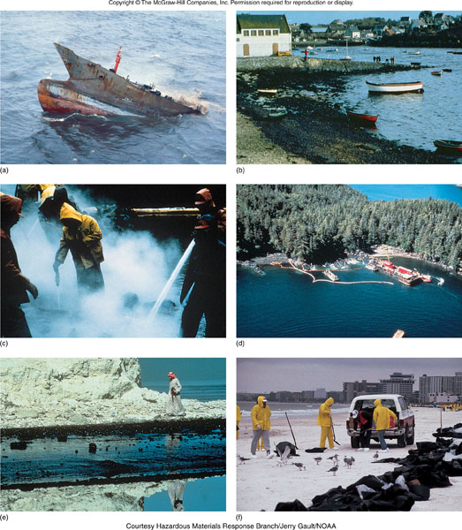
Marine Pollution
Many forms
chemicals, sewage, solid waste, sediment, heat
Impact of a pollutant depends on quantity, toxicity of the pollutant to each organism, & its affect on the environment

Slide 11
Marine Pollution

Slide 12
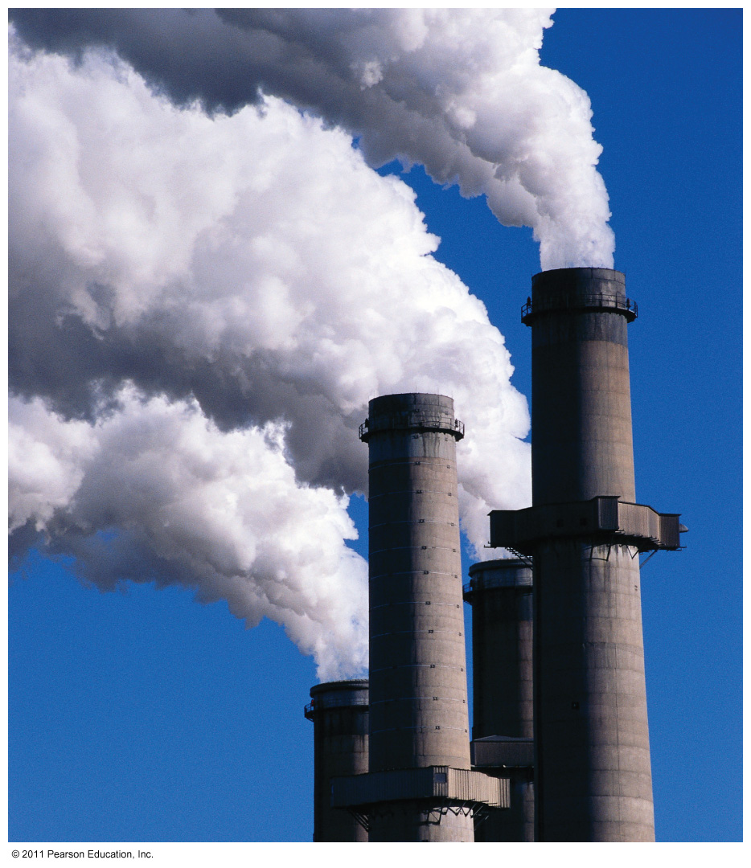
Ocean Pollution
Global Warming
Greenhouse gases (Chloroflorocarbons CFC’s,
Methane (Cow farts!), CO2, Water Vapour)
CO2 → burning fossil fuels, deforestation
Oil Spills
Oil and water do not mix!
Wide distribution range due to currents
Chemical Runoff
Herbicides, pesticides, insecticides used on crops enters ocean through river runoff
Sewage
Changes nutrient content
Ocean Acidification
Absorption of CO2 by the ocean is changing ocean chemistry

Slide 13
Global Warming
The global temperature trend has been generally upward in the 18,000 years since the last ice age, but the rate of increase has recently accelerated.
We are entering a period of rapid global warming, some or most of which is caused by human activity.

Slide 14
Earth Temperatures are Rising
Projected thickness of Arctic ice over 100-year time span.
Northern polar sea ice is predicted to decline to 54% of its 1995 volume by the year 2055.

Slide 15
Maldives
The Maldives in the Indian Ocean – 80% pop. live only 1m above sea level

Slide 16
Coral Bleaching
Environmental damage can cause coral animals to expel their symbiotic dinoflagellates (zooxanthellae).
If conditions do not improve, the animals can be overtaken by algae and die.

Slide 17
Marine Impacts of Global Warming
Sea-level Rise (4-10 inches last century)
Coastal habitats, corals
Coral Bleaching
Habitat shifts: Species dispersion
Circulation patterns

Slide 18
Oil Spills
Oil spills can harm marine organisms in two ways:
The Oil itself:
The chemical composition of oil is toxic!
Oil affects organisms both from internal exposure to oil through ingestion or inhalation and from external exposure through skin and eye irritation.
Oil can smother some small species of fish or invertebrates
Oil coats feathers and fur, reducing birds' and mammals' ability to maintain their body temperatures.
The clean up efforts
Chemicals are used to “disperse” or break up the oil.

Slide 19
Oil Spills
The effects of an oil spill on marine life depend on a number of physical and biological factors.
The distribution of the oil spill will be affected by currents and wind
In addition, the amount of oil spilled will determine the eventual geographic boundaries of the impact area.
The physical and chemical properties of the oil will determine the behaviour of the slick, in terms of its thickness and rate of spreading.

Slide 20
Oil Spills
Environmental conditions such as salinity, water temperature, and type and slope of shoreline will determine habitat effects and clean-up procedures
Some example habitats include sandy beach, mud, cliffs, estuaries and open water.
In terms of difficulty of clean-up and relative vulnerability, a salt marsh ranks the highest, followed by eelgrass, mud, mixed-fine sediment, mixed-coarse sediment, rock, sand, algae (kelp) and open water.

Slide 21
Oil Spills
Biological characteristics of the organisms affected will determine the severity of impact.
These characteristics include the type of species, life stage (larval, juvenile or adult) and size.

Slide 22
Ocean Acidification
Ocean acidification is the ongoing decrease in the pH of the Earth's oceans, caused by the uptake of carbon dioxide (CO₂) from the atmosphere.
Ocean acidification is decreasing the ability of many marine organisms to build their shells and skeletal structure.
An estimated 30–40% of the carbon dioxide from human activity released into the atmosphere dissolves into oceans, rivers and lakes.
https://www.youtube.com/watch?v=qAkhuETYn5U

Slide 23
The concentration of Bicarbonate ions decreases.

Slide 24
What does Ocean Acidification mean for Marine Organisms?
The reduction in pH reduces the availability of carbonate ions
Carbonate ions play an important role in shell formation for marine organisms (shells are made of calcium carbonate – our bones are made of calcium)
CO2 is corrosive to the shells and skeletons of marine organisms
Some of the organisms affected: Corals, sea urchins, some marine plankton, marine snails, crabs

Slide 25
Why are these effects significant?
Coral reefs are less resilient to bleaching, disease, and death
The rate of reef building is decreased
The base of the food web (algae and zooplankton) is reduced creating a ripple affect along the food web
The economy will be negatively affected
Fisheries (i.e. shellfish, sea urchins) may decline
Tourism may decline
Affect on bio-tech and pharmaceuticals

Slide 26
Dangers of Ocean Acidification
TED Talk: Ocean Acidification
https://www.youtube.com/watch?v=evfgbVjb688

