Slide 1
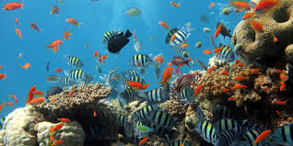
Intro to Marine Ecology

Slide 2
Marine Ecology
The interdependence of all organisms living in the ocean, shallow coastal waters and on the seashore.
The marine environment for all organisms consists of
non-living (abiotic factors)
living (biotic factors)

Slide 3
Abiotic Factors
The physical, chemical and geological variables that have a bearing on the type of life that can exist in an area.
They include:
water, light, temperature, pH, salinity, substratum, nutrient supply, dissolved gases, pressure
tides, currents, waves, exposure to air.

Slide 4
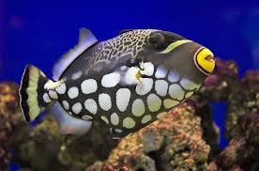
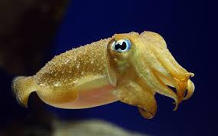
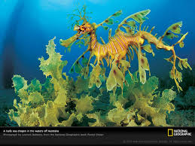
Biotic Factors
Living components of an ecosystem.
Interactions among living organisms
Adjust to salinity and temperature changes; Inhabit coastal areas which fit their adaptations.

Slide 5
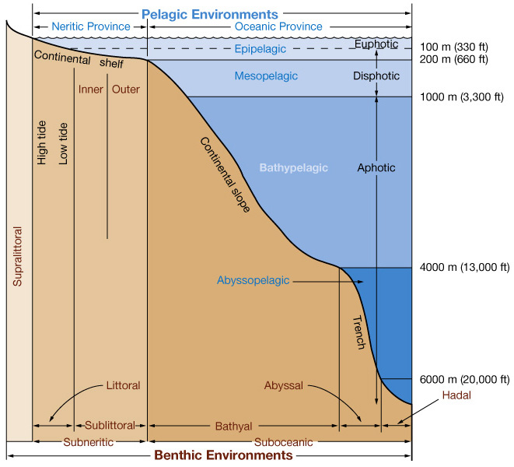
Zones of the Ocean
The ocean is divided into Zones:
Pelagic Zone:
“Open water”
Part of the ocean that is not near the coast or the sea floor.
Benthic Zone:
Lowest ecological region
Includes the sediment surface and some sub-surface layers.
Organisms generally live in close relationship with the substrate bottom and many are permanently attached to the bottom.

Slide 6
Pelagic Zones: Water Column
Oceanic – beyond shelf break
Neritic – area that lies over shelf
Divided vertically by depth depending on level of sunlight:
Epipelagic
Mesopelagic
Bathypelagic
Abyssopelagic
Hadopelagic

Slide 7
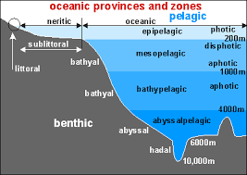
Photic and Aphotic Zones
Euphotic Zone:
Good light.
2/3 of all photosynthesis of all photosynthetic activity on Earth occurs in this zone.
Disphotic Zone:
Bad light
Only 1% of sunlight is able to penetrate into this layer.
Aphotic Zone:
Without light
No light is able to penetrate down to this level.

Slide 8
Zones of the Oceans
Zones of Surface Layers:
Neritic zone: the surface waters of the coastal areas until a continental slope
Contains: plant plankton, fish larva, invertebrate larva.
Epipelagic zone: the surface waters of the open ocean
Less productive, less life than Neritic zone.

Slide 9
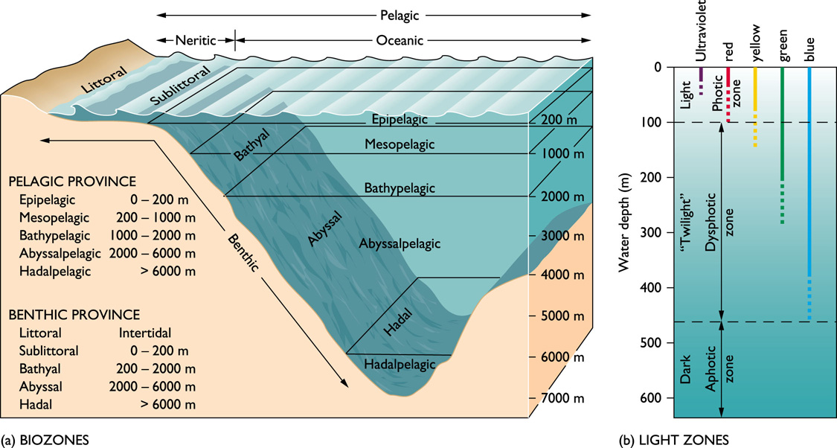
Zones of the Ocean
Epipelagic Zone: Surface to 200m.
Mesopelagic Zone: 200m-1000m
Bathypelagic Zone: deep sea layer 1000-4000m
Abyssopelagic Zone: below 4000m has limited food supplies. Some bacterica have been found to make their own food.
Hadopelagic Zone: Trench zone, depths of approximately 6000 m.

Slide 11
Zones of the Ocean Foldable
Front Cover
Fold Paper in Half
Hamburger Style
Ocean Life Zones
Cut along dashed lines to create 5 flaps

Slide 12
Foldable
Epiplagic Zone
For each Zone include:
Where is it in the water column (depth)
Photic, disphotic , aphotic
What organisms live there
What are the benefits and challenges of living in this zone?
Any other interesting characteristics.
Turn your foldable sideways and label the sections
Mesopelagic Zone
Bathypelagic Zone
Ocean Life Zones
Abyssopelagic Zone
Hadopelagic Zone

Slide 13
Sea Legacy
https://vimeo.com/137293533

