Slide 1
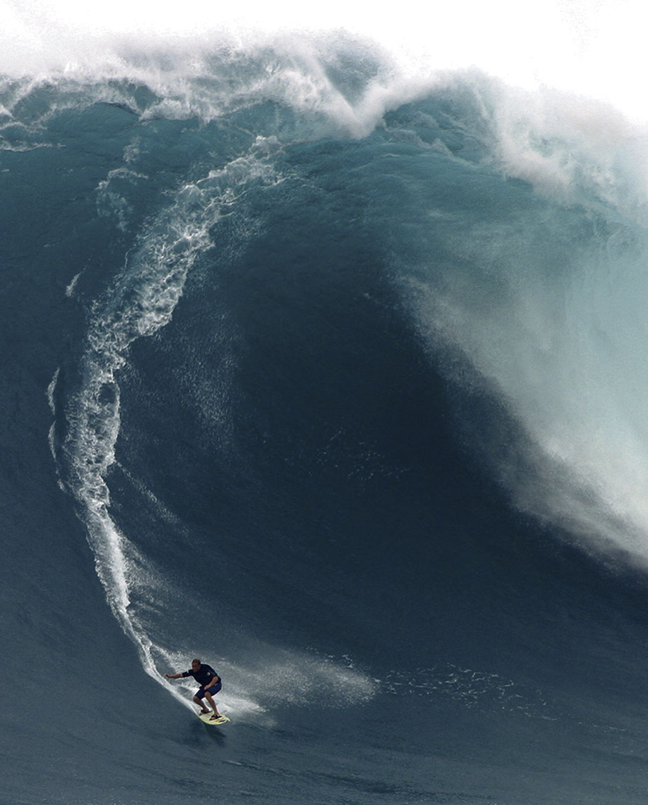
Waves
Part 1

Slide 2
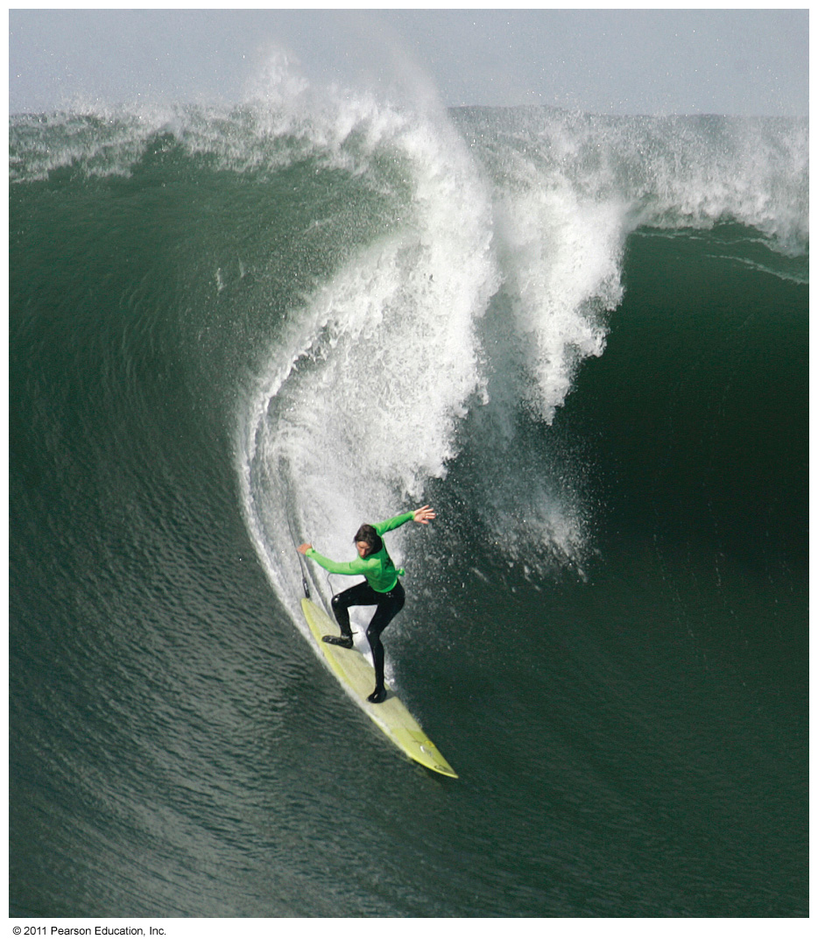

Slide 3
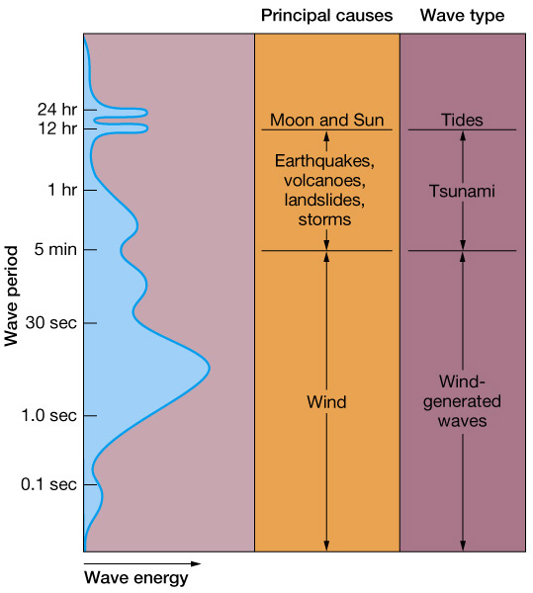
What is a wave?
Waves are disturbances in the ocean that transmit energy from one place to another.
Usually generated by wind
Can be generated by tides, volcanoes, landslides and storms

Slide 4
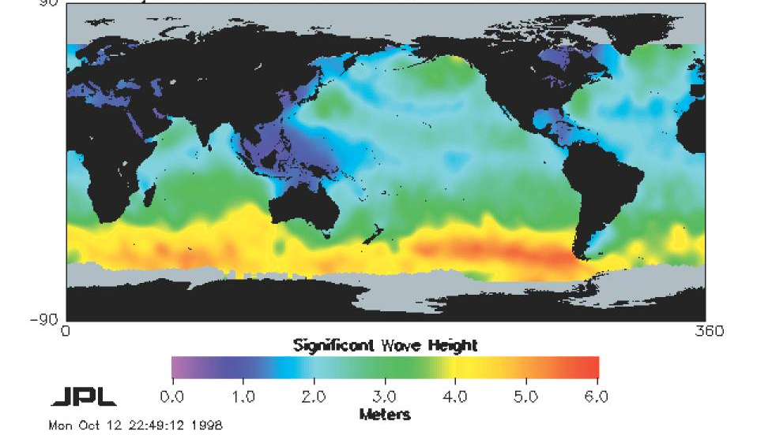
Fetch: Distance wind travels

Slide 5
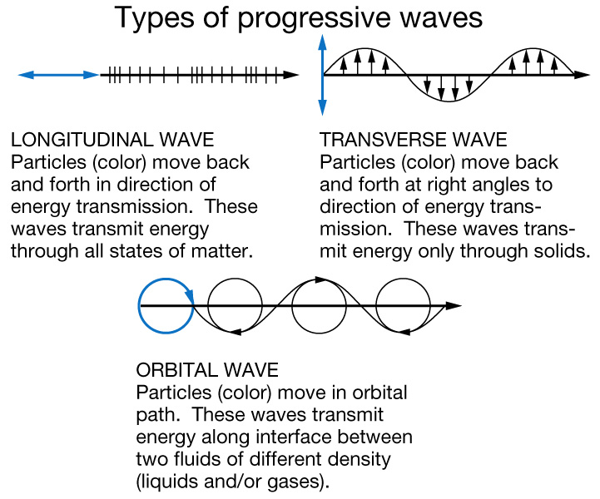
Types of Waves
Longitudinal
Back-and-forth motion
Transverse
Side-to-side motion
Orbital
Combination (Ocean waves)

Slide 6
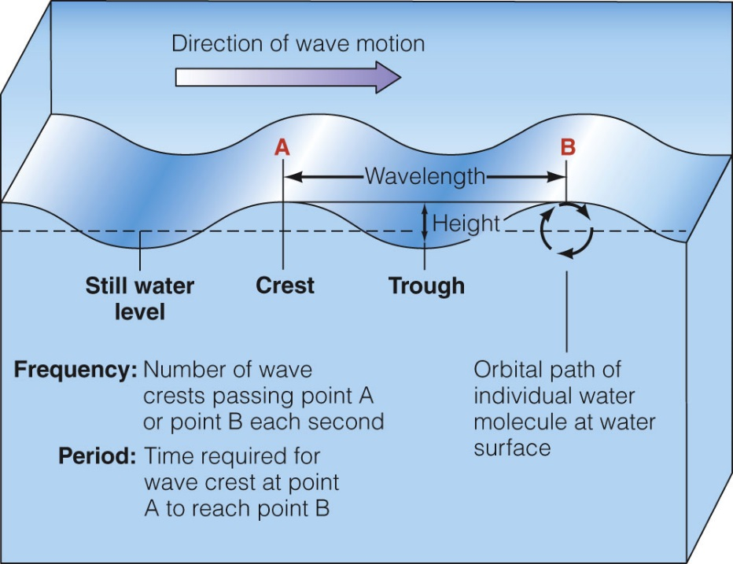
Wave characteristics and Terminology
Crest ,Trough, Wave height (H)
Wavelength (L), Still water level, Wave depth (d)

Slide 8
Wave Steepness

Slide 9
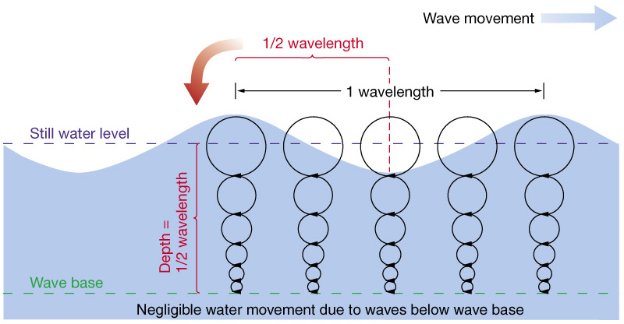
Orbital motion in waves
Orbital size decreases with depth to zero at wave base

Slide 10
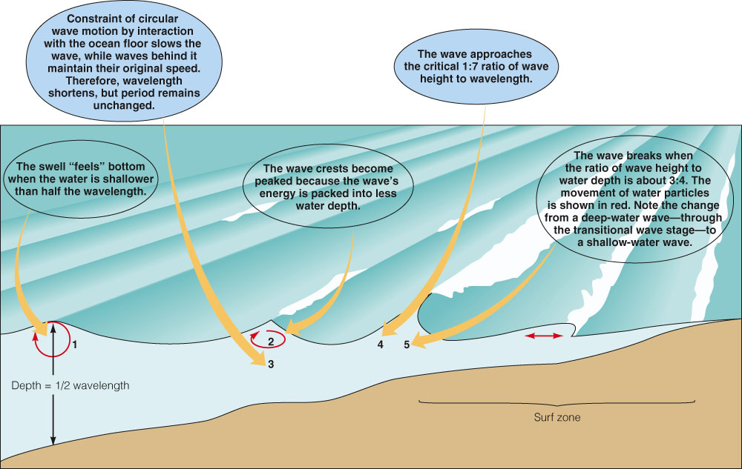
Waves approaching shore

Slide 11
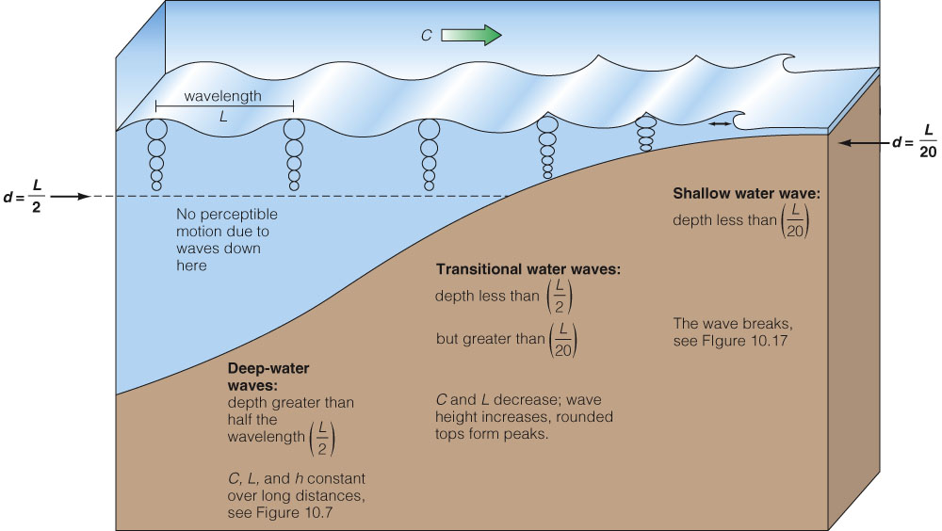
Intermediate depth

Slide 12
Wave speed (S)
General formula:
Deep-water waves:
Wave speed (S) in meters per second = 1.56 T in seconds
Shallow-water waves: (d = water depth)

Slide 13
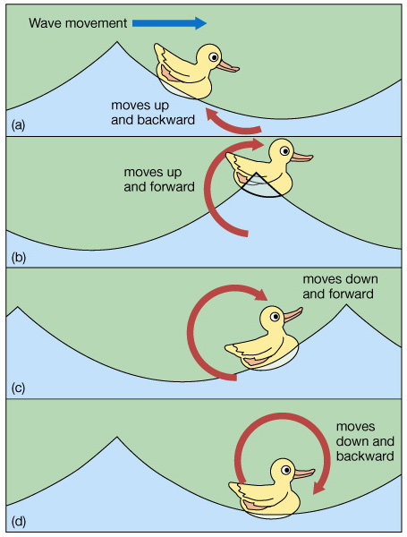
Circular orbital motion
As a wave travels, the water passes the energy along by moving in a circular orbit
Floating objects follow circular orbits

Slide 14
Orbital motion in waves
Orbital size decreases with depth to zero at wave base

Slide 15
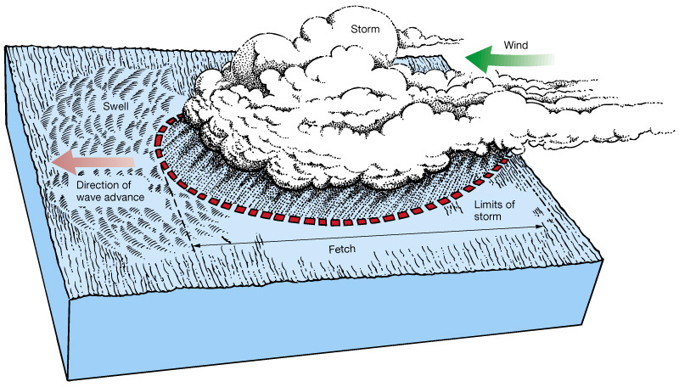
The “Sea-Swell”
Swell describes the area of origination path travelled by a wave

Slide 17
STORM
(b)
SWELL
(c)

Slide 18
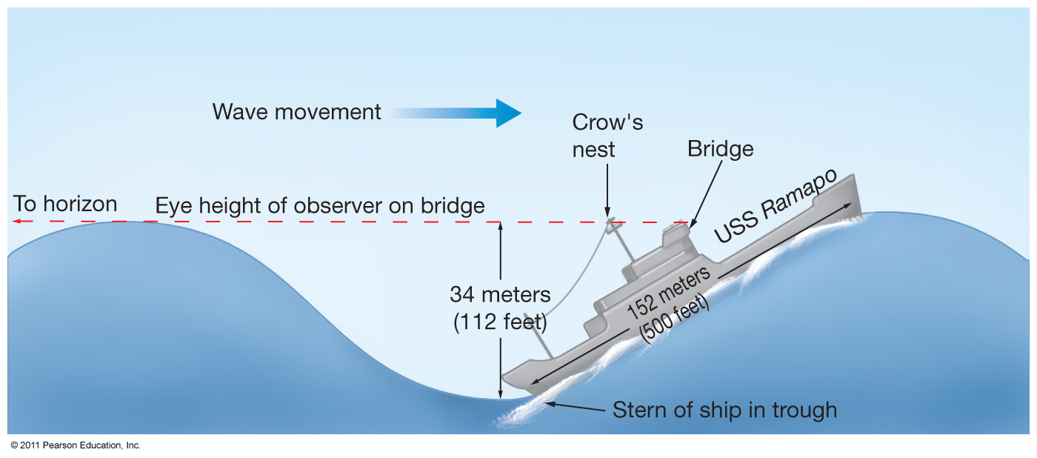
Largest wind-generated waves recorded
Wave height was measured at 34 meters

Slide 19
Rogue Waves

Slide 21
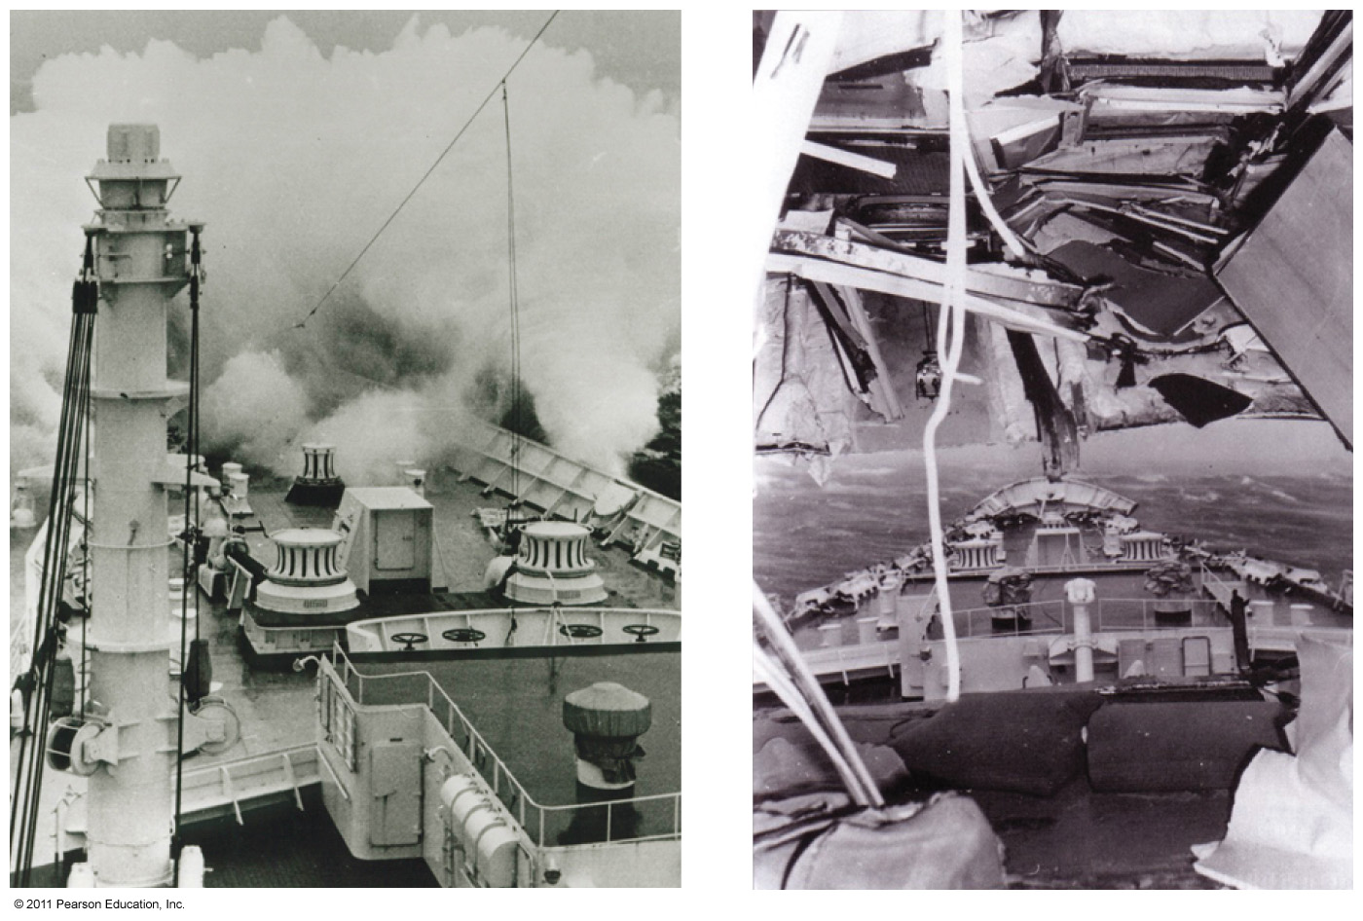

Slide 22
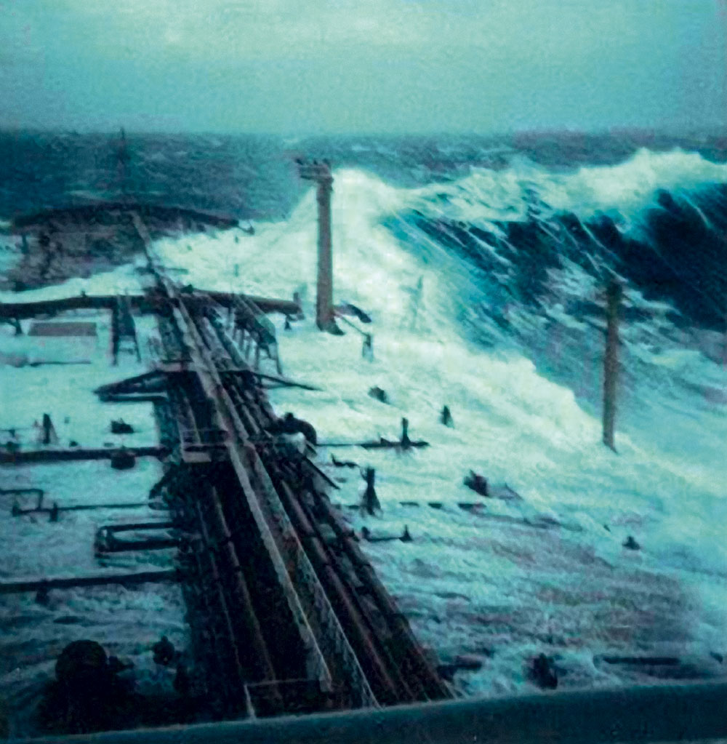
Notes:
Figure 10.13 A huge wave sweeps forward along the starboard (right) side of the large oil tanker Esso Languedoc during a storm off Durban, South Africa. The wave was between 5 and 10 meters (16 and 33 feet) high.

Slide 23
Notes:
Figure 10.14 How the great wave observed from the USS Ramapo was measured. An offi cer on the bridge was looking toward the stern and saw the crow’s nest in his line of sight to the crest of the wave, which had just come in line with the horizon. Wave height was later calculated based on the ship’s design plans and the geometry of the situation.

Slide 24
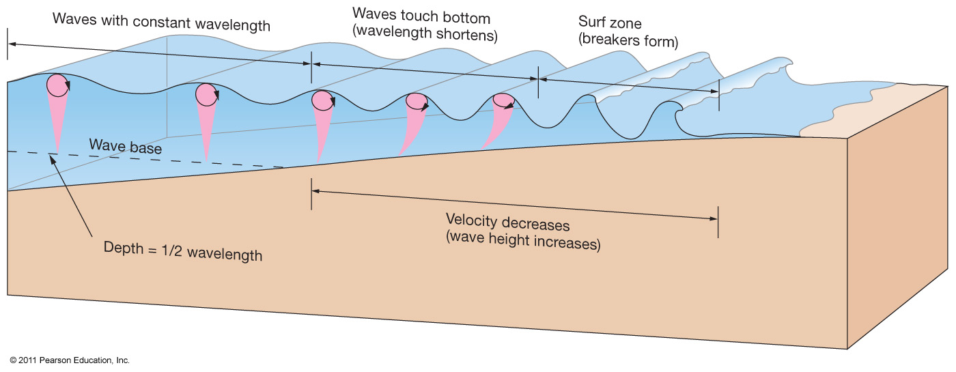
Waves undergo physical changes in the surf zone

Slide 25
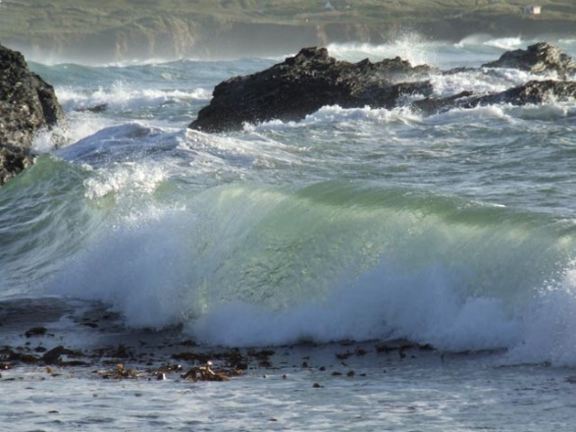
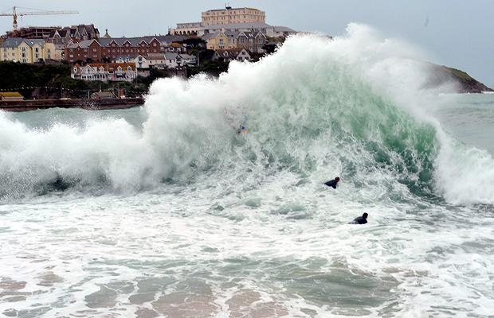
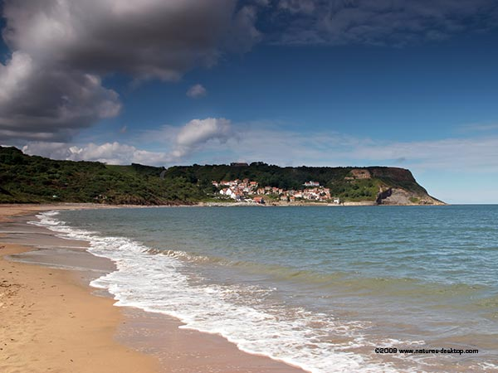
Types of breakers
Spilling breakers
Gentle beach slope allows waves to disperse energy gradually
Plunging breakers
Moderately steep beach slope gives waves a curling shape that propels surfers
Surging breakers
Abrupt beach slope makes waves build up and break rapidly at the shore

Slide 26
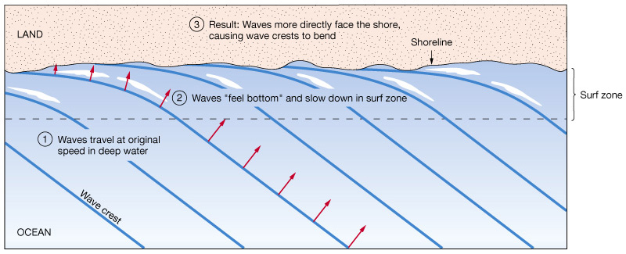
Waves can bend along a straight shoreline (Refraction)

Slide 28
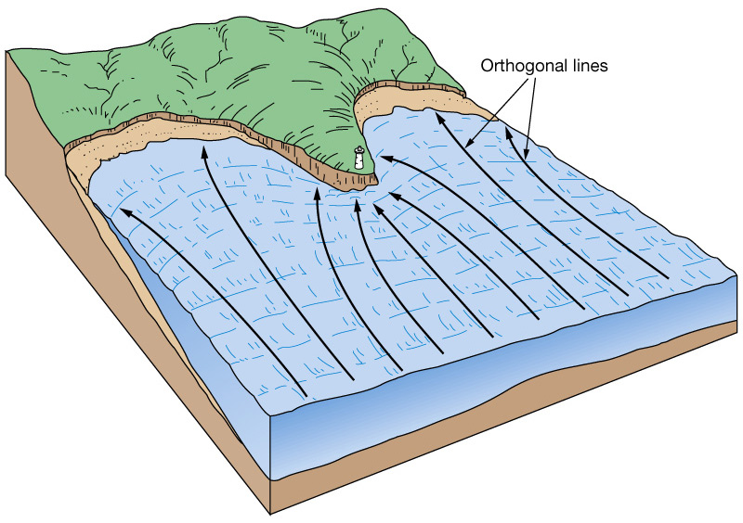
Wave refraction erodes shorelines
During wave refraction energy is concentrated at headlands and dispersed in bays.
This causes erosion of the coastline.

Slide 31
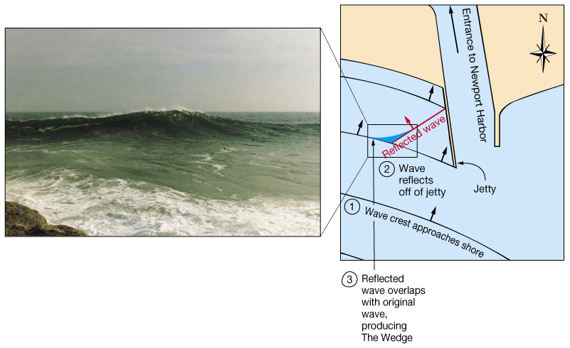
Wave reflection
Wave energy is reflected (bounced back) when it hits solid objects
Wave reflection produces large waves and erosion.

Slide 34
The parts of a wave

Slide 35
Parts of the wave: terms to know
Crest: The highest part of the wave
Trough: The lowest part of the wave
Wavelength: the distance between to crests or two troughs
Wave height: The distance from the crest to the trough of a wave
Frequency: the total number of wave crests passing a point per second
Period: The time the wave crest takes to get from point A to point B

