Slide 1
Unit 4 Fisheries and Aquaculture Part 2
Exam Review

Slide 2
Photograph by HBOI

Slide 3
Types of Aquaculture
Mariculture: The husbandry of marine organisms
(the care, cultivating and breeding of crops and animals)
Aquaponics: The husbandry of marine animals and plants together.
(Husbandry: The care , cultivating, and breeding of crops and animals.)

Slide 4
Aquaculture is Agriculture
The husbandry of freshwater and marine organisms is no different than their terrestrial counterparts.
Engineering, nutrition, health management, system and personnel management, marketing and business planning are comparable.

Slide 5
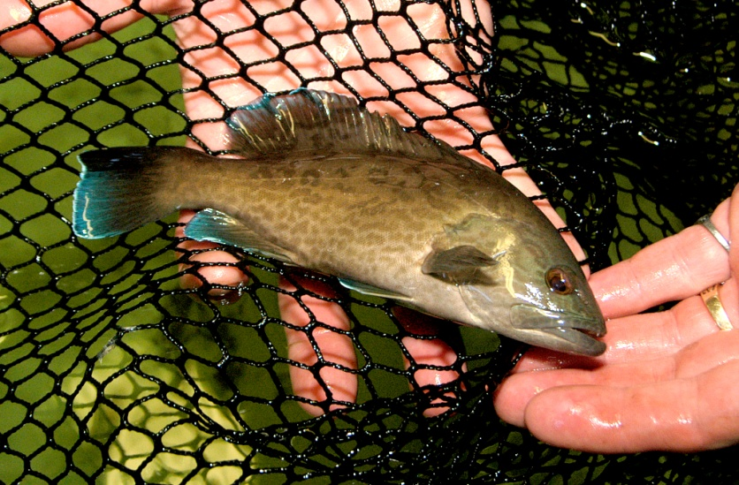
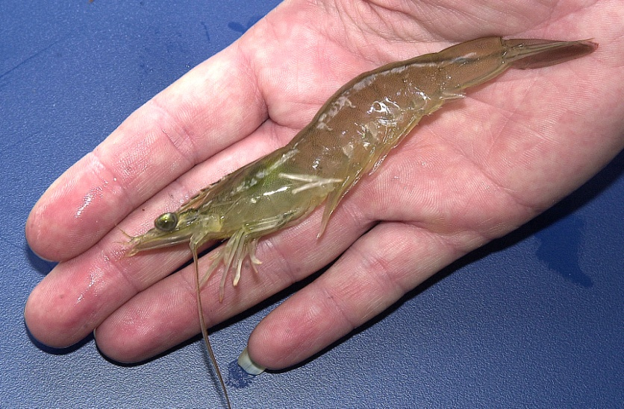
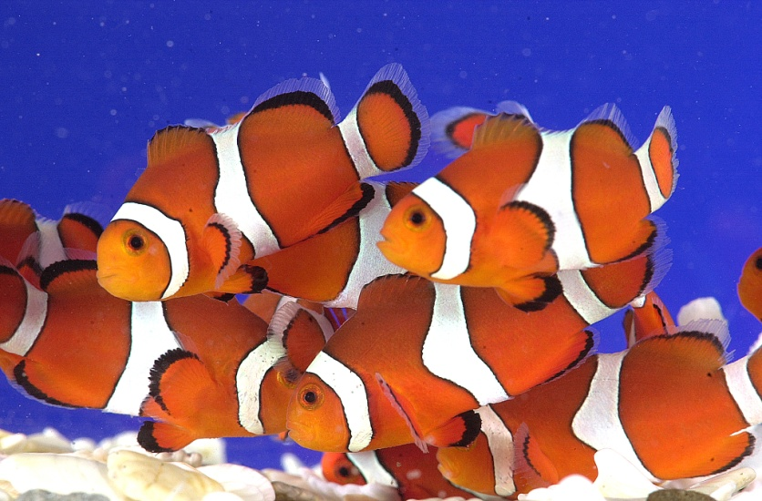
Photograph by HBOI
Photograph by HBOI
Fisheries stock enhancement
Bait production
Photograph by HBOI
Photograph by HBOI
Ornamentals
Biomedical

Slide 6
How many of you eat seafood?
About 40% of the seafood we eat is from aquaculture farms
Aquaculture production in North America is valued at $1.5 billion

Slide 7
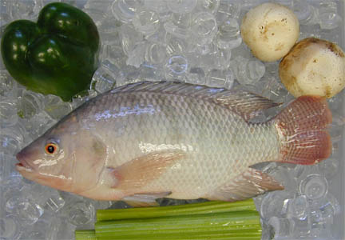
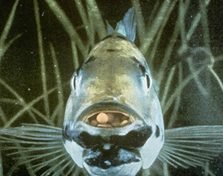
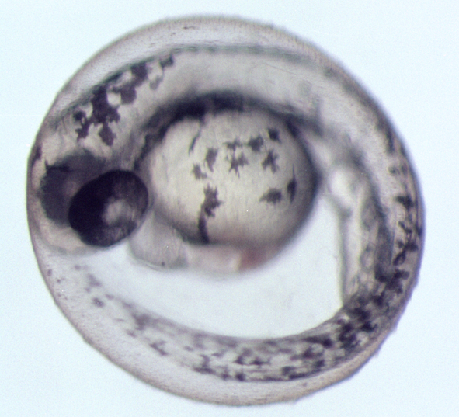
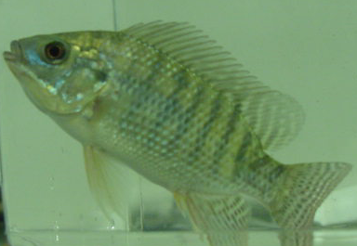
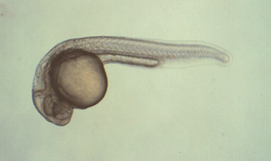
Phases of Aquaculture
Broodstock
Management
Harvest & Market
Hatchery
Production
Grow-out
Nursery
Production

Slide 8
Aquaculture Systems
Open
Netpens, cages, longlines, bottom culture
Semi-closed
Ponds, raceways, tanks
Closed
raceways, tanks

Slide 9
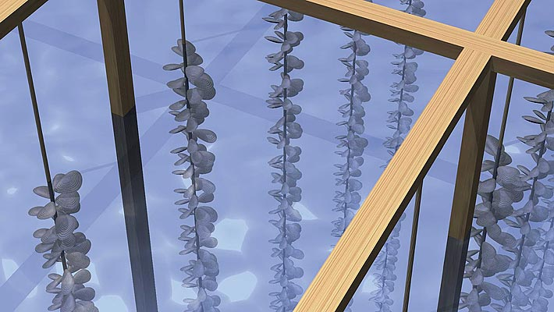
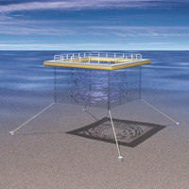
Aquaculture systems: Open
Organisms are reared in natural systems
No diversion or pumping of water
Floating netpens, floating racks, longlines, on-bottom culture

Slide 10
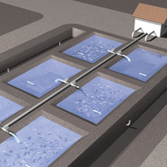
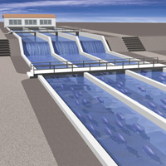
Aquaculture systems: Semiclosed
Organisms are reared in manmade impoundments
Water is diverted from natural flows or pumped
Examples are ponds and raceways

Slide 11
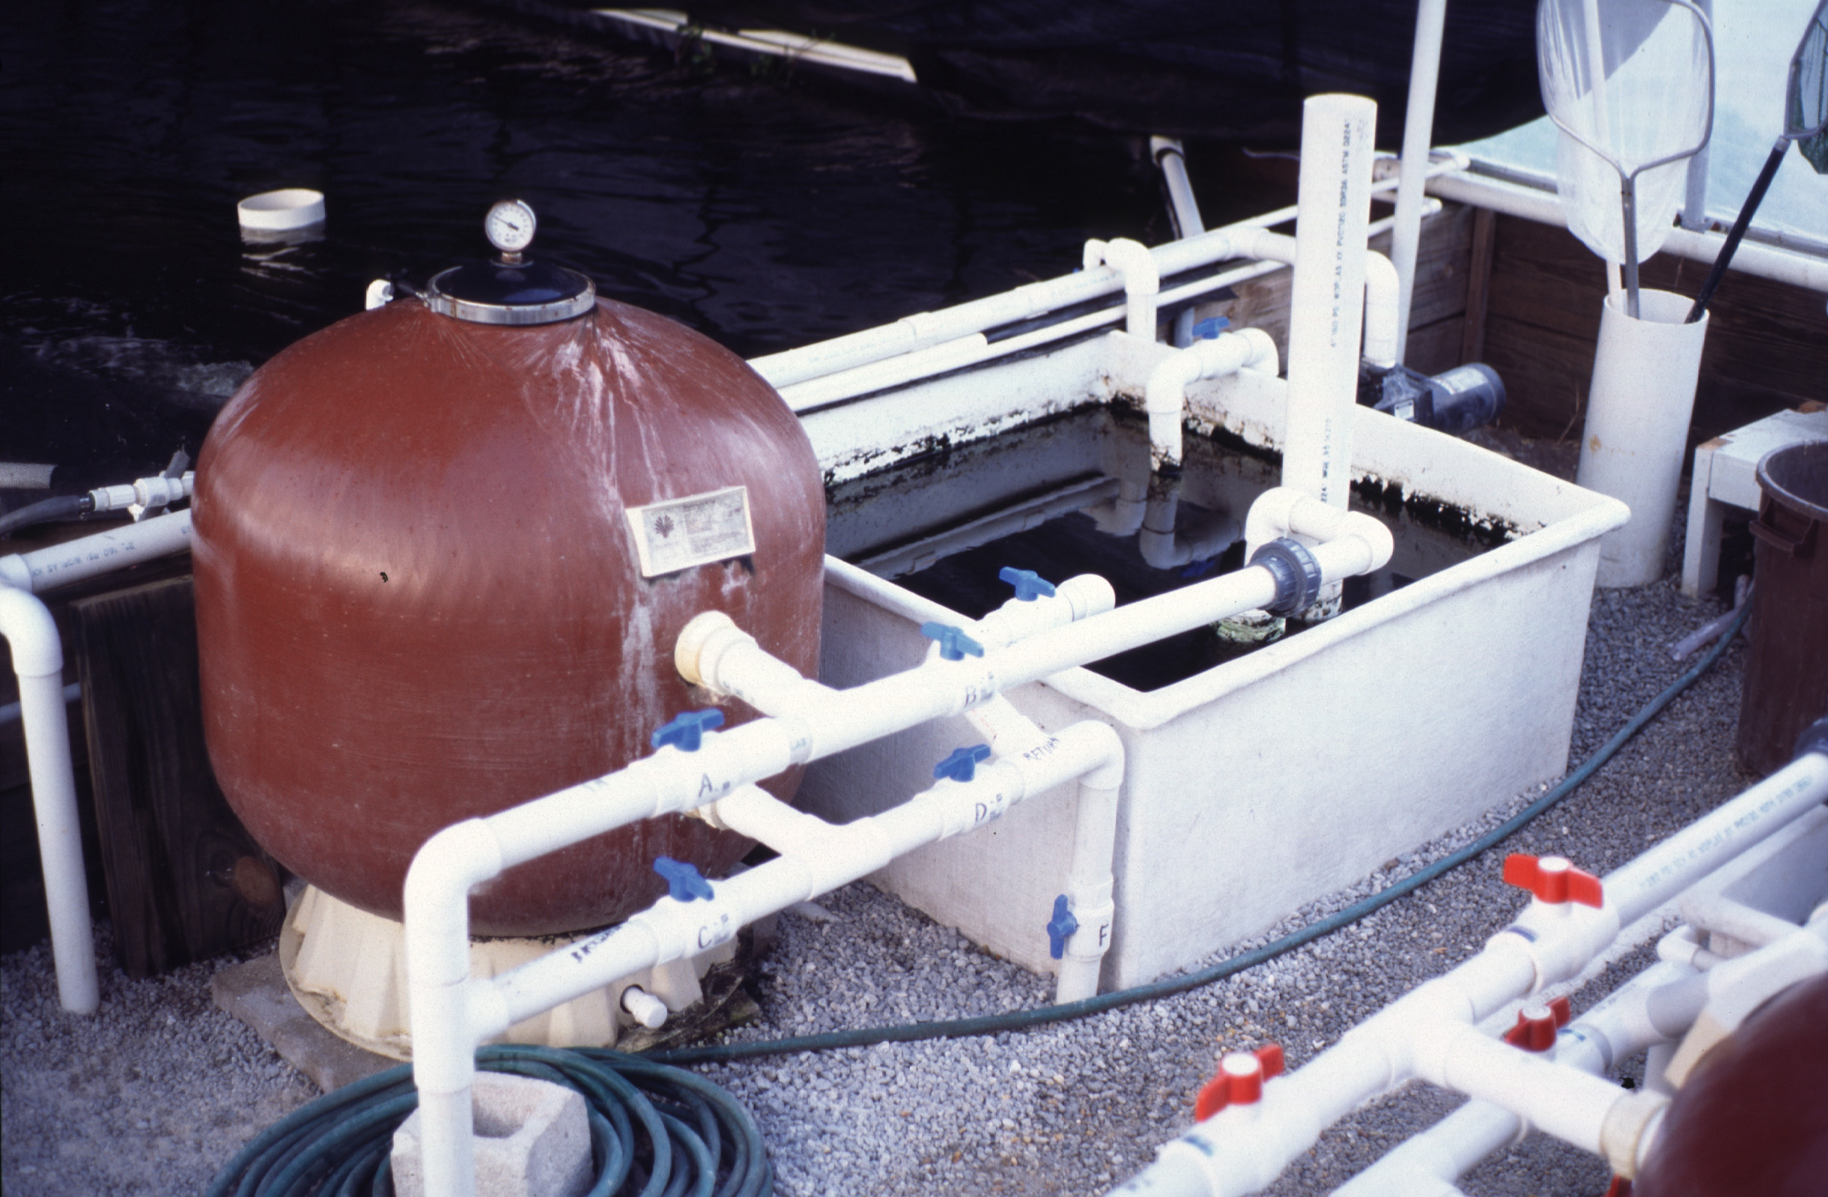
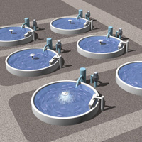
Aquaculture systems: Closed
Water is reused - little or no effluent
Sophisticated water filtration and treatment
Recirculating aquaculture systems, aquariums
Photograph by HBOI

Slide 12
Water Systems
Flow-through: one time use of water
Recirculation: reuse of water

Slide 13
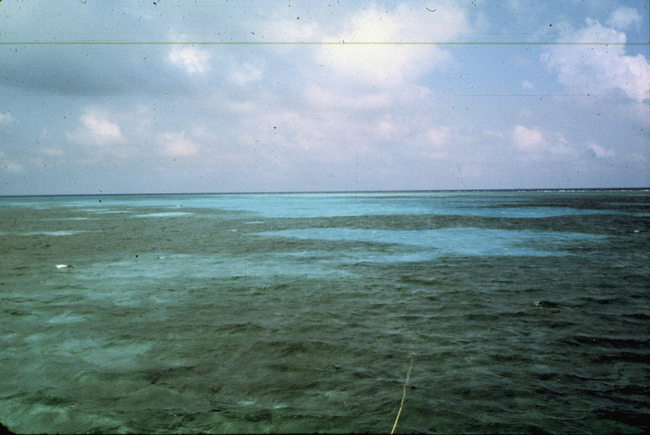
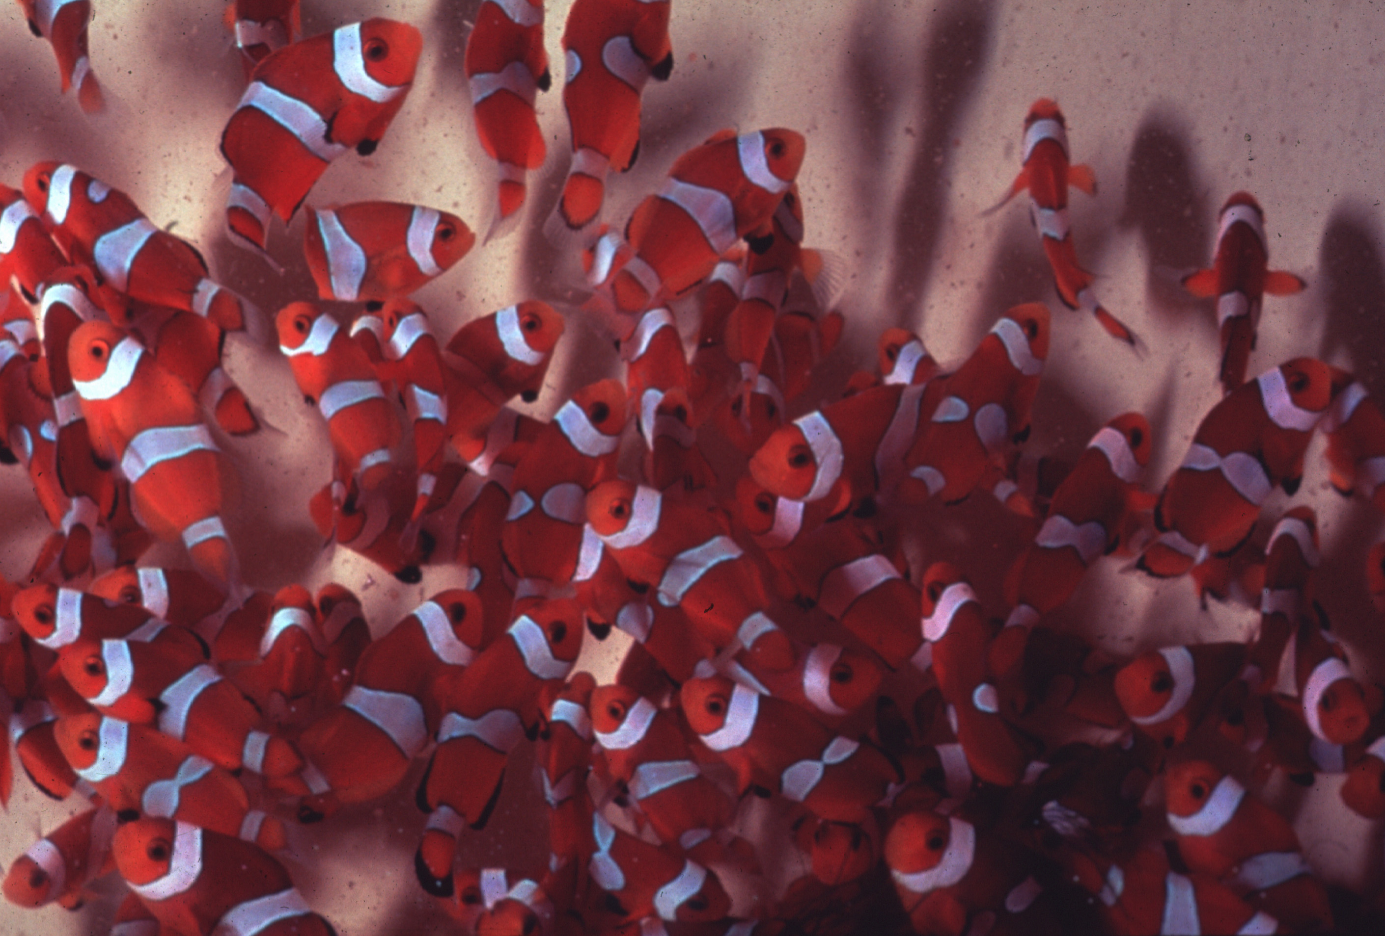
Aquaculture systems: Flow-through
Pretreatment
Water
Source
Effluent
Rearing
Tank
Photographs by HBOI

Slide 14
Flow-through aquaculture systems
Advantages
Lower cost
Simplicity
Provides ambient food
Requires lower skill level
Disadvantages
No environmental control
Source of contaminants, pollutants
Greater regulatory constraints

Slide 15
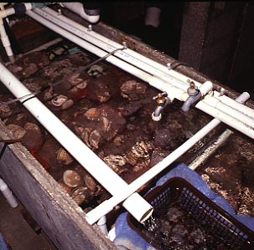
Aquaculture systems: Recirculating
Water
Source
Post treatment
Effluent
Pretreatment
Water treatment
Biofiltration
Disinfection
Rearing
Tank

Slide 16
Recirculating aquaculture systems
Advantages
Environmental control
Free of outside contaminants
Fewer regulatory constraints
Disadvantages
Higher costs
Higher skill level
Complex system, potential problems
Must provide all feed
Buildup of toxins & pathogens

Slide 17
Methods of Cultivation Extensive vs. Intensive
Extensive =
Utilize natural productivity
Low density
No or supplemental feeds
Low water exchange
Intensive =
Maximize production
Limited space
High density
Complete diet
High water exchange

Slide 18
World Seafood Production (FAO)
Aquaculture
Fisheries
200
180
160
140
120
100
80
60
40
20
0
1975
1985
1995
2010
2030

Slide 19
The Good: Need for a Solution
The world’s resources are limited; nowhere is that more clear than with seafood.
Many of the global fisheries are fish at or beyond capacity, potentially facing collapse by 2050.
Done right Aquaculture holds great promise to produce high quality, large volumes of seafood.

Slide 20
Total Production & Value: NB, NL, NS, PEI

Slide 21
Key Industry Drivers
Rural Based
Providing an Economic Alternative for Rural & Coastal Communities.
Residents can stay, & educated young people can return, to their communities.
Science Based
Highly Efficient Producer of Protein using Science & Technology.
Market Based
Food Industry - Growing Demand by Consumers.
Producing High Quality, Safe, Nutritious, products year round.

Slide 22
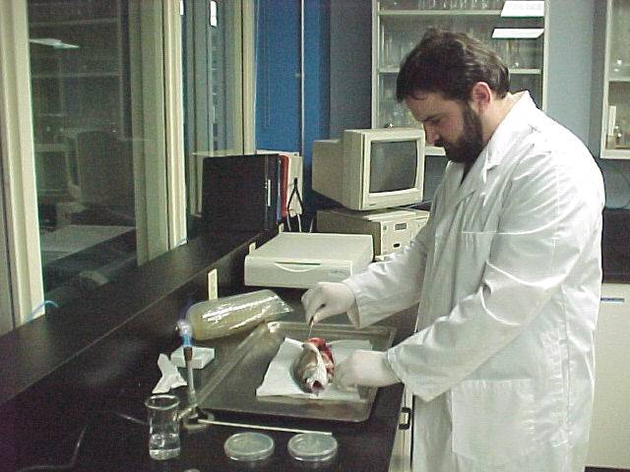
Science Based Industry

Slide 23
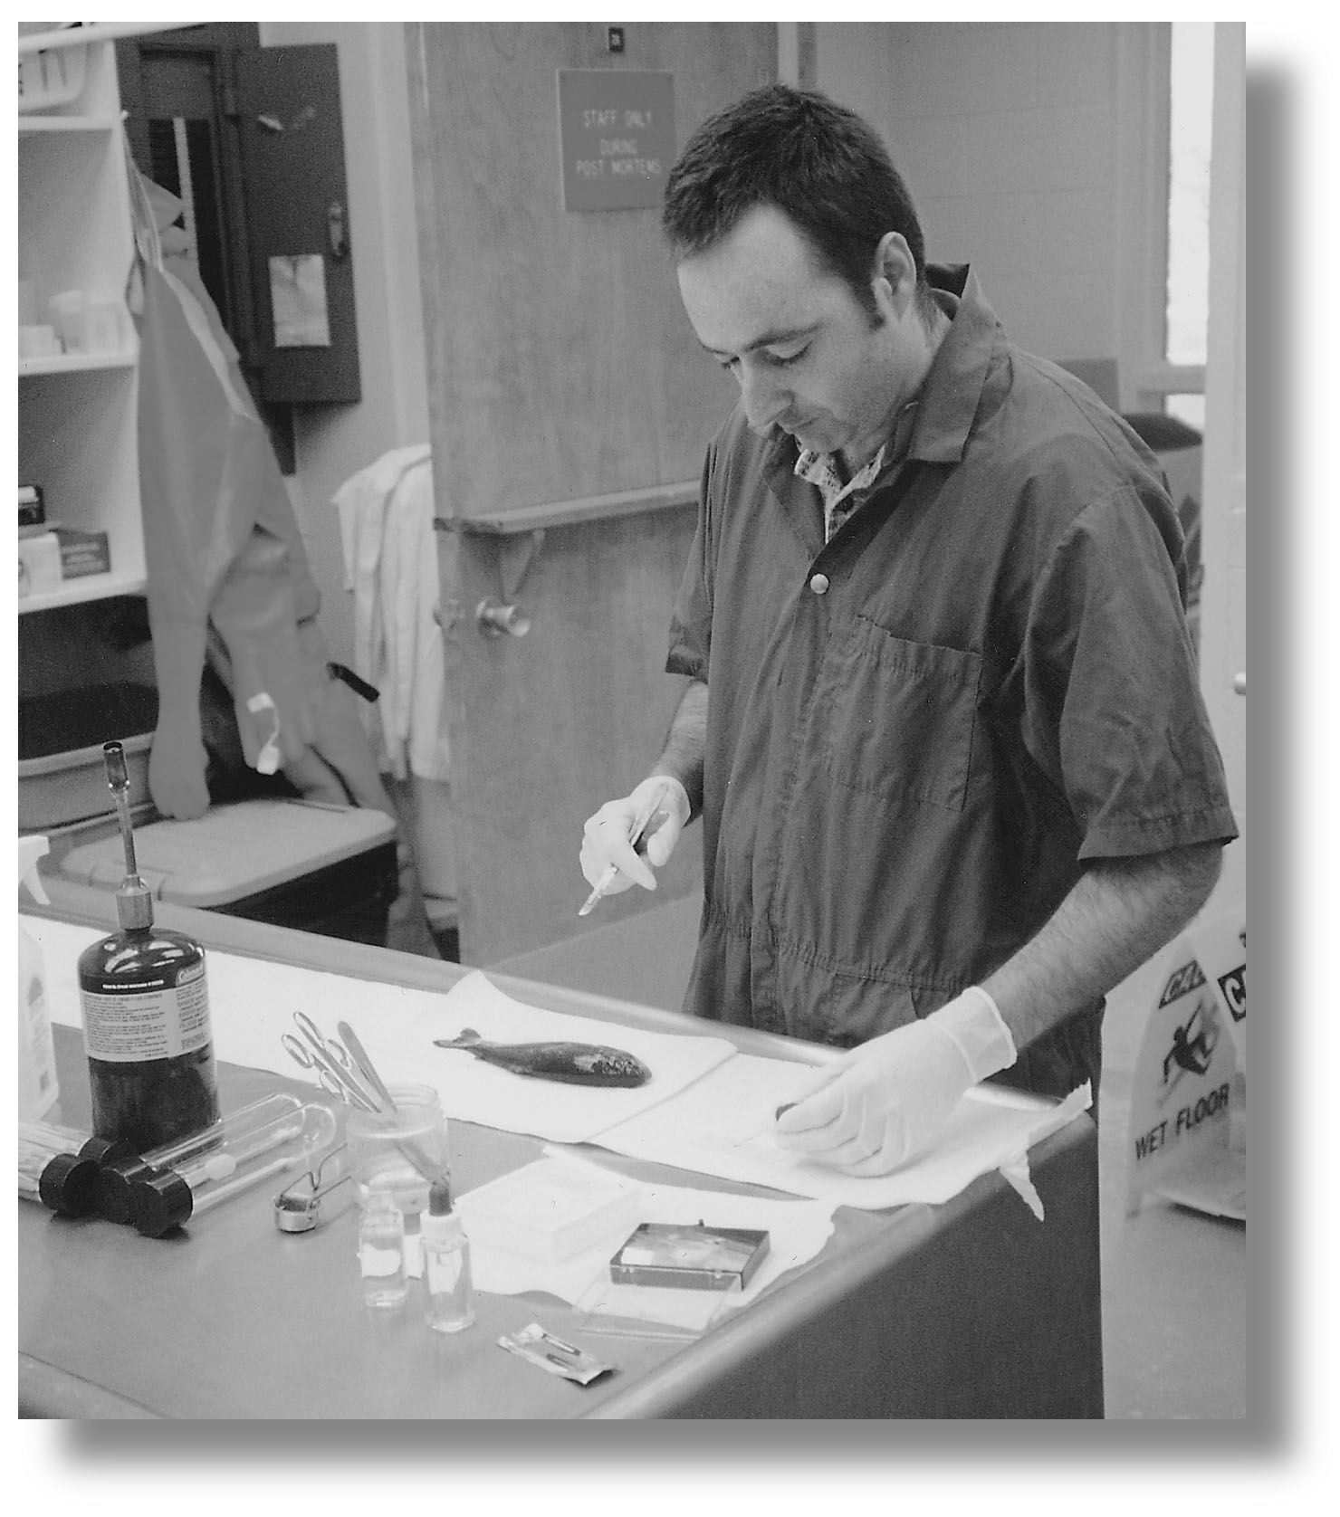
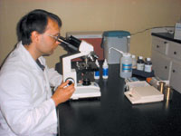
Monitoring and Sustainability
The Industry and Government are working together to provide for Sustainable Aquaculture Development.
Programs include:
Environmental Impact Assessments pre licensing.
Environmental Monitoring & Codes of Practice.
Canadian Shellfish Sanitation Program.
National Aquatic Animal Health Program.
Processing Plant Quality Management Program (QMP).
Safe Quality Food Institute Certification Program.

Slide 24
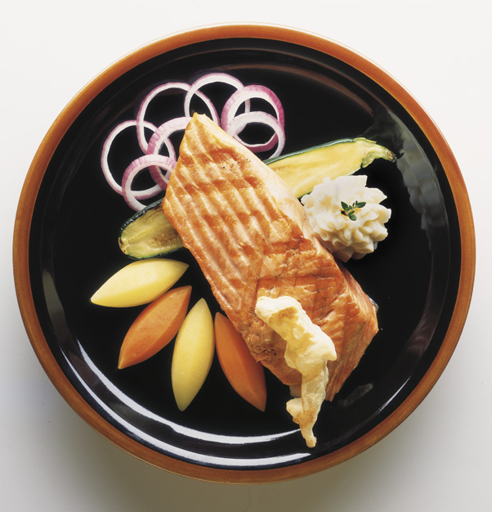
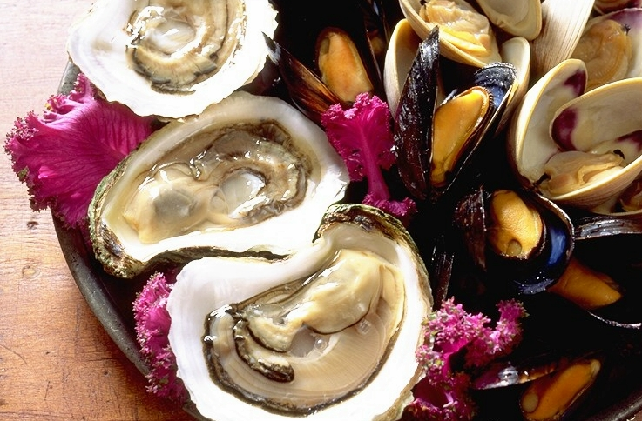
Market Based Industry
Producing Safe, Healthy Food in a Sustainable Environment

Slide 25
The Bad: New Practice
New practice: Aquaculture has only been around for 30 – 40 years. There is a steep learning curve for sustainability (trying to learn in 30 years what land farmers have learned in 6000 years!!)

Slide 26
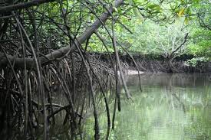
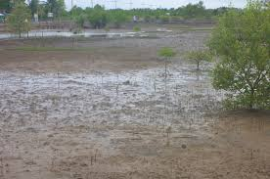
Habitat Degradation
Degradation of hundreds of thousands of hectares of mangrove forests and coastal wetlands for construction of aquaculture sites.

Slide 27
Fish Meal
Much of the food provided for farmed fish comes from smaller wild fish (anchovies, herring).
This creates heavy fishing pressure on smaller ocean fish who play a vital role in ocean food systems.
This has the potential to deplete food for wild fish stocks, seals and seabirds.

Slide 28
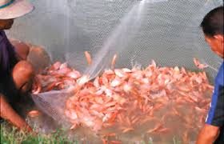
Introduction of Exotics
Introduction of species (accidental or deliberate) may alter or impoverish existing communities and populations.
Receiving communities may be altered through inter-breeding, predation, and competition for food, space, habitats, etc.

Slide 29
Spawning Difficulties
Some organisms depend on certain factors to trigger specific biological reactions (ex: spawning)
Many cultured organisms cannot be bred in captivity. Captive spawning is possible with artificial spawning or fertilization, in some cases with hormone injections, as in the case with sturgeon and salmon.

Slide 30
Diseases
Aquatic animals are more sensitive to pollution whether chemical or their own excrement.
To make maximum profits, intensive aquaculture utilize a dense stocking rate (overcrowding). Studies have shown that dense stocking rates may induce stress and increase susceptibility to diseases.
Overcrowding leads to poor water quality due to decreased oxygen levels, high accumulated metabolic products and excrement, rapid growth, transmission of noxious parasites, micro-organisms and pathogens.

Slide 31
Pollution
The prime factor for aquaculture is control of water quality, especially in high stocking density.
Fish excretion is high in ammonia, nitrite and nitrate. Nitrite binds with the haemoglobin of blood in fish and can be fatal.
Overfeeding must also be avoided in order to prevent contaminating the water.

