Slide 1
Unit 3 Coastal Zones
Exam Review

Slide 2
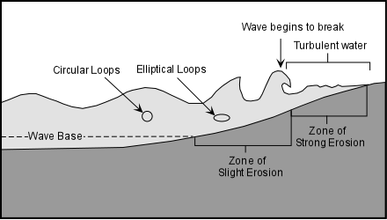
What is a Coastal Zone?
A coastal zone is the interface between the land and water.
These zones are important because a majority of the world's population inhabit such zones.
Coastal zones are continually
changing because of the dynamic
interaction between the oceans
and the land.

Slide 3
Subsystems of the Coastal Zone
The coastal zone is commonly considered to be composed of 3 subsystems:
  Marine sub-system
  Coast sub-system
  Terrestrial sub-system
Each sub-system has its own characteristics, resources and problems.

Slide 4
Marine Sub-System
The marine sub-system consists of the oceanic component of a coastal zone.
Characteristics:
  Water depth, salinity, and temperature
  Wave and tide ranges
  Water currents
  Diversity of marine habitats
Resources:
  Exploitation of fisheries, oil and gas, tourism and recreation,
  Uses for navigation, transportation and waste discharge

Slide 5
Coast Sub-System
The Coast sub-system is a relatively narrow and dynamic transition zone between the marine and terrestrial sub-systems.
It includes the littoral zone (between low and high tide marks), and the supralittoral zone (salt water spray zone).
Characteristics:
  Coastal profile (sandy beach, pebble beach, rocky shore)
  Tidal regime, shore line topography, wind and wave regime
Resources:
  Sand and gravel extraction
  Exploitation for tourism and recreation, and forest resources
  Uses for human settlement, port development, aquaculture, and land reclamation.

Slide 6
Terrestrial Sub-System
The Terrestrial sub-system consists of land where human or other activity can affect the marine environment.
Characteristics
  Topography
  Soil types
  Surface water resources
  Aquifer structure and groundwater resources
Resources:
  Use of terrestrial and freshwater resources
  Agriculture and aquaculture
  Industry
  Human Settlement

Slide 7
Coastline vs. Shoreline
Coast: Area of contact between land and sea—Extend inland until meets a different geographical setting
Coastline follows the general line of the coast(sometimes in the case of small inlets or bays the coastline is measured as running directly across, joining the coastline on the opposite side.)
Coastline is not measured as precisely as shoreline.
Shoreline: Precise boundary where water meets adjacent dry land.
The shoreline is the perimeter of the land along the water’s edge, measured to the closest exactness as possible. As a result shoreline is generally longer for a particular location.

Slide 8
Canada’s Coastline
Globally, Canada has the longest coastline of any country. The coastline includes the mainland coast and also the coasts of offshore islands.
The total length of Canada’s coastline is 243 042 km.

Slide 9
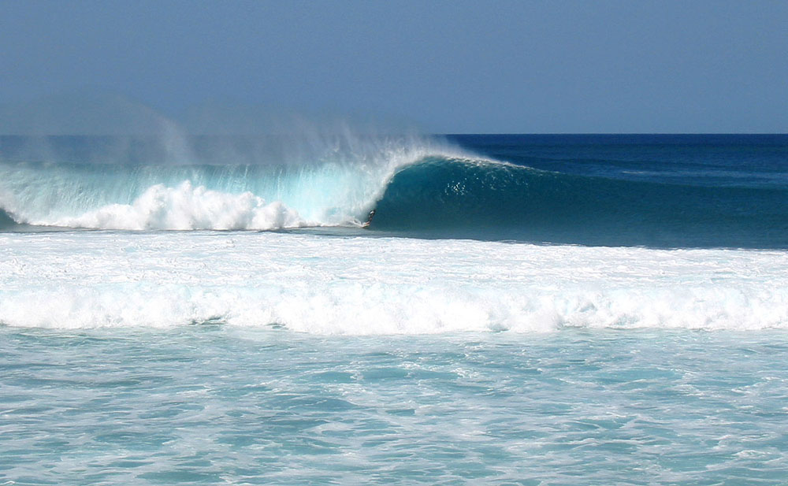
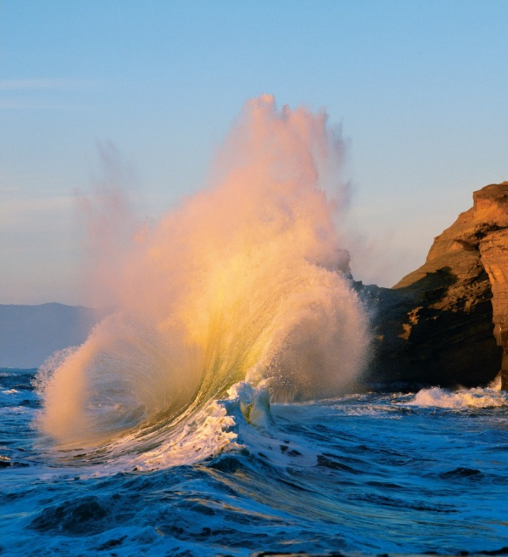
Shaping of Shorelines
Waves: transport energy by motion—ultimate source of wave energy is the sun
Longshore current: Current that parallels shoreline developed by waves coming in at an angle to shore.

Slide 10
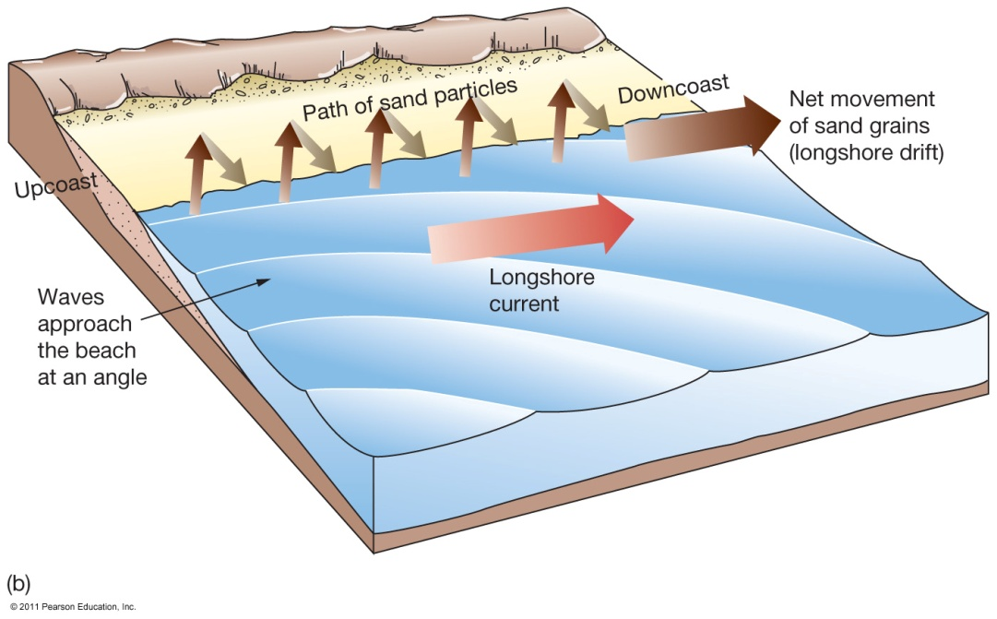
Longshore Currents
Parallel motion of water along shoreline
Caused by wave refraction(bending)
  Causes zigzag motion of water in surf zone

Slide 11

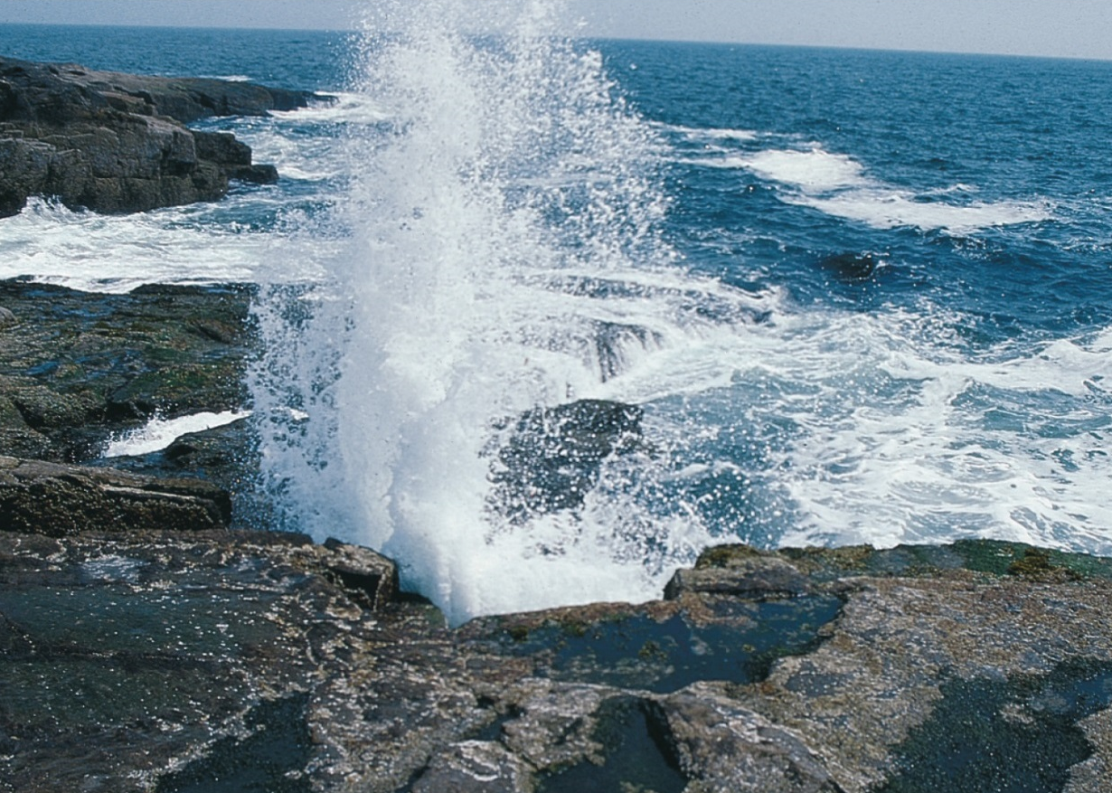
Coastal Erosion
Waves are dominant mechanism in coastal erosion—Water forced into cracks in rock at high pressures
Coastal Erosion is wearing away of land and the removal of beach or dune sediments by wave action, tidal currents, wave currents, drainage or high winds

Slide 12
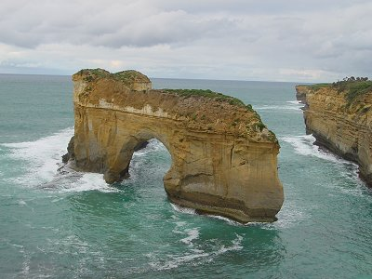
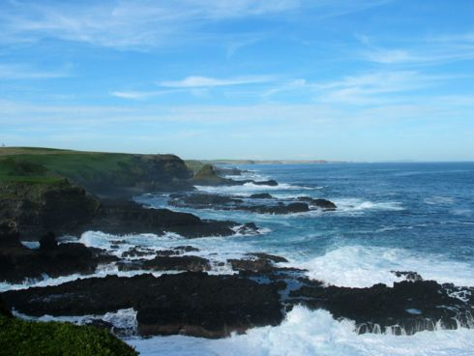
Coastal Erosion
Wave energy is focused on prominent points that jut out into deep water
attack the sides of points and form sea caves, sea arches, and sea stacks by undercutting them
Sea stack with sea arch in it

Slide 13
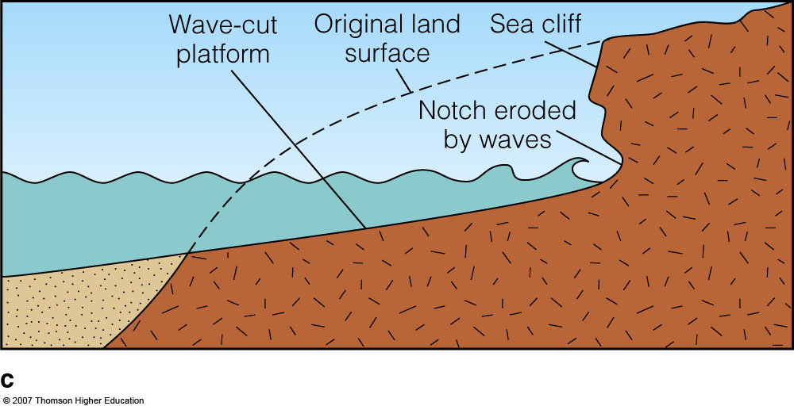

Slide 14
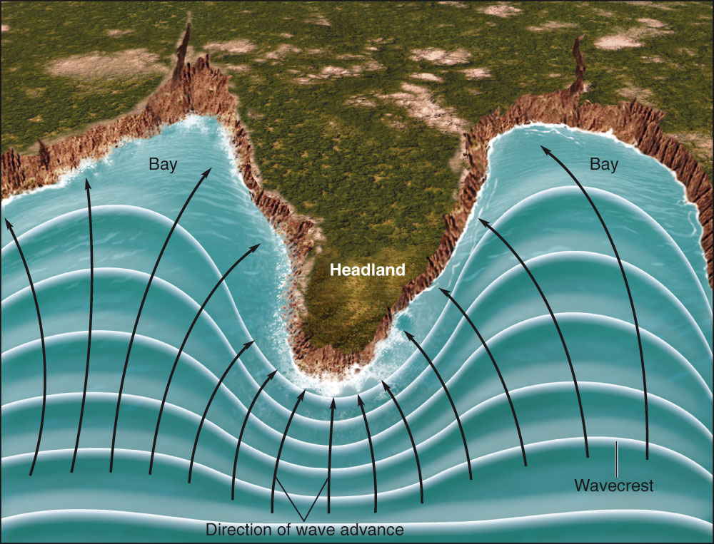
Shorelines Can Be Straightened by Erosion (Wave Energy)
  Marine erosion is most rapid on high-energy coasts, areas battered by large waves. (erosionional shore)
  Low-energy coasts are infrequently attacked by large waves. (deposional shore)

Slide 15
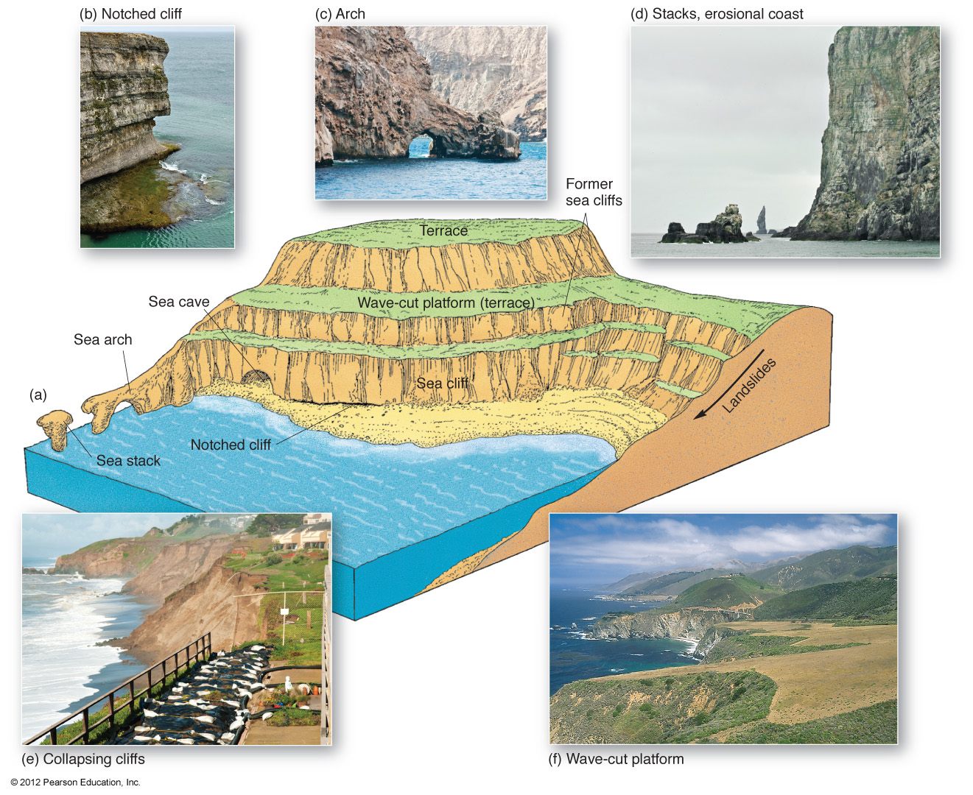

Slide 16
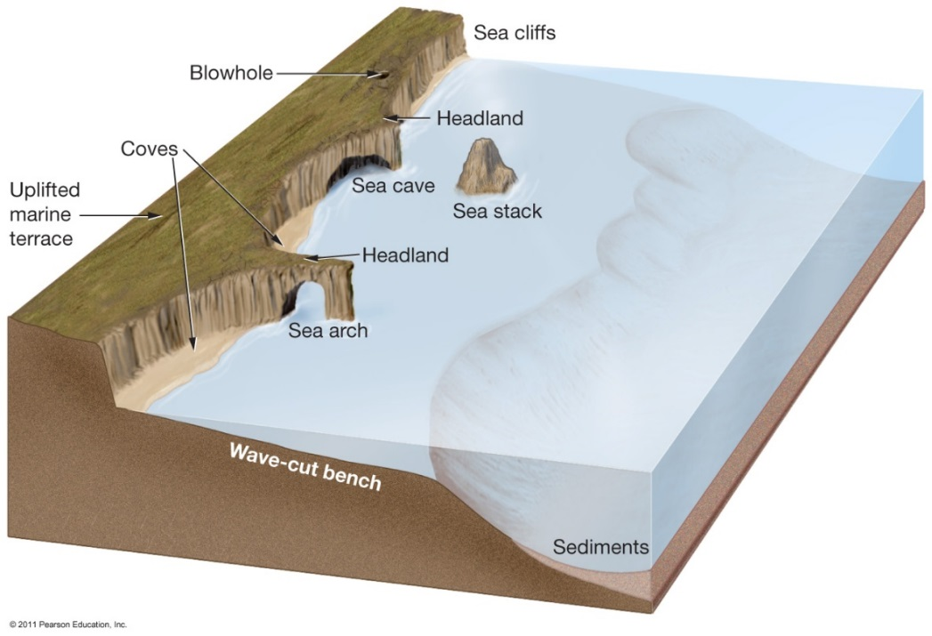
Erosional Shores-Features
Protruding bits of land called headlands absorb much wave energy.
Wave cut cliffs and sea caves are other features carved out by wave activity.

Slide 17
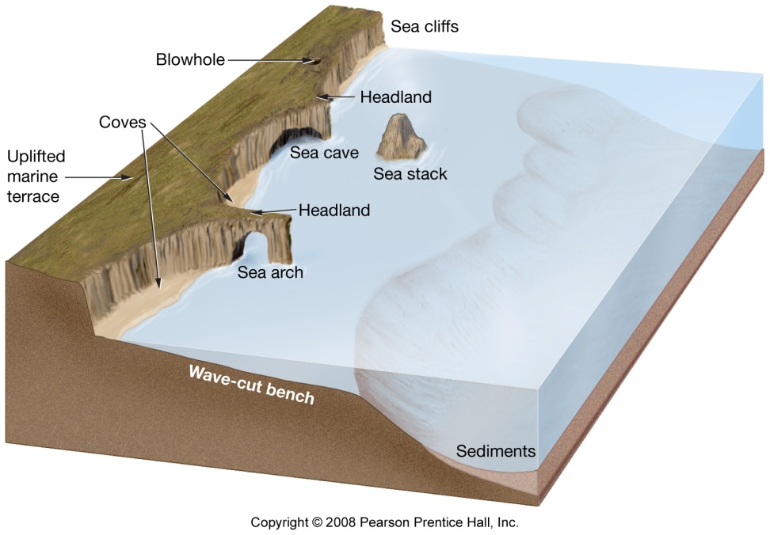
Erosional Shores
Sea arches form where sea caves in headlands erode all the way through.
Sea stacks form when the tops of sea arches erode away completely.
Bedrock uplift generates a marine terrace.

Slide 18
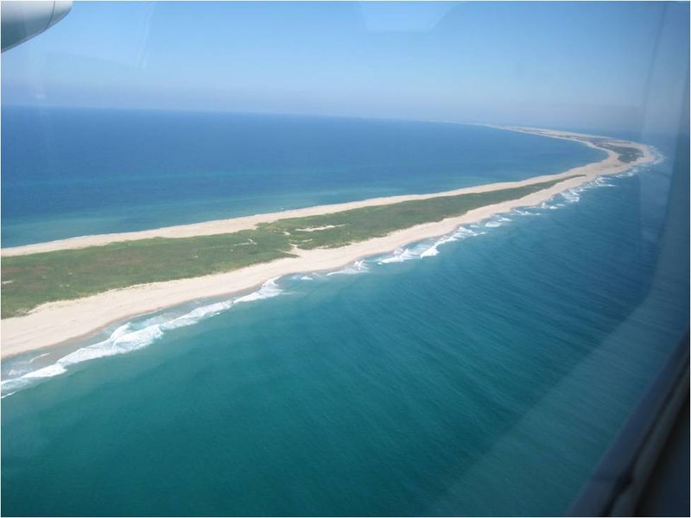
Depositional Shoreline Features
Common along East and coast of the North America
Coastal deposition is the laying
down of material on the coast by
the sea.

Slide 19
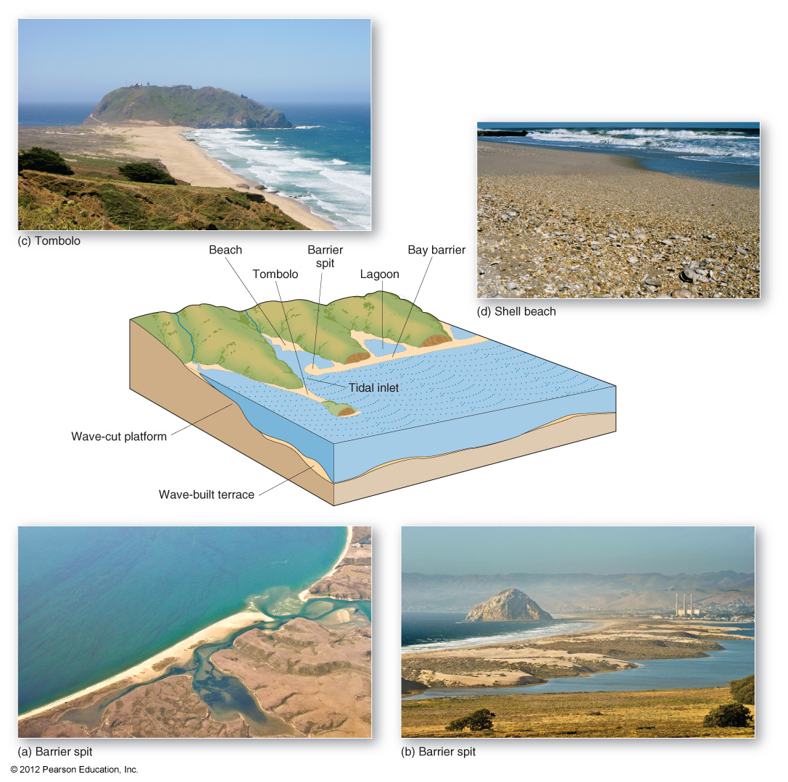

Slide 20
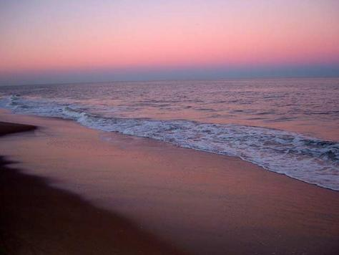
Overview: Beaches and Shoreline Processes
The beach is a dominant coastal feature.
Wave action modifies the beach and coastal areas.
Waves affect deposition and erosion of sand and coastal features.
Sea level changes affect the coast.
Humans attempt various coastal stabilization measures.

Slide 21
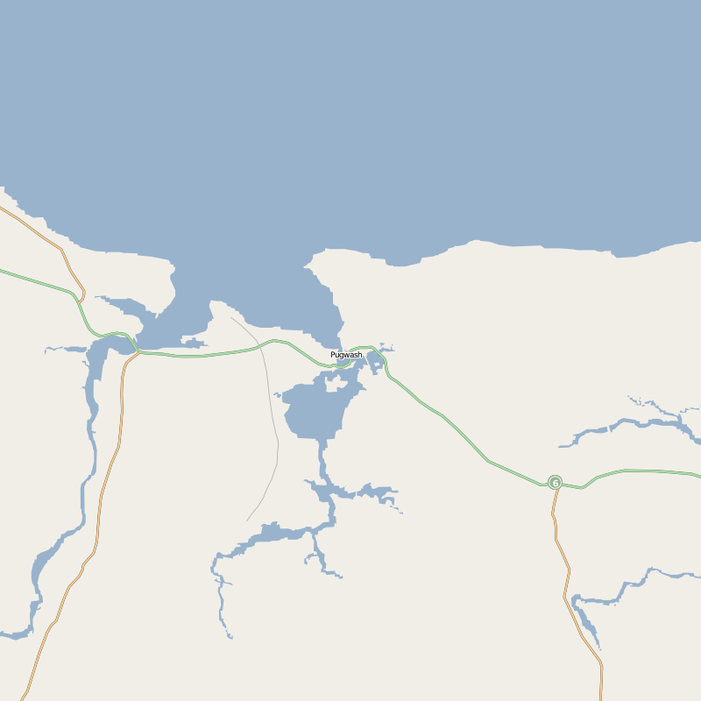
Coastal Regions
General Features
  Shore – Zone that lies between the low tide line and the highest area on land affected by storm waves
  Coast – extends inland as far as ocean related features are found
  Coastline – boundary between shore and coast

Slide 22
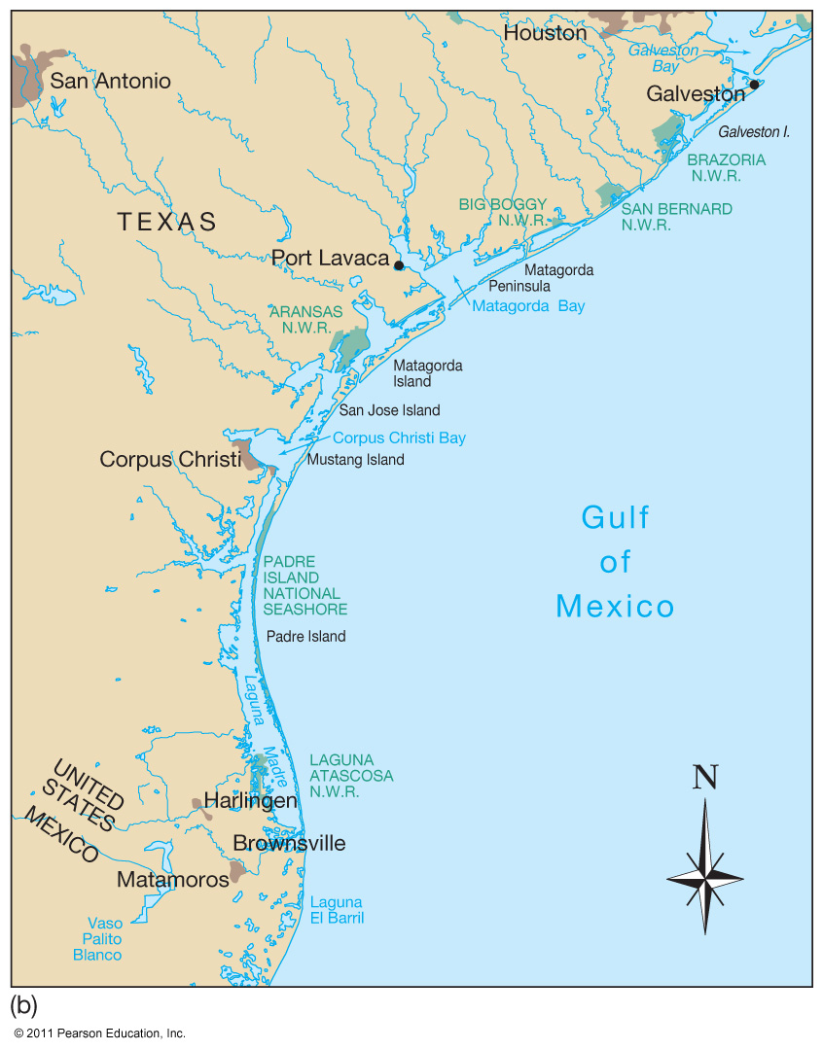
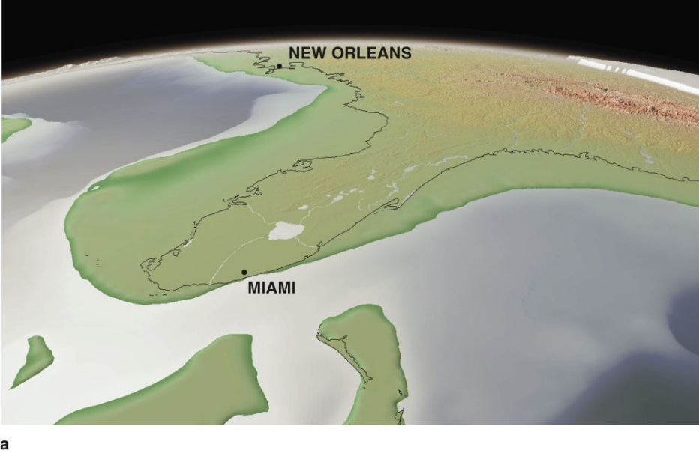
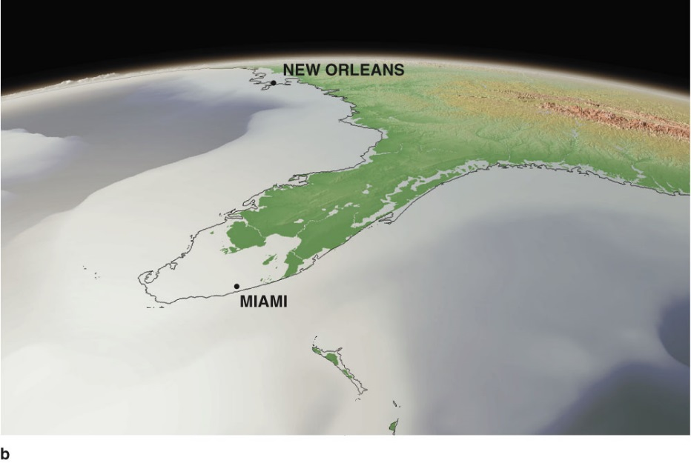
Coasts Are Shaped by Marine and Terrestrial Processes

Slide 23
Shorelines Can Be Straightened by Erosion
  Erosion is most rapid on high-energy coasts (large waves(erosion coastline)
  Low-energy coasts are infrequently attacked by large waves.(deposional coastline)

Slide 24
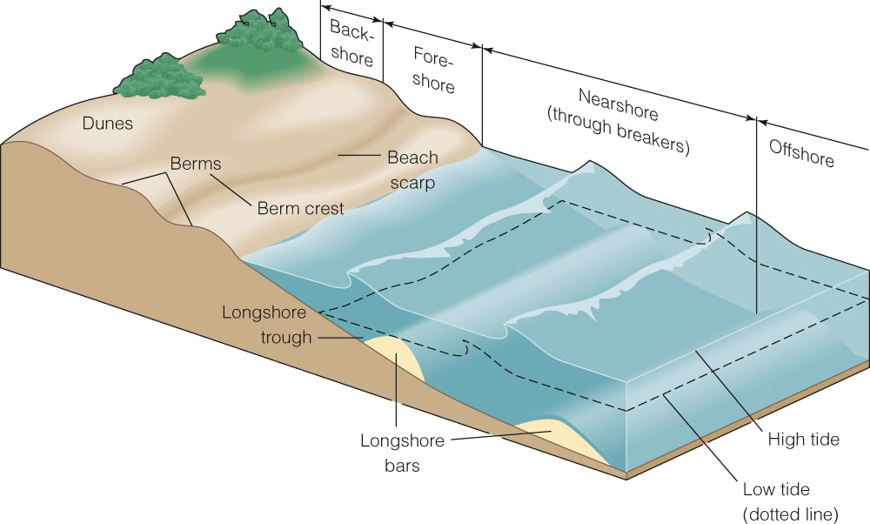
Beaches Often Have a Distinct Profile
A beach is a zone of loose particles that covers a shore.

Slide 25
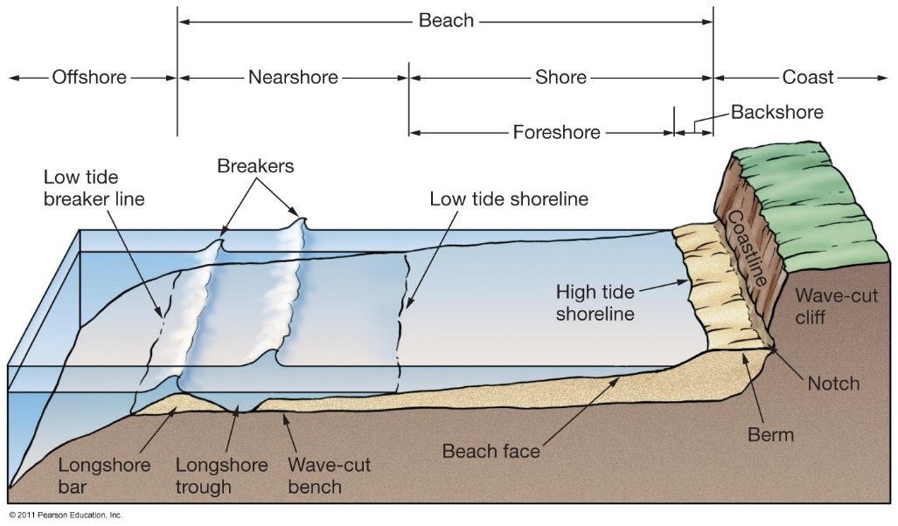
Beach Features
Beach – entire active area of a coast affected by waves.
Consists of:
  Shore – divided into
    Backshore – above high tide line; covered with water only during storms
    Nearshore – from low tide water line to where waves break at low tide
  Offshore – area beyond low tide breaking waves

Slide 26


Slide 27
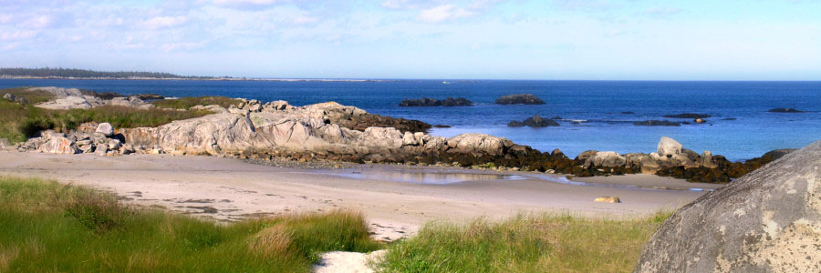
Composition of Beaches
Formed from locally available material
May be coarse or fine grained sediment
  Boulders from local cliffs ,Sand from rivers, Mud from rivers
Significant biologic material on tropical beaches
  Coral reef material
Material is always in transit along the shoreline.

Slide 28
Sand Movement Along Beach
Two Major Types
Perpendicular to shoreline (toward and away)
  Swash – water rushes up the beach
  Backwash – water drains back to the ocean
Parallel to shoreline (up or down coast)
  Longshore current – transports sand along the beach

Slide 29
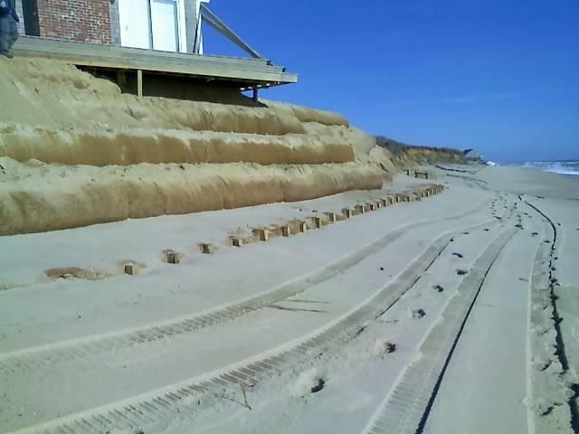
Hard Stabilization
Structures built to decrease coastal erosion and interfere with sand movement
Also called armouring of the shore
  Some structures may increase wave erosion

Slide 30
Hard Stabilization
Four major types of stabilization structures:
  Jetties
  Breakwaters
  Seawalls
  Groins

Slide 31
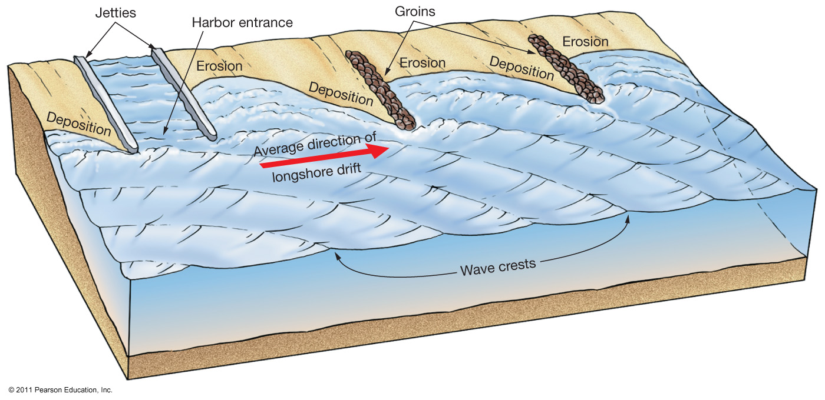
Jetties/Groins
Built perpendicular to shore
Built in pairs
Built to protect harbor entrances (Jetties)

Slide 32
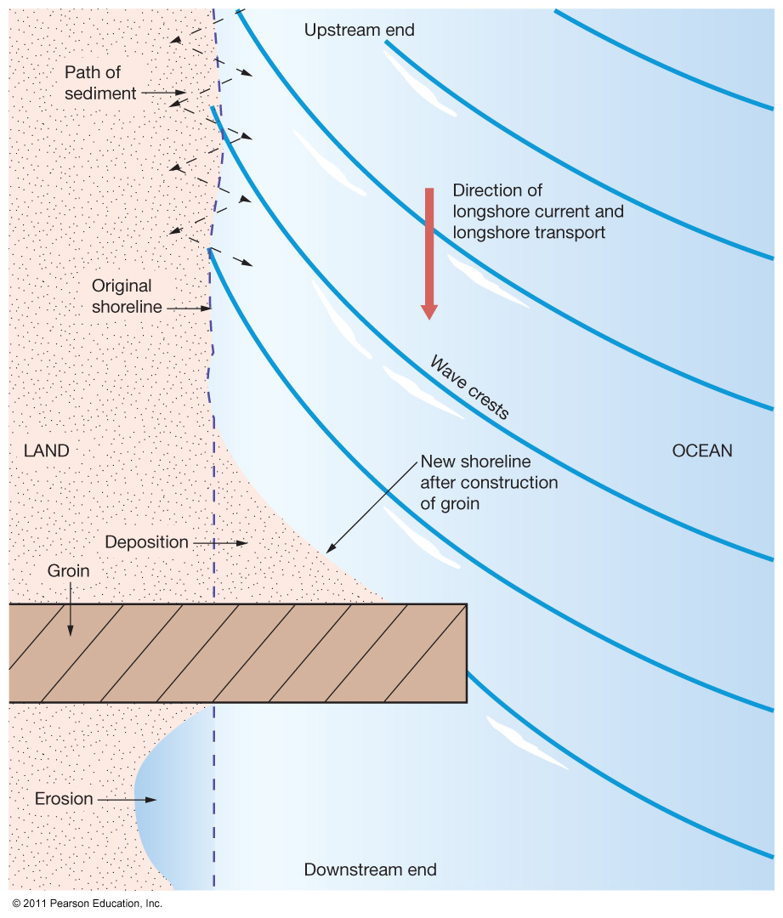
Groins and Groin Fields
Built perpendicular to the beach
  Often made of rip rap, or large blocky material
Traps sand upcoast, which can cause erosion downstream of the longshore current
May necessitate a groin field, or a series of groins built along a beach

Slide 33
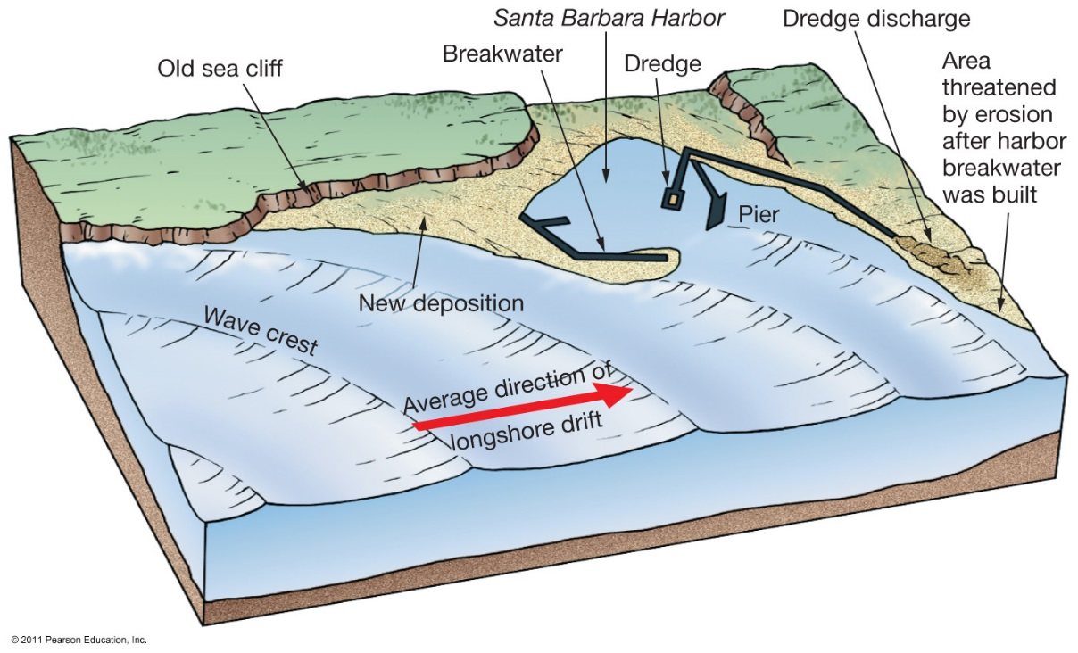
Breakwaters
Built parallel to a shoreline
Designed to protect harbors from waves
Can cause excessive erosion, requiring dredging to keep area stable

Slide 34
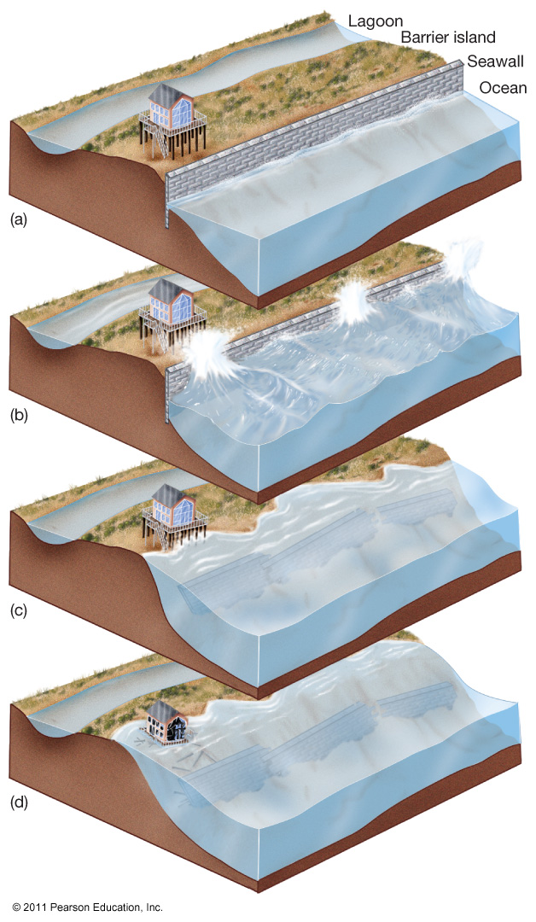
Seawalls
Destructive to environment
Designed to armor coastline and protect human developments
One large storm can remove beach
Wave activity eventually undermines seawall structure; need continual repair or will collapse

Slide 35
Nova Scotia’s Coast
Defining the coast:
  The interface between land and sea
  High mixing, productivity, biodiversity and sensitivity
  Living coasts are dynamic and always changing
Nova Scotia Facts:
- 13,300 km of coastline
- 70% of Nova Scotia’s
population lives on the coast

Slide 36
Pressures on the Coast
Conflicts between changing
expectations and uses of coast
and traditional views of the
coast
Consequences:
- Habitat loss (especially wetlands)
- Inappropriate development
- Degrading water quality
- Property at risk
- Reduced public access

Slide 37
Add Climate Change
Expected impacts:
Storm surges and floods
Accelerated erosion
Changes in precipitation
Sea level rise
Contamination of wells
Loss of sea ice

Slide 38
6 Priority Coastal Issues in Nova Scotia
Coastal Development
Working Waterfronts
Public Coastal Access
Sea Level Rise and Storm Events
Coastal Water Quality
Sensitive Coastal Ecosystems and Habitat

Slide 39
Coastal Zone Variation in NS
Complete the Coastal Zone Variation assignment.
Tips on Getting Started…
Look up pictures of your specific area, based on what you see you might be able to determine the type of physical coastline.
Research the characteristics of your physical coastline (If you have a rocky shore look up the physical characteristics of a rocky shore…)
Look up the biological aspects associated with the type of coastline.
Look at the location of your coastline. What are the uses for this area? From this you can determine which of the priority issues are the most important.

Slide 40
What are we doing to Protect our Coasts?
Sustainable Coastal Development Strategy (public
consultation May/June 2010)
Draft NS Coastal Strategy (completion date: 2010)
Draft NS Water Strategy
(stakeholder consultation May/June 2010)
Regional Adaptation
Collaboration (RAC)
Integrated Community
Sustainability Plans (ICSP)

Slide 41
Municipalities and Climate Change
How will be affected:
Rising costs of damaged infrastructure
Protection and repair
Public safety
Water quality and sewage
Liability
Public expectation

Slide 42
Adaptation
….. getting ready for the
changes in our climate
that have begun to
happen, and will occur
slowly …..like rising sea
levels, as well as being
prepared for catastrophic
events like major storms

Slide 43
Adaptation Principles
Public safety
Ensure water quality and quantity
Protect buildings and roads
Let the coast do the work

Slide 44
Public Safety
 | Adaptation Measure | Relevance to Climate Change | Example
Low | Identify known flood risk and erosion areas | Reduces infrastructure losses and human safety risks of sea level rise, storm surge and flooding | Annapolis Royal, Antigonish
Med | Develop emergency measures plans | Proactive planning and capacity building addressing specific needs of community increases resilience and ability to respond to extreme climate events and flooding | Annapolis Royal, Colchester County
High | LIDAR Flood risk mapping | Can give detailed information about flood risk areas, and vulnerability assessments | Truro, HRM, PEI, NB

Slide 45
Ensure water quality and quantity
 | Adaptation Measure | Relevance to Climate Change | Example
Low | Low Education of public/homeowners | Builds knowledge base, support and capacity to deal with climate change impacts | Kings County Lakes water quality + HRM Naturally Green Newsletters
Med | Storm water management to encourage absorption and recharge | Minimizes pollutant and nutrient overloading of coastal waters, slow down runoff | HRM (planning on doing one) Toronto, Seattle
High | Mandate or provide incentives: septic tank pump outs and repairs, water harvesting | Can minimize runoff and pollution of coastal waters | City of Guelph, IBC/Wingham Pilot project, Lunenburg new bylaws

Slide 46
Protect buildings and roads
 | Adaptation Measure | Relevance to Climate Change | Example
Low | Establish buffers along the coast: setbacks, rolling easements | Reduces infrastructure losses, mitigates erosion and flooding, allows coast to change naturally, allows for public access | Kings County, HRM and Cow Bay
Med | Relocation of buildings away from shore, adjust construction methods (stilts, temporary structures) | Reduces infrastructure losses and human safety risks of sea level rise, storm surge an flooding and erosion | Pointe Du Chene, NB, Parks and boardwalks (ie. Cole Harbour trail)
High | Hardening/armouring to protect critical infrastructure (roads, buildings) | Temporary, last response option as buffer against sea level rise, storm surge, erosion | Causeway between NB and NS, wharves and buildings

Slide 47
Let the coast do the work
 | Adaptation Measure | Relevance to Climate Change | Example
Low | Plant more vegetation along waterways and throughout region | Stabilization of shoreline protects from storm surge and erosion, and absorption of runoff | Dune stabilization Sable Island (marman grass)
Med | Allow coastal habitats to migrate (through setbacks, easements, land purchases, land exchanges | Living coasts allow for natural protection against sea level rise, storm surge, flooding | Ducks Ultd: doing no maintenance of coastal empoundments, NSNT,
High | Coastal realignment of engineered structures - salt marsh restoration | Restores living habitat to protect from sea level rise, reduce negative effects of armouring | Cheverie, NS

