Slide 1
Unit 1 Structure and Motion
Part 3
Exam Review

Slide 2
What are Tides?
Tides are high and low water levels caused by the gravitational pull of the moon and the sun and the spinning of the Earth.
The difference between water levels at high and low tide is called the tidal range.

Slide 3
The Moons Relation to Ocean Tides
The primary source of ocean tides is lunar gravity.
A secondary source is solar gravity.
The height of the tides depends on the distance between the earth and the moon on a given day.

Slide 4
Since the moon and the earth are not always the same distance apart, the tidal range changes daily.
When the moon is farthest from the earth the lunar gravity is somewhat weaker.

Slide 5
High Tide/Low Tide
Some shorelines experience two almost equal high tides and two low tides each day, called a semi-diurnal tide.
Some locations experience only one high and one low tide each day, called a diurnal tide.

Slide 6
High Tide
The moon produces 2 tidal bulges on the Earth.
Due to strong gravitational attraction, the ocean is drawn to the moon at the location on the Earth that is closest to the moon.
A tidal bulge also occurs simultaneously on the opposite side of the Earth, pulling away from the moon.

Slide 7
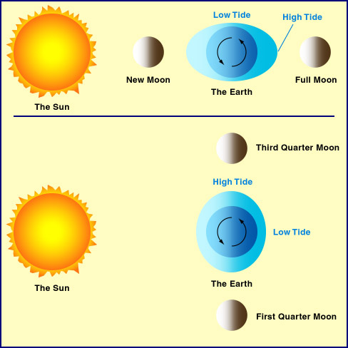

Slide 8
Low Tide
Low tides occur in areas that are between the areas of high tide.

Slide 9
Tidal Period
The Earth completes one rotation every 24 hours.
The moon takes 27 days to revolve around the Earth.
As a result each tidal period is 24 hours and 50 minutes long.

Slide 10
Spring Tides
Highest High Tides and Lowest Low Tides.
Occurs every 14 – 15 days during full and new moons.

Slide 11
Neap Tides
When the moon, the Earth and the sun are at right angles to each other the smallest tidal range occurs.
Neap tides are the lowest high tides and the highest low tides.
These occur during the first and last quarter of the lunar cycle.

Slide 12
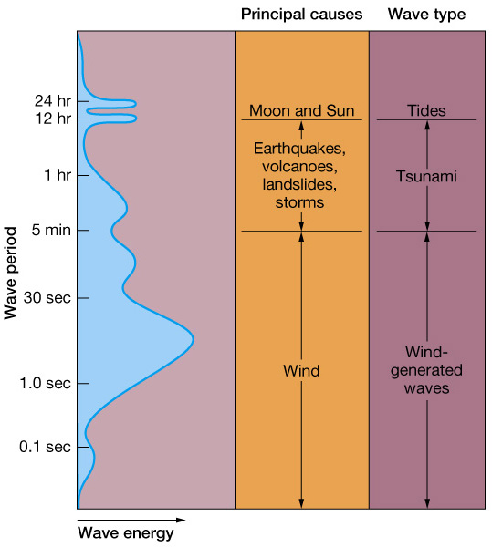
What is a wave?
Waves are disturbances in the ocean that transmit energy from one place to another.
Usually generated by wind
Can be generated by tides, volcanoes, landslides and storms

Slide 13
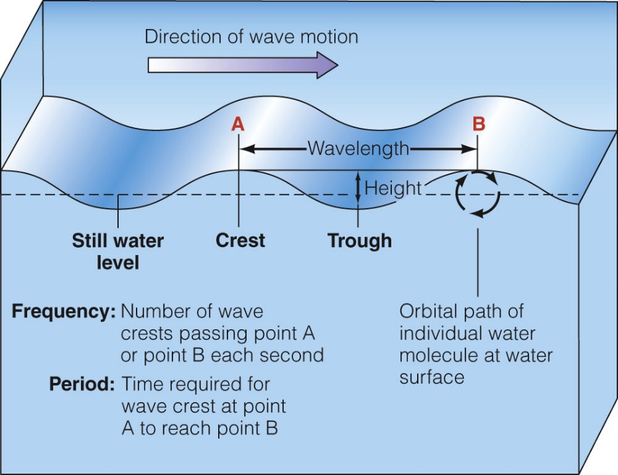
Wave characteristics and Terminology
Crest ,Trough, Wave height (H)
Wavelength (L), Still water level, Wave depth (d)

Slide 14
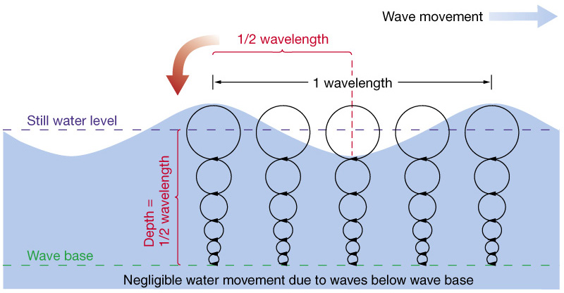
Orbital motion in waves
Orbital size decreases with depth to zero at wave base

Slide 15
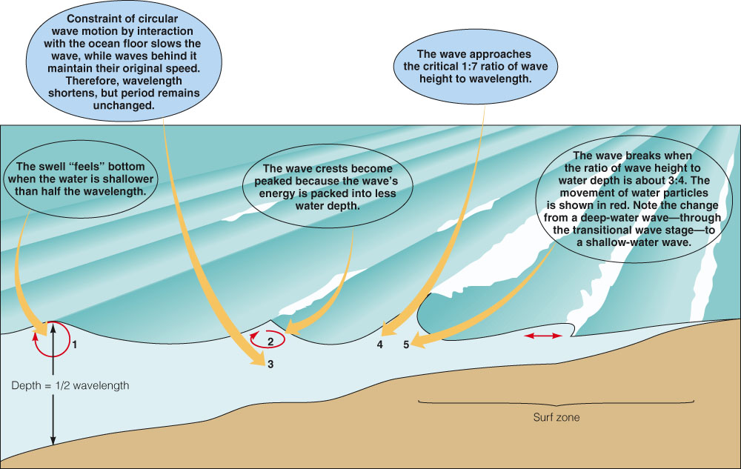
Waves approaching shore

Slide 16
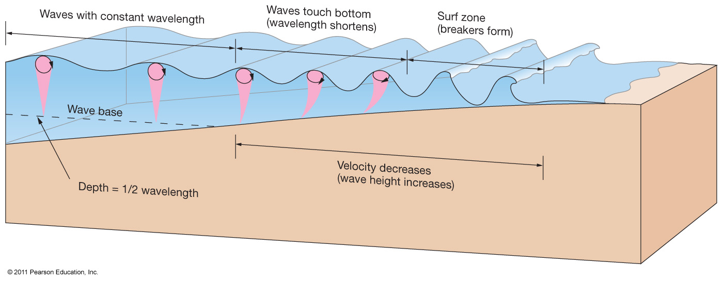
Waves undergo physical changes in the surf zone

Slide 17
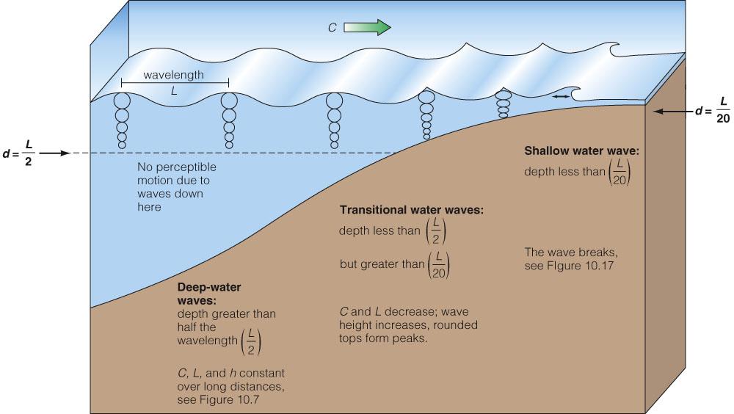
Intermediate depth

Slide 18
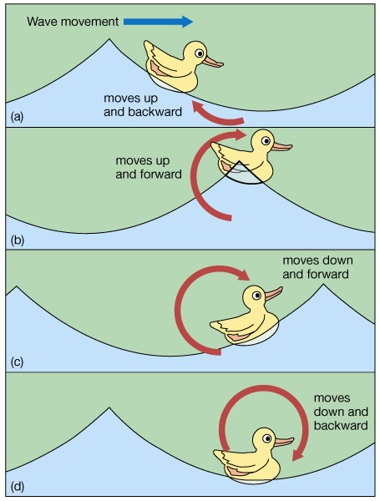
Circular orbital motion
As a wave travels, the water passes the energy along by moving in a circular orbit
Floating objects follow circular orbits

Slide 19
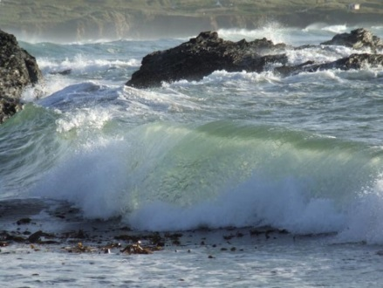
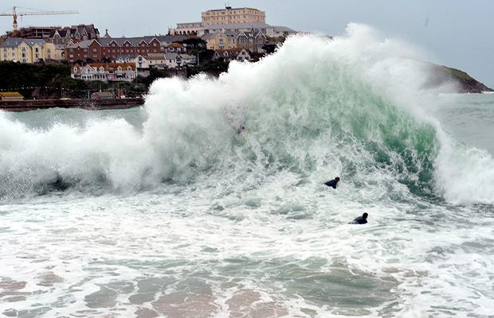
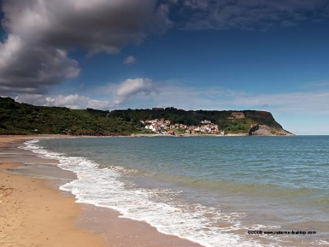
Types of breakers
Spilling breakers
  Gentle beach slope allows waves to disperse energy gradually
Plunging breakers
  Moderately steep beach slope gives waves a curling shape that propels surfers
Surging breakers
  Abrupt beach slope makes waves build up and break rapidly at the shore

Slide 20
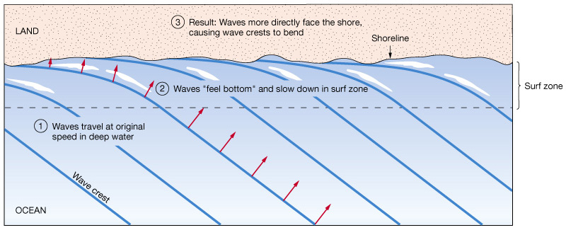
Waves can bend along a straight shoreline (Refraction)

Slide 21
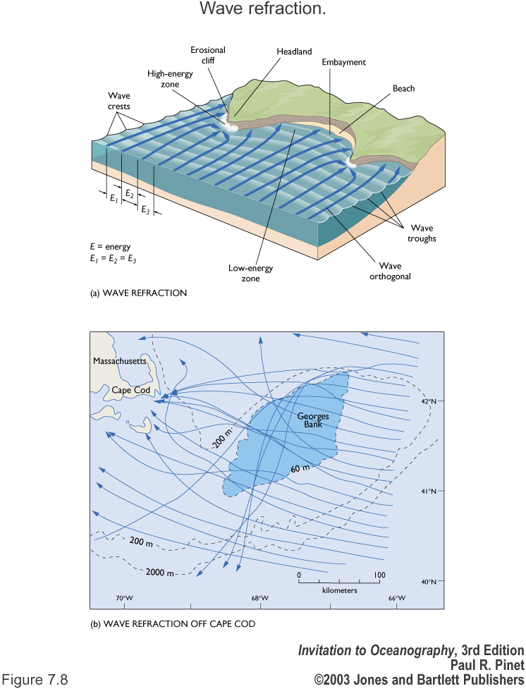

Slide 22
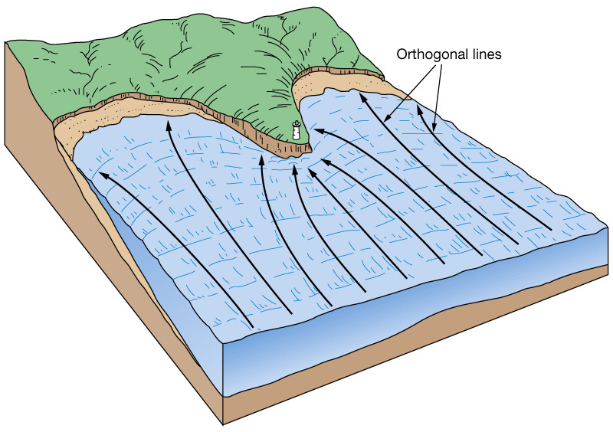
Wave refraction erodes shorelines
During wave refraction energy is concentrated at headlands and dispersed in bays.
This causes erosion of the coastline.

Slide 23
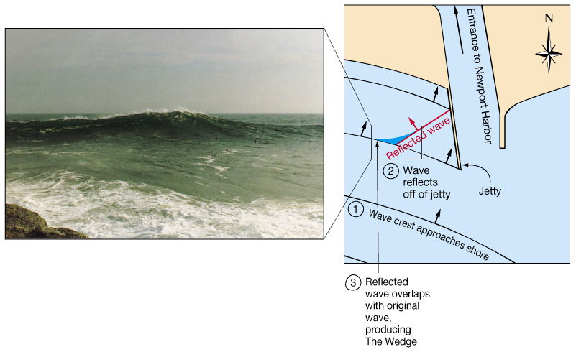
Wave reflection
Wave energy is reflected (bounced back) when it hits solid objects
Wave reflection produces large waves and erosion.

Slide 24
Tsunami
Tsunami terminology
  Japanese term meaning “harbour wave”
  Also called “seismic sea waves”
Created by movement of the ocean floor by:
  Underwater fault movement
  Underwater avalanches
  Underwater volcanic eruptions

Slide 25
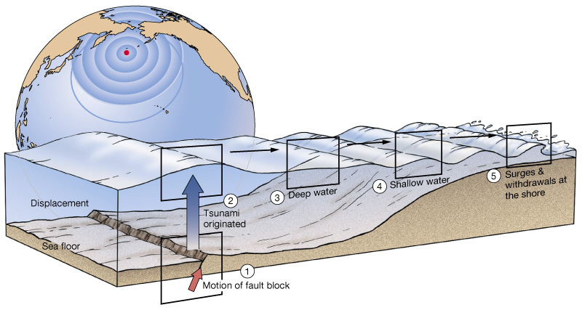
Where do Tsunamis Originate?
Most tsunami originate from underwater fault movement

Slide 26
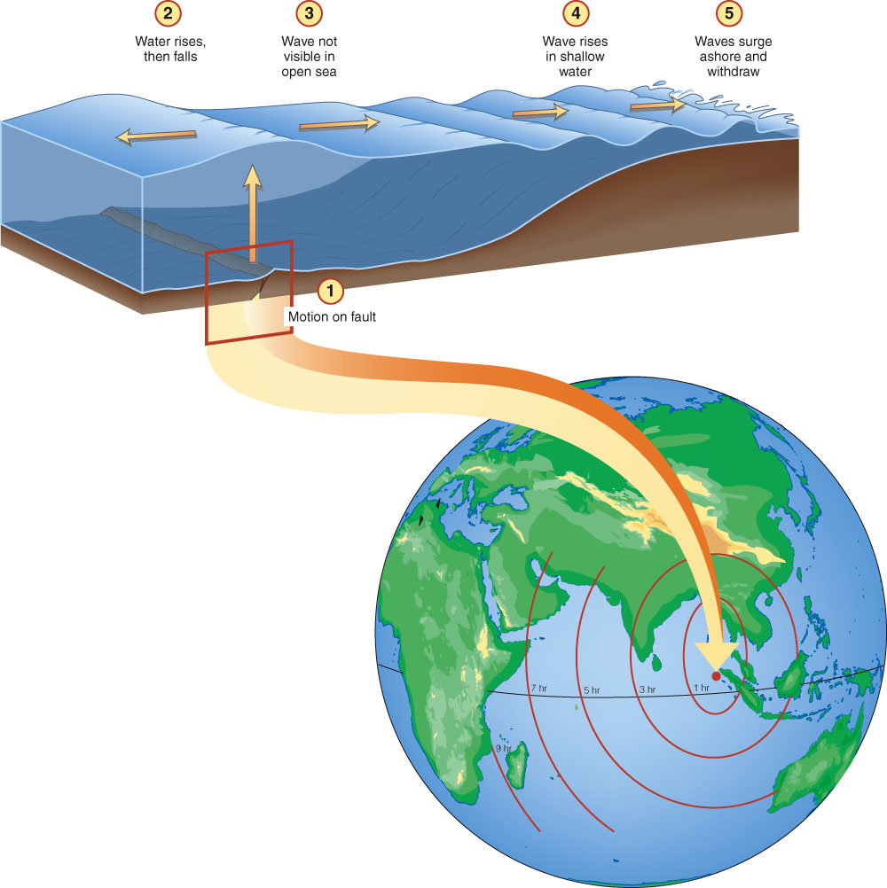

Slide 27
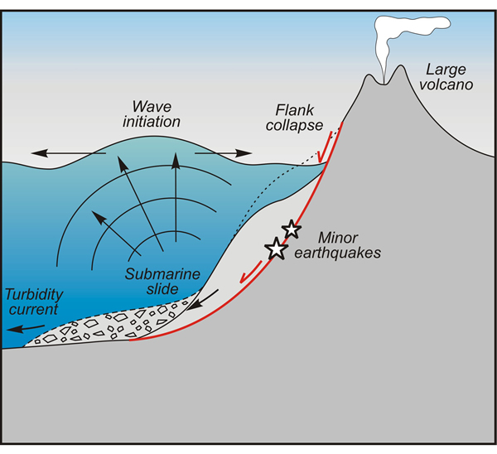
Underwater fault movement

Slide 29
Tsunami characteristics
Can travel at speeds over 700 kilometers
Small wave height in the open ocean, so pass beneath ships unnoticed
Build up to extreme heights in shallow coastal areas

Slide 30
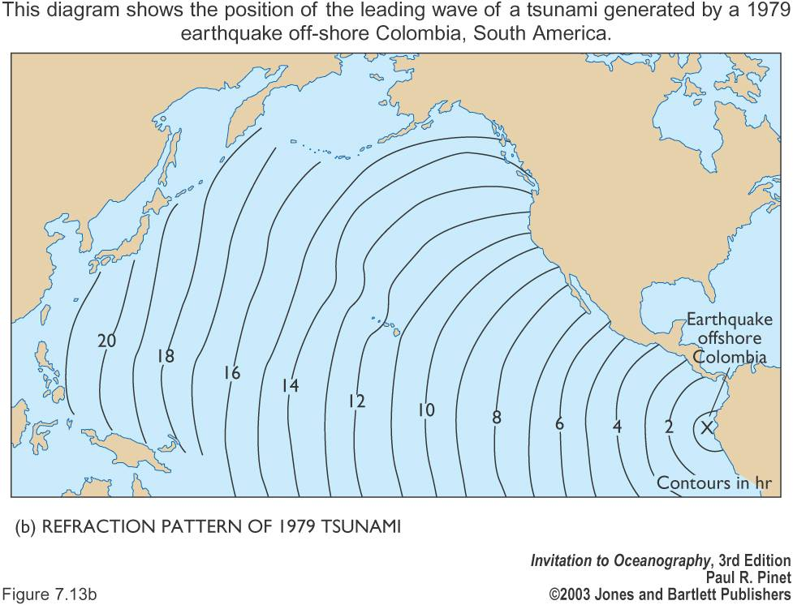

Slide 31
Coastal effects of tsunami
If trough arrives first, appear as a strong withdrawal of water (similar to an extreme and suddenly-occurring low tide)
If crest arrives first, appear as a strong surge of water that can raise sea level many meters and flood inland areas

Slide 32
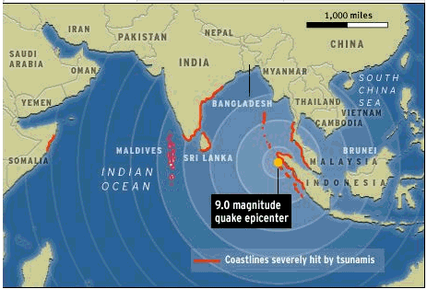
December 26, 2004
Sumatra Indonesia
Maximum wave: 35 meters (115 ft!)
Fatalities: 300 000

Slide 33
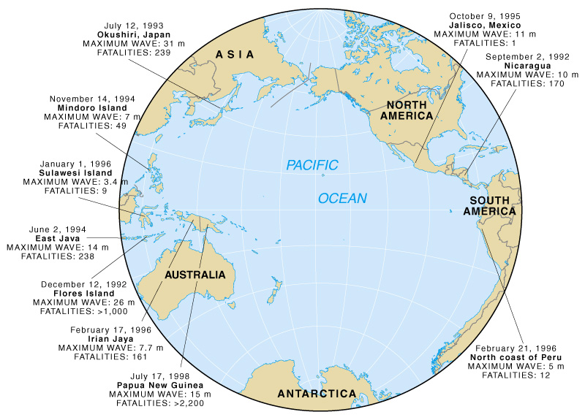
Tsunami since 1900
Most tsunami are created near the margins of the Pacific Ocean along the Pacific “Ring of Fire”

Slide 34
Tsunami warning system
Seismic listening stations track underwater earthquakes that could produce tsunami
Once a large earthquake occurs, the tsunami must be verified at a nearby station
If verified, a tsunami warning is issued
Successful in preventing loss of life (if people heed warnings)
Damage to property has been increasing

Slide 35
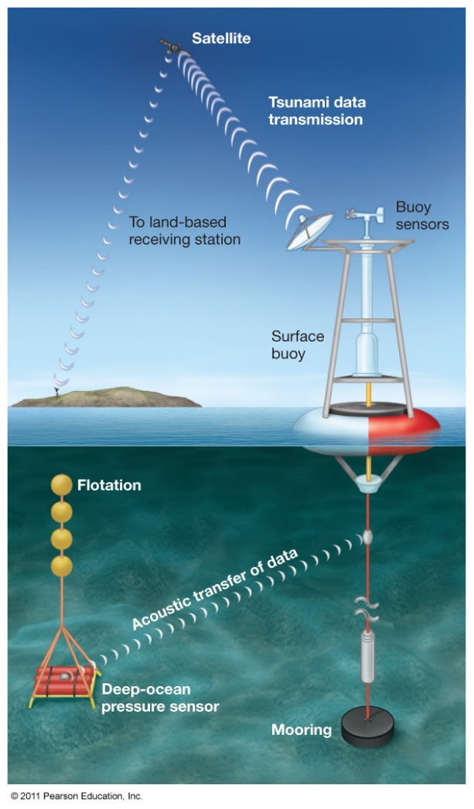

Slide 36
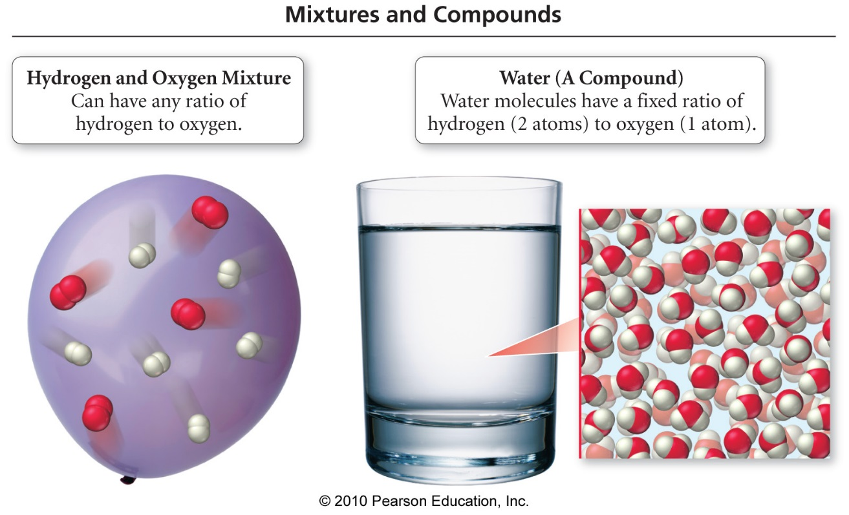
Formation of Water from Its Elements
Water is composed of Hydrogen and Oxygen atoms that combine in a fixed ratio.
Notes:
36

Slide 37
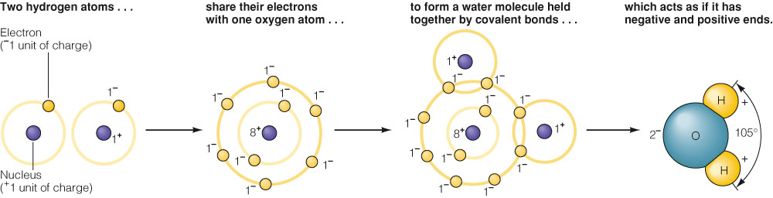
The Water Molecule Is Held Together by Chemical Bonds
A molecule is a group of atoms held together by chemical bonds.
A water molecule is composed of two hydrogen atoms and one oxygen atom.
Water is a polar molecule, having a positive and a negative side.

Slide 38
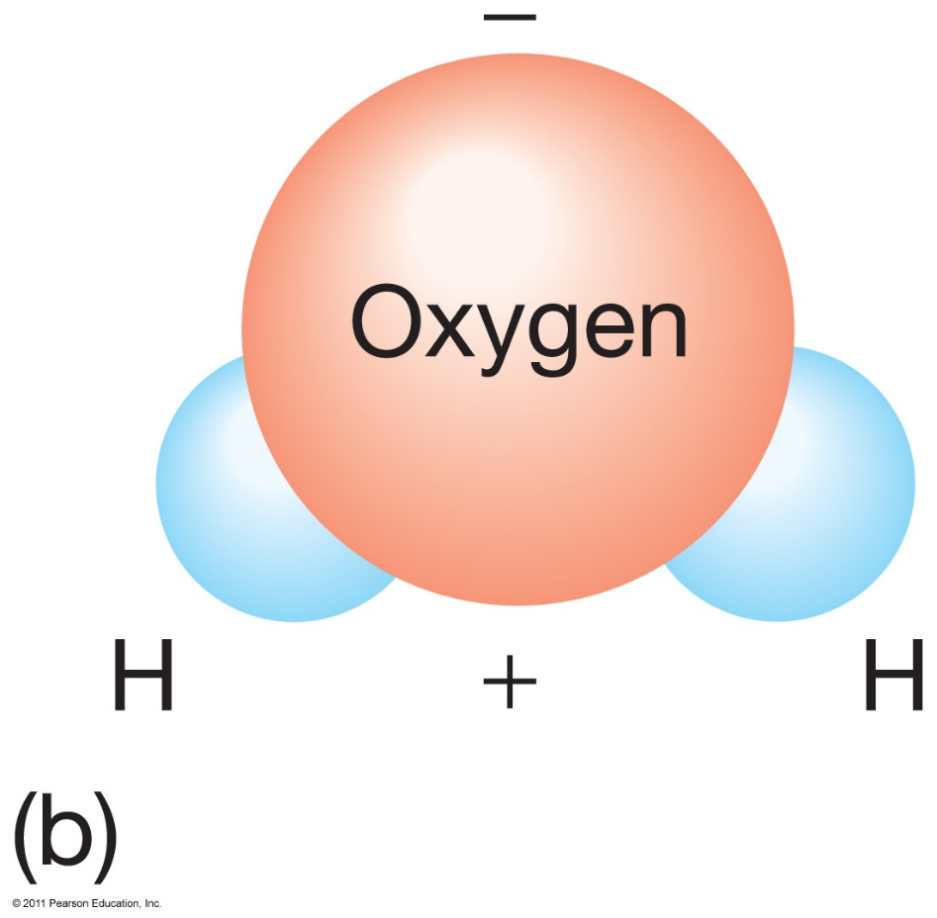
Draw and label the Water Molecule

Slide 39
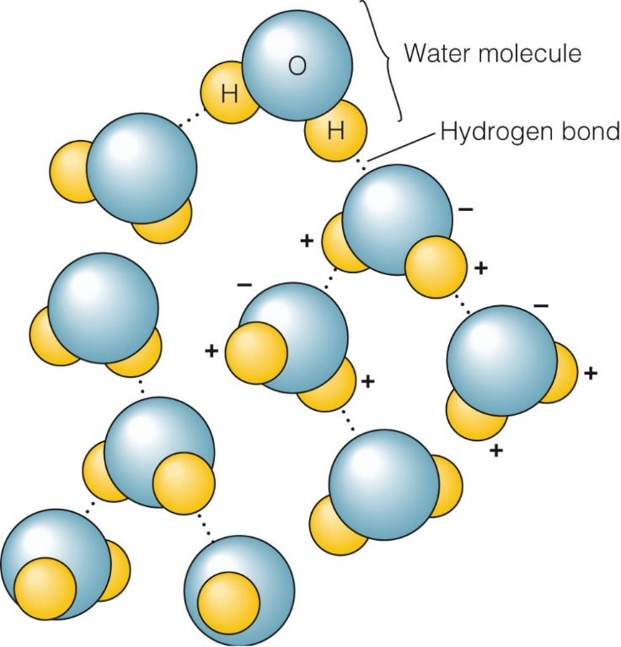
What holds water molecules together?
Hydrogen bonds
form when the positive end of one water molecule bonds to the negative end of another water molecule.
What are two important properties of water molecules?
Cohesion – the ability of water molecules to stick to each other, creating surface tension.
Adhesion – the tendency of water molecules to stick to other substances

Slide 40
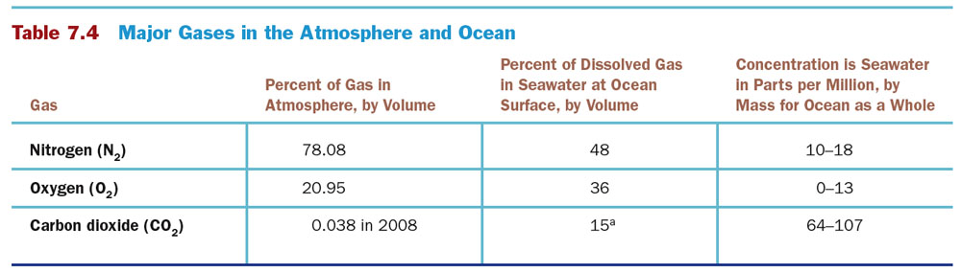
Water is a great solvent (dissolver) ….. It dissolves many gases and salts. The stuff that dissolves in solvents are called solutes
Solvent: What does the dissolving (always the largest part of the solution)
Solute: What is dissolved

Slide 41
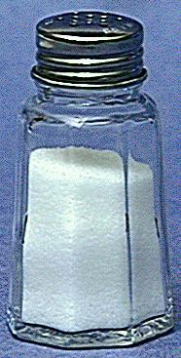
Salinity
Total amount of dissolved solids(salts) in water including dissolved gases
Ratio of mass of dissolved substances to mass of water sample

Slide 42
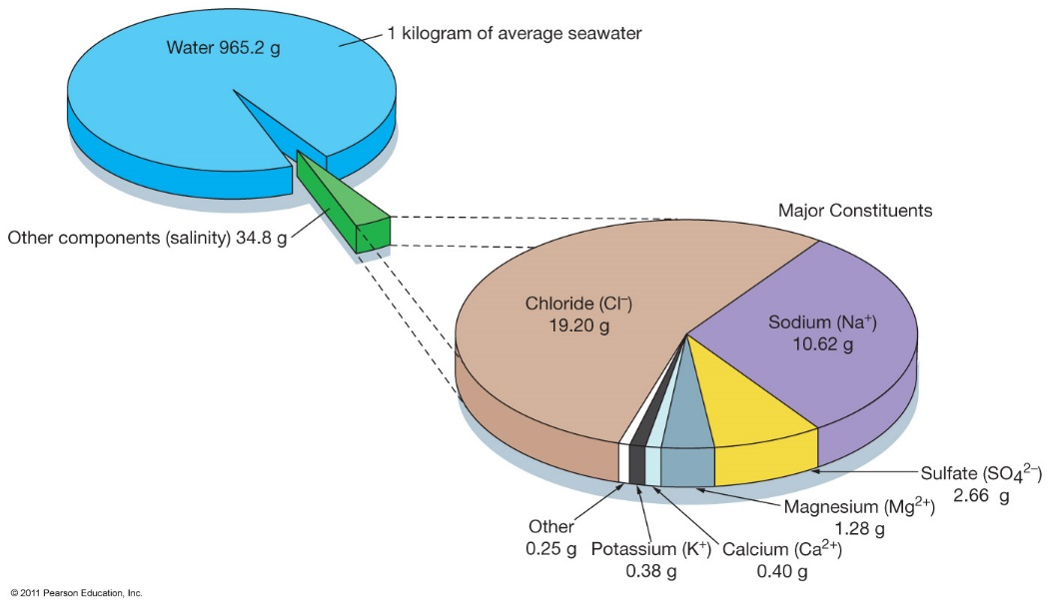
Salinity
Expressed in parts per thousand (ppt)
Average ocean salinity is 35 ppt (º/_{oo})

Slide 43
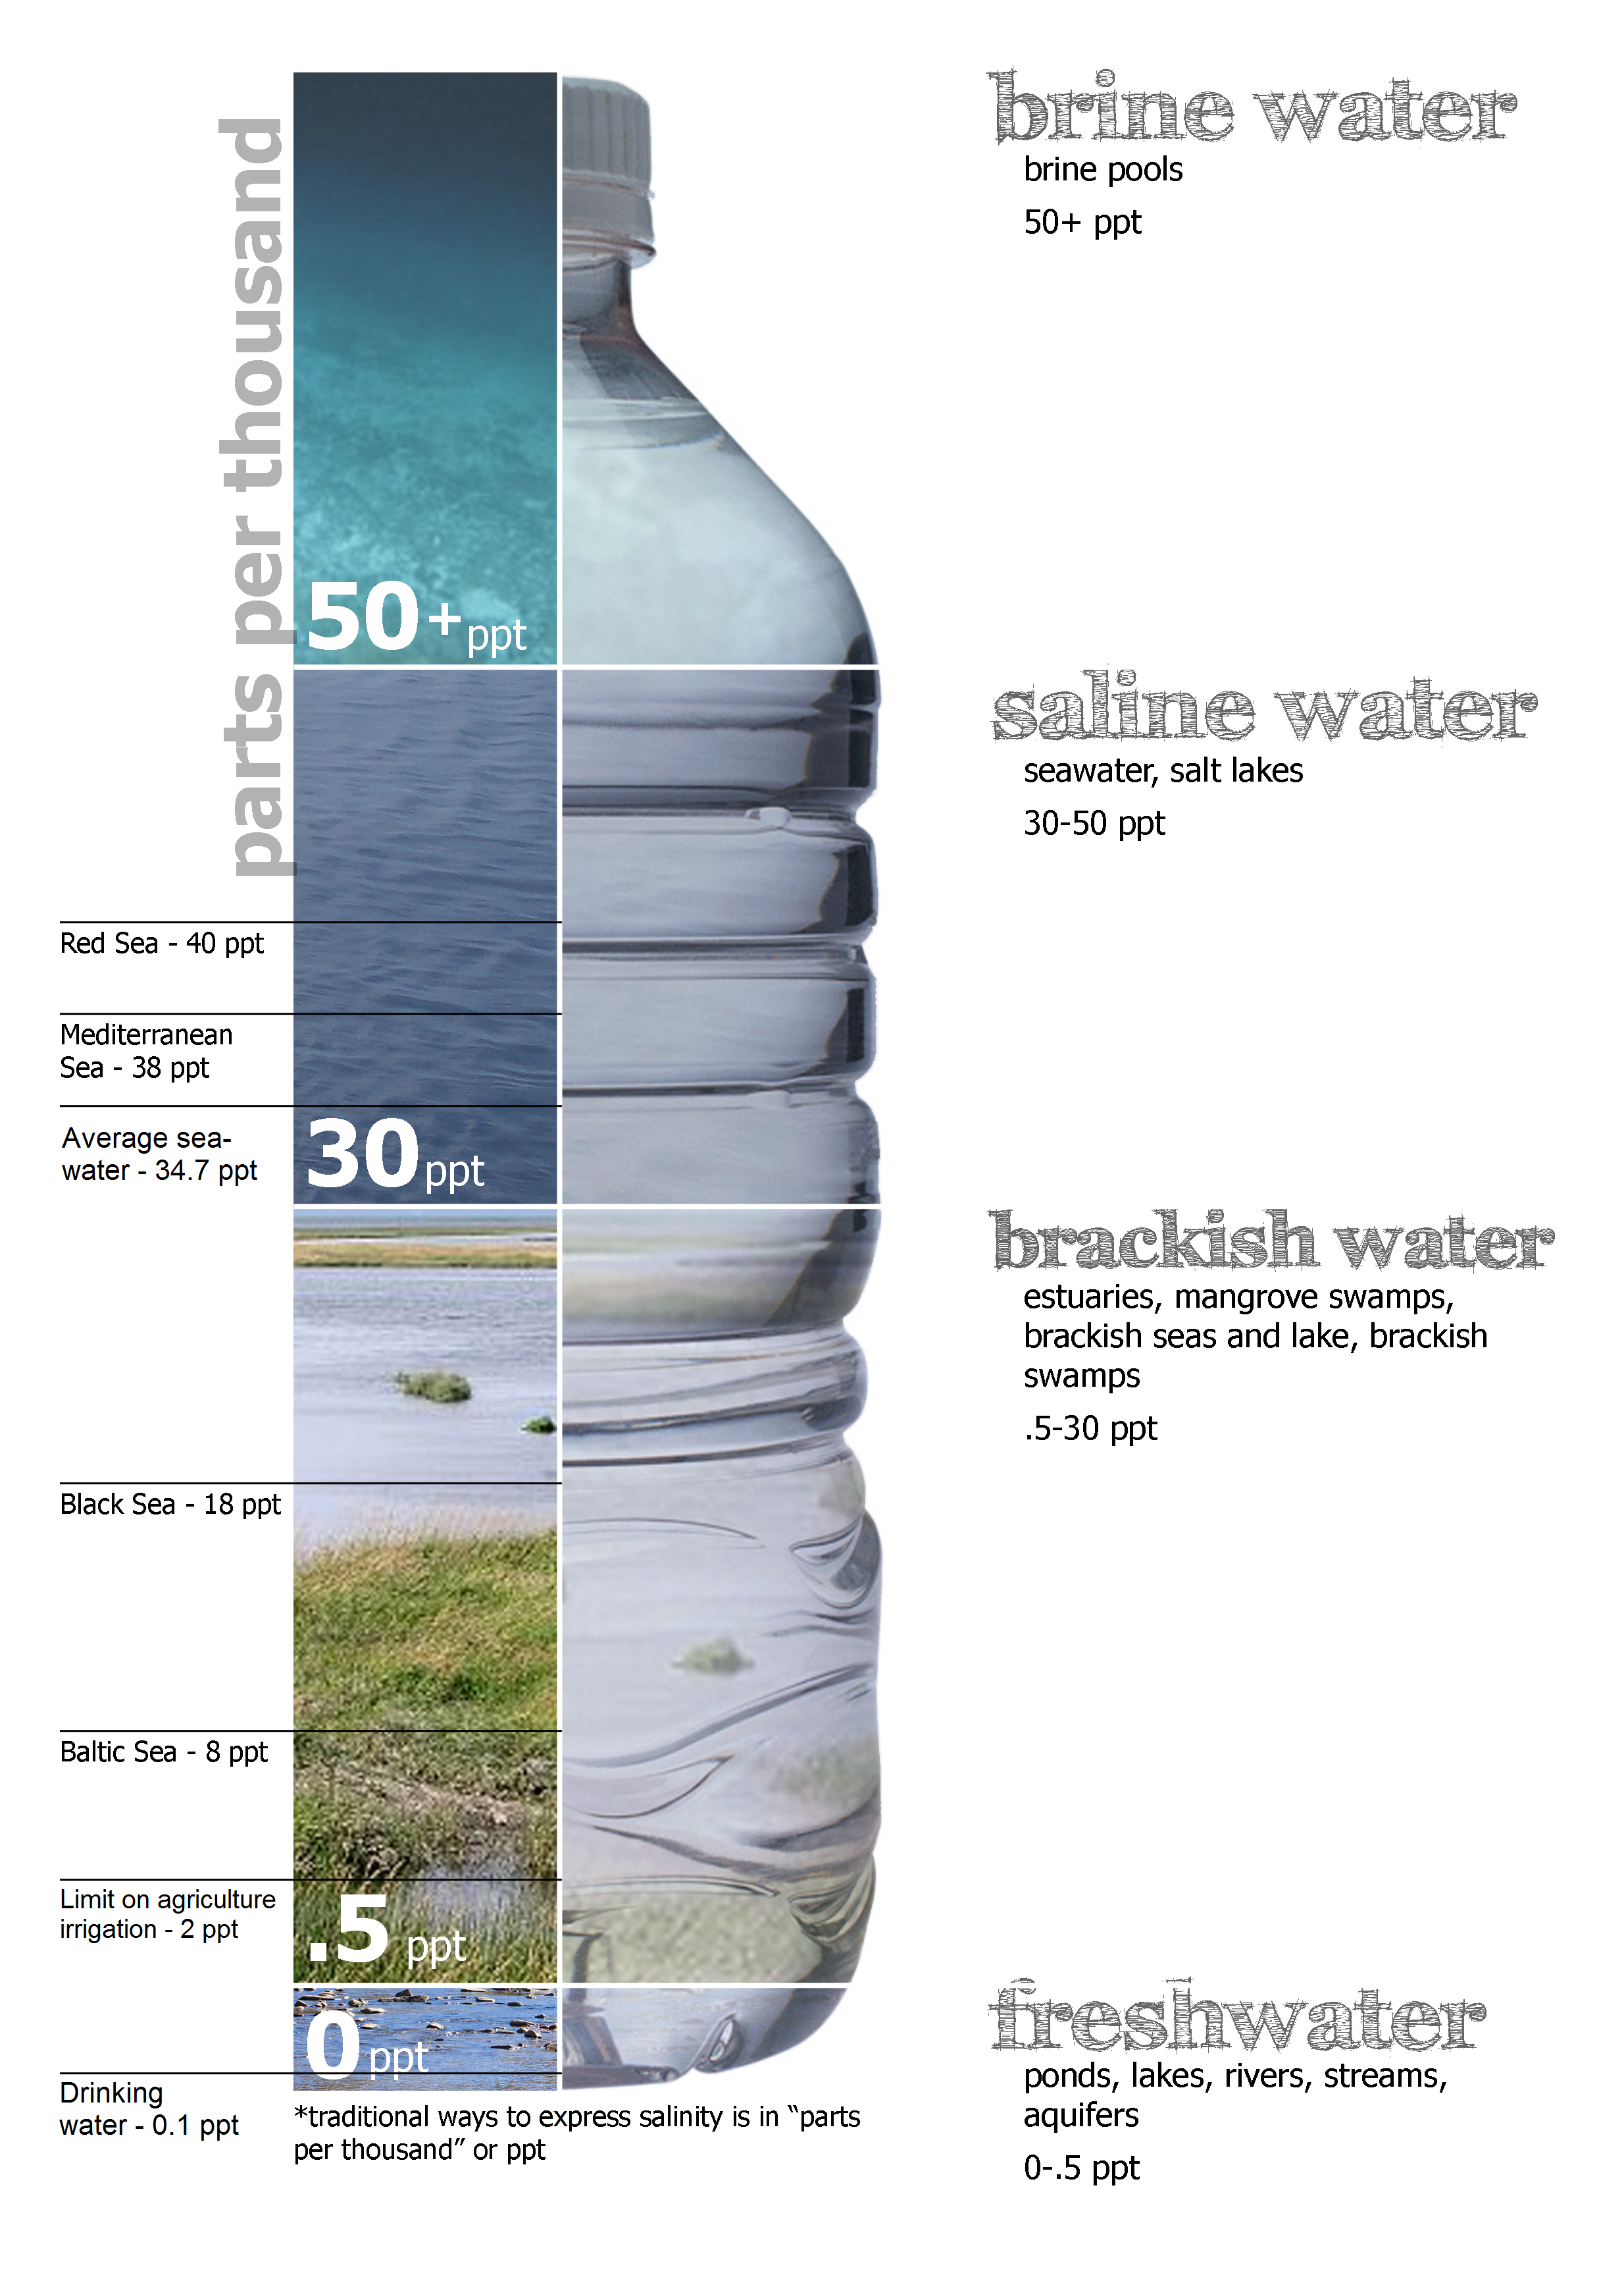

Slide 44
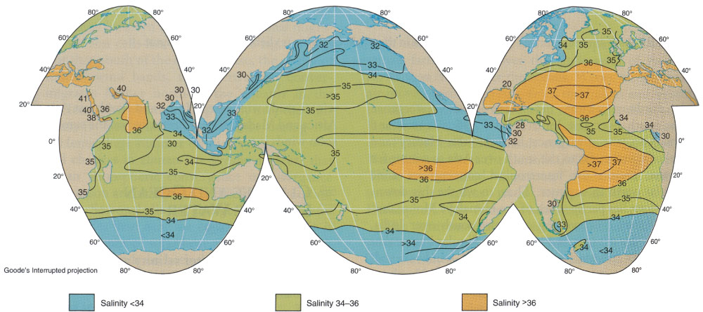
Ocean-Surface Conditions Depend on Latitude, Temperature, and Salinity
Sea-surface average salinities in parts per thousand (‰).

Slide 45
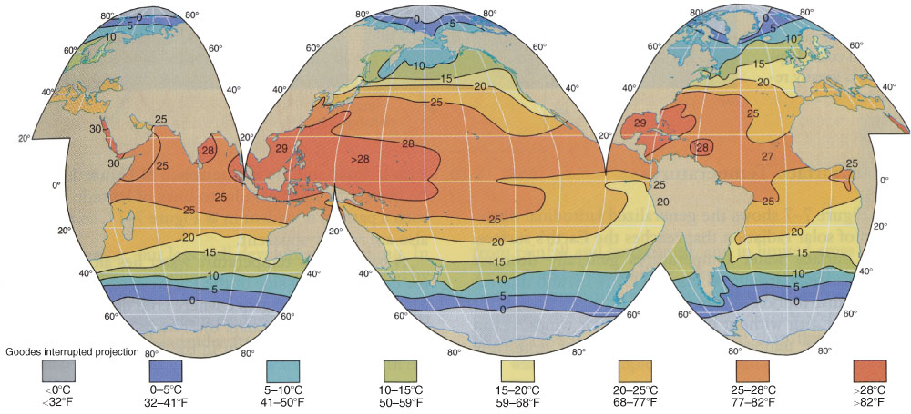
Ocean-Surface Conditions Depend on Latitude, Temperature, and Salinity
Sea-surface temperatures during Northern Hemisphere summer.

Slide 46
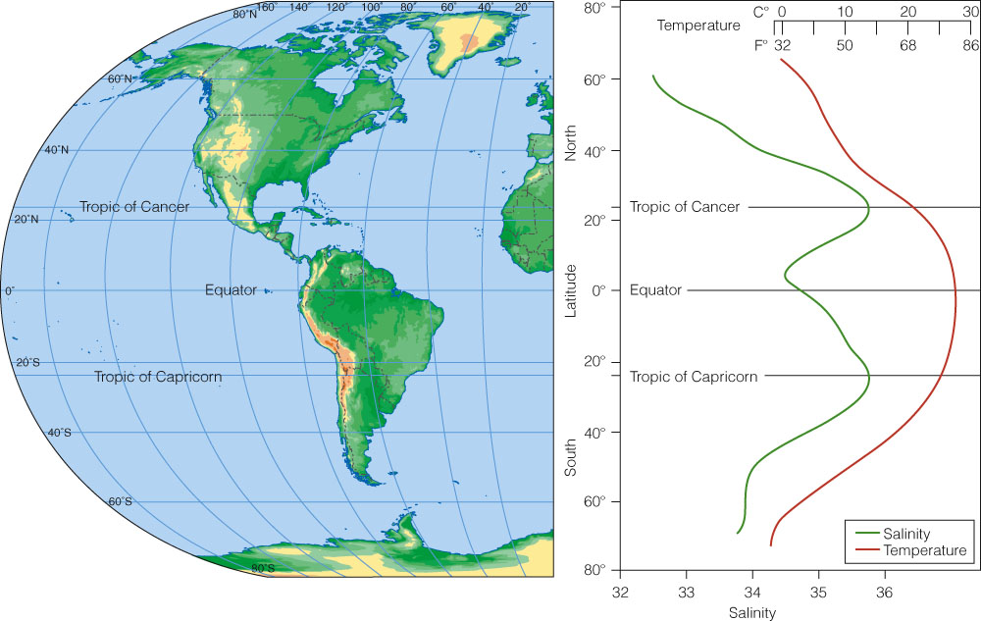
Temperatures are lowest in the polar regions and highest near the equator. Heavy rainfall in the equatorial regions “freshens” the ocean near the equator, whereas hot and dry conditions near the tropics result in high surface salinity in the tropics

Slide 47
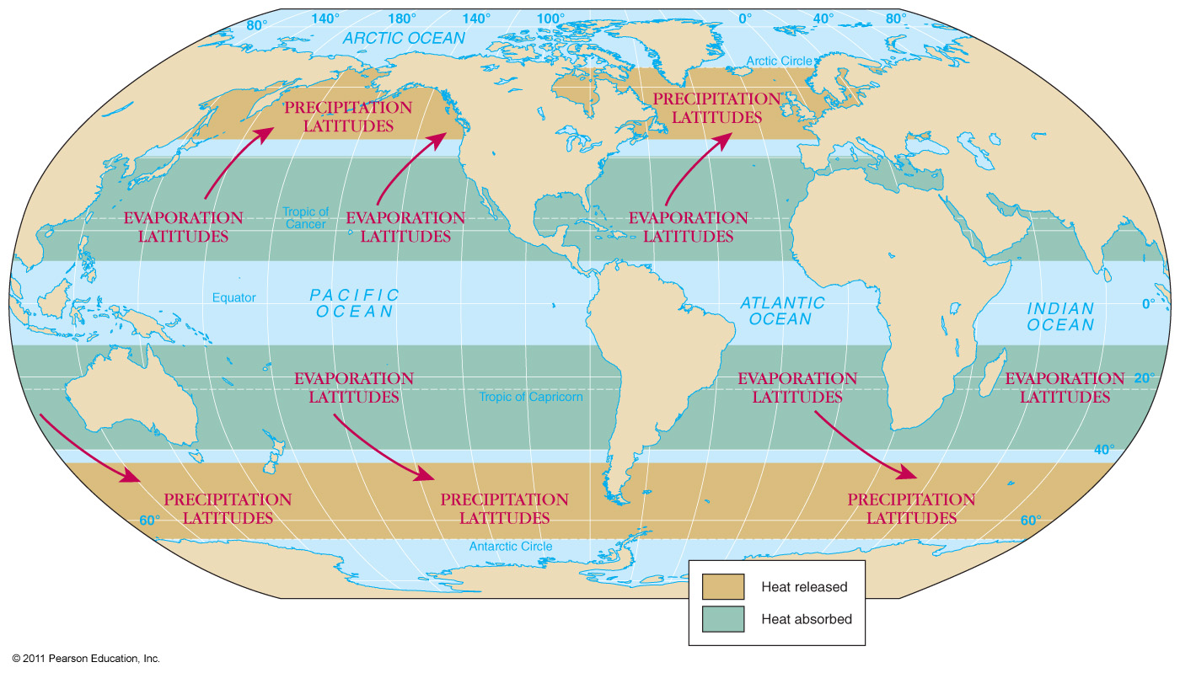

Slide 48
Salinity Variations
Open-ocean salinity is 33–38 o/oo(ppt). Coastal areas salinity varies more widely.(Why?)
  Freshwater lowers salinity or creates brackish conditions.
  A greater rate of evaporation raises salinity or creates hypersaline conditions.
  Salinity may vary with seasons (dry/rain).

Slide 49
Processes Affecting Salinity
Decrease salinity – add fresh water to ocean
  Runoff, melting icebergs, melting sea ice
  Precipitation
Increasing salinity – removing water from ocean
  Sea ice formation
  Evaporation

Slide 50
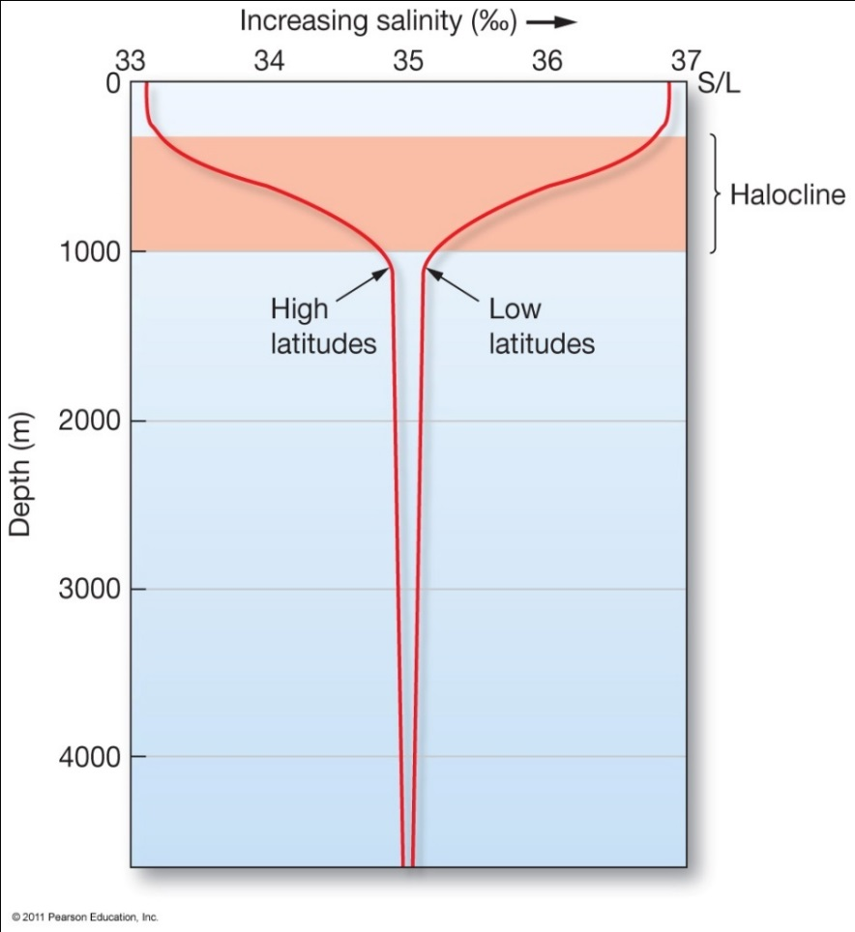
Variation of Salinity with Depth “Halocline Graphs”
Excess evaporation at the surface
Runoff, ice melting, less evaporation at surface
Similar salinity at depth

Slide 51
The 3 Clines:
Thermocline:
  Transition layer between the mixed layer at the surface and the deep water layer.
  The definitions of these layers are based on temperature (surface water is warmer due to sun’s radiation).
Halocline:
  Cline caused by a strong, vertical salinity gradient within a body of water.
  Since salinity (along with temperature) affects the density of seawater, it can play a role in its vertical stratification.
Pycnocline:
  Cline (or layer) where the density gradient (^{∂ρ}⁄_{∂z}) is greatest within a body of water.

Slide 52
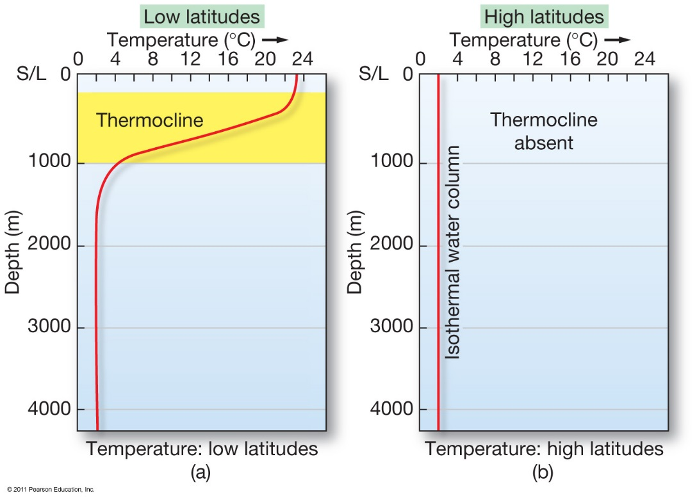
Variation of Temperature with Depth “Thermocline Graphs”
Sun warms the surface
Cold at depth
Cold
everywhere

Slide 53

Isothermal: Where there is not a strong change in temperature (Thermocline is absent)

Slide 54
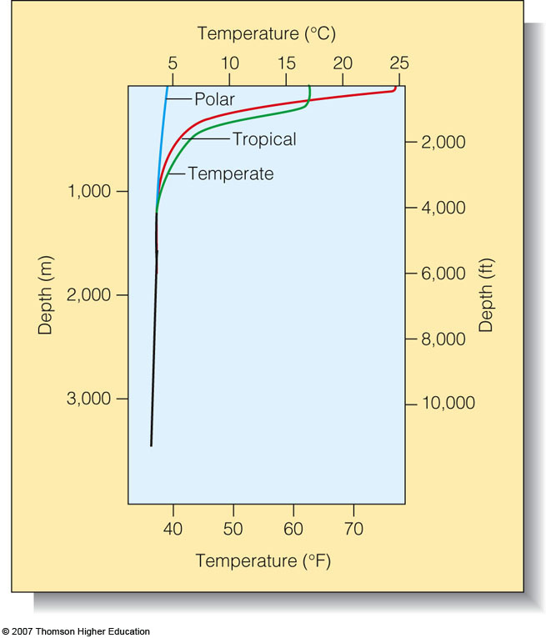
Thermocline graphs are also controlled by latitudes. (Why?)

Slide 55
Density Zones
The ocean is broken into density zones
The 3 density zones are controlled by:
  Temperature
  salinity
Zone 1:
  Surface zone – the upper layer of the ocean, least dense of all seawater. (2%)
Zone 2:
  Pycnocline – the density of the water increases with depth.(18%)
Zone 3:
  Deep zone – Ocean water density is constant in this layer. (80%)

Slide 56
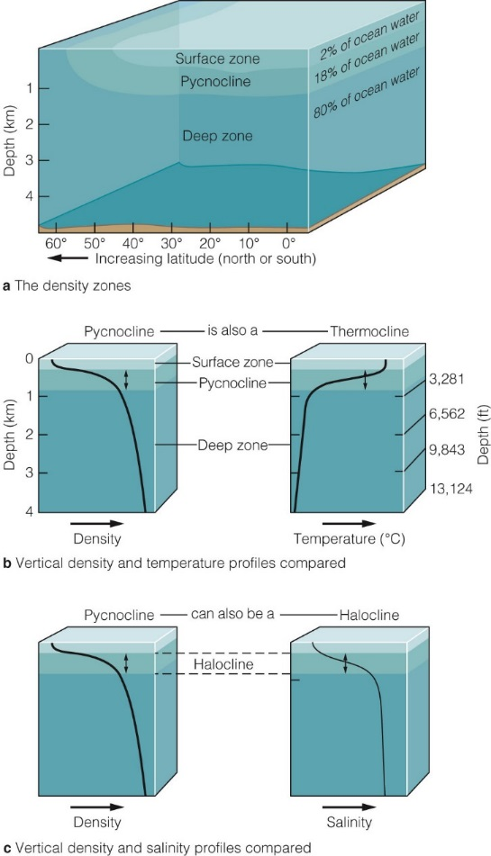
The Ocean Is Stratified into Three Density Zones by Temperature and Salinity
Density increases rapidly with depth in the pycnocline.
Below the pycnocline lies the deep zone of cold, dense water.
As the water gets deeper, the temperature decreases
As the water gets deeper, the salinity increases
  more dissolved particles = heavier water

Slide 57
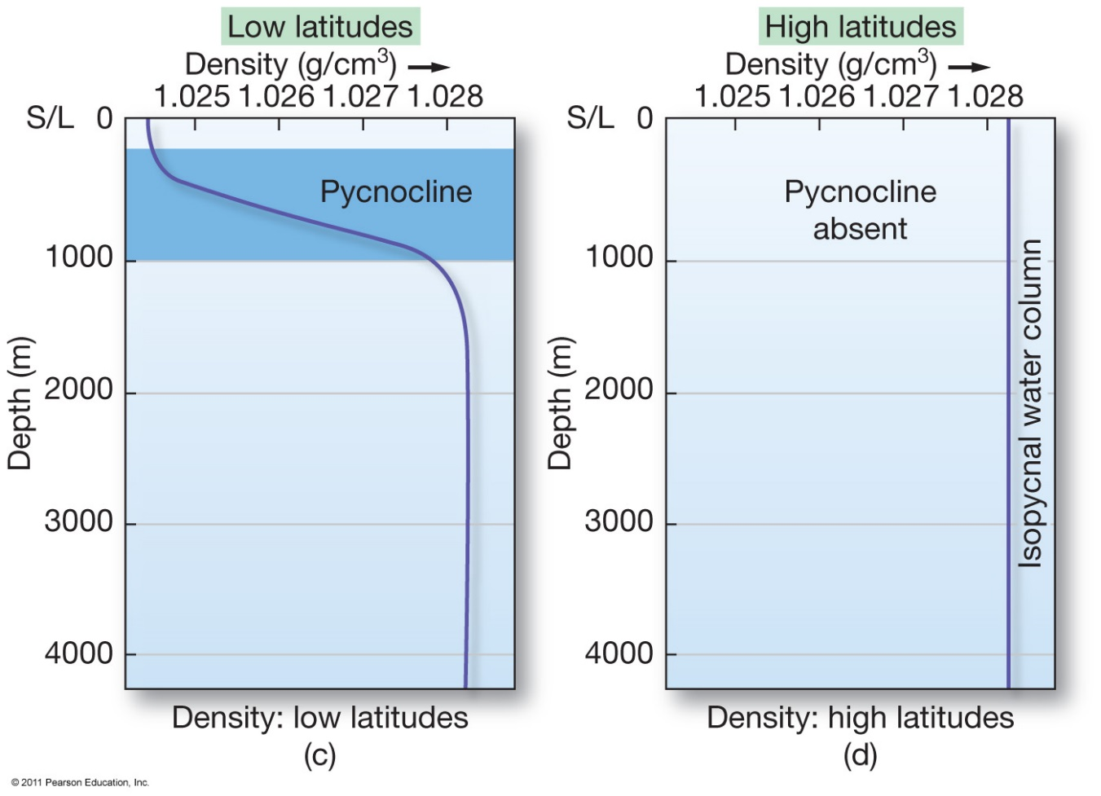
Pycnocline graphs are also controlled by latitude – Why?

