Slide 1
Unit 1 Structure and Motion Part 2
Exam Review

Slide 2
Ocean Currents
An ocean current is a large amount of ocean water that moves in a particular unchanging direction.
There are more than 20 major ocean currents.
Currents can be warm or cold, depending on their origin.

Slide 3
http://www.pbslearningmedia.org/asset/ttv10_vid_currents/

Slide 4
Two types of ocean currents
surface currents (extend to an average depth of 200m).
Caused by: Wind action, the Earth’s spin (Coriolis Effect), and the shape of the continents.
Thermohaline currents (occur deeper than 200m).

Slide 5
Wind Action
As air moves over the ocean’s surface, its energy is transferred by friction to the water molecules, causing the ocean water to move.

Slide 6
Earth’s spin (Coriolis Effect)
Earth spins from west to east (counter-clockwise), as winds and currents move over this spinning body, their paths get re-directed depending on what side of the equator they are on.
As a result:
clockwise pattern in the northern hemisphere
counter-clockwise pattern in the southern hemisphere.
Coriolis Effect: http://video.mit.edu/watch/the-coriolis-effect-4407/

Slide 7
Coriolis Effect Demo

Slide 8
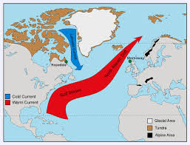
Shape of Continents
Moving currents are forced to turn when they meet a solid surface.

Slide 9
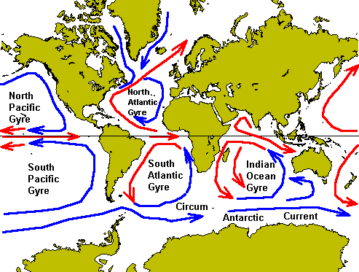
Gyres
The currents in oceans appear to move in a circular pattern called gyres. The right side of gyres has cool water and the left side holds warm water (both affect weather on the land).

Slide 10
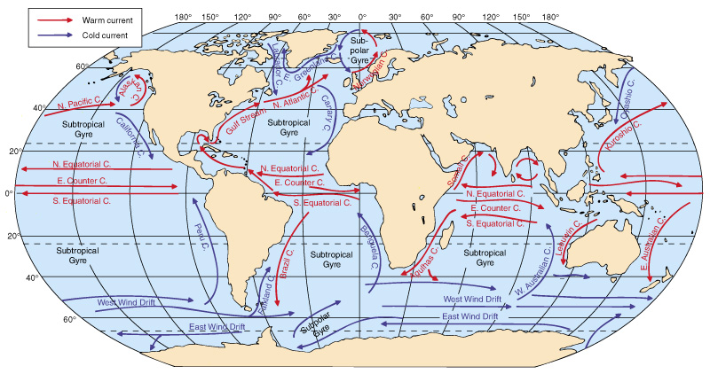
Wind-driven surface currents
Figure 7-4

Slide 11
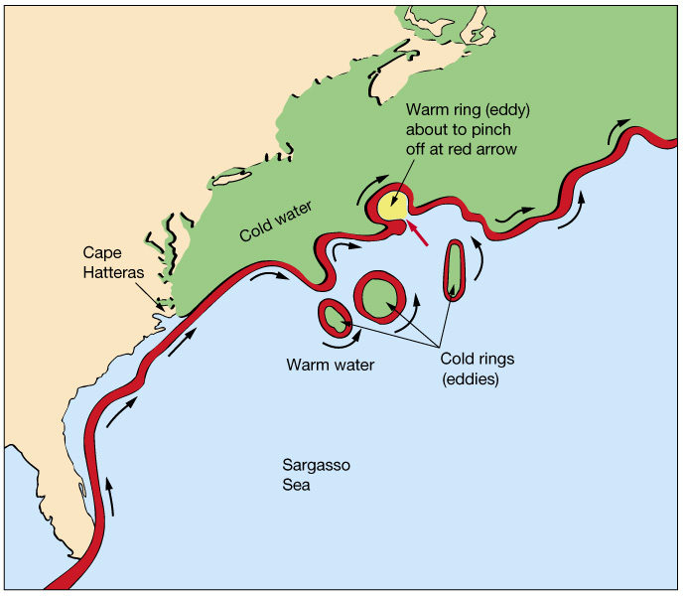
The Gulf Stream and sea surface temperatures
The Gulf Stream is a warm, western intensified current
Meanders as it moves into the North Atlantic
Creates warm and cold core rings
Figure 7-16

Slide 12
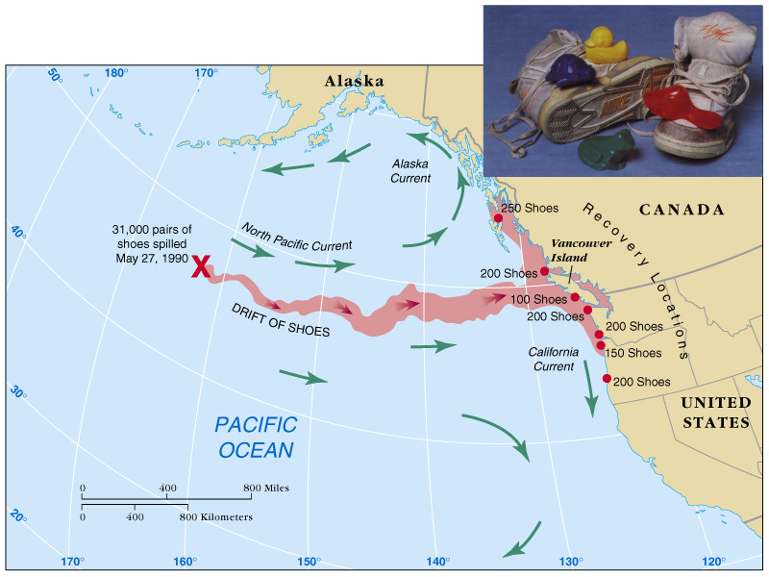

Slide 13
Deep ocean characteristics
Conditions of the deep ocean:
Cold
Still
Dark
Essentially no productivity ( very little food)
Sparse life
Extremely high pressure

Slide 14
Thermohaline:
As opposed to wind-driven currents the thermohaline circulation is that part of the ocean circulation which is driven by density differences.
Sea water density depends on temperature and salinity, hence the name thermo-haline.

Slide 15
Deep currents (Thermohaline Circulation)
Deep currents:
Form in subpolar regions at the surface
Are created when high density surface water sinks
Factors affecting density of surface water:
Temperature (most important factor)
Salinity
Deep currents are known as thermohaline circulation

Slide 16
Temperature
Water temperature varies with depth. There are three layers:
Surface – warmest layer
Thermocline – the water temperature may drop from 20ºC to 5ºC
Deep water – temperatures are close to the freezing point

Slide 18
Temperature affects the density of ocean water. Cold water is more dense than warm water and tends to sink.
Temperature differences in water may cause vertical convection currents where warmer water is rising and colder water is sinking.

Slide 19
Salinity of Water
Density currents can also be caused by differences in salinity (amount of salt).
Water with a high salinity is denser than water with a lower salinity.
What is happening at the poles?

Slide 20
Pycnocline
A layer where the density gradient is greatest within a body of water.
An ocean current is generated by the forces such as breaking waves, terms of temperature and salinity differences, wind, Coriolis effect, and tides caused by the gravitational pull of the Moon and the Sun.

Slide 21
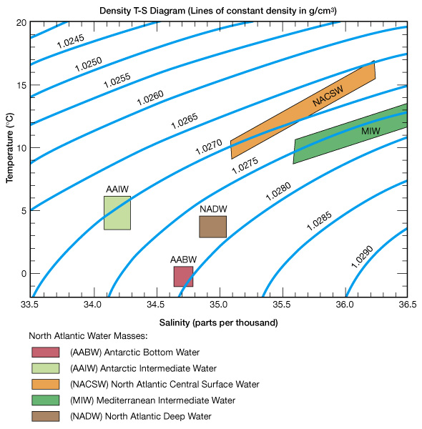
Identification of deep currents
Deep currents are identified by measuring temperature (T) and salinity (S), from which density can be determined

Slide 22
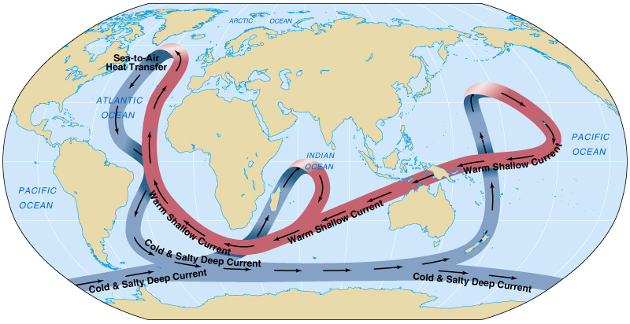
Conveyer-belt circulation

Slide 23
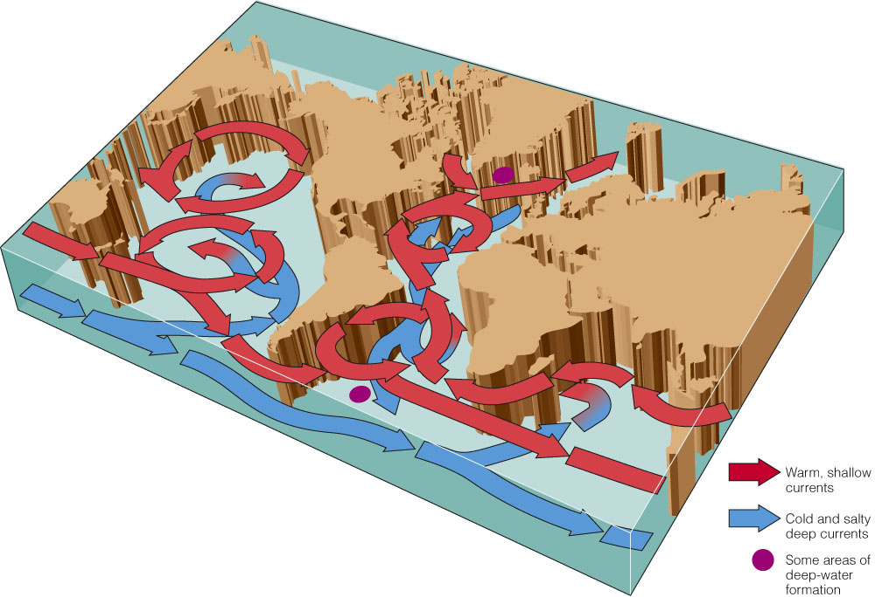

Slide 24
http://oceanservice.noaa.gov/education/kits/currents/06conveyor2.html

Slide 25
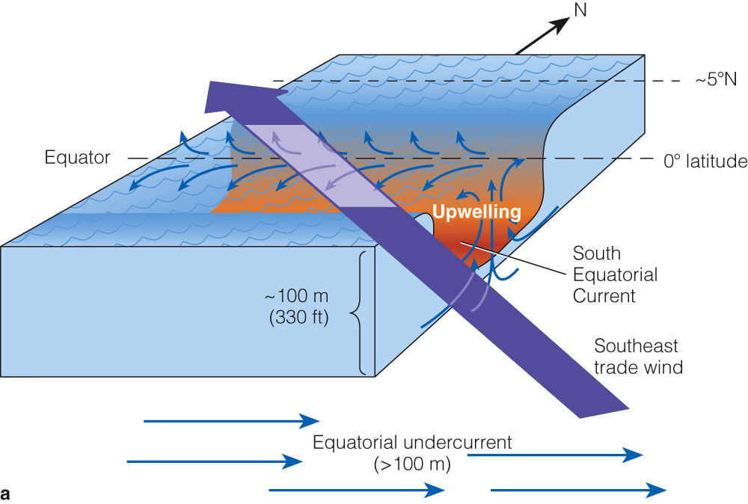
Upwelling
Nutrient rich water rises near the equator.
Nutrient rich water upward motion of water. This motion brings cold, nutrient rich water towards the surface

Slide 26
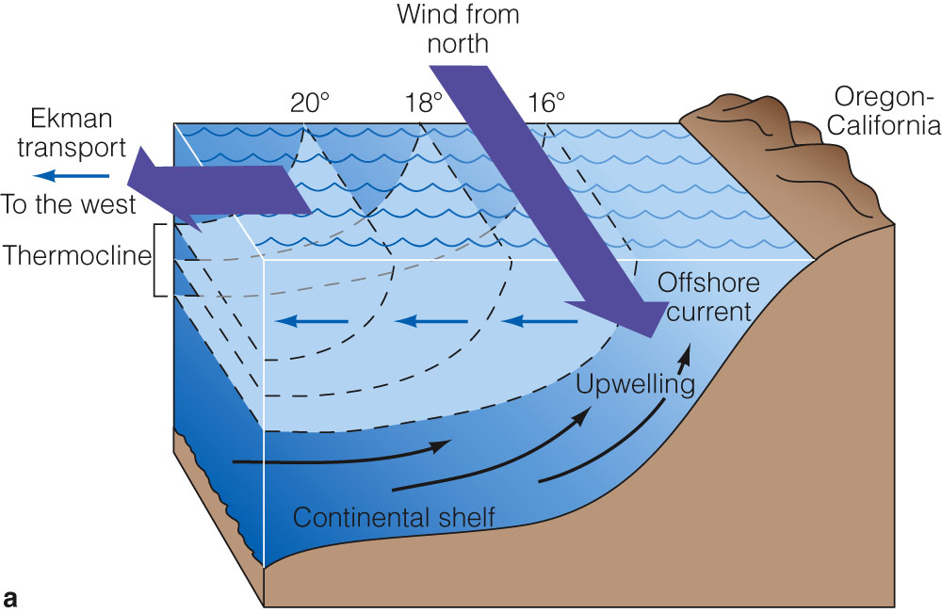
Types of Upwelling
Coastal upwelling: Northern Hemisphere: caused by winds from the north blowing along the west coast of a continent.

Slide 27
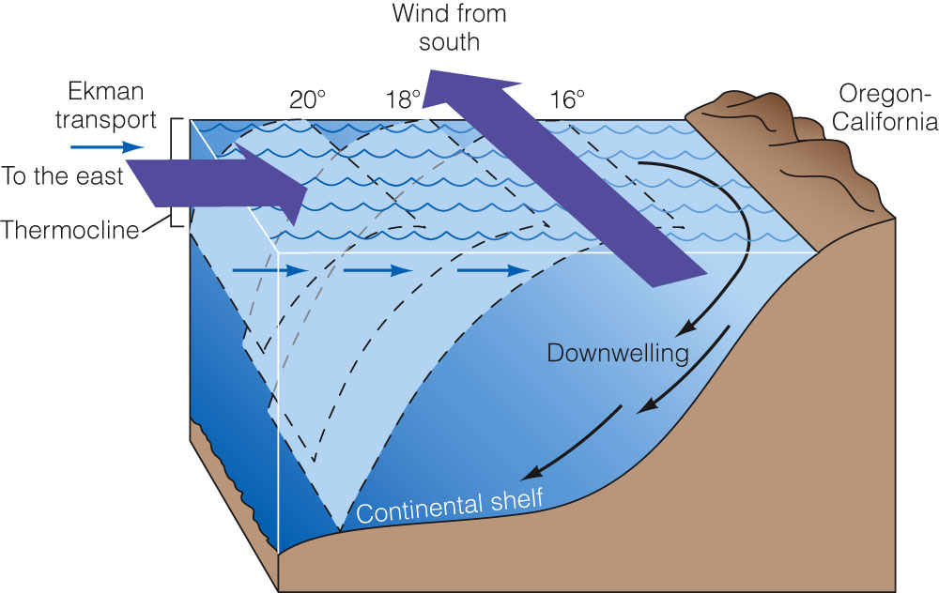
Downwelling
Coastal Downwelling: Areas of downwelling are often low in nutrients and therefore relatively low in biological productivity.

Slide 28
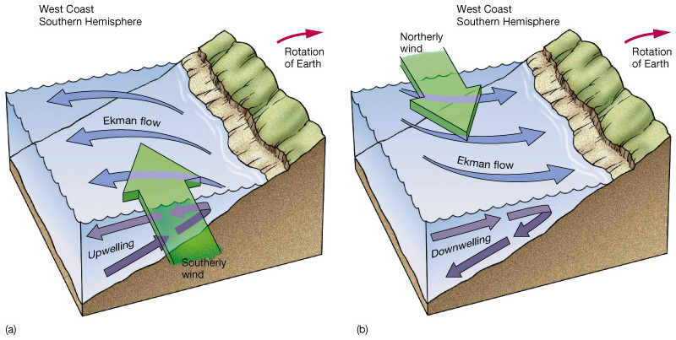
Coastal upwelling and downwelling

Slide 30
How the Oceans Influence Climate
Long term and Short Term
Over the long term the shape and the location of the continents helps to determine the oceans’ circulation patterns.
Patterns of ocean circulation and upwelling can change rapidly, resulting in climate variations and fluctuations on a human time scale (short term).

Slide 31
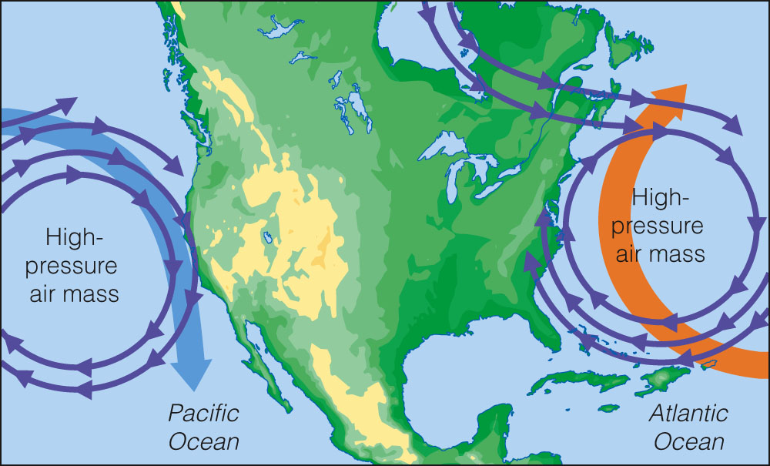
Surface Currents Affect Weather and Climate

Slide 32
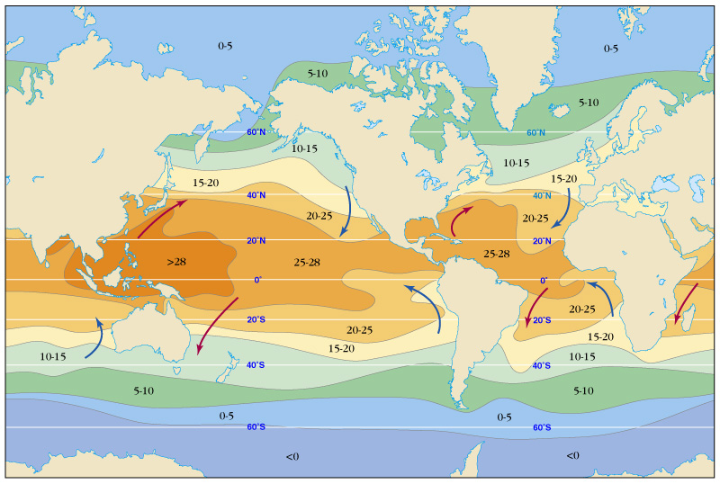
Currents and Climate
Warm current  warms air  high water vapor  humid coastal climate
Cool current  cools air  low water vapor  dry coastal climate

