Slide 1
Unit 1 Structure and Motion
Part 1
Exam Review

Slide 2
Continental Drift
In 1912 Alfred Wegner Wegener proposed that millions of years ago all of the continents were part of one supercontinent called Pangaea.
Evidence for Continental Drift:
  Wegener proposed Pangaea – one large continent existed
  200 million years ago
  Panthalassa – one large ocean
  Noted puzzle-like fit of modern continents
  Matching sequences of rocks and mountain chains
  Similar rocks on different continents

Slide 3
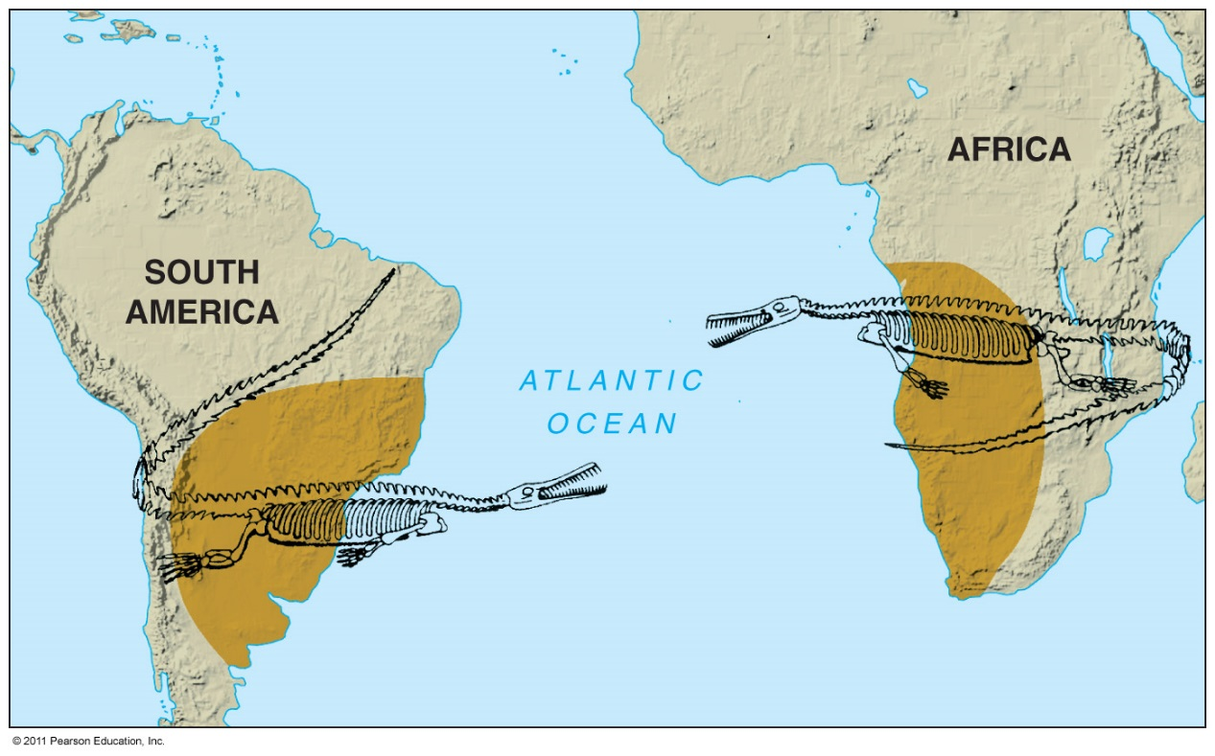
Evidence for Continental Drift
Same fossils found on continents that today are widely separated

Slide 4
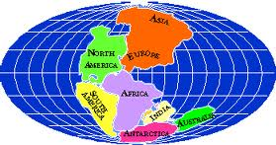
Pangaea

Slide 5
Theory of Plate Tectonics
Lithosphere – tectonic plates that float on ductile asthenosphere
Large scale geologic features occur at plate boundaries
The theory of plate tectonics caused a Paradigm shift in how the Earth moves and how new crust is created.
Paradigm Shift: Change in world view

Slide 6
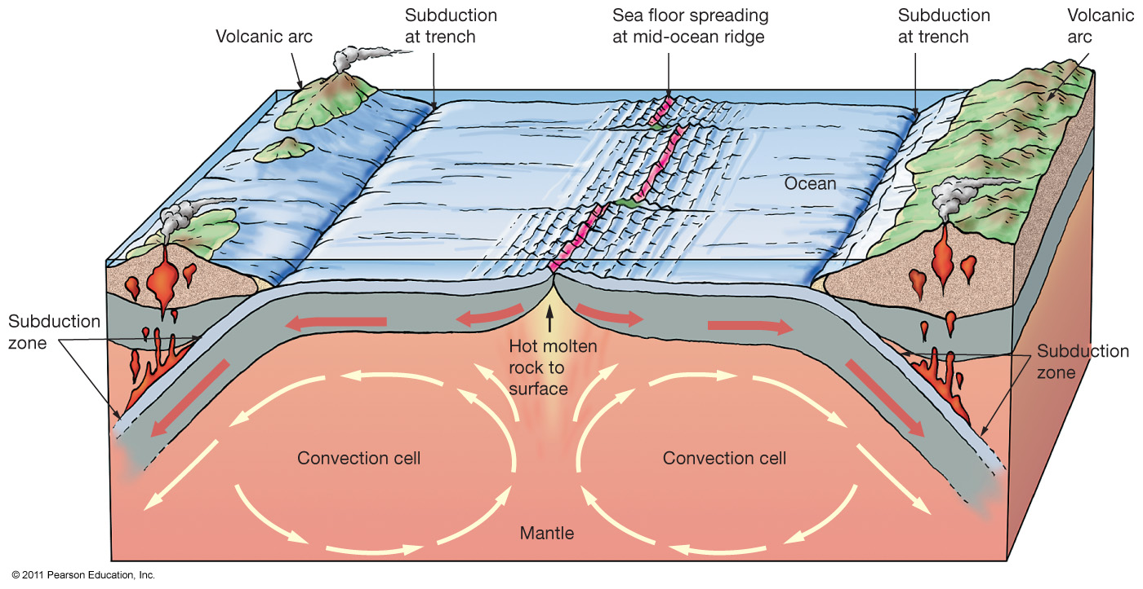
Plate Tectonic Processes

Slide 7
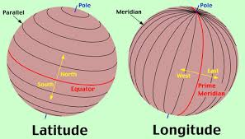
A Little Lesson on Longitude and Latitude

Slide 8
Latitude & Longitude
Latitude is distance north or south of the Equator and longitude is distance east or west of the prime meridian.
Both are measured in terms of the 360 degrees (symbolized by °) of a circle. Imaginary lines of latitude and longitude intersect each other, forming a grid that covers the Earth and helps us locate points on it.

Slide 9
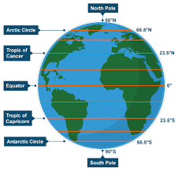
Latitude
The Equator is the line of 0° latitude, the starting point for measuring latitude.
The latitude of the North Pole is 90° N, and that of the South Pole is 90° S.
The latitude of every point in between must be some degree north or south, from 0° to 90°.

Slide 10
Longitude
The line which runs through Greenwich in London is called the Greenwich Meridian or Prime Meridian.
The Prime Meridian is 0° longitude. •The Earth is then divided into 180°east and 180°west. •The International Date Line lies at 180°east/west

Slide 11
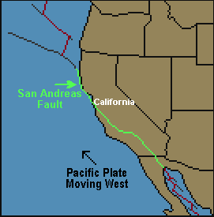
Plate Boundaries
There are 3 main plate boundaries:
1) Convergent Boundary
2) Divergent Boundary
3) Transform Boundary

Slide 12
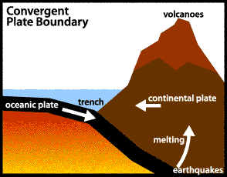
1. Convergent Boundaries
Occurs when 2 plates collide.
Oceanic plate is denser (3.2 g/cm₃), faster and thinner - it is usually forced under the continental plate (2.8 g/cm₃).

Slide 13
The rock in the Oceanic plate melts as the plate sinks. The melted rock rises up causing volcanic eruptions.
The area of convergence is called a SUBDUCTION ZONE.
When two continental plates collide:
They are the same density.
This causes the plates to fold and bend (mountain building) as well as earthquakes.

Slide 14
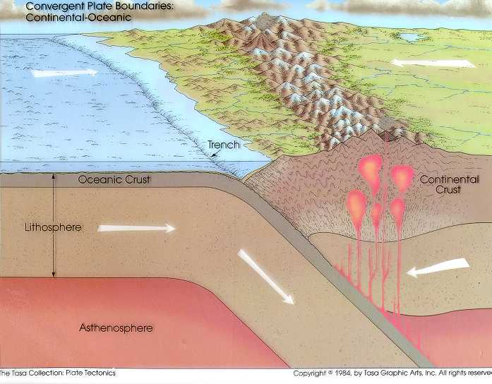
Example of a Convergent Plate Boundary
South America:
Oceanic Nazca Plate is colliding into the South America plate.
Producing the Andes Mountains (volcanoes along the mountain crest) and formed a deep trench off the coast in the Pacific Ocean.

Slide 15
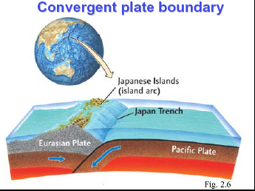

Slide 16
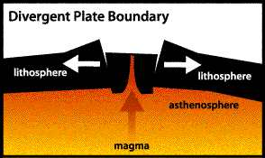
Divergent Plate Boundaries
Plates are being pulled apart by convection currents in the mantle.
As the plates separate along the boundary, they crack into faults and blocks. Magma from the mantle rises through the cracks. This cools and new crust is formed along the boundary.
Earthquakes occur along the faults, and volcanoes form where the magma reaches the surface.

Slide 17
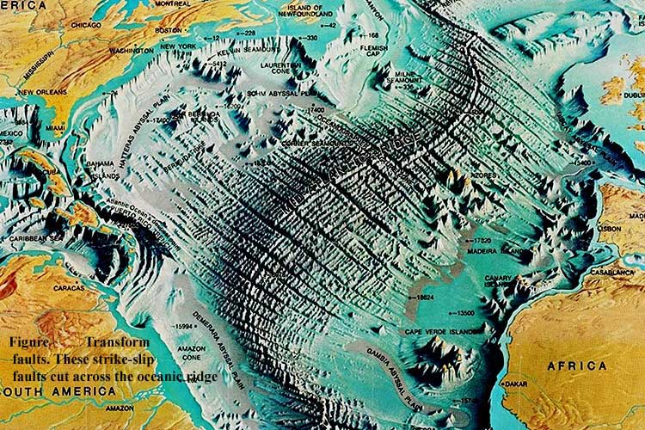
Mid Atlantic Ridge
Mid-Atlantic Ridge is a Divergent Plate Boundary.
Over 15 000 km long.
Average height of volcanoes - 3 km.

Slide 18
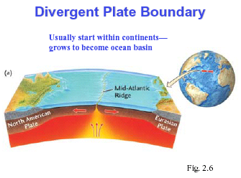

Slide 19
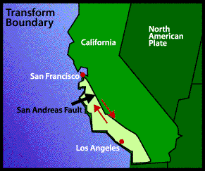
Transform Boundary
Places where plates slide past each other sideway.
Transform boundaries are not marked by spectacular surface features, but their sliding motion causes lots of earthquakes.
The slice of California to the west of the fault is slowly moving north relative to the rest of California.

Slide 20
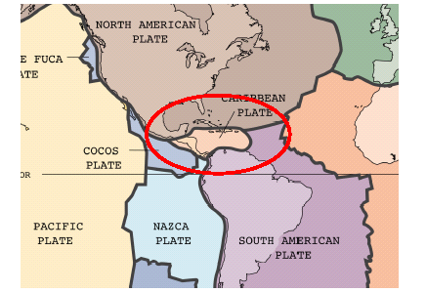
The Problems of Haiti…

Slide 21
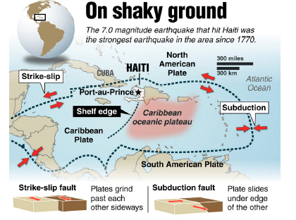

Slide 22
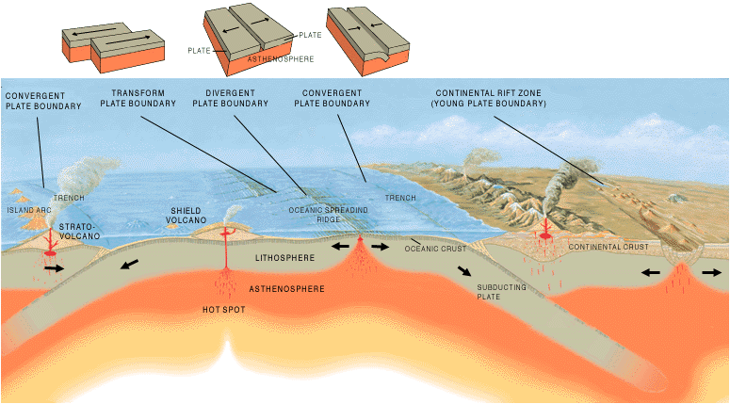

Slide 23
Ocean Bathymetry
The study of underwater depth and ocean floor.
In the same way that topographic maps represent the three-dimensional features of overland terrain, bathymetric maps illustrate the land that lies underwater.
Variations in sea-floor relief may be depicted by color and contour lines called depth contours or isobaths.

Slide 24
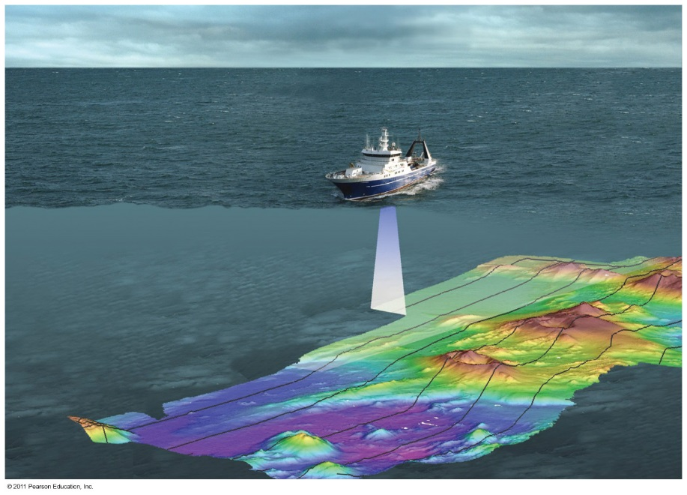
Measuring Bathymetry
Modern Acoustic Instruments
Side scan sonar
Towed behind ship. Provides a detailed bathymetric map.

Slide 25
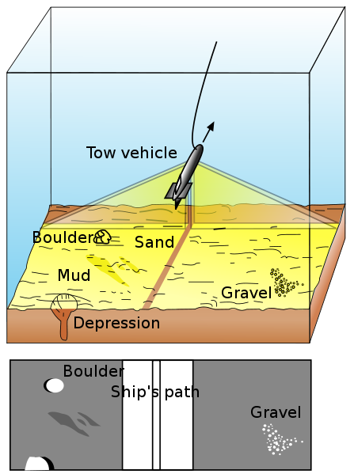
Side-scan sonar is used to create an image of large areas of the sea floor.
This tool is used for mapping the seabed in conjunction with seafloor samples it is able to show differences in material and texture type of the seabed.

Slide 26
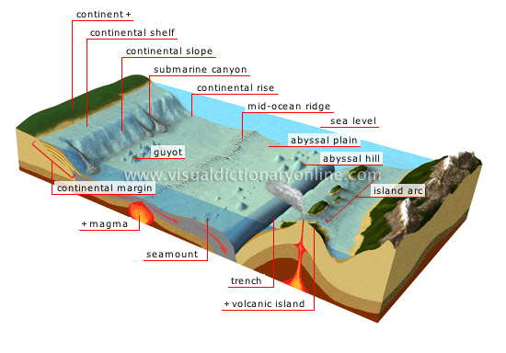
Main Features

Slide 27
Ocean Areas
Three Major Areas
Continental Margins:
  Shallow areas close to shore, includes: Continental Shelf, Continental Slope and Continental Rise.
Deep-ocean basins
  Deep areas farther from land; includes Abyssal plains and oceanic ridges
Others:
  Trenches, Seamounts and Guyots, Atolls

Slide 28
Continental Areas
Non-Active
  Not close to plate boundaries
  No major tectonic activity
  Example: East coast of Canada
Active
  Associated with convergent or transform plate boundaries
  Much tectonic activity

Slide 29
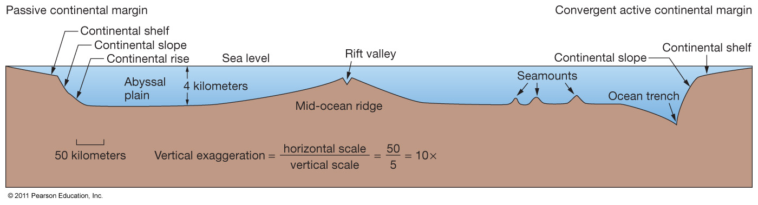
Passive and Active Continental Margins

Slide 30
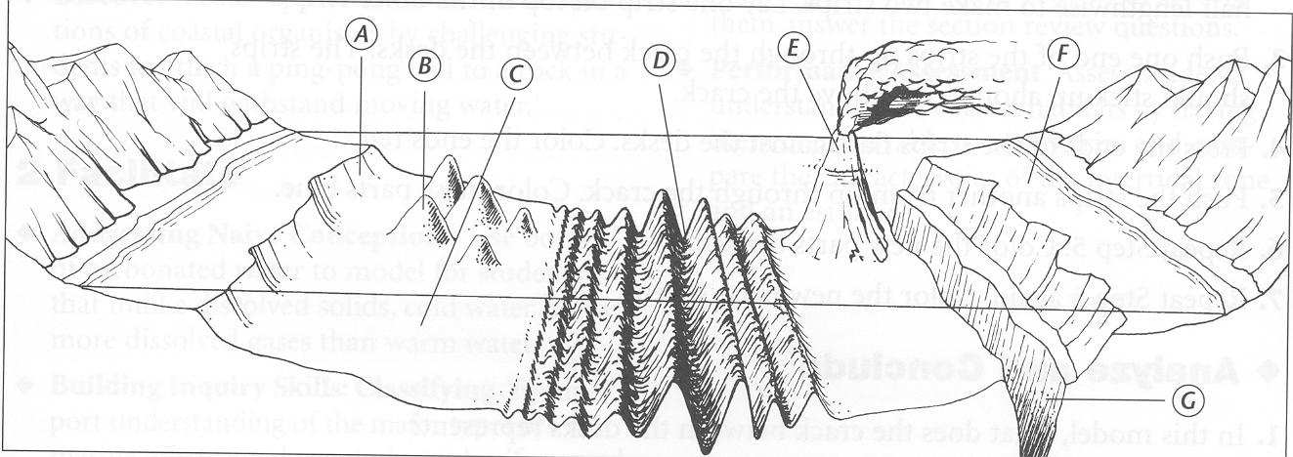
Major Sea Floor Structures:
B. Continental Slope
D. Mid Ocean Ridge
E. Island
F. Continental Shelf
C. Sea Mount
I. Abyssal Plain
H. Oceanic Trench
J. Rift
G. Guyot

Slide 31
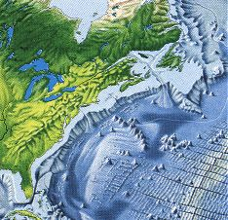
Definitions
Continental Shelf – Almost flat gradual slope seaward at the edges of the continent
This is very wide off of Canada’s maritime provinces. (Grand Banks and Scotian Shelf)

Slide 32
  Continental Slope – steeper slope seaward; contains submarine canyons
Continental Rise: shallower slope composed of sediments that have fallen from slope
Abyssal Plain – The largest portion of the earth’s sea bed. Vast, empty and usually boring.

Slide 33
Seamounts and Guyots
Both are undersea volcanoes that originated at a hotspot or along a ridge
Guyots once reached the surface of the ocean and have flat, eroded tops
Seamounts never reached the surface, so they have pointy tops

Slide 34
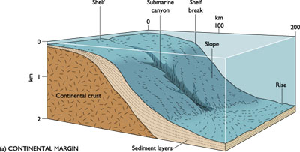
Submarine Canyons
V-shaped indentations in the continental shelf, usually ending in a fan shaped wedge of sediments.
How do submarine canyons form?
Thought to be fast moving currents and underwater landslides.

Slide 35
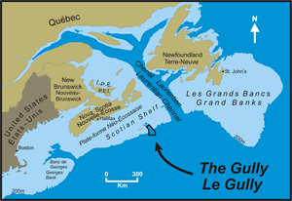
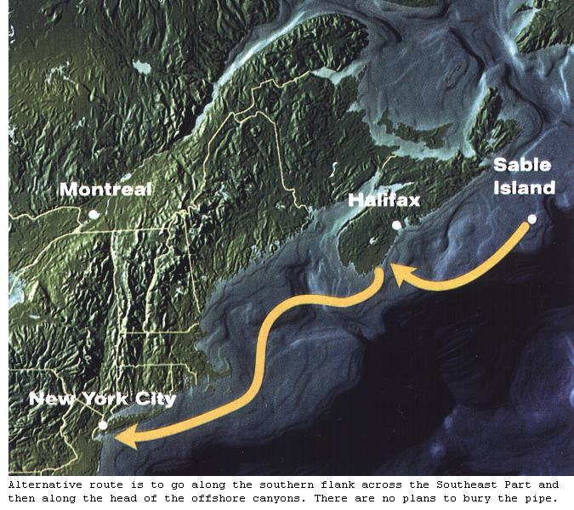
The Gully!
Submarine canyon off Nova Scotia
Marine Protected Area because of the rare corals found there
The natural gas pipeline goes right by it…problems?
The Gully

Slide 36
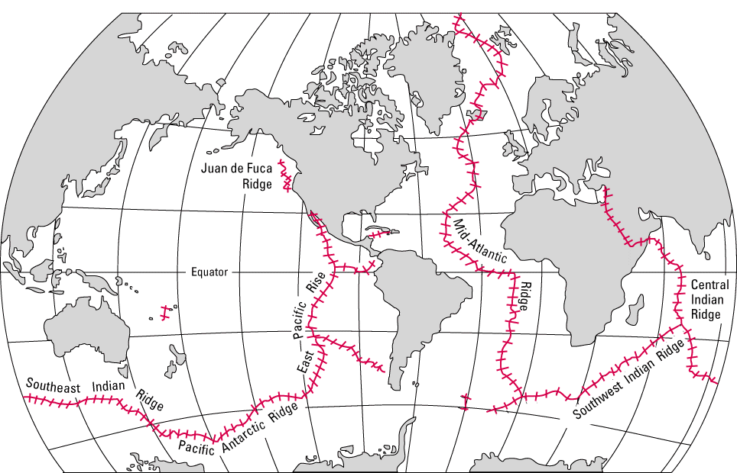
Mid-Ocean Ridge
A large underwater mountain chain.
Part of a cast system extending some 40,000 miles through four of the world’s oceans
Caused by divergent plate boundaries

Slide 37
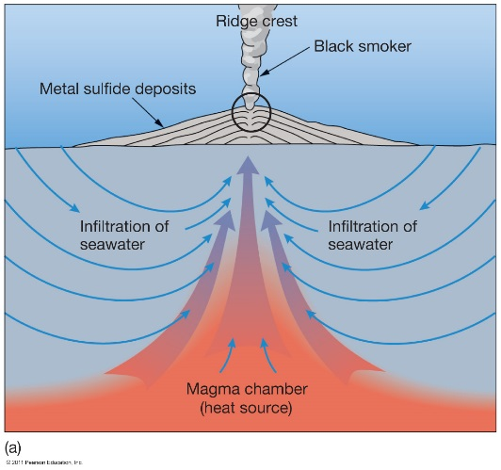
Mid-ocean Ridge Features
Hydrothermal Vents
Sea floor hot springs
Create ecosystems able to survive without sunlight
https://www.youtube.com/watch?v=D69hGvCsWgA

Slide 38

Hydrothermal Vents

Slide 39
Ocean Trenches and Volcanic Arcs
Convergent tectonic plates create ocean trenches.
  Deepest part of oceans
  Deepest – Mariana Trench at
  11,022 meters (36,161 feet)
Volcanic arc on non subducted ocean plate
  May produce island arc, Japan
Island Arc – A series of islands of volcanic origin, usually found at or near the edge of an ocean basin.

Slide 40
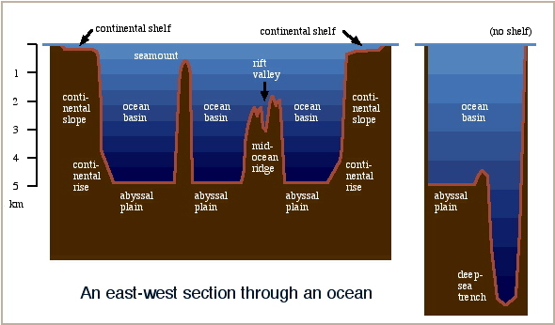

Slide 41
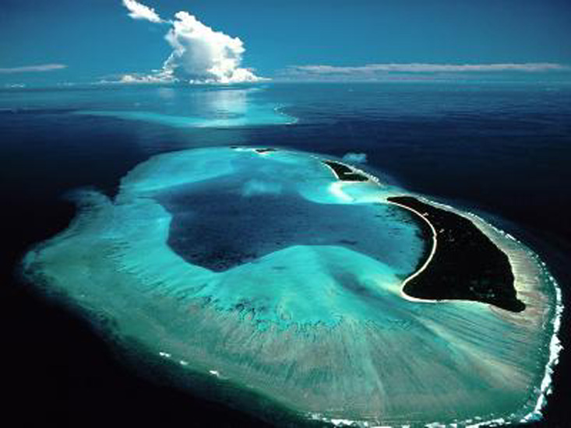
Atolls
A ring shaped island of coral reefs and coral debris. These often form over sinking inactive volcanoes.

Slide 42
Where are atolls?
Most of the world's atolls are in the Pacific Ocean and Indian Ocean
The Atlantic Ocean has no large groups of atolls other than eight atolls east of Nicaragua

