Slide 1
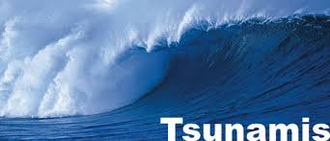
Tsunami
Waves part 2

Slide 2
Tsunami
Tsunami terminology
  Japanese term meaning “harbour wave”
  Also called “seismic sea waves”
Created by movement of the ocean floor by:
  Underwater fault movement
  Underwater avalanches
  Underwater volcanic eruptions

Slide 3
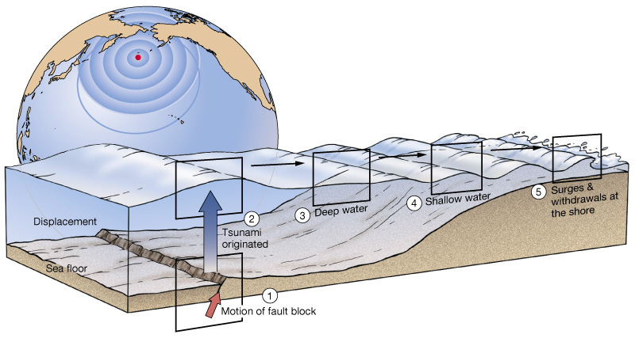
Where do Tsunamis Originate?
Most tsunami originate from underwater fault movement

Slide 4
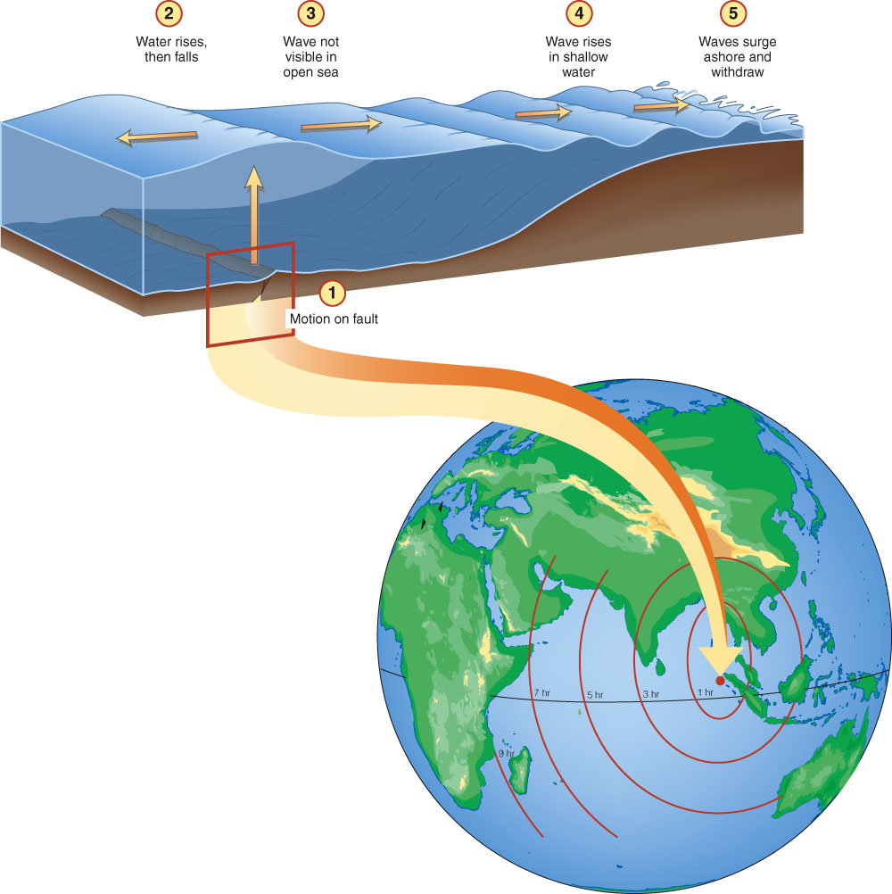

Slide 5
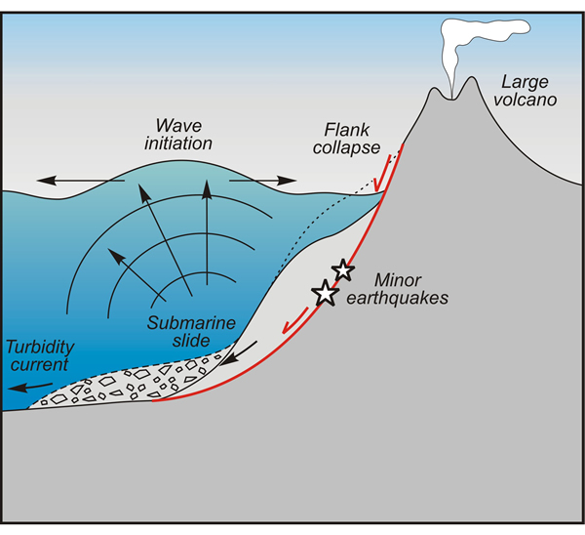
Underwater fault movement

Slide 7
Tsunami characteristics
Can travel at speeds over 700 kilometers
Small wave height in the open ocean, so pass beneath ships unnoticed
Build up to extreme heights in shallow coastal areas

Slide 8
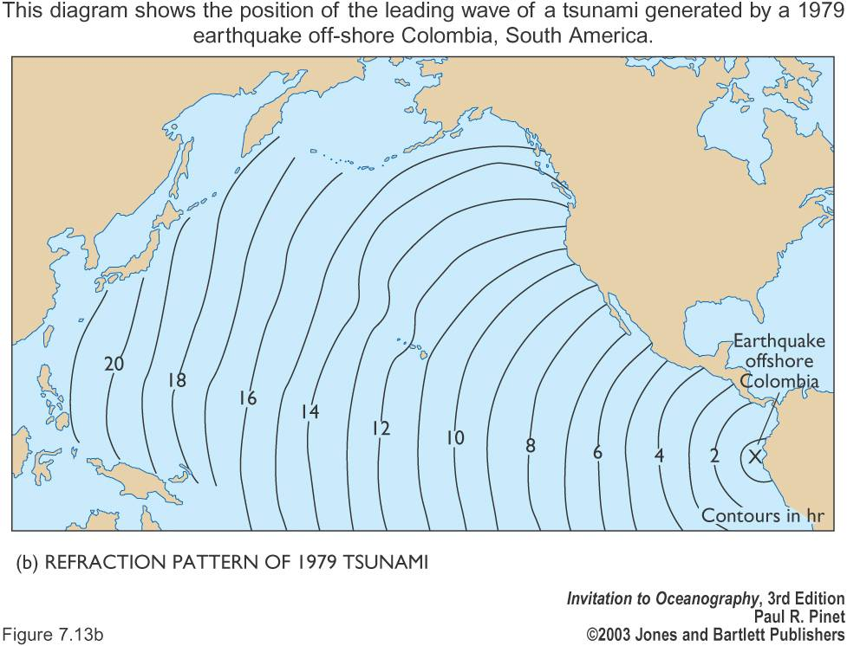

Slide 9
Coastal effects of tsunami
If trough arrives first, appear as a strong withdrawal of water (similar to an extreme and suddenly-occurring low tide)
If crest arrives first, appear as a strong surge of water that can raise sea level many meters and flood inland areas

Slide 10
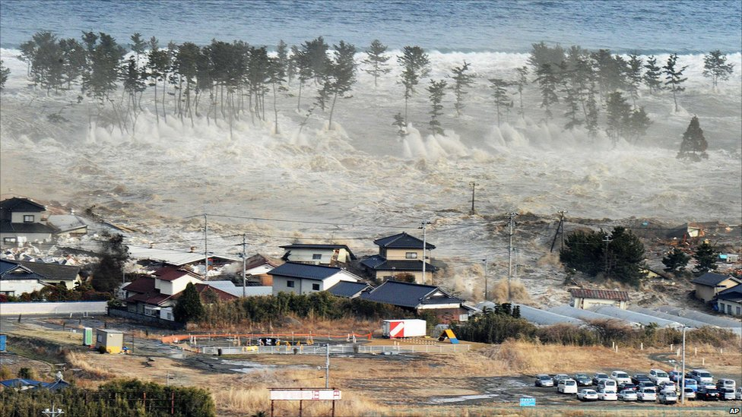

Slide 11
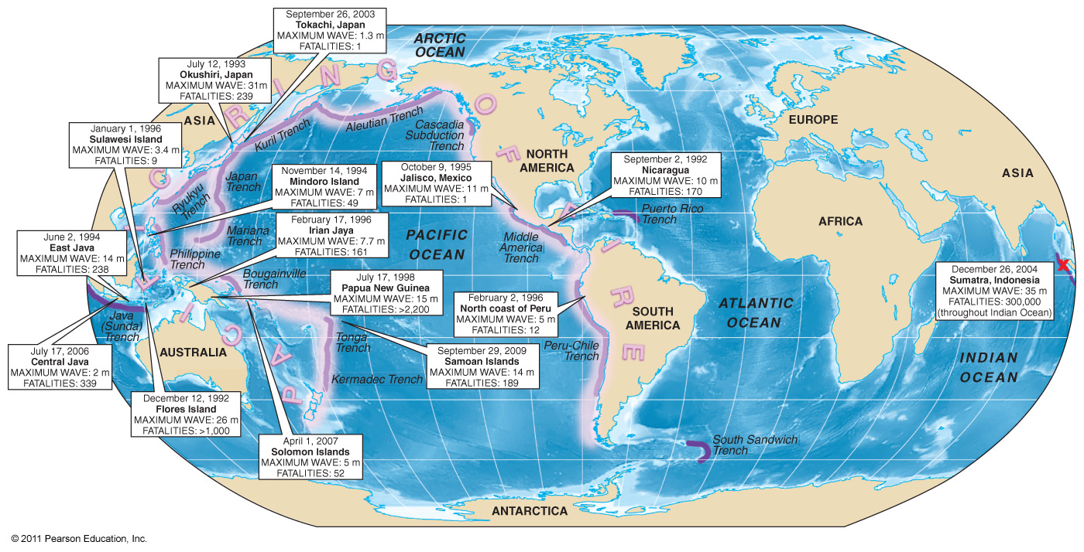
Tsunamis: Dates & Fatalities

Slide 12
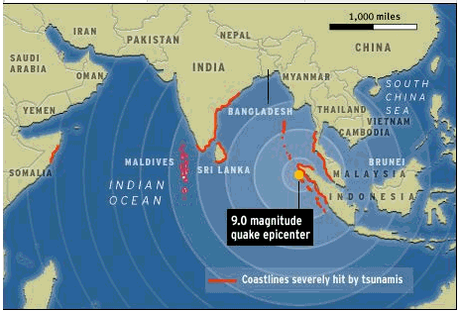
December 26, 2004
Sumatra Indonesia
Maximum wave: 35 meters (115 ft!)
Fatalities: 300 000

Slide 13
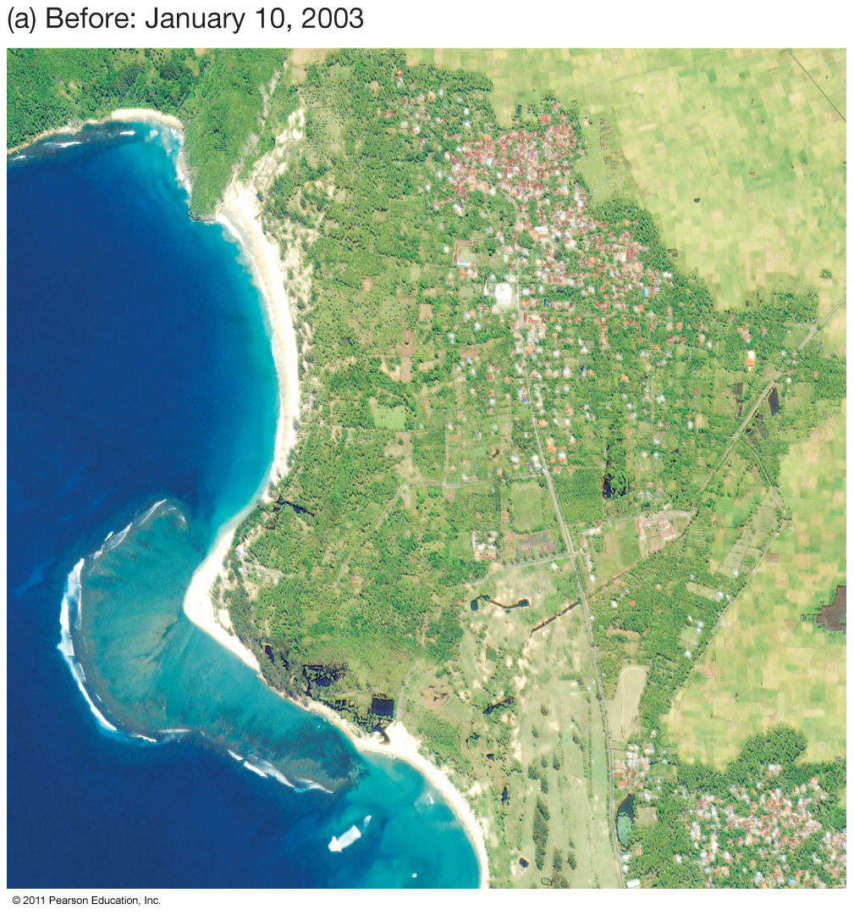

Slide 14
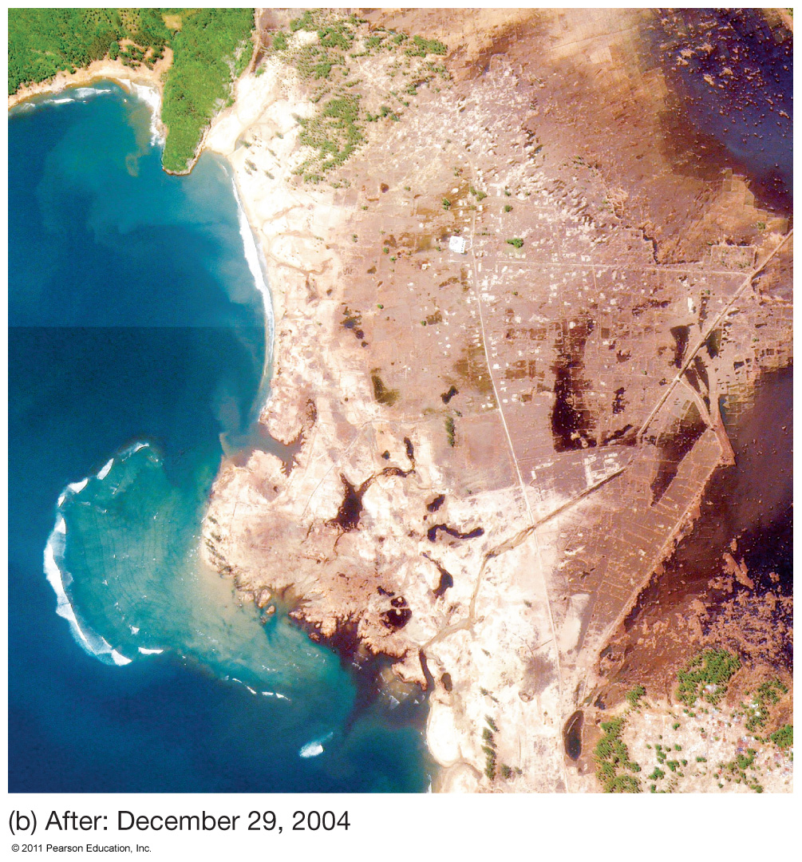

Slide 15
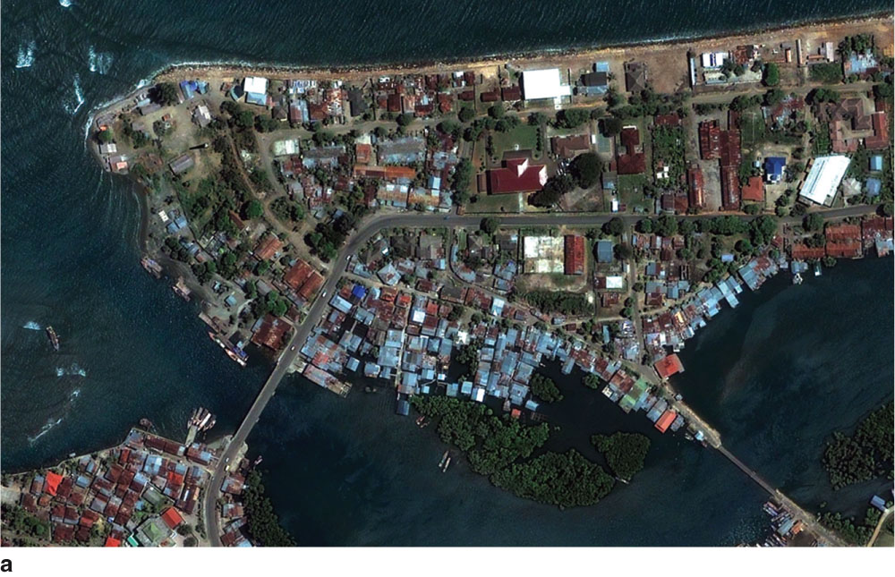

Slide 16
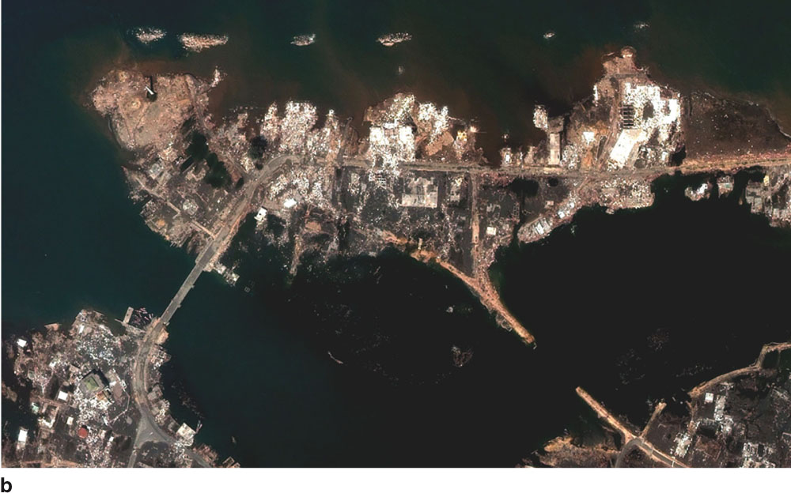

Slide 17
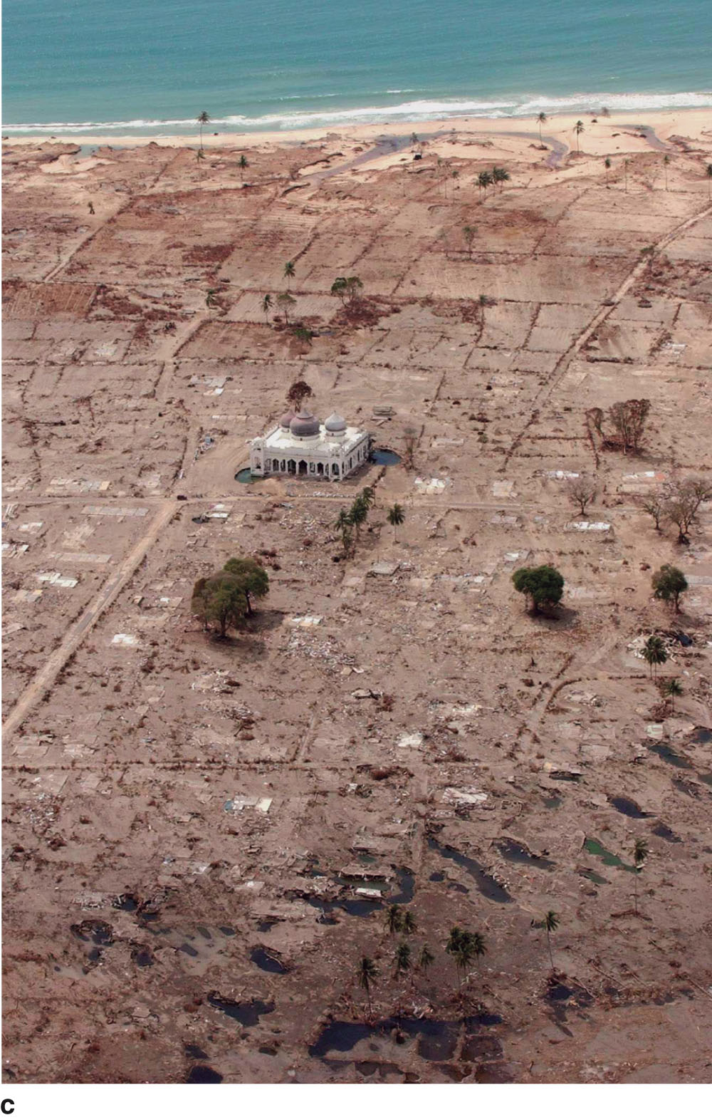

Slide 18
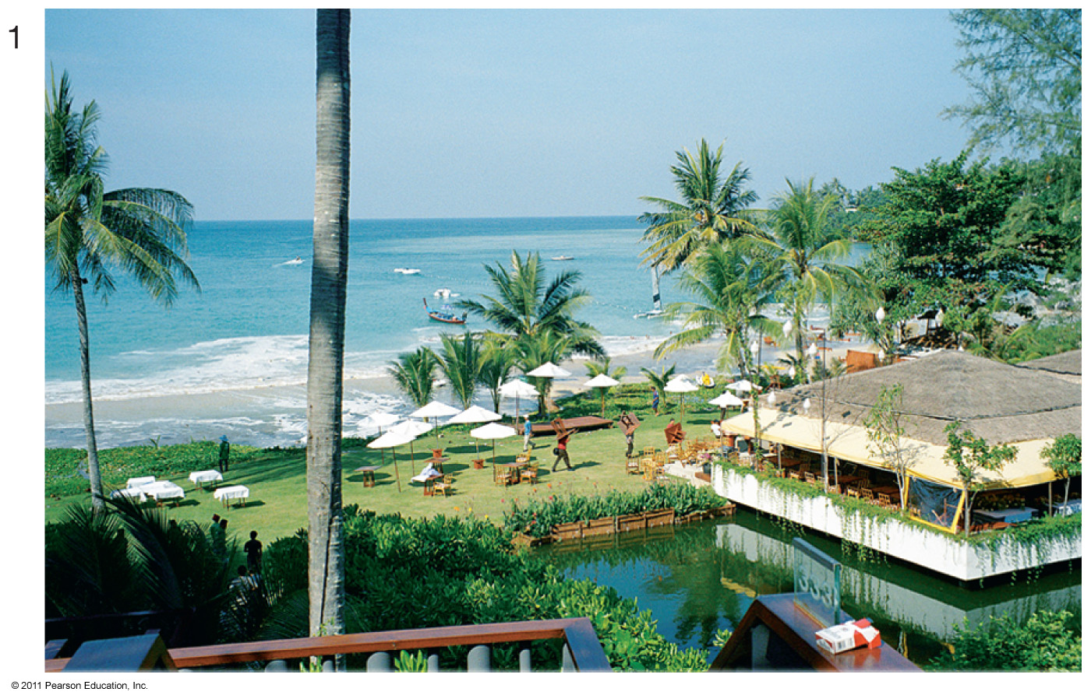

Slide 19
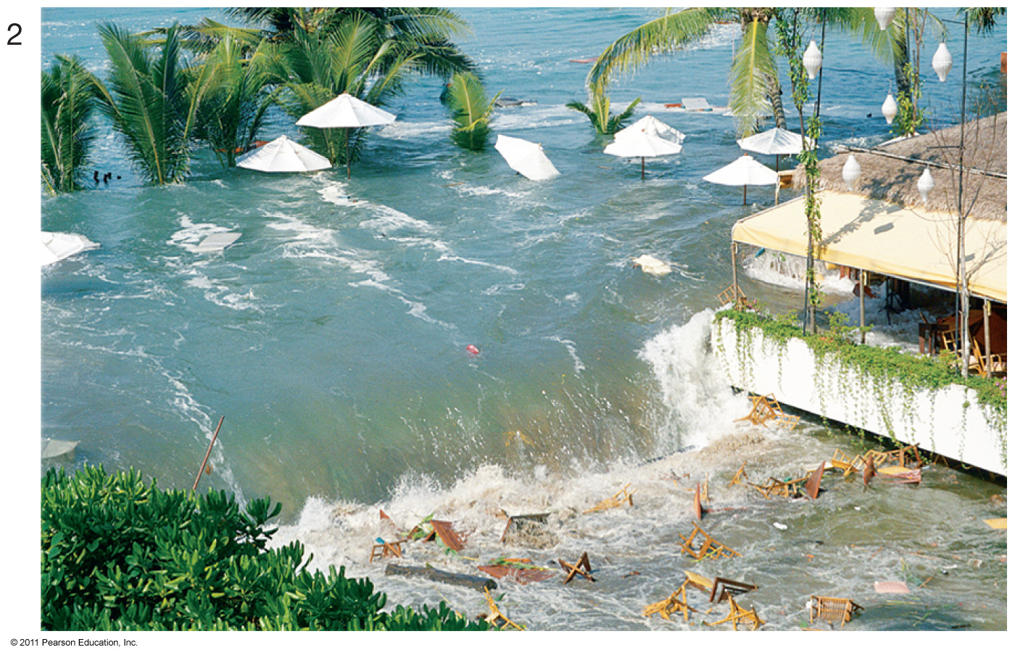

Slide 20
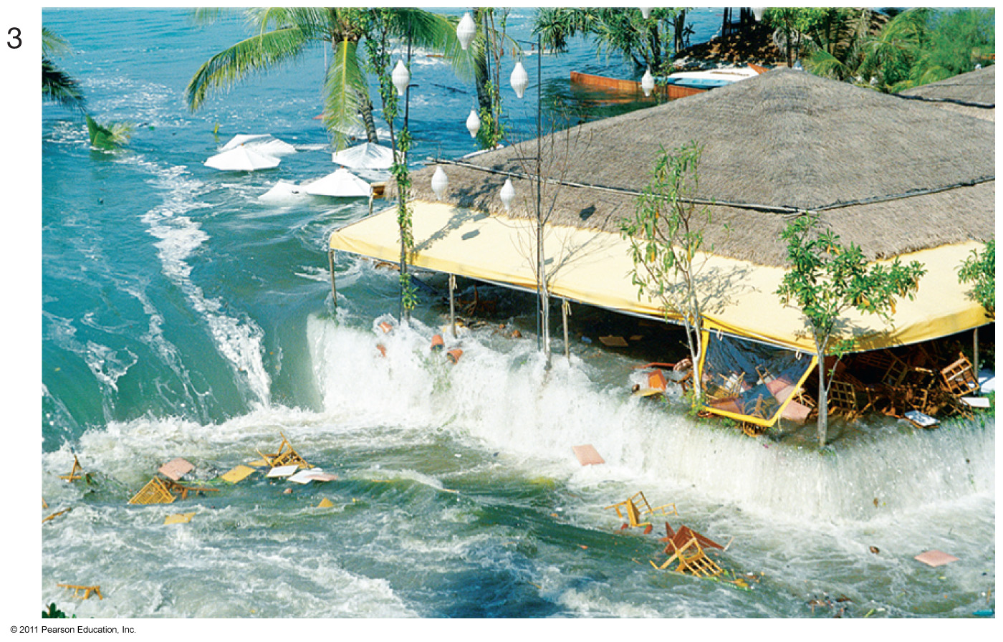

Slide 21
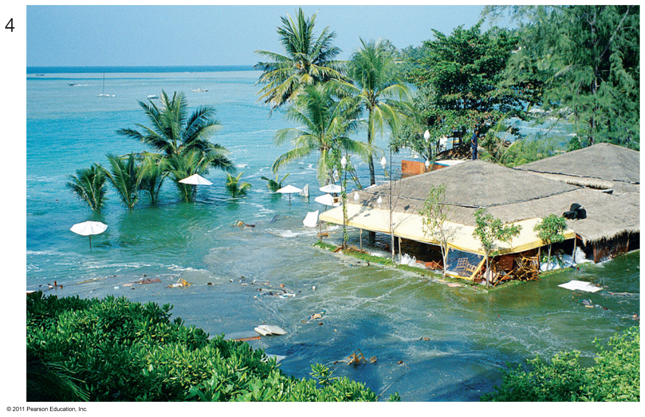

Slide 22
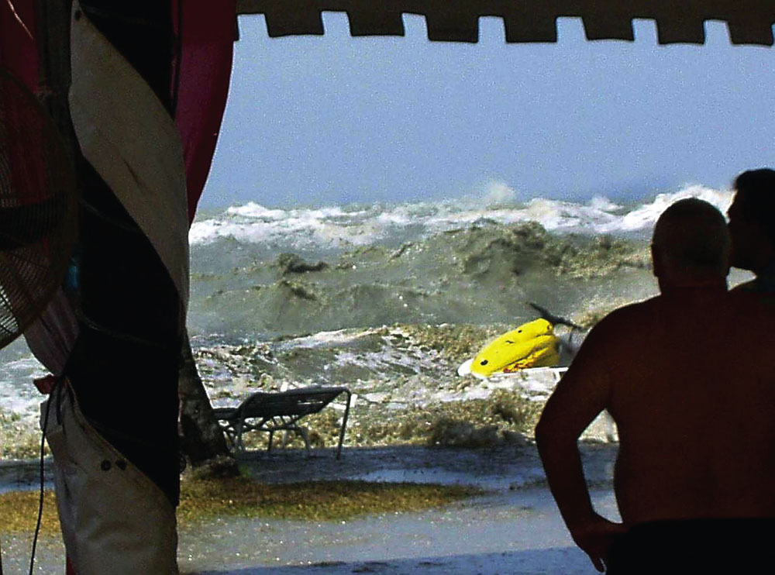

Slide 23
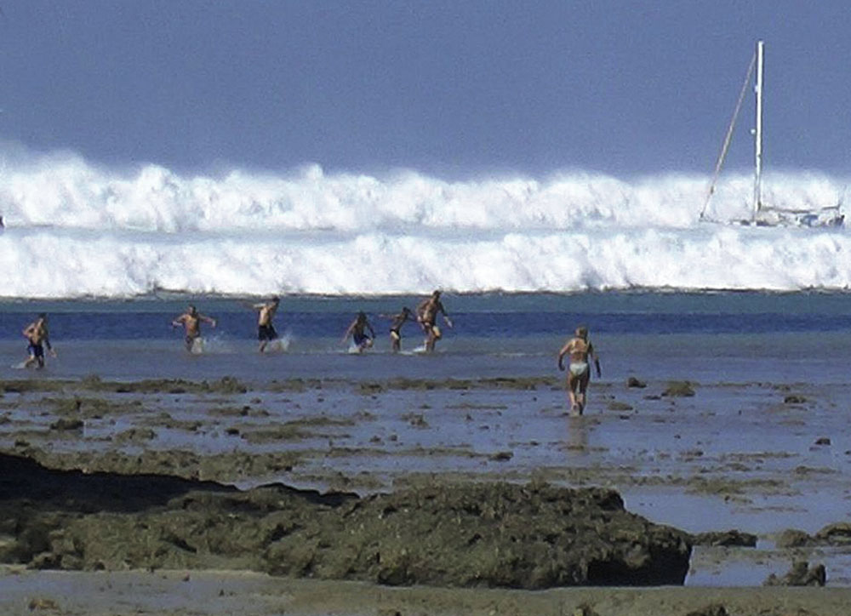

Slide 24
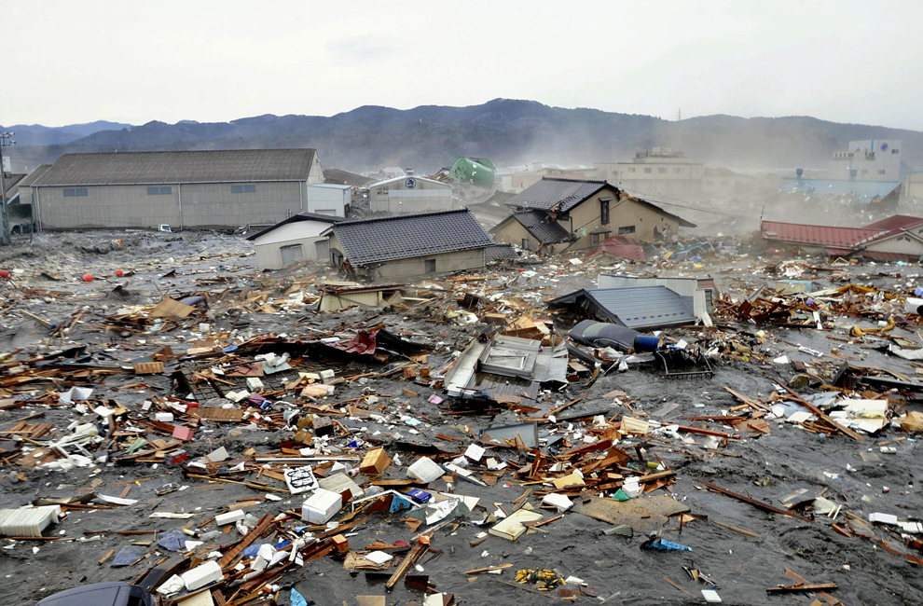

Slide 25
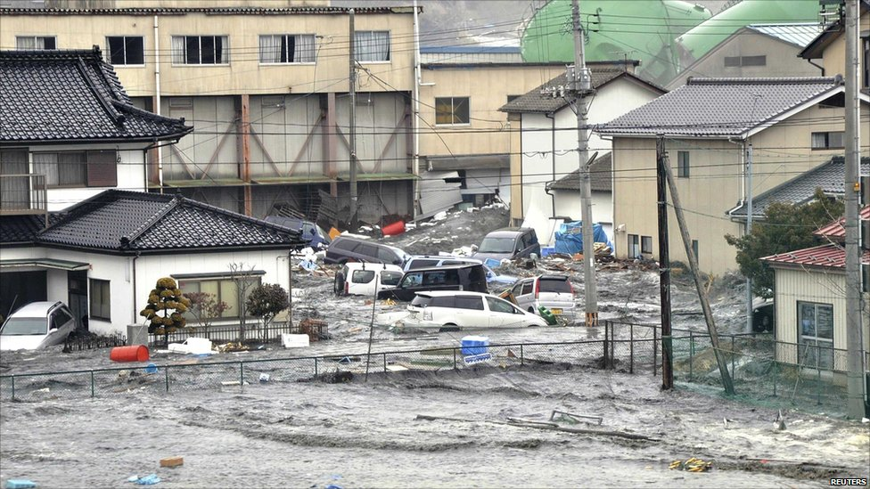

Slide 26
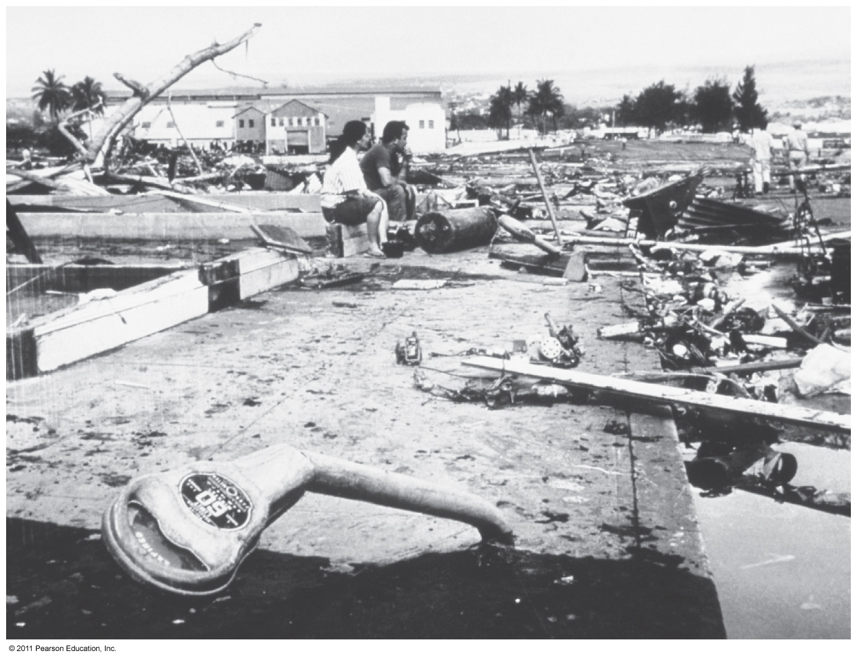

Slide 27
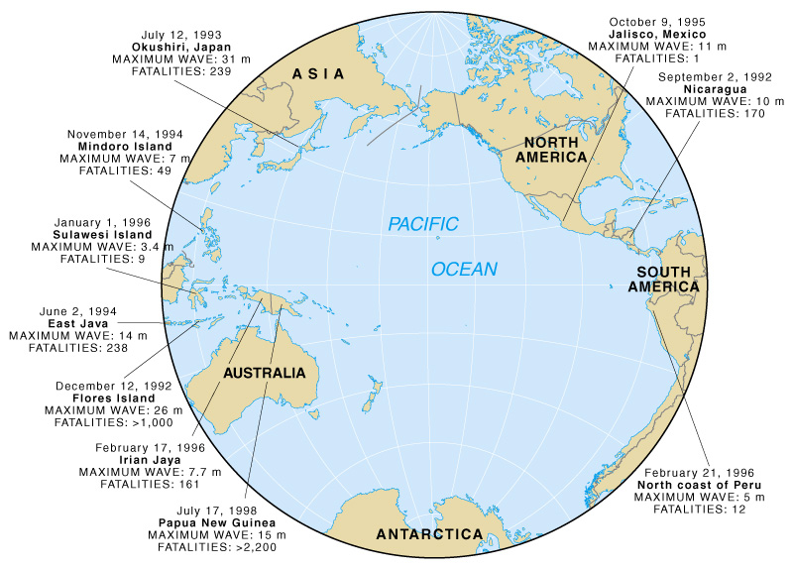
Tsunami since 1900
Most tsunami are created near the margins of the Pacific Ocean along the Pacific “Ring of Fire”

Slide 28
Tsunami: Indonesia 2004
http://www.youtube.com/watch?v=RDOuwMj7Xzo

Slide 29
Tsunami warning system
Seismic listening stations track underwater earthquakes that could produce tsunami
Once a large earthquake occurs, the tsunami must be verified at a nearby station
If verified, a tsunami warning is issued
Successful in preventing loss of life (if people heed warnings)
Damage to property has been increasing

Slide 30
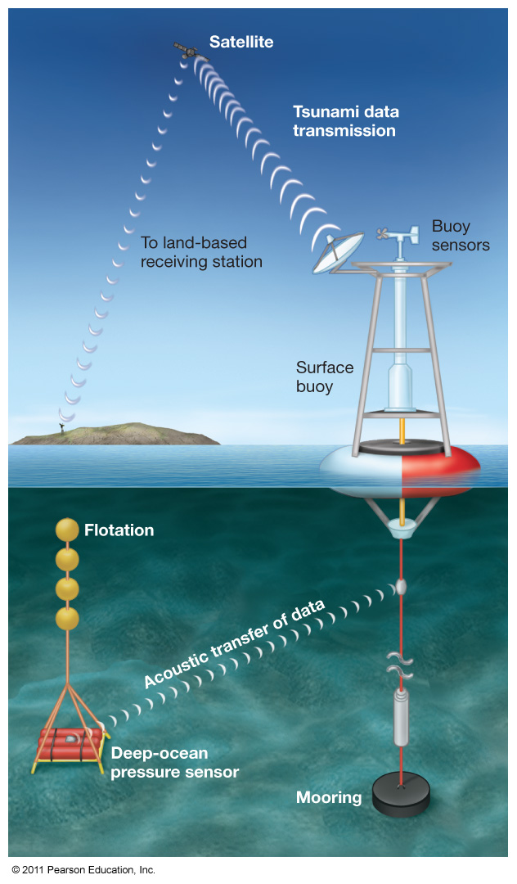

Slide 31
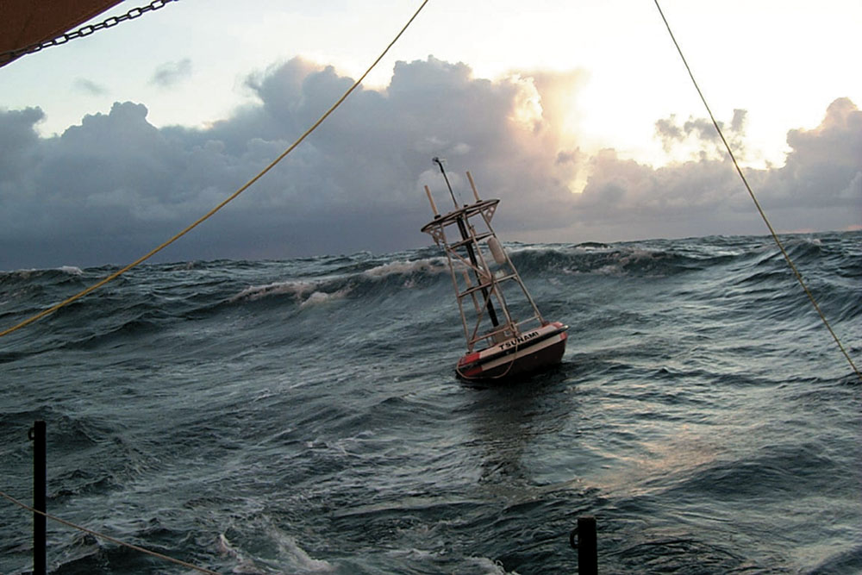

Slide 32
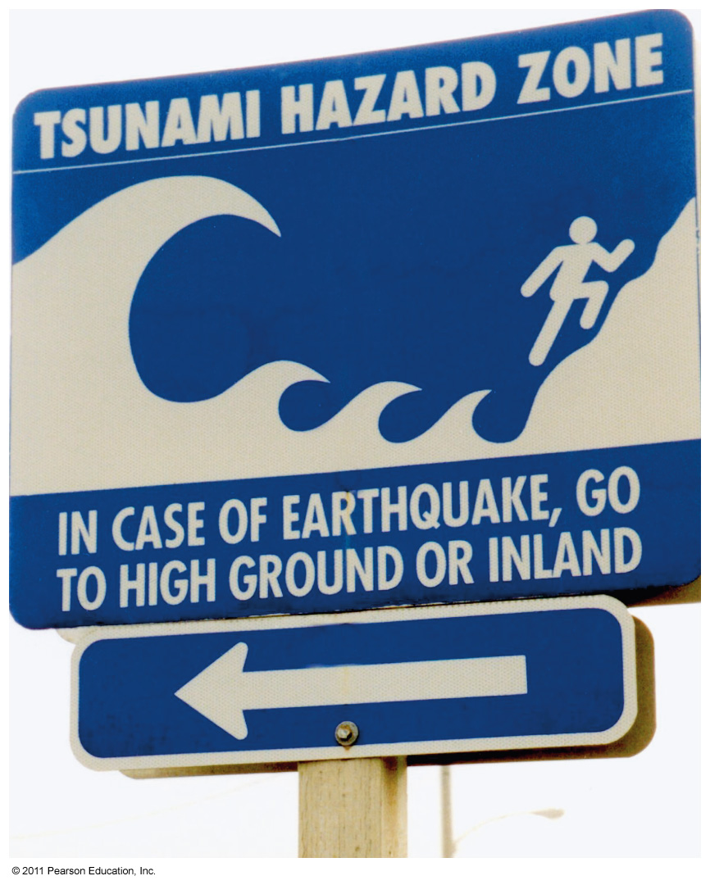

Slide 33
Tsunami Activity
Velocity: Tsunami velocity is controlled by the water depth, so velocity changes as a wave nears the shore.
V = √(g)(D)
  D is water depth and
  g is the acceleration due to gravity (9.81 m/s )
Amplitude: If the amplitude in deep water is known, the amplitude in shallower water can be calculated.
  As = Vd
Ad Vd
As = Ad ( Vd /Vs )
  d is the value in deeper water
  s is the value in shallower water

Slide 34
Part A: Creating Your Table
Site | Water Depth (m) | Acceleration due to gravity (m/s ) | Velocity (m/s) | Amplitude ( m)
A | 1000 | 9.81 | V = √(9.81)(1000) V = √9810 V = 99.04
B | 250 | 9.81
C | 100 | 9.81
D | 50 | 9.81
E | 10 | 9.81
Step 1: Copy the table and Graph onto loose leaf.
Step 2: Calculate Velocity for all 5 sites, using the formula.
Step 3: Calculate Amplitude using velocity
Step 4: Graph your data. You will have TWO graphs

Slide 35
Part B: Calculating Travel Time
Step 1: Copy Chart onto loose leaf.
Step 2: Trace the map of Newfoundland onto tracing paper.
Step 3: Measure the distance between the epicenter and the 6 points. Note: All measurements need to be from the epicenter!
Step 4: Calculate the Travel Time using the Time formula.
Step 5: The time the Tsunami started was 5:00. Convert the travel time into minutes and add it to 5:00 to find the actual time.
Step 6: Using a compass draw arcs at each point on your map, record the time on the map.
Step 7: Answer questions 5 – 8.

