Slide 1
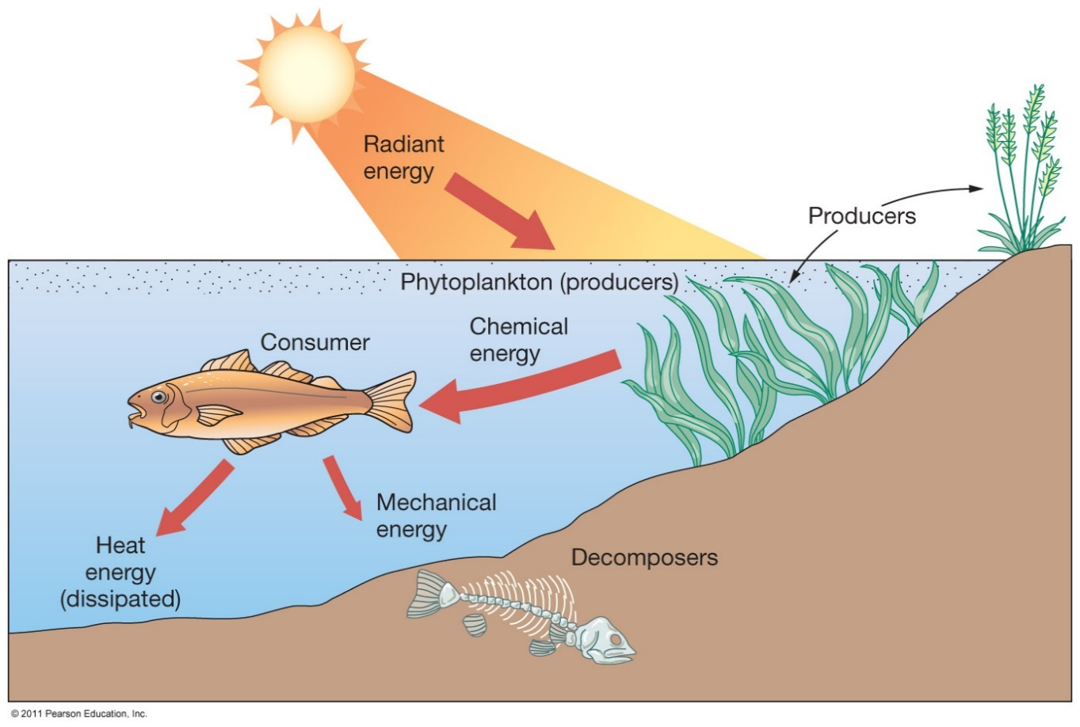
Trophic Relationships
AKA Feeding

Slide 2
HOW is energy from the sun distributed in marine biomes and ecosystems.?
TROPHIC STRUCTURES:
Flow of energy or matter through an ecosystem, a “feeding” or trophic system
Primary, Secondary etc. PRODUCERS AND CONSUMERS
Food web/chain/pyramid

Slide 3
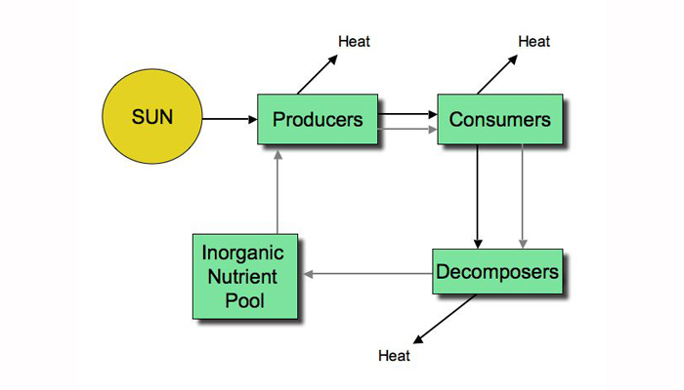

Slide 4
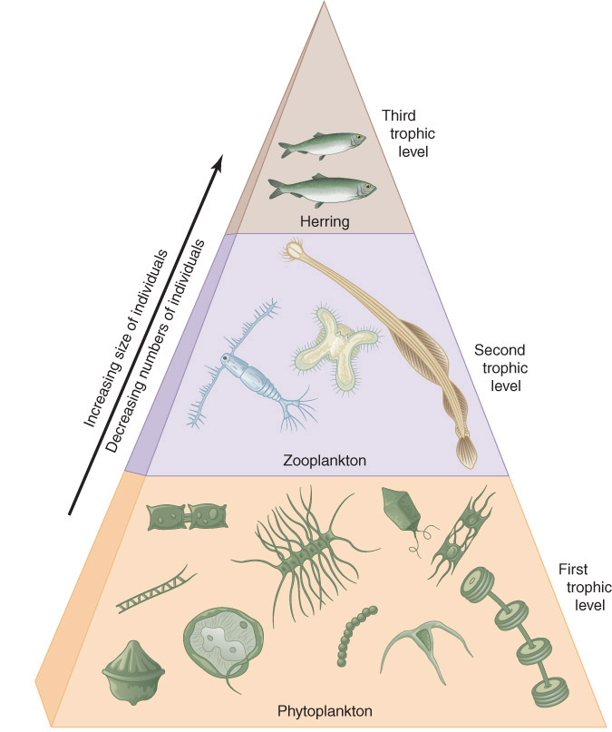
Feeding in the ocean
Trophic = feeding
Food Pyramid: the higher in the pyramid, the larger the animal but the fewer the animal

Slide 5
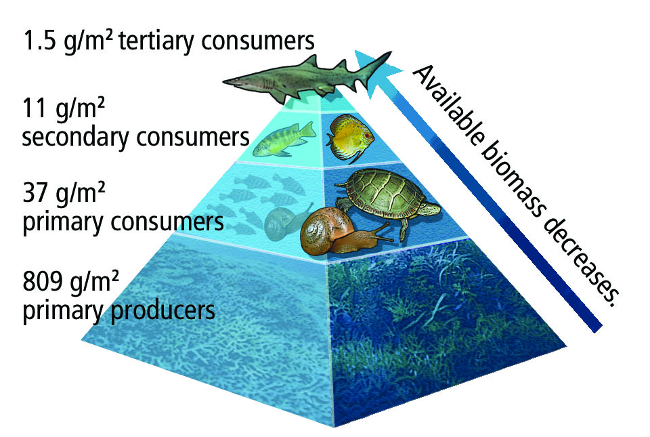
Autotrophs
Autotrophs:
absorb sunlight and transfer inorganic mineral nutrients into organic molecules
In surface waters: flowering plants such as sea grass, algae
In the deep ocean: chemosynthetic bacteria that take the inorganic energy to make organic matter for organisms that can’t absorb sunlight
https://www.youtube.com/watch?v=EN1Yxq8KMsw

Slide 6
Heterotrophs
Heterotrophs = consumers of energy that must rely on primary producers
Food Chain = series of step of consumers being eaten and eating
Trophic level = Each step of the food chain

Slide 7
Food Web
Includes all of the interactions within the trophic levels.

Slide 8
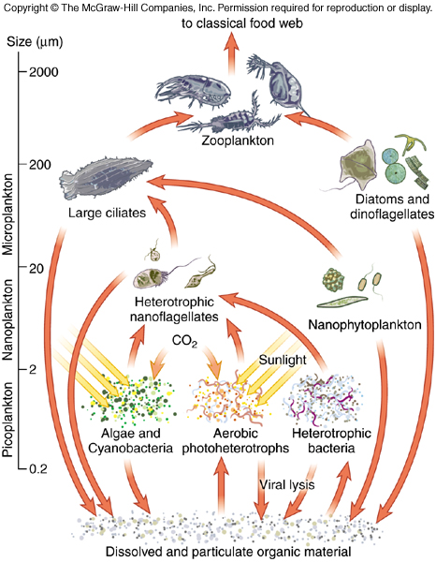
Decomposers
Decomposers:
live off of dead plant and animal material plus waste products. Their job gives the essential ingredients back to the autotrophs to continue the cycle.

Slide 9
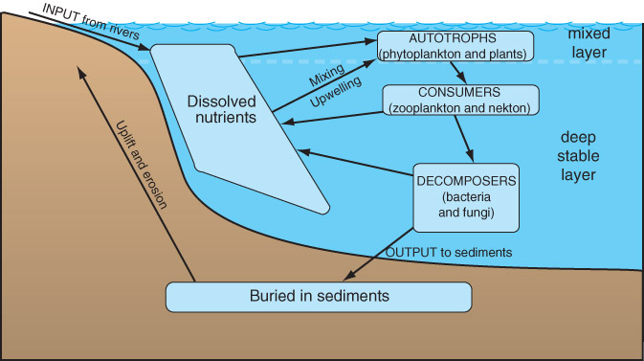
Decomposer Cycle

Slide 10
Energy Transfer in Marine Environments
Energy pyramid:
Energy distribution at each trophic level as it passes from producers to consumers
Some energy is lost by:
Consumers because they don’t usually consume the entire organism
Energy is used to capture food
Energy is lost to keep animal alive

Slide 11
The Energy Transfer

Slide 12
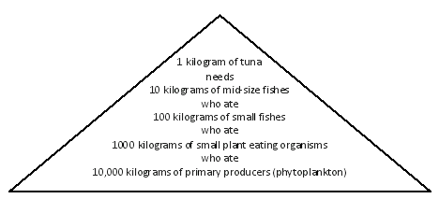

Slide 13
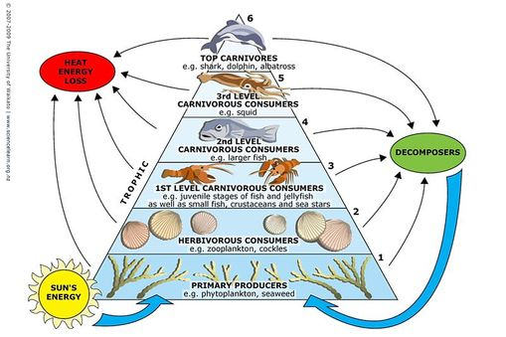

Slide 14
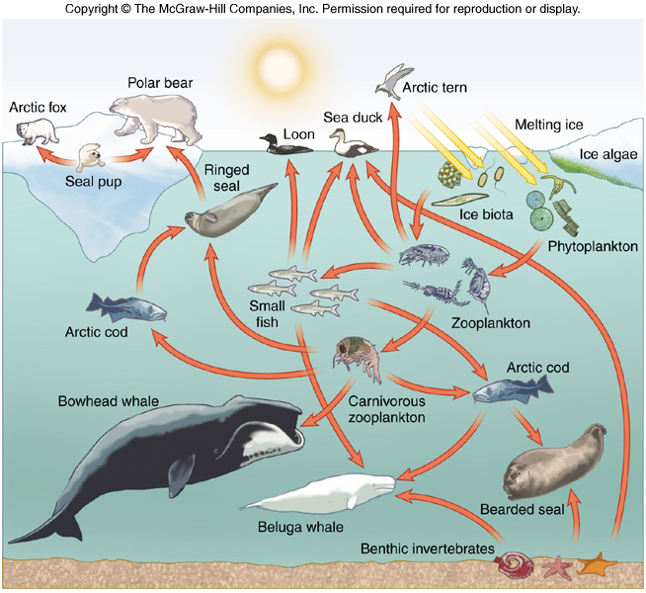
Feeding Relationship

Slide 15
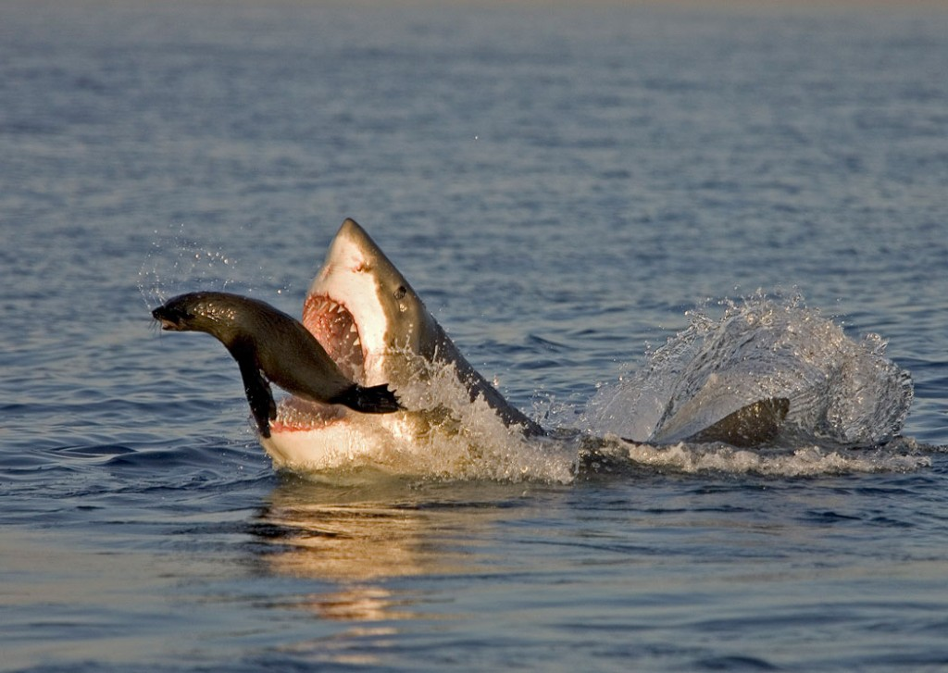
Predator - Prey
predator kills and eats another organism

Slide 16
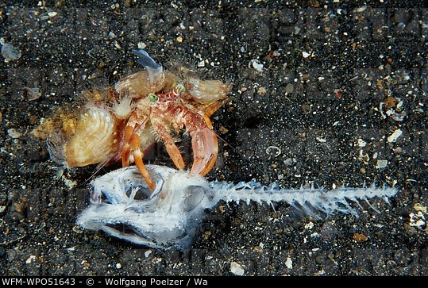
Scavengers
feed on dead plants and animals that they have NOT killed
Examples: crabs ripping chunks of flesh from fish on the beach

Slide 17
Symbiotic Relationship
refers to close nutritional relationship between two different species
Commensalism
Mutualism
Parasitism

Slide 18
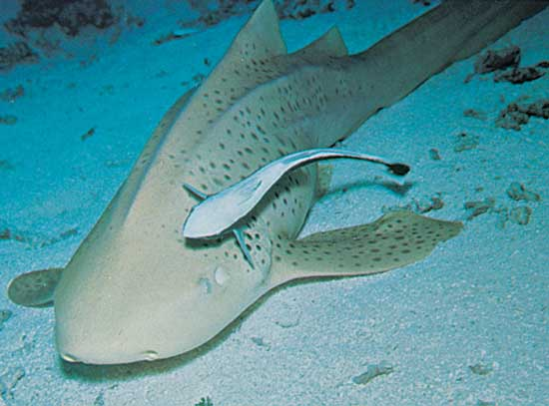
Commensalism relationship
One benefits the other is unaffected
Remora fish attaches itself to the leopard shark to hitch a ride. This allows the remora to save it’s energy to get to other places and the shark is unharmed.

Slide 19
Mutualism Relationship
Both benefit
The clownfish feeds on small invertebrates that otherwise have potential to harm the sea anemone

Slide 20
Parasitism
One benefits at the hosts expense
Loggerhead turtle can have leeches attached to its exposed body parts. The leeches use the turtle as a source of food and a place to lay eggs.
If the turtle becomes to infested, it could die.

Slide 21
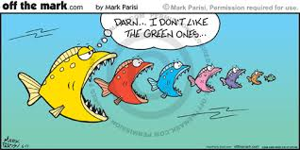
Food Chains: Examples in the Ocean

Slide 22
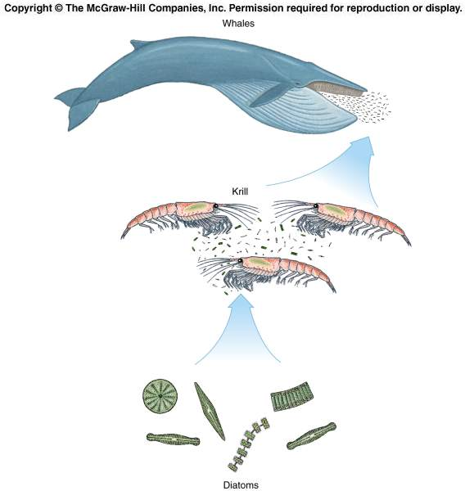
Antarctic
food
chain

Slide 23
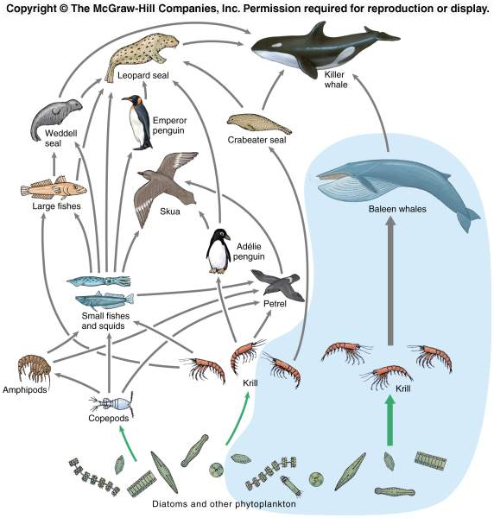

Slide 24
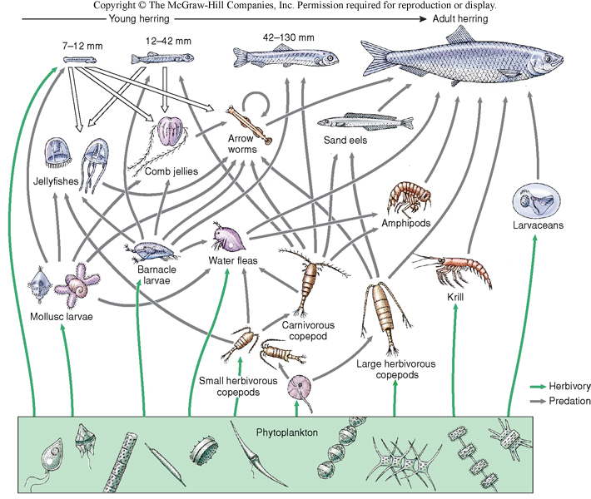

Slide 25
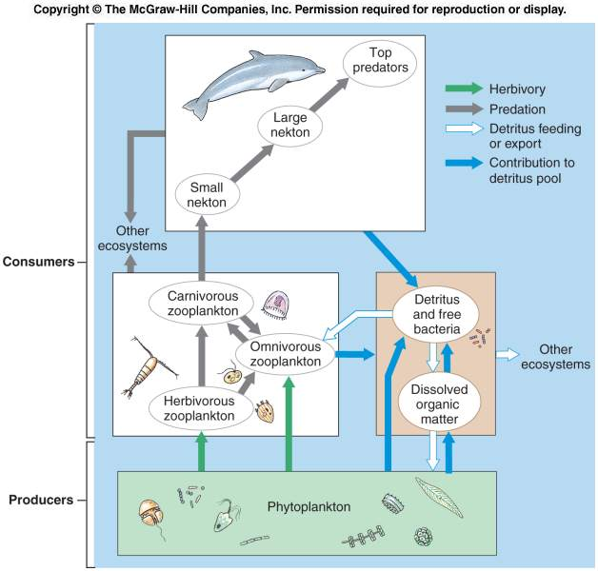

Slide 26
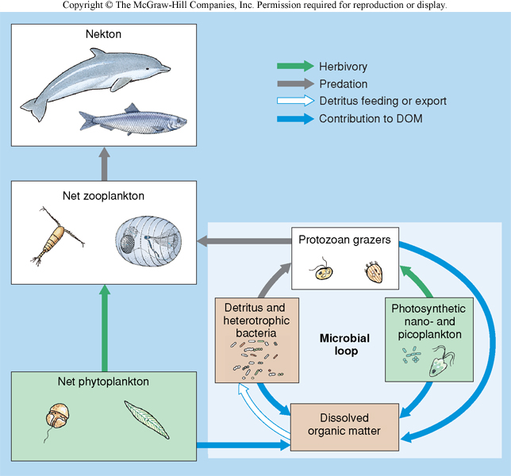

Slide 27
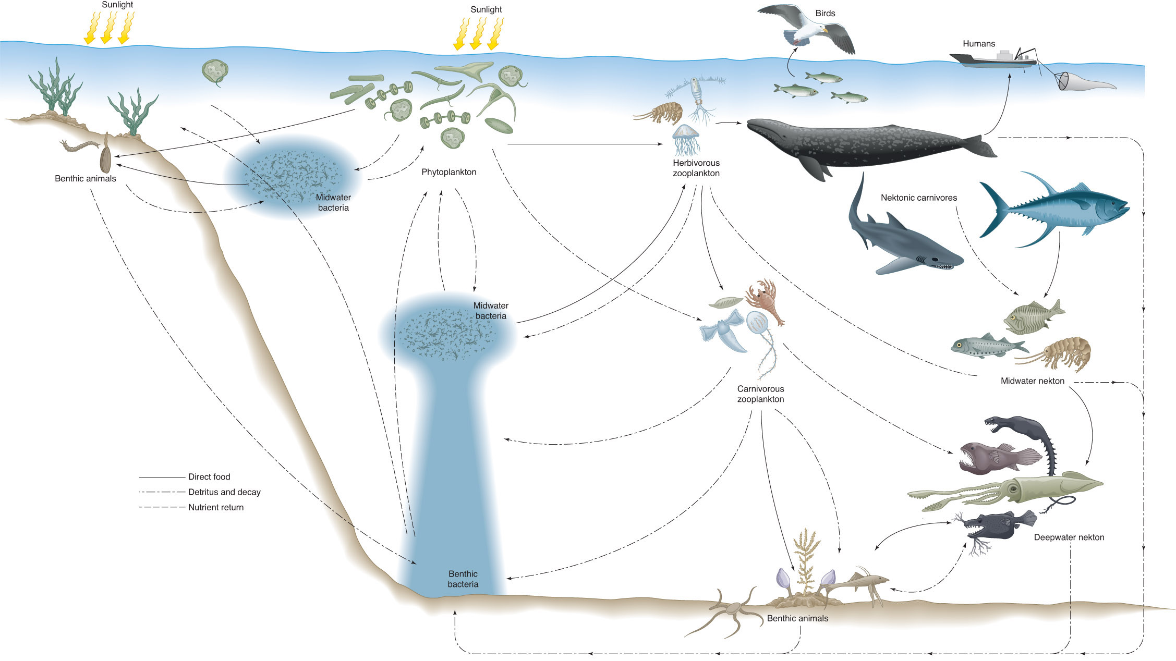

Slide 28
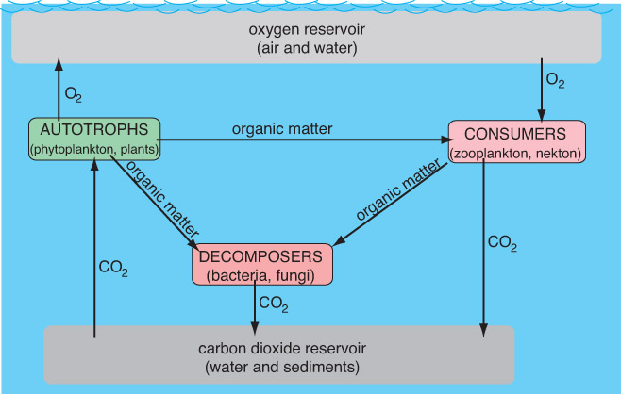
Simplified paths of the flow of oxygen and carbon in an idealized marine ecosystem

Slide 29
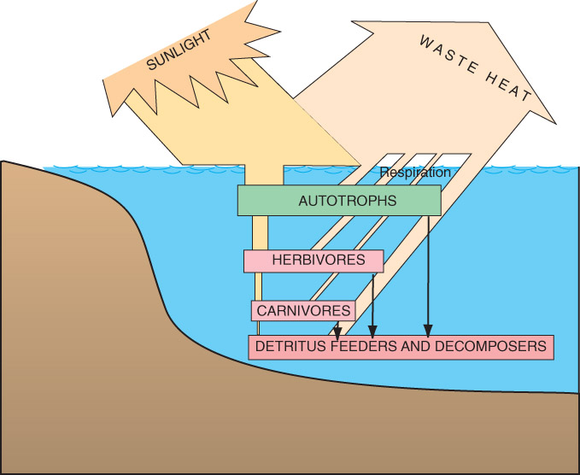
Energy flow in a marine ecosystem

