Slide 1
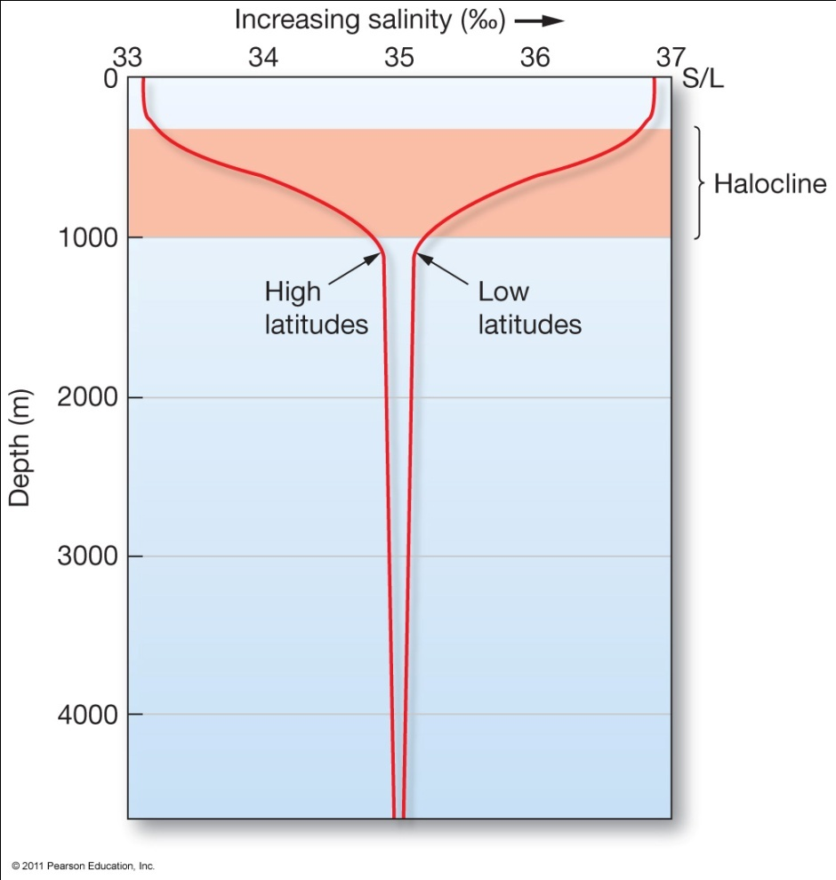
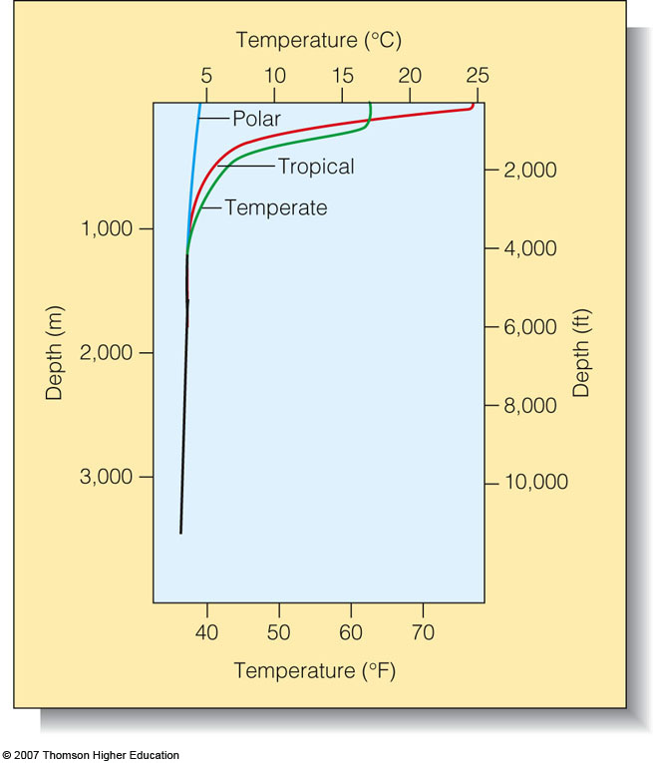
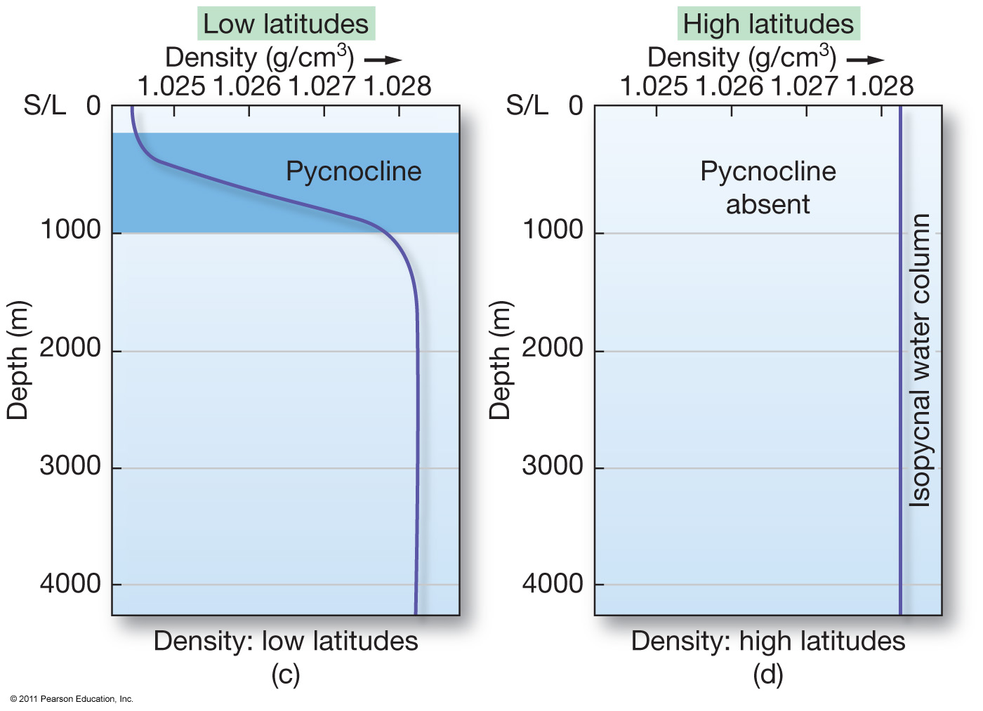
The 3 “Clines”of Seawater

Slide 2
The 3 Clines:
Thermocline:
  Transition layer between the mixed layer at the surface and the deep water layer.
  The definitions of these layers are based on temperature (surface water is warmer due to sun’s radiation).
Halocline:
  Cline caused by a strong, vertical salinity gradient within a body of water.
  Since salinity (along with temperature) affects the density of seawater, it can play a role in its vertical stratification.
Pycnocline:
  Cline (or layer) where the density gradient (^{∂ρ}⁄_{∂z}) is greatest within a body of water.

Slide 3
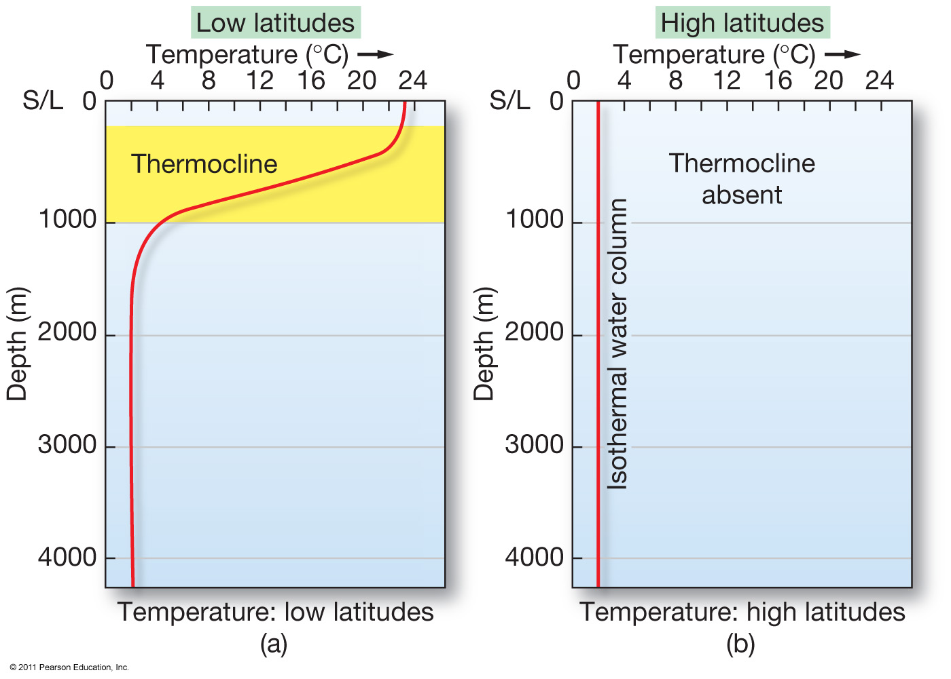
Variation of Temperature with Depth “Thermocline Graphs”
Sun warms the surface
Cold at depth
Cold
everywhere

Slide 4
Isothermal: Where there is not a strong change in temperature (Thermocline is absent)

Slide 5
Thermocline graphs are also controlled by latitudes. (Why?)

Slide 6
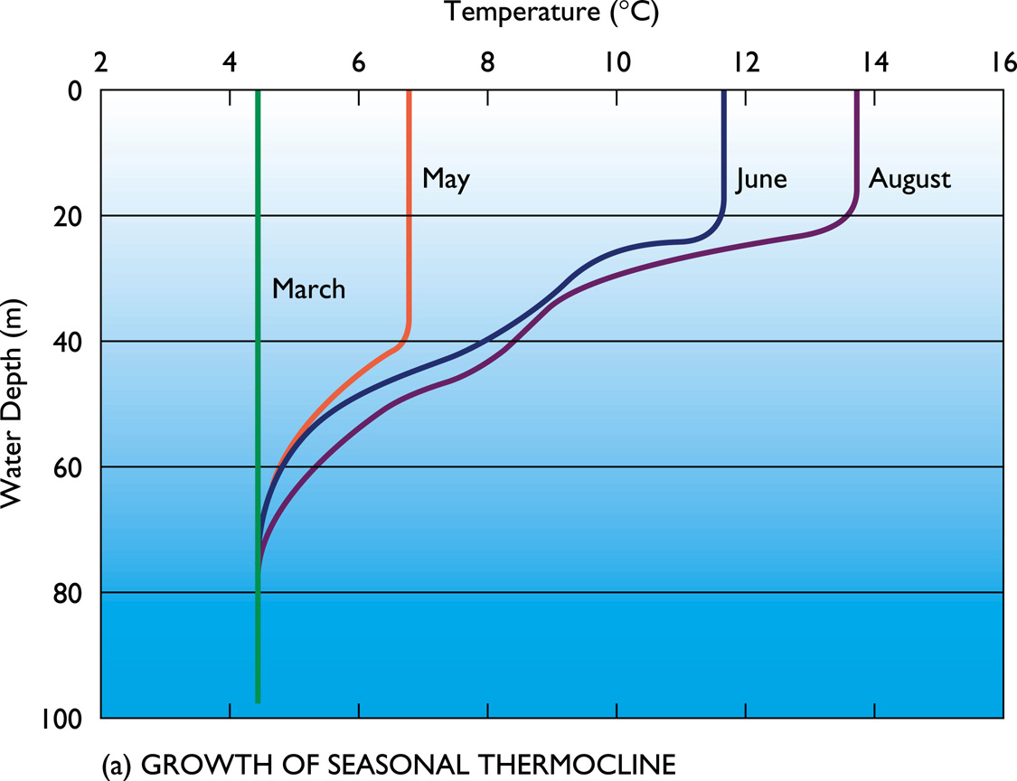
Thermocline graphs are also controlled by the seasons. (Why?)

Slide 7
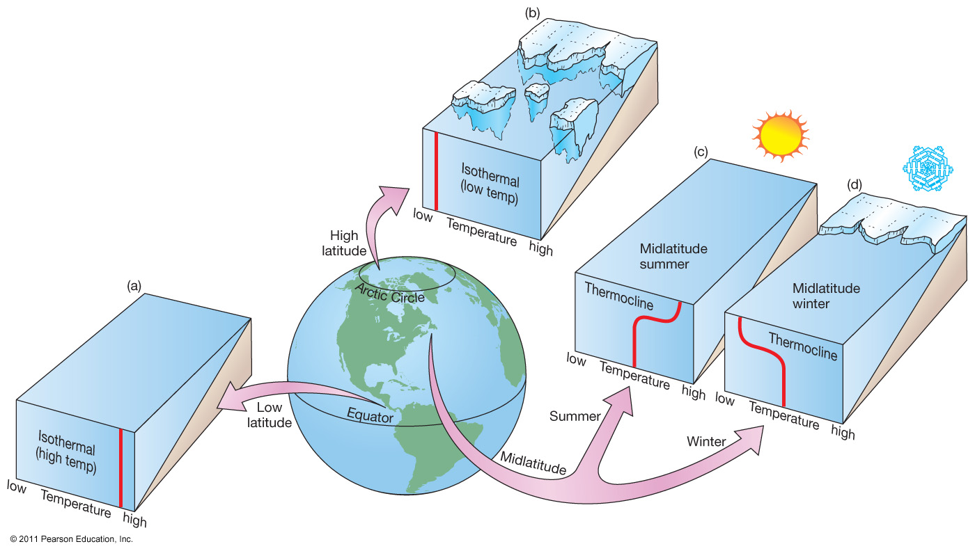

Slide 8
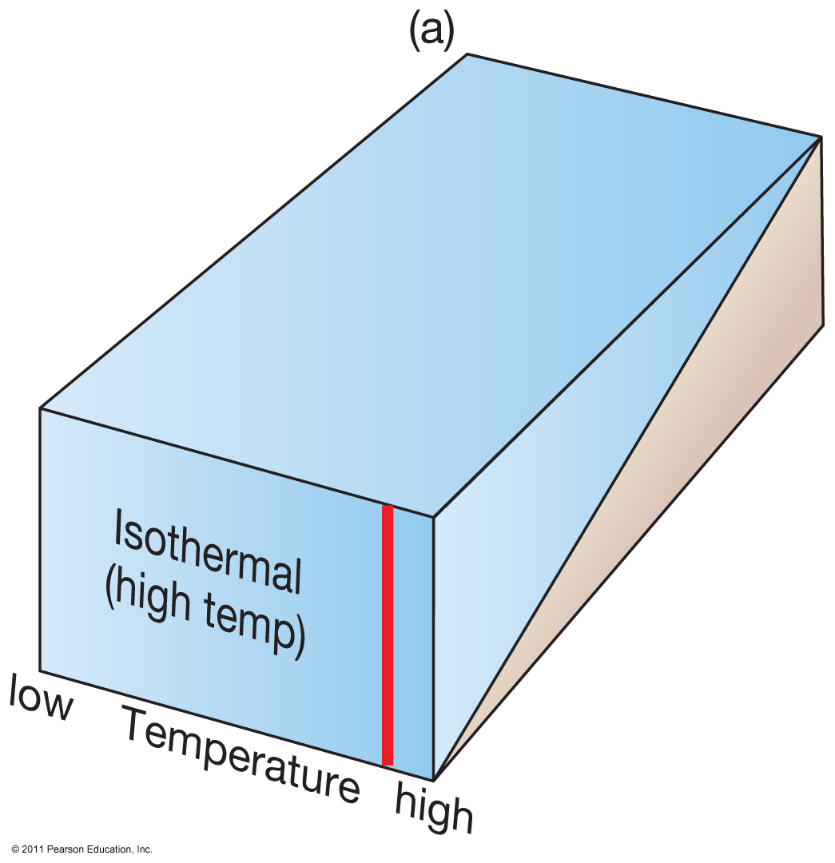

Slide 9
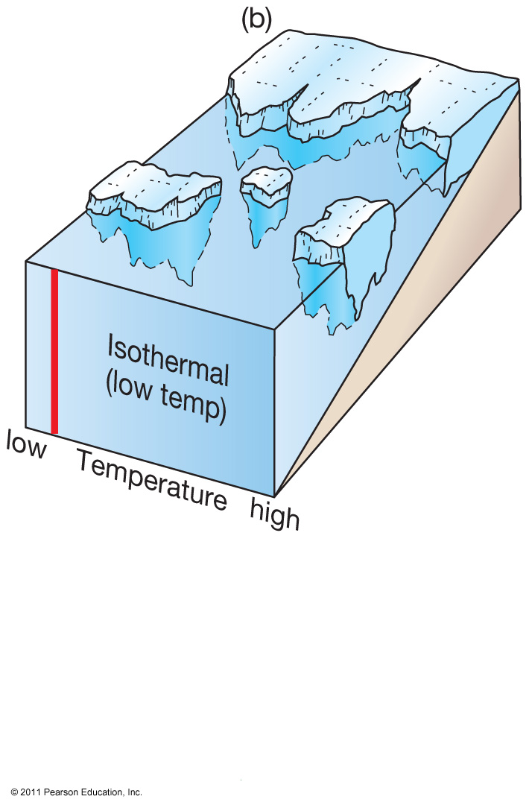

Slide 10
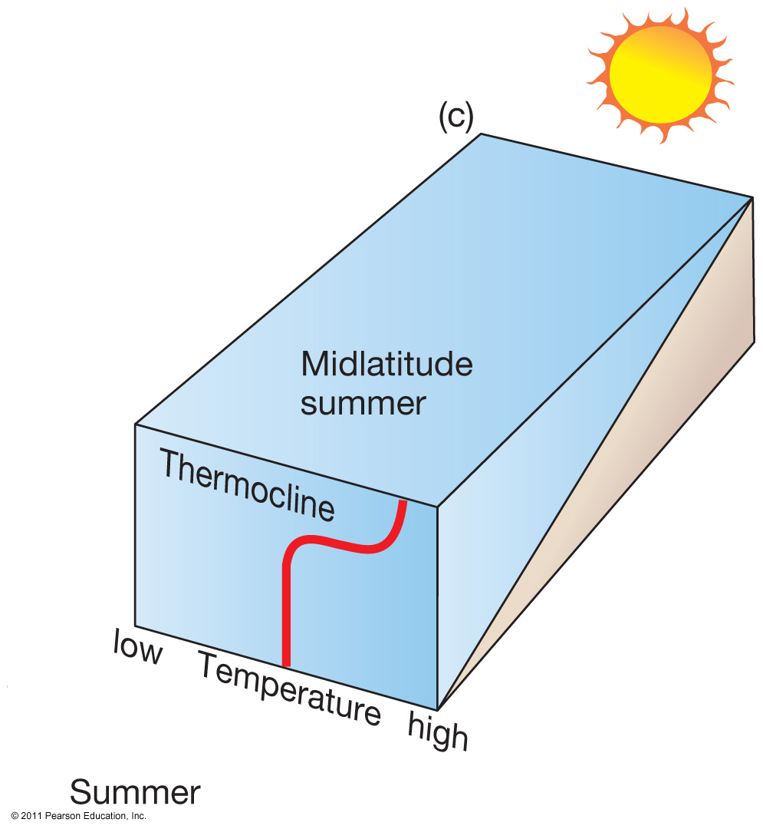

Slide 11
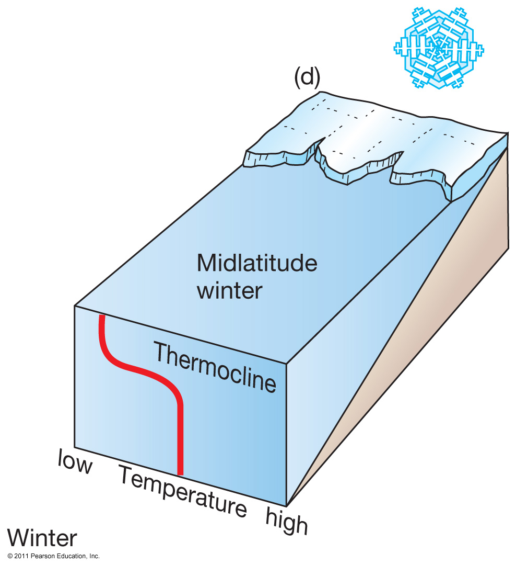

Slide 12
Density Zones
The ocean is broken into density zones
The 3 density zones are controlled by:
  Temperature
  salinity
Zone 1:
  Surface zone – the upper layer of the ocean, least dense of all seawater. (2%)
Zone 2:
  Pycnocline – the density of the water increases with depth.(18%)
Zone 3:
  Deep zone – Ocean water density is constant in this layer. (80%)

Slide 13
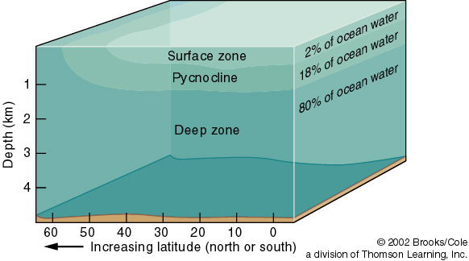
Density Zones in the Ocean

Slide 14
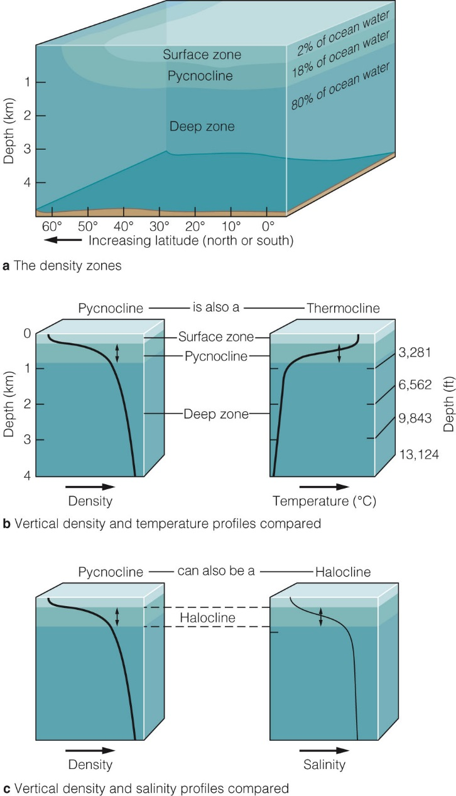
The Ocean Is Stratified into Three Density Zones by Temperature and Salinity
Density increases rapidly with depth in the pycnocline.
Below the pycnocline lies the deep zone of cold, dense water.
As the water gets deeper, the temperature decreases
As the water gets deeper, the salinity increases
  more dissolved particles = heavier water

Slide 15
Pycnocline graphs are also controlled by latitude – Why?

Slide 16
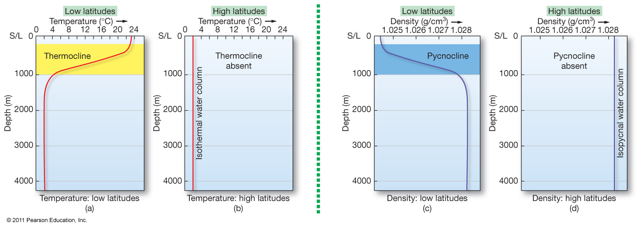
Explain these graphs ….. And explain how the Pynocline graph is the opposite of the Thermocline graph.

Slide 17
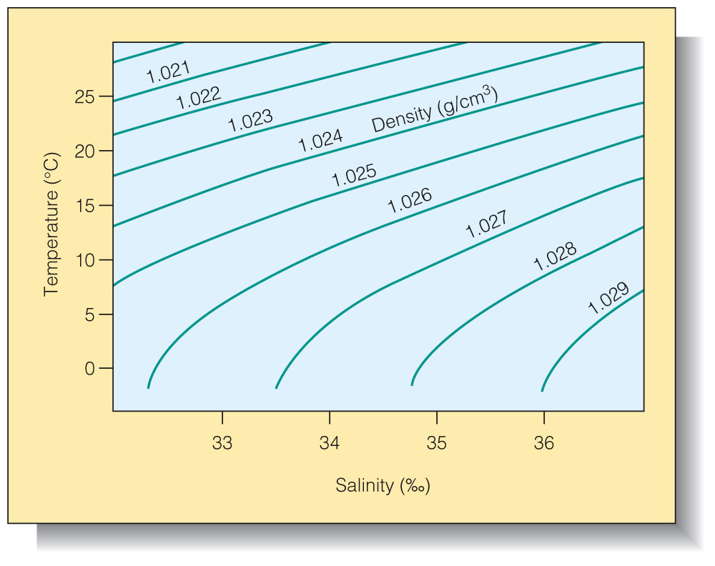
The relationship between temperature and salinity of seawater controls the density of seawater.(Explain this trend)

Slide 18
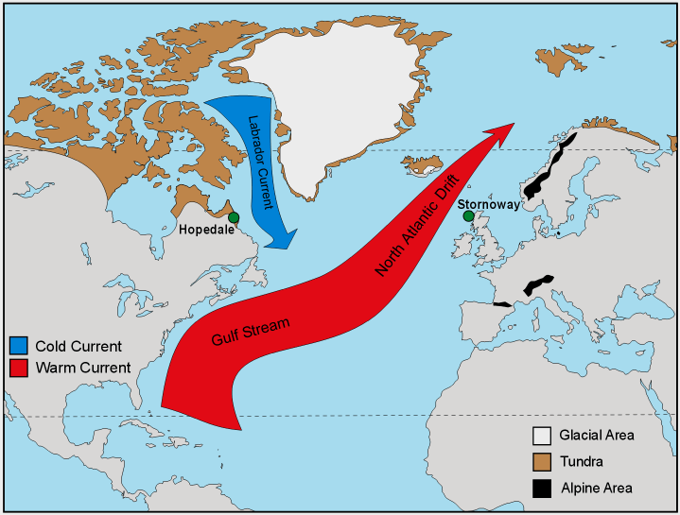
Surface Water Controls Global Temperature

Slide 19
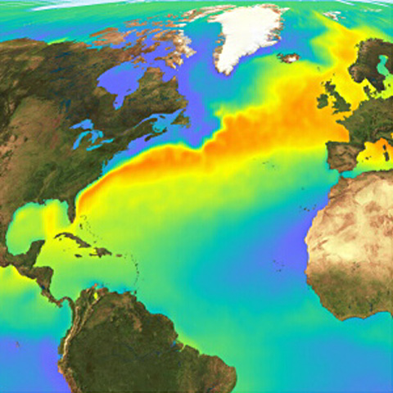

Slide 20
Density depends on Latitude
There is no pycnocline in the higher latitudes, Why?
Pycno = density
cline = slope

Slide 21
Explain these graphs ….. And explain how the Pynocline graph is the opposite of the Thermocline graph.

Slide 22
Temperature and Salinity
The relationship between temperature and salinity of seawater controls the density of seawater.
Explain this trend

Slide 23
Surface Water and Global Temperature
What is responsible for bringing warm water to Stornoway?
What is responsible for bringing cold water to Hopedale?
What area is still Glacial?
What might happen if the warm current stops getting to Stornoway?

Slide 25
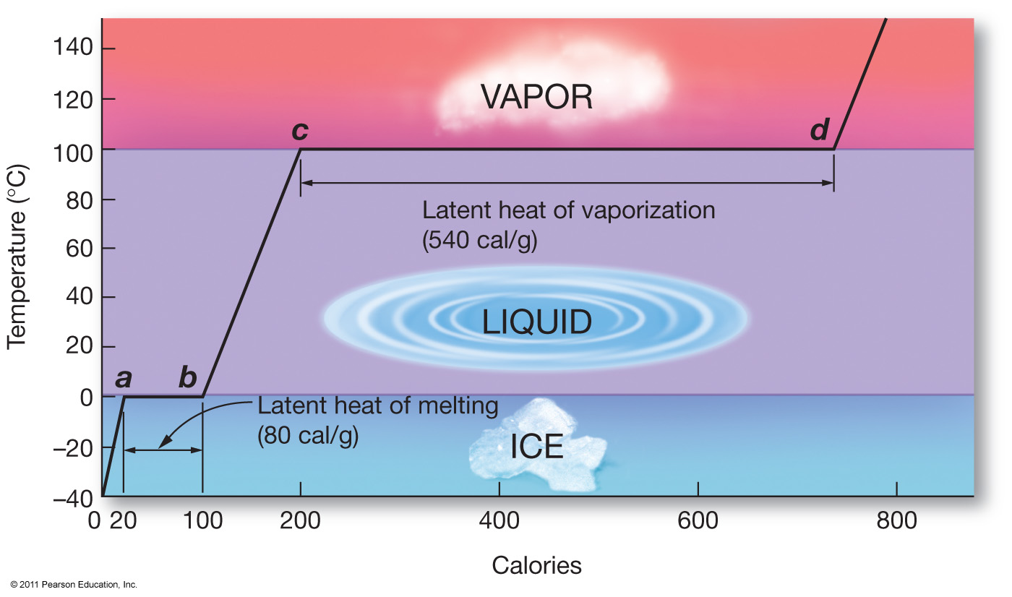
Water and Evaporation
Water has the highest Heat of Vaporization of any known substance.
Before A ice is forming
Between A and B ice is absorbing energy to start melting but the temperature stays the same
Between C and D, water is storing energy to evaporate but does not change temperature
After D, water evaporates

Slide 26
General Idea:
  It takes much more energy for liquid water to evaporate than for liquid water to freeze.
  During the Vaporization and Latent stages the temperature of the water does not change.

Slide 27
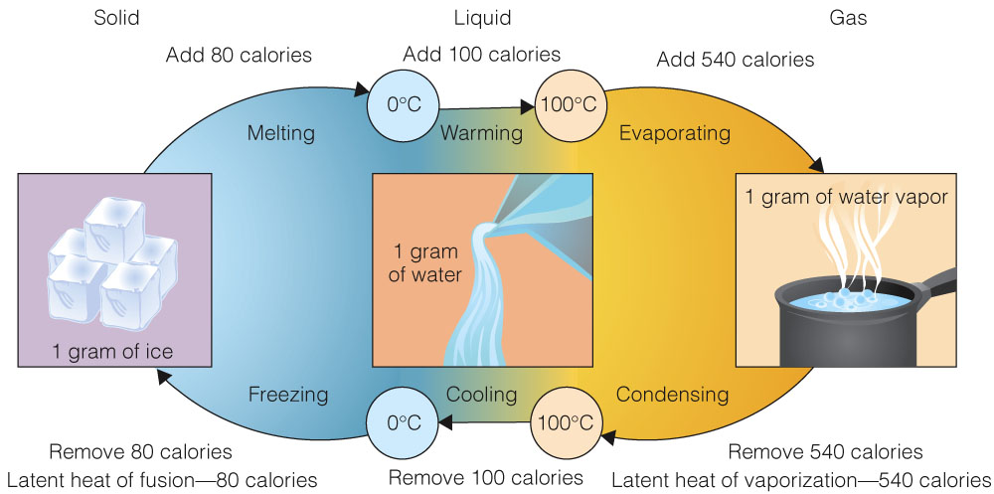
Water Removes Heat from Surfaces As It Evaporates

Slide 28
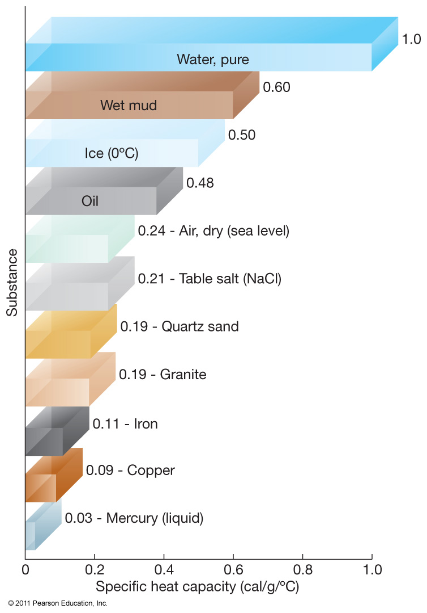
Heat Capacity of Water
Water has a very high heat capacity, which means it can absorb huge amounts of heat.
Not all substances have the same heat capacity

Slide 29
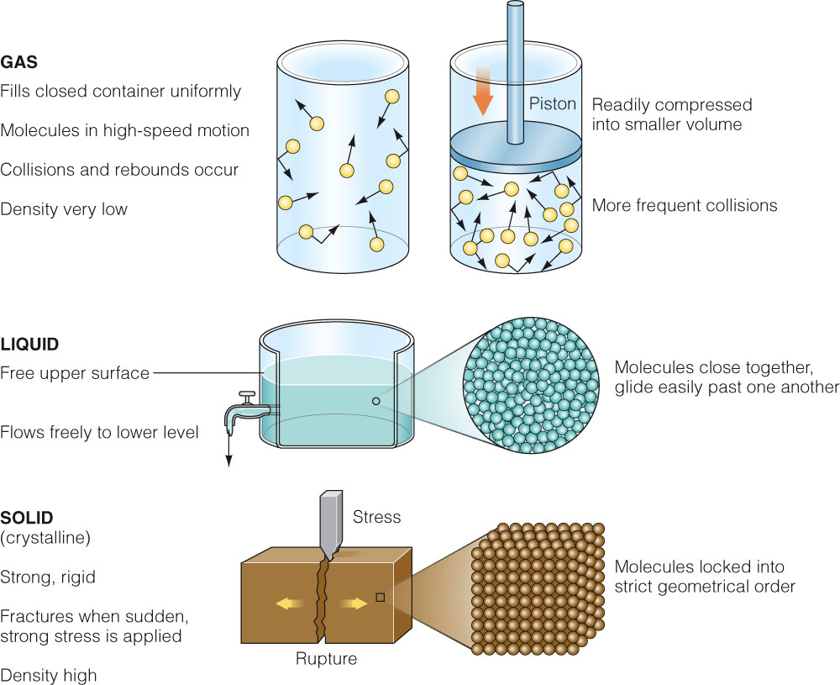
Water’s Temperature Affects Its Density

Slide 30
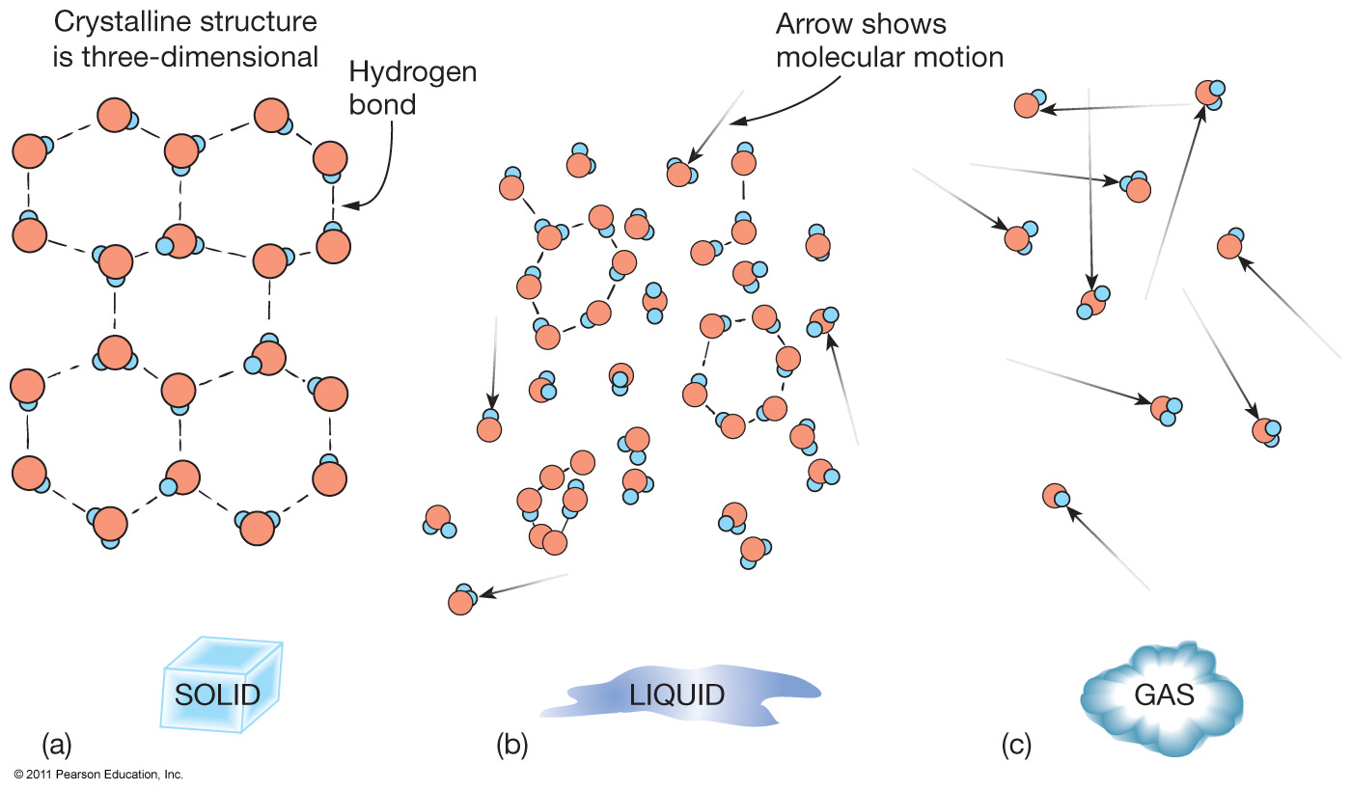
Solid, Liquid and Gas

Slide 31
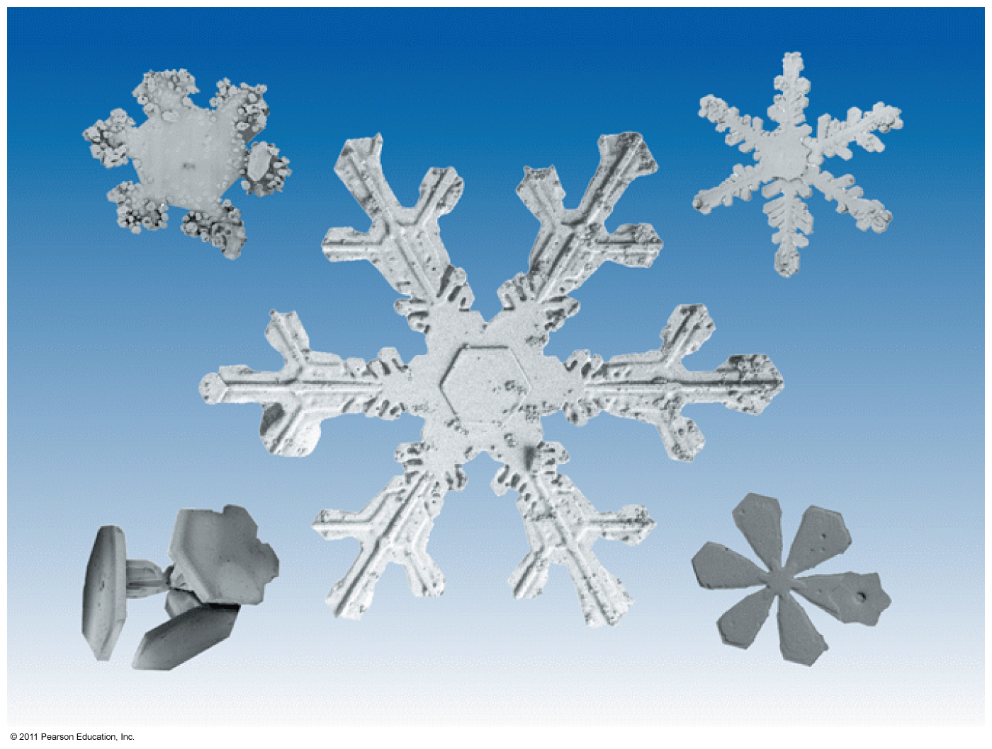
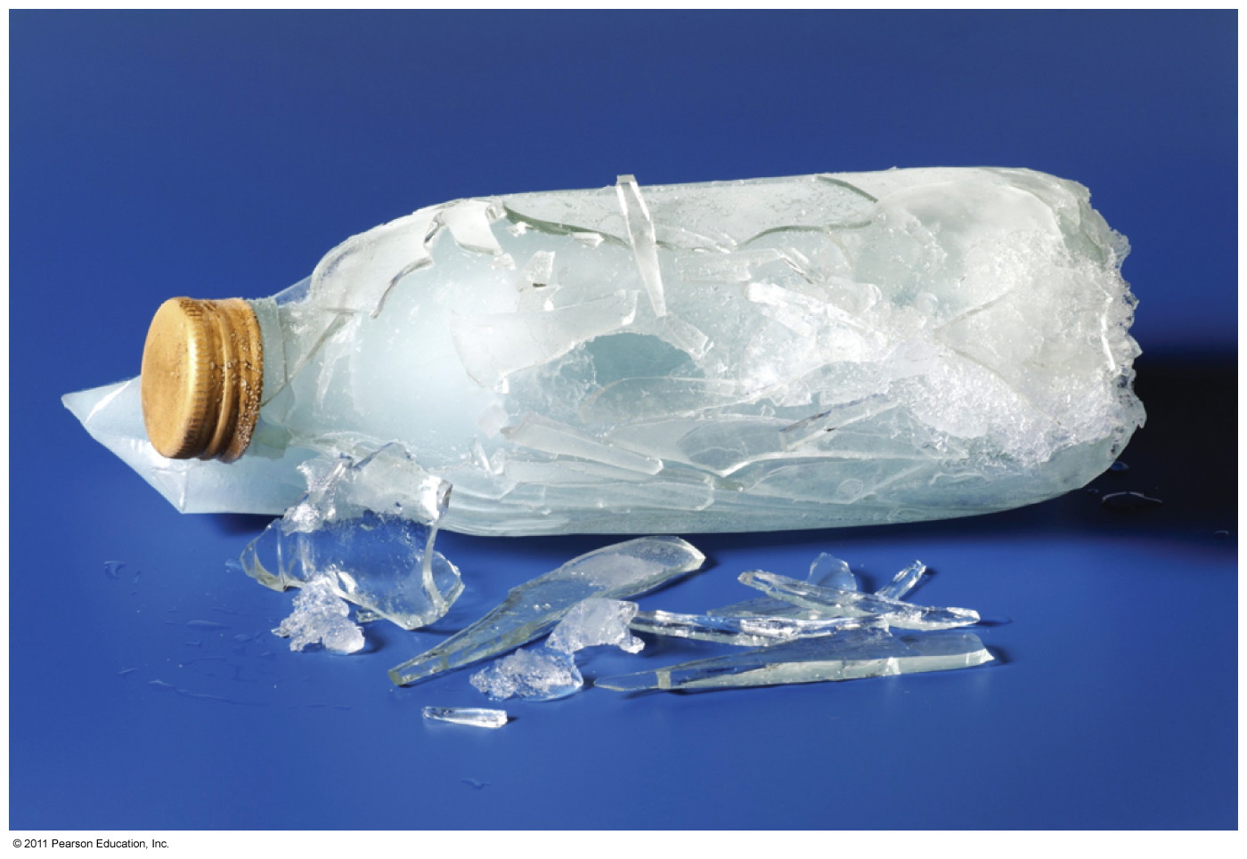
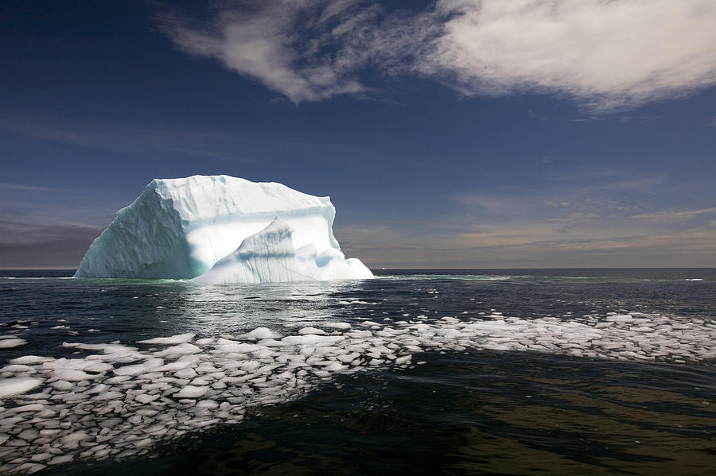
Solid
Crystals of frozen water have an unique shape .
This causes water to expand when it freezes to forms ice.
This also makes ice less dense causing ice to float on seawater
What would happen if ice did not float but sank to the bottom of lakes during the winter?

