Slide 1
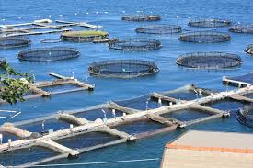
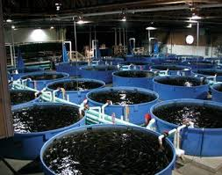
The Good, the Bad and the Ugly of Aquaculture

Slide 2
World Seafood Production (FAO)
Aquaculture
Fisheries
200
180
160
140
120
100
80
60
40
20
0
1975
1985
1995
2010
2030

Slide 3
The Good: Need for a Solution
The world’s resources are limited; nowhere is that more clear than with seafood.
Many of the global fisheries are fish at or beyond capacity, potentially facing collapse by 2050.
Done right Aquaculture holds great promise to produce high quality, large volumes of seafood.

Slide 4
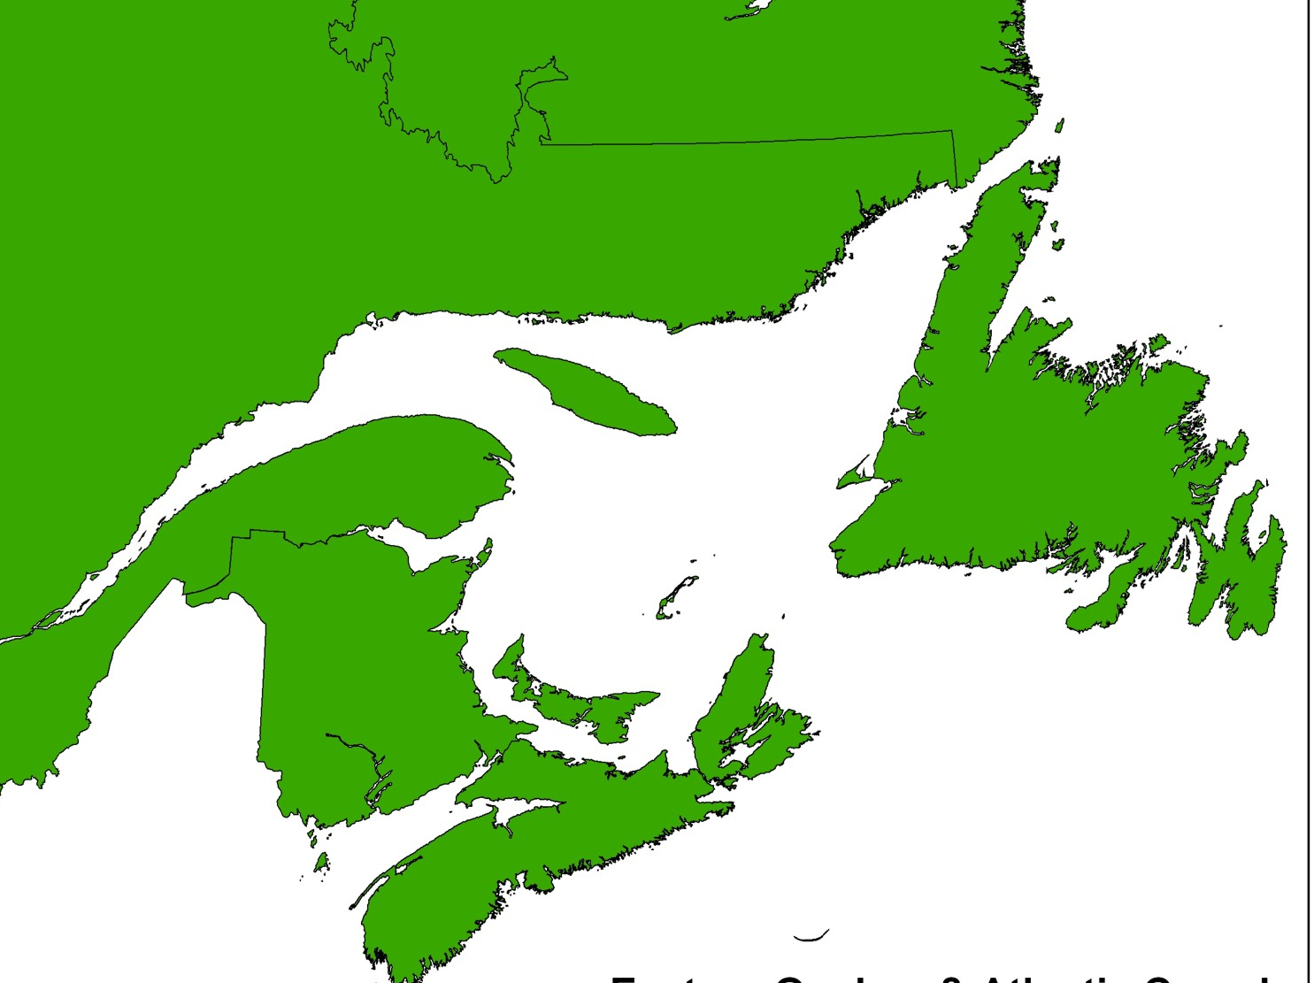
Economic Profile
Aquaculture in Eastern Canada

Slide 5
Total Production & Value: NB, NL, NS, PEI

Slide 6
Major Species Farmed by Volume 2004

Slide 7
Key Industry Drivers
Rural Based
Providing an Economic Alternative for Rural & Coastal Communities.
Residents can stay, & educated young people can return, to their communities.
Science Based
Highly Efficient Producer of Protein using Science & Technology.
Market Based
Food Industry - Growing Demand by Consumers.
Producing High Quality, Safe, Nutritious, products year round.

Slide 8
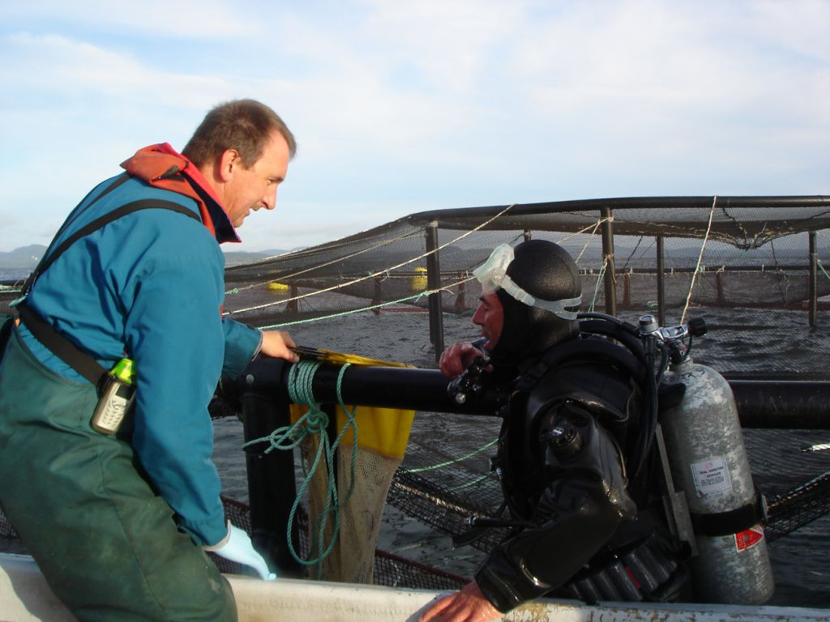
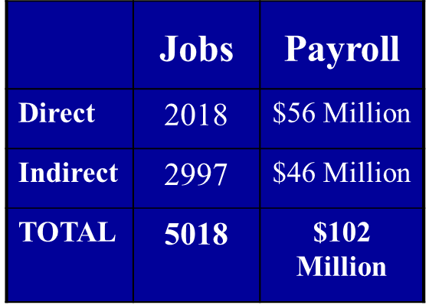
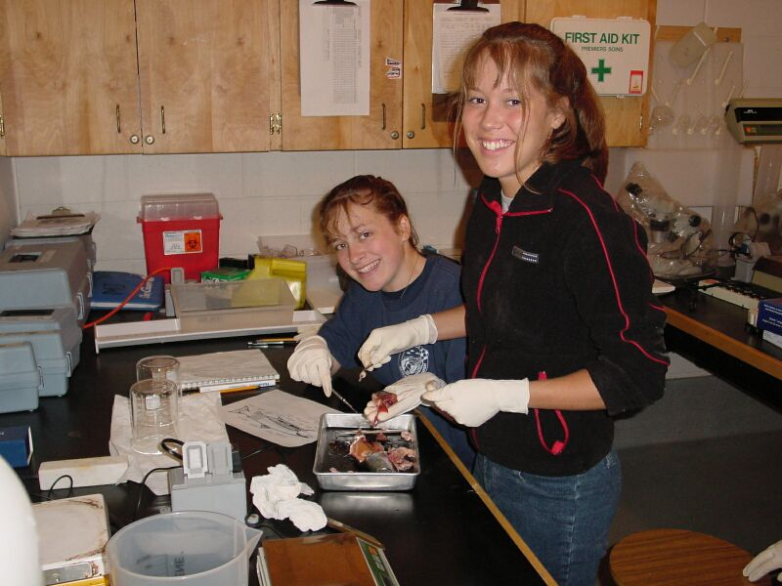
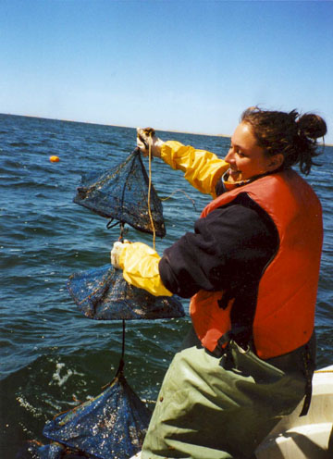
Faces of the Industry
Processor
Diver
Biologists
Technicians
75% of industry employees are under 40 years of age.

Slide 9
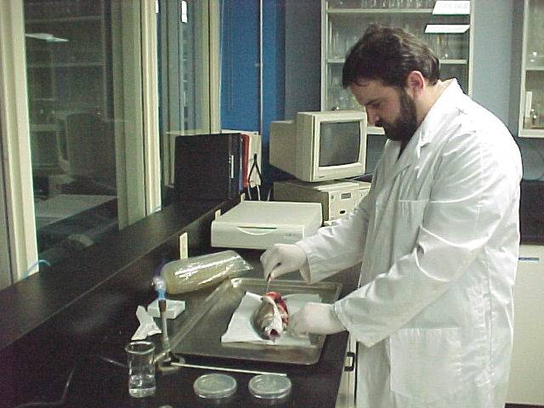
Science Based Industry

Slide 10
Aquaculture Education & Research Institutions

Slide 11
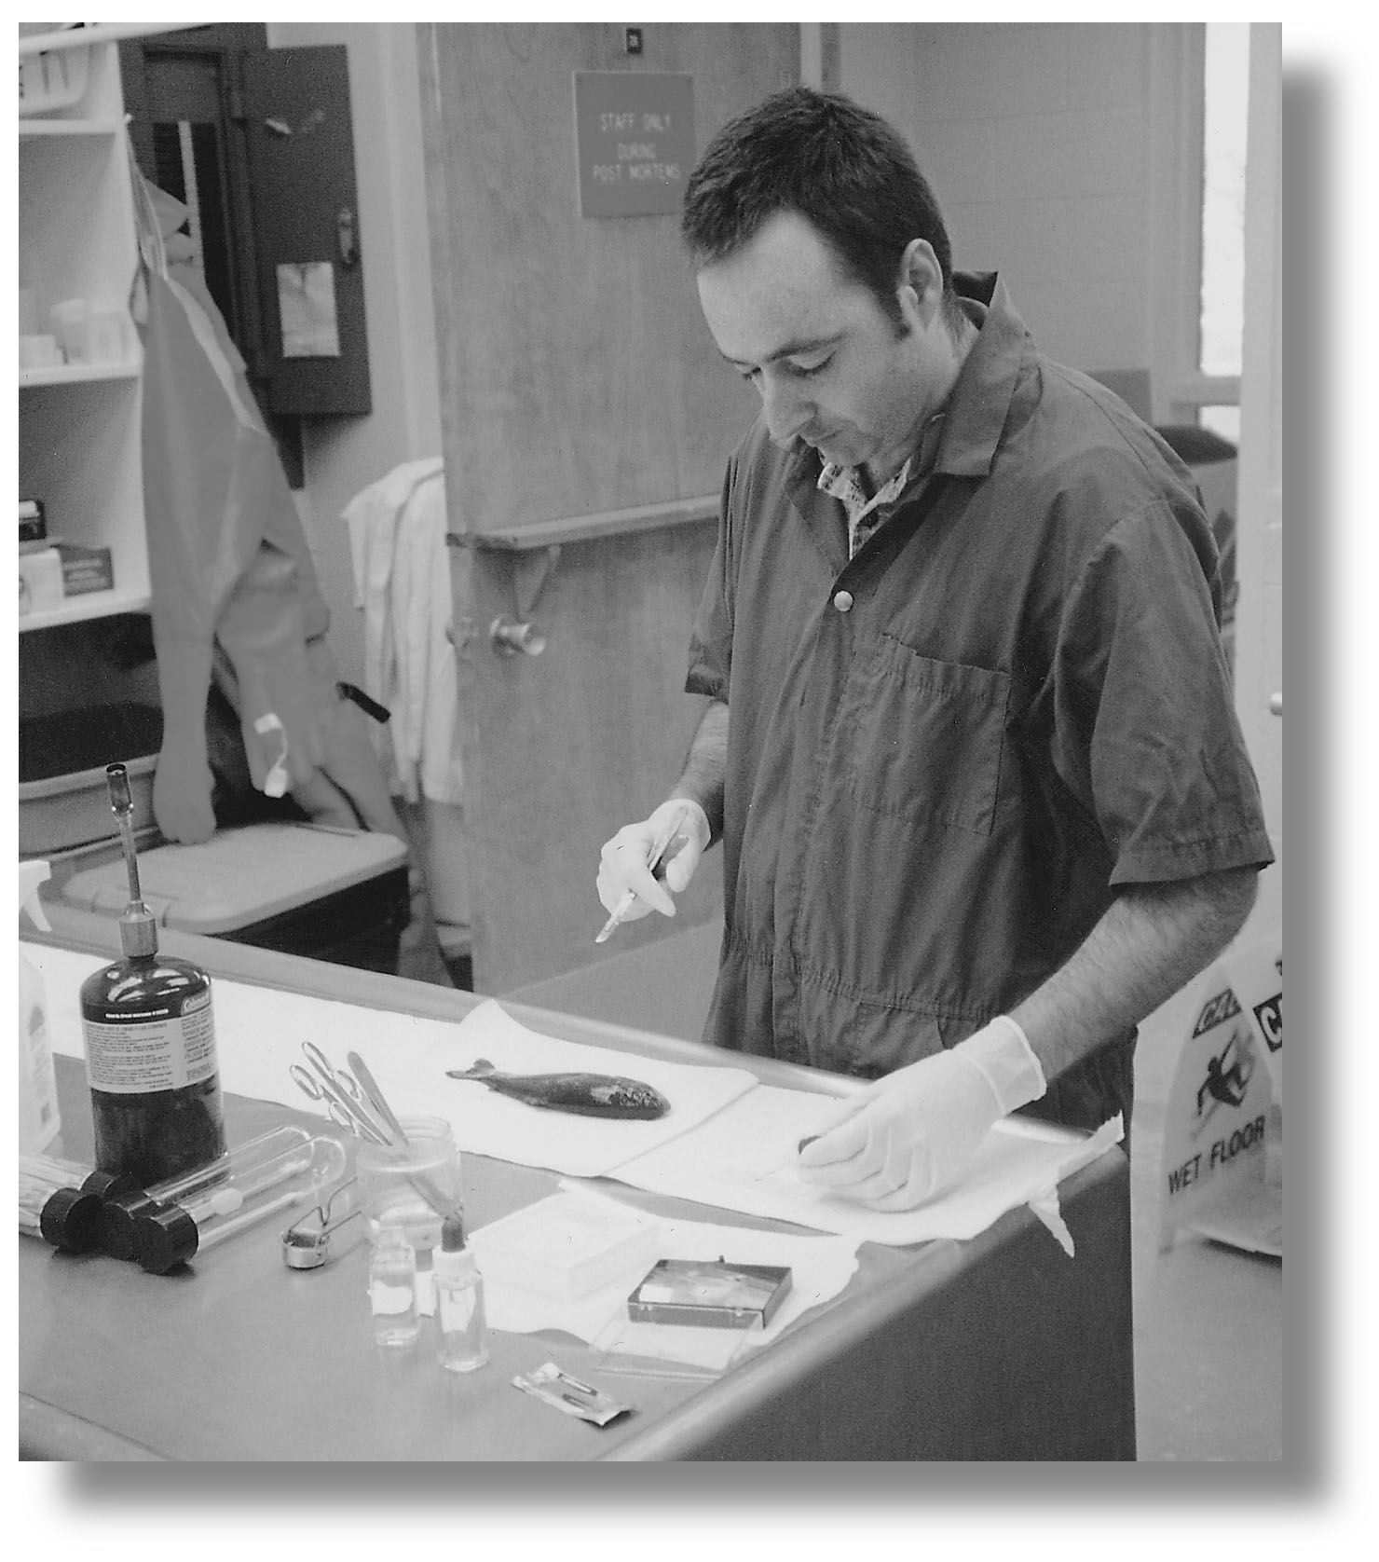
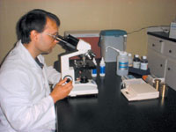
Monitoring and Sustainability
The Industry and Government are working together to provide for Sustainable Aquaculture Development.
Programs include:
Environmental Impact Assessments pre licensing.
Environmental Monitoring & Codes of Practice.
Canadian Shellfish Sanitation Program.
National Aquatic Animal Health Program.
Processing Plant Quality Management Program (QMP).
Safe Quality Food Institute Certification Program.

Slide 12
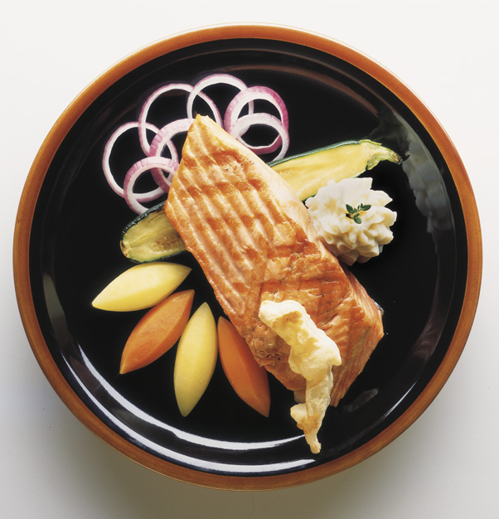
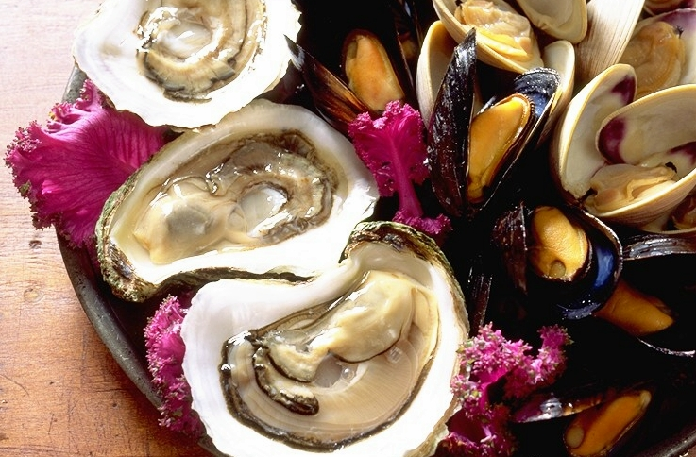
Market Based Industry
Producing Safe, Healthy Food in a Sustainable Environment

Slide 13
The Bad: New Practice
New practice: Aquaculture has only been around for 30 – 40 years. There is a steep learning curve for sustainability (trying to learn in 30 years what land farmers have learned in 6000 years!!)

Slide 14
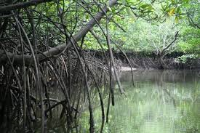
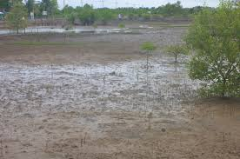
Habitat Degradation
Degradation of hundreds of thousands of hectares of mangrove forests and coastal wetlands for construction of aquaculture sites.

Slide 15
Fish Meal
Much of the food provided for farmed fish comes from smaller wild fish (anchovies, herring).
This creates heavy fishing pressure on smaller ocean fish who play a vital role in ocean food systems.
This has the potential to deplete food for wild fish stocks, seals and seabirds.

Slide 16
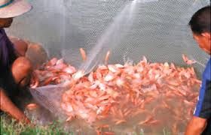
Introduction of Exotics
Introduction of species (accidental or deliberate) may alter or impoverish existing communities and populations.
Receiving communities may be altered through inter-breeding, predation, and competition for food, space, habitats, etc.

Slide 17
Spawning Difficulties
Some organisms depend on certain factors to trigger specific biological reactions (ex: spawning)
Many cultured organisms cannot be bred in captivity. Captive spawning is possible with artificial spawning or fertilization, in some cases with hormone injections, as in the case with sturgeon and salmon.

Slide 18
Diseases
Aquatic animals are more sensitive to pollution whether chemical or their own excrement.
To make maximum profits, intensive aquaculture utilize a dense stocking rate (overcrowding). Studies have shown that dense stocking rates may induce stress and increase susceptibility to diseases.
Overcrowding leads to poor water quality due to decreased oxygen levels, high accumulated metabolic products and excrement, rapid growth, transmission of noxious parasites, micro-organisms and pathogens.

Slide 19
Pollution
The prime factor for aquaculture is control of water quality, especially in high stocking density.
Fish excretion is high in ammonia, nitrite and nitrate. Nitrite binds with the haemoglobin of blood in fish and can be fatal.
Overfeeding must also be avoided in order to prevent contaminating the water.

Slide 20
https://www.ted.com/talks/dan_barber_how_i_fell_in_love_with_a_fish?language=en

Slide 21
Aquaculture Assignment
Aquaculture practices are controversial, at best! Clearly a sustainable solution to our overfished and under pressure fisheries industry is needed, but is Aquaculture the right one?
As with all issues there are many positive and negative attributes that Aquaculture brings to the table.
Do you feel Aquaculture is a sustainable industry that can help our economy aid in replenishing our oceans?
OR
Do you feel it is a necessary evil that will further degrade our oceans and the environment without providing the predicted payoff?
In this assignment you will express you position about Aquaculture in a 1-2 page opinion based paper. Remember to back up your opinion with facts!

