Slide 1
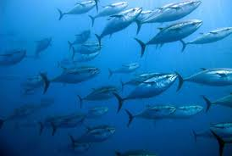
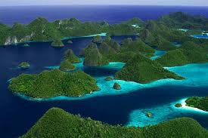
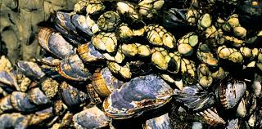
Marine Resources and the Environment

Slide 2
Main Concepts
We have used more natural resources since 1955 than in all of recorded human history up to that time.
Fish provide 3.0 billion people with at least 15% of their average per capita animal protein intake.
Our present level of growth and exploitation of marine resources is unsustainable.
http://visual.ly/35-fish-facts-will-make-you-never-want-eat-fish-again?utm_source=visually_embed

Slide 3
Marine Resources
How are marine resources classified?
  Physical resources – result from the deposition, precipitation, or accumulation of useful substances in the ocean or seabed.
  Biological resources – living animals and plants collected for human use.
  Marine energy resources – result from the extraction of energy directly from the heat or motion of ocean water
  Non-extractive resources – uses of the ocean in place – transportation of people and commodities by sea, recreation, and waste disposal.

Slide 4
Marine Resources
Resources can be further classified as renewable or nonrenewable.
  Renewable resources – naturally replaced by the growth of marine organisms or by other natural physical processes
  Nonrenewable resources – oil, gas, and solid mineral deposits are present in the ocean in fixed amounts and cannot be replenished over time spans as short as human lifetimes.

Slide 5
Facts and Figures about Fisheries and Nova Scotia
The Nova Scotia fishing industry (harvesting and processing) is a major source of direct and indirect employment and income, and is the province’s leading source of export earnings.
In 2006 the value of Nova Scotia’s commercial Landings was $656 694 000

Slide 6
Fisheries in Nova Scotia
The Maritime Region contains an increasingly viable fishing industry - the Scotia-Fundy commercial fishing industry is worth 40% more today than it was a decade ago.
This creates more than 30,000 direct and indirect jobs, including approximately 13,000 full and part-time fishers, operating approximately 4,750 fishing vessels.

Slide 7
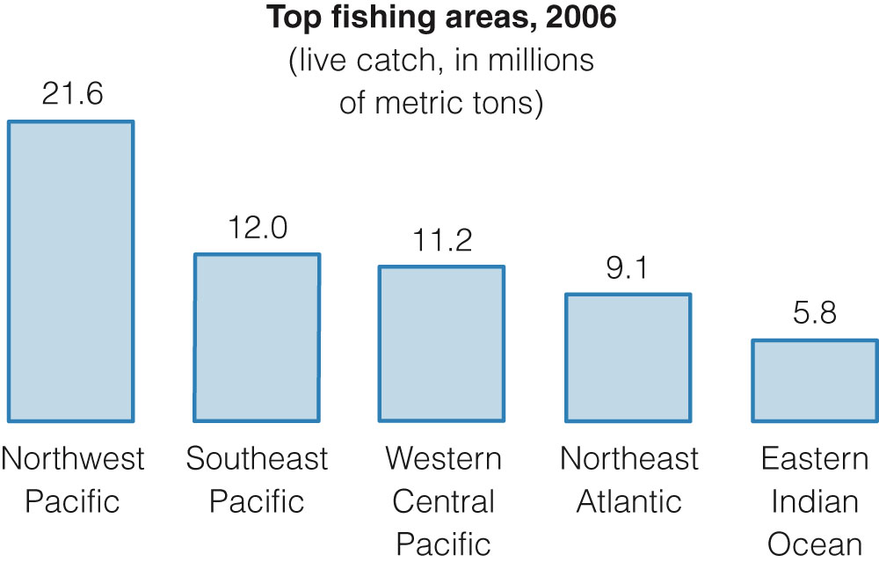

Slide 8
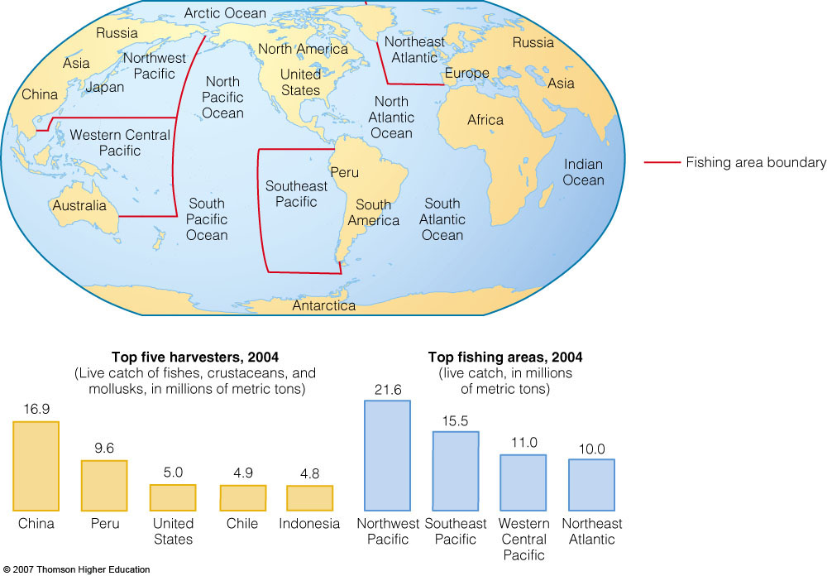

Slide 9
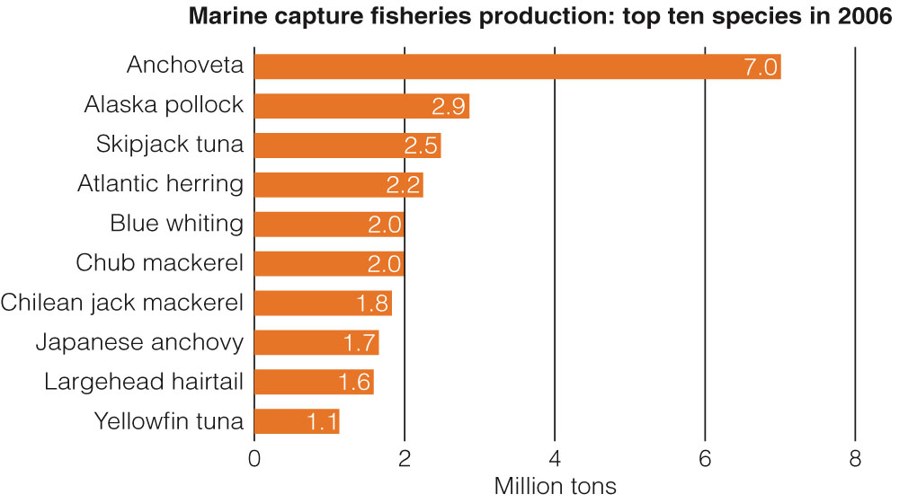
What is Being Caught?

Slide 10
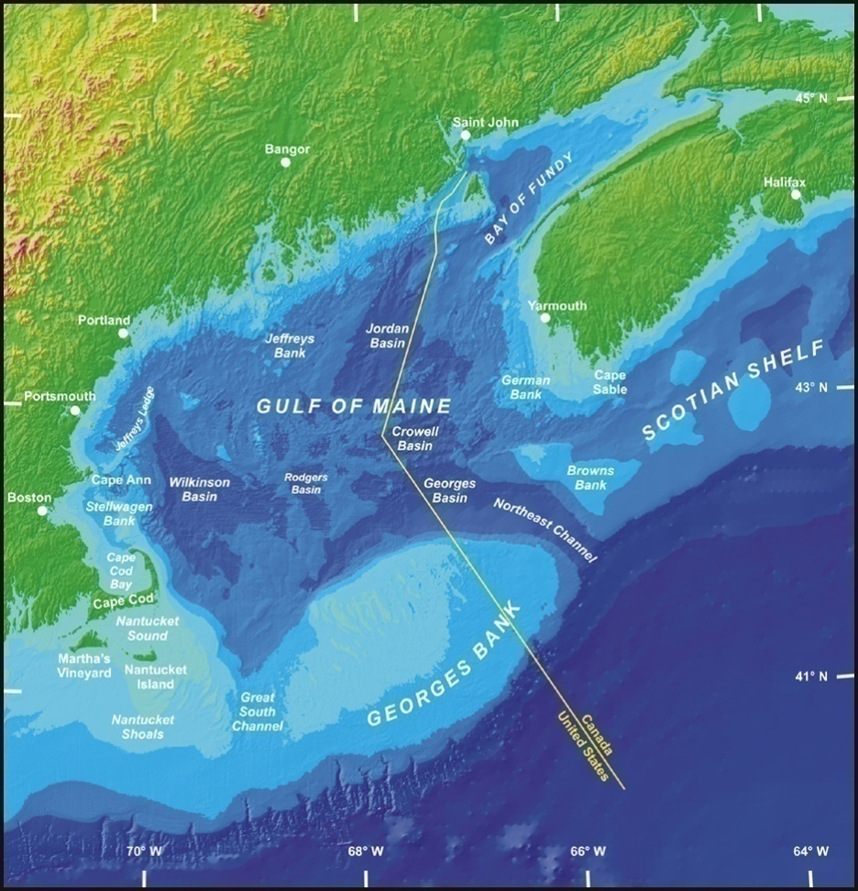
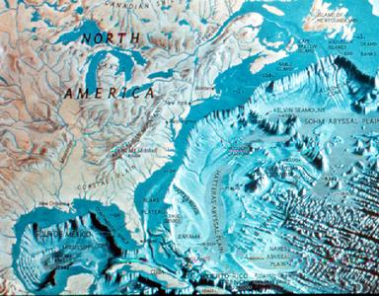
Fisheries in Nova Scotia
Georges Bank
East Scotian Shelf
Grand Banks

Slide 11
Major types of Commercial Fisheries
Type of Organisms | Examples
Groundfish | Cod, Haddock, Hake
Pelagic Fish | Sardine, Anchovy, Herring, Mackerel, Tuna
Crustaceans | Crab, Lobster, Shrimp, Krill
Molluscs | Oysters, Mussels, Clams. Squid, Scallops

Slide 12
Fisheries
Of the thousands of species of marine organisms in the ocean, only ~500 species are regularly caught as part of a commercial fishery.
The largest commercial harvest is of Herring and its relatives (sardines, anchovies).
This fishery comprises a fifth (1/5) of the worldwide catch of marine resources caught each year.

Slide 13
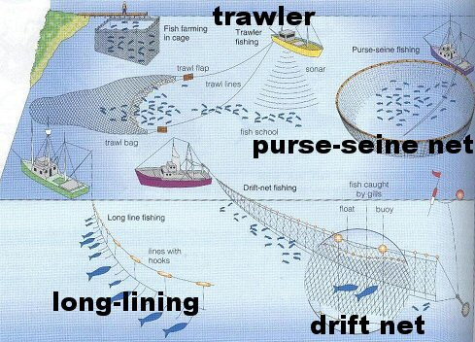
Fishing Techniques
Fishing techniques has changed. Fishermen have started to use bigger nets, longer fishing lines and fish trackers.

Slide 14
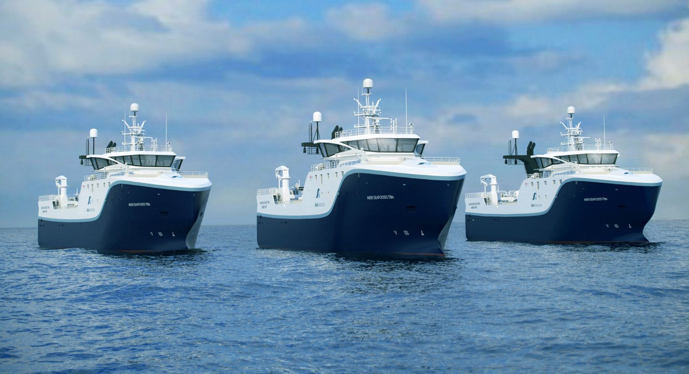

Slide 15
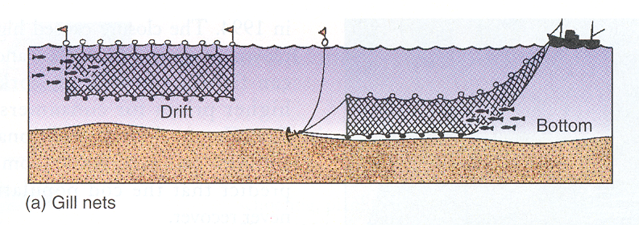

Slide 16
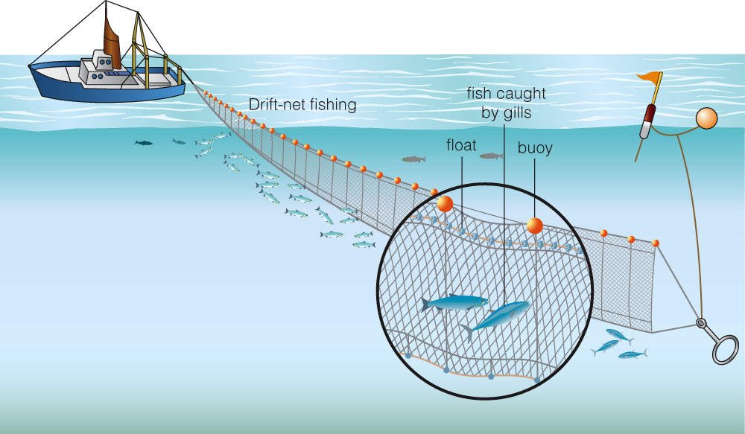

Slide 17
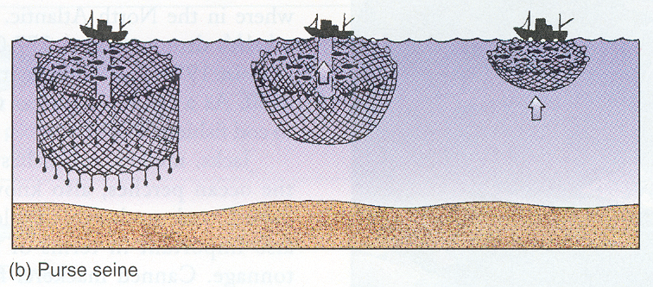

Slide 18
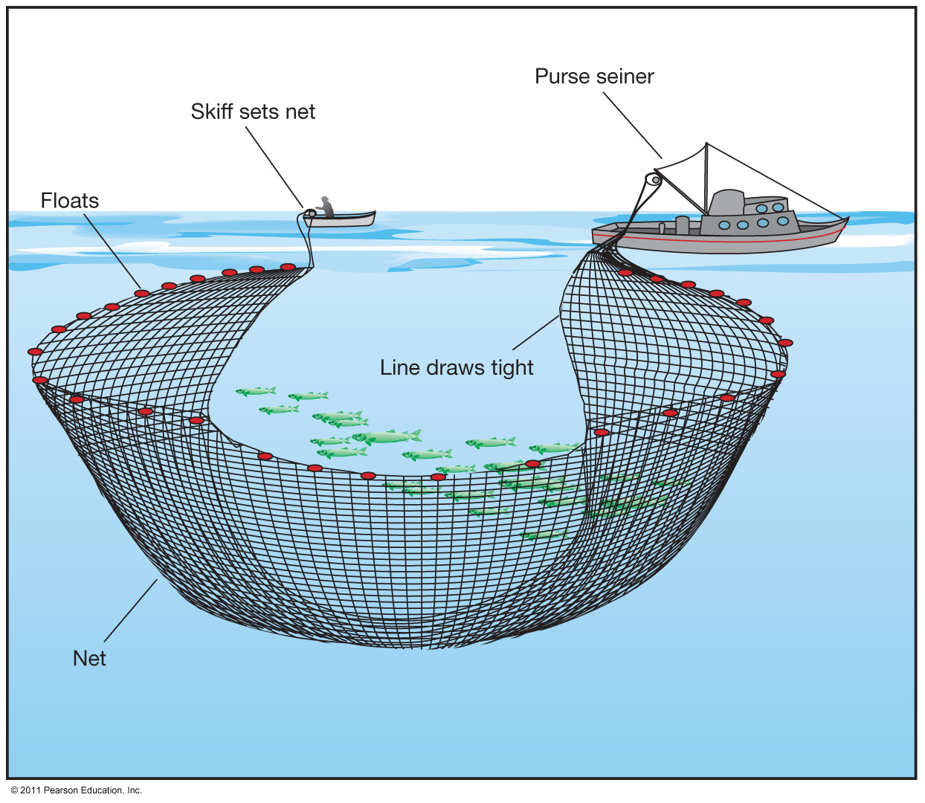
Purse Seine Net

Slide 19
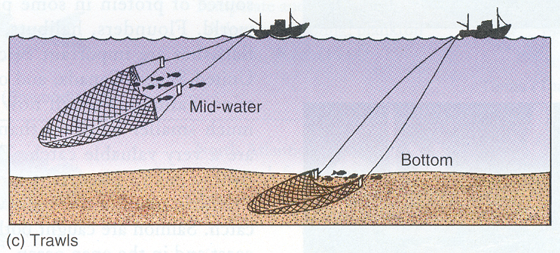

Slide 20
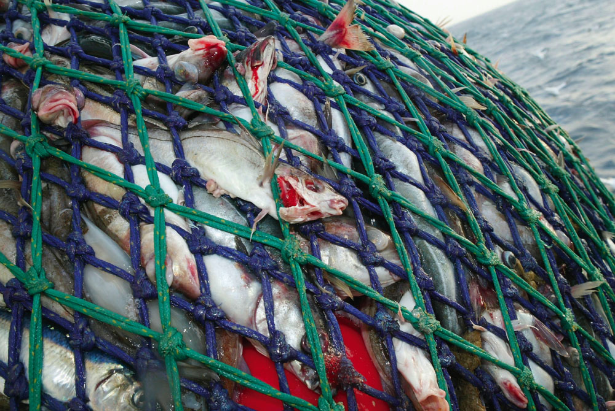

Slide 21
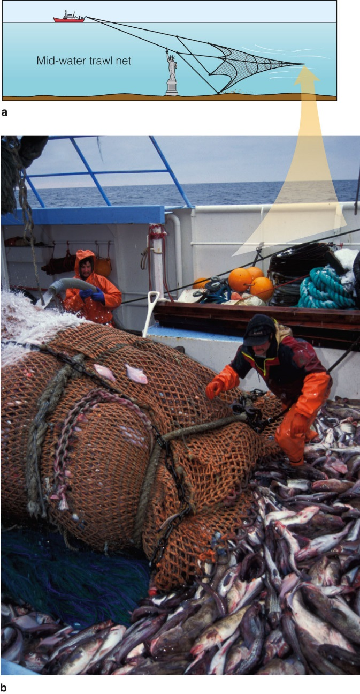

Slide 22
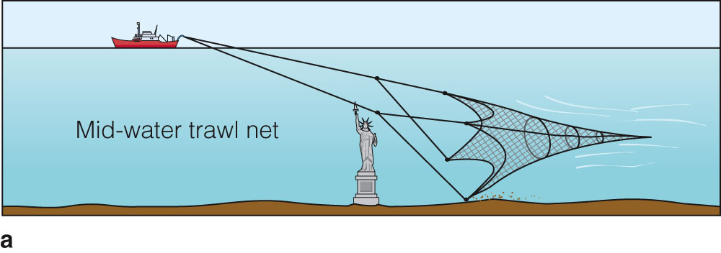
The Ocean’s Most Valuable Biological Resource
Stern trawler fishing: After sonar on the trawler finds the fish, they’re captured by a trawl net more than 122 meters (400 feet) wide. The largest nets extend about 0.8 kilometer behind the towing vessel and are large enough to hold a dozen 747 jetliners.

Slide 23
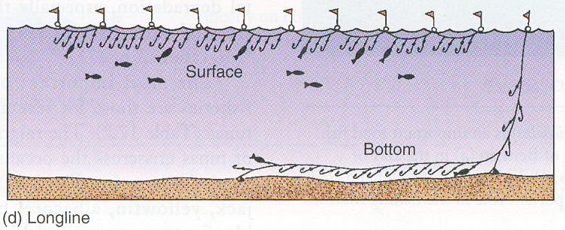

Slide 24
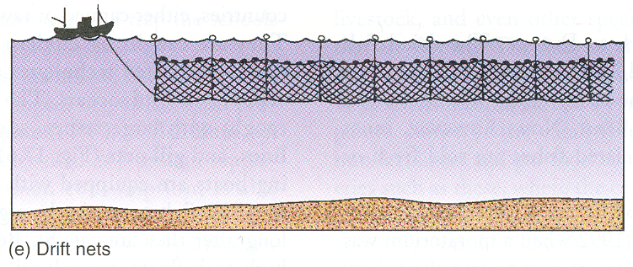

Slide 25
By-Catch
Animals that are unintentionally killed when desirable organisms are fished
In many cases, by-kill exceeds the target catch
Example:
  Thousands of dolphins were by-caught in tuna nets until regulations changed the net design and ship maneuvers

Slide 26
Technology Improves Catches
75% of fishers are vast commercial fleets who find fish by using:
  satellite sensors
  aerial photography
  scouting vessels
  sonar
  global positioning systems
Huge factory ships follow along to can and freeze the fish as they are caught

Slide 27
Declining Fish Populations
Fish stocks worldwide have been declining; many have collapsed, due to overfishing - too many fishers, too little fish
Other reasons for declining numbers are mismanagement, habitat destruction, interference with breeding, increased ocean pollution

Slide 28
Fishing Methods
Complete the worksheet on Fishing Methods
Describe the method, what is caught, and the environmental impacts; is it sustainable?

