Slide 1
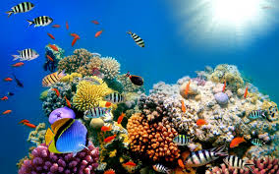
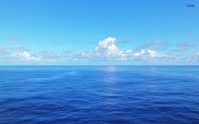
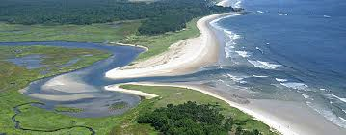
Marine Biomes

Slide 2
Importance of Marine Biomes
Oceans represent the largest and most diverse of the ecosystems.
Salt water evaporates and turns to rain which falls on the land regions, while most of the oxygen in our atmosphere is generated by algae.
Algae is also responsible for the absorption of large amounts of carbon dioxide from our atmosphere.

Slide 3
Marine Biomes
The marine regions are divided between:
Coral reefs
Estuaries
Oceans

Slide 4
Oceanography Conference
You have been invited to an Oceanographer’s Conference ☺
A meeting of Chemical, Physical, and Biological Oceanographers.
Task 1:
You will be assigned to one of the groups of Oceanographers.
Each group will prepare a description of one of the 3 marine biomes, based on the type of oceanography they have been assigned.
Physical Oceanographers will address physical features
Chemical Oceanographers will address ocean chemistry
Biological Oceanographers will address marine life and biological aspects.

Slide 5
Assignment Questions:
What are the chemical properties of the seawater in this region?
What influences salinity and density?
What are the physical properties of the seafloor in this region?
What tectonic plates are nearby this region?
What land features are nearby?
How do they influence the seafloor?
What are the biological properties of this region?
What organisms can exist here?
What factors determine habitability for marine organisms?

Slide 6
Physical Oceanographers
1. What seafloor features are found within this region?
2. What are the surrounding tectonic plates? Are there fault lines nearby?
3. Are there convergent, divergent or transform fault lines? How could these impact the marine biome?
4. What sediments exist on the seafloor in this region? Where did they most likely come from? How are they transported?

Slide 7
Chemical Oceanographers
1. Do you think the salinity of the ocean varies within your region? Why or why not?
2. Where does the majority of the salt in the sea come from?
3. What is the rate of precipitation in your region? What is the rate of evaporation? How might they affect salinity?
4. What is the water temperature in your region? How is this determined?

Slide 8
Biological Oceanographers
How much sunlight is present in the water column in your region? How does this affect the biological diversity in your region?
Is there a lot of primary production in your region? Why or why not?
How does the chemical composition of the seawater determine the biological diversity of the region?
How might changes in water depth affect the biological diversity of your region?

Slide 9
http://ths.sps.lane.edu/biomes/marine3/marine3.html
http://www.ucmp.berkeley.edu/exhibits/biomes/marine.php
http://www.thewildclassroom.com/biomes/MARINE.html
http://www.windows2universe.org/earth/Water/marine_ecology.html

Slide 10
Task 2:
Once each group has compiled their information, new groups will be assigned, consisting of 1 of each type of oceanographer.
Oceanographers looking at each type of biome will be grouped together.
Ex: Oceanographers researching Coral Reefs will be placed in the same group.
Each group will be assigned a different region within the biome.
Groups will compile Physical, Chemical and Biological characteristics specific to that region.
New groups will use chart paper and markers to draw a diagram of all the oceanographic properties of that marine biome/region.

Slide 11
Resources:
Coral Reefs:
Barrier Reefs: Great Barrier Reef
http://www.greatbarrierreef.org/
Fringing Reefs: Chumbe Island Tanzania
http://www.chumbeisland.com/
Atolls: Northwestern Hawiian Islands
http://www.papahanaumokuakea.gov/visit/welcome.html
Ocean:
Arctic
Atlantic
Indian
Estuaries:
Coastal
Tectonic
Bar Built
http://omp.gso.uri.edu/ompweb/doee/science/descript/esttype1.htm

