Slide 1
Oceans 11 Seating Plan
Daniel
Mira
Victoria
Emily
Noah
Rachel
Cameron
Eric
Stephanie
Amy
Aiden
Jon
Ian
Chris
Sarah
Wajdy
Mackenzie
Mikayla
Riley
Petra
Omar
Ryan H
Ryan L
Gillian
Robyn
Dani
Cheyenna
Kyle
Noah
Jada
Matthew
Mrs. McPherson

Slide 2
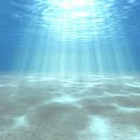
Oceans 11
Mrs. McPherson

Slide 3
Course Outline
Units:
Structure and Motion
Coastal Zones
Marine Biomes
Fisheries/Aquaculture

Slide 4
Fire Evacuations/Lock Down Procedure
Exit down the stairwell to the left at the end of the hall.
Follow the stairs down to the bottom floor exit the building and walk around the outside of the building to the front of the school.
Meet at station 37.
If you are out of this classroom when the fire bell goes off; exit at the closest exit and meet at station 37.

Slide 5
Expectations: Negotiables/Non-Negotiables
On the following slides, I have listed what will not be flexible in our relationship as Teacher – Student
And what will not be flexible in our relationship as Teacher – Student

Slide 6
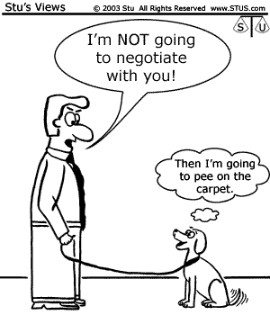

Slide 7
Cell Phones/Electronic Devices
Keep on silent/vibrate
This should not disrupt the class!
Should not a distraction to you or another student.
When I am teaching, I am expecting that you are engaged in what we are doing. Using your cell phone does not tell me this!
If I have given permission or directed you to use it
If cell phones become an ongoing issue, I will take them and you will have to address the issue with someone in the office.

Slide 8
Leaving the Room
Ask me, I will rarely say no unless we are in the middle of something!
You may be asked if you can wait
Generally speaking 5 minutes is enough time!
1 person at a time
When you are out of class you miss important details. Frequently leaving the class will need to be addressed.

Slide 9
Discussion
No need to yell
Respect people’s opinion
One voice at a time
Wait for someone to finish before you begin
Use hands when the teacher is talking

Slide 10
Other
When lessons are happening no headphones
IPads, computers etc. can be used for class purposes only.
When we are up out of our seats for activities be mindful of others and other people’s property.

Slide 11
The Non-Negotiables
Late/Attendance
Missing Assignments
Polite
Announcements

Slide 12
Late/Attendance
When the bell goes you must be in the class or you’re considered late.
The beginning of class is very important. It sets the tone for the rest of the class so be there or you will miss it.

Slide 13
Missing Summative Assessments
When students miss the due dates for legitimate reasons, I will consult with the student to set an absolute deadline and negotiate a plan for successful completion.
No extensions will be given to students without a legitimate reason.
If you sense you will need extra time talk to me early (I can be very nice ☺)

Slide 14
Polite
Be Respectful
Be polite. Your words can hurt people and your actions can impact others
Please and Thank you
Treat any materials, course references, and supplies well.
Put them back when finished with them

Slide 15
Announcements
Listen to the announcements
Or be quiet so others around you can hear them

Slide 16
Now it’s Time to Play…

Slide 17
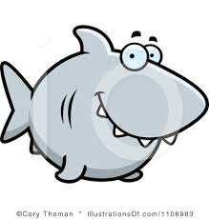
Why Oceans 11 is the most important science course you will take…
Ocean science is relevant and multidisciplinary:
Chemistry (Ocean acidification!)
Physics (waves and optics)
Biology (all the sea creatures ☺)
Affects our climate, weather systems, biodiversity, oxygen quality and quantity, carbon dioxide levels and much, much, more.

Slide 18
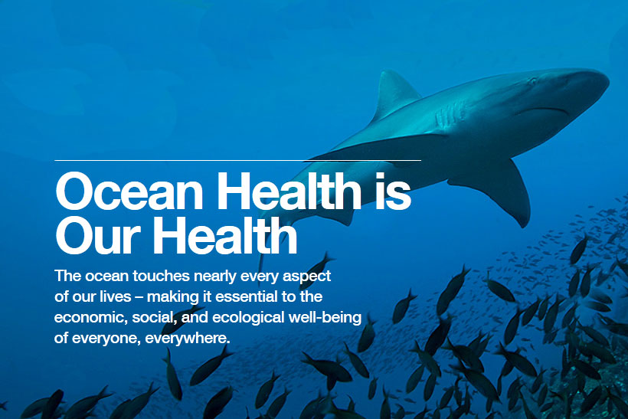
http://www.worldoceanobservatory.org/index.php?q=content/ocean-health-index

Slide 19
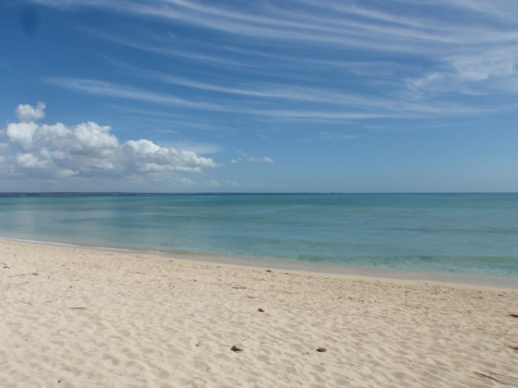
http://jamesintz.blogspot.ca/2012/08/mtwara.html

Slide 20
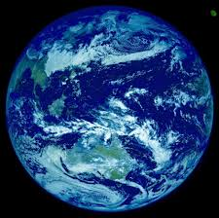
Why Oceans?
Oceans cover 71% of our Earth’s
surface
Integral to:
climate regulation
absorption of CO₂
providing food for billions of people.
Over ½ of global populations live in
coastal areas.

Slide 21
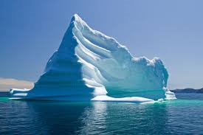
Did you know… Quick Facts!
The oceans contain 97 percent of the Earth's water.
Less than 1 percent is fresh water, and 2-3 percent is contained in glaciers and ice caps.

Slide 22
Did You Know…
Canada has the longest coastline of any country, at 56, 453 miles, approximately 15% of the world’s 372, 384 miles of coastline.
At the deepest point in the ocean the pressure is more than 8 tons per square inch, or the equivalent of one person trying to support 50 jumbo jets!

Slide 23
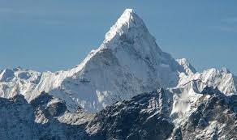
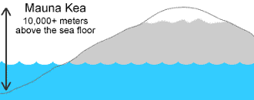
Did You Know…
Although Mount Everest, at 29, 028 feet, is often called the tallest mountain on Earth, Mount Mauna Kea, an inactive volcano on the island of Hawaii is actually taller.
Only 13, 796 feet of Mount Mauna Kea is visible above sea level, yet if measured from the ocean floor it stands 33, 465 feet.

Slide 24
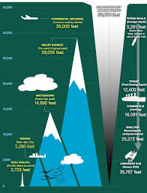
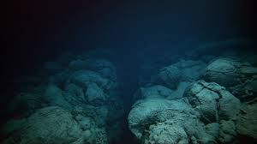
Did You Know…
The deepest part of the ocean Mariana’s Trench has a depth of 36, 201 feet.
If you put the tallest mountain in the deepest trench it would be underwater…

Slide 25
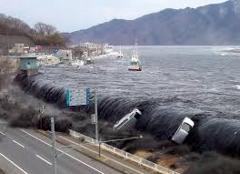
Did You Know…
Undersea earthquakes and other disturbances can cause tsunamis, or great waves.
The largest recorded tsunami measured 210 feet above sea level when it reached the shore of Siberia’s Kamchatka Peninsula in 1737.

Slide 26
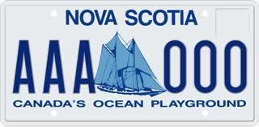
Why Study Oceans in Nova Scotia?

Slide 27
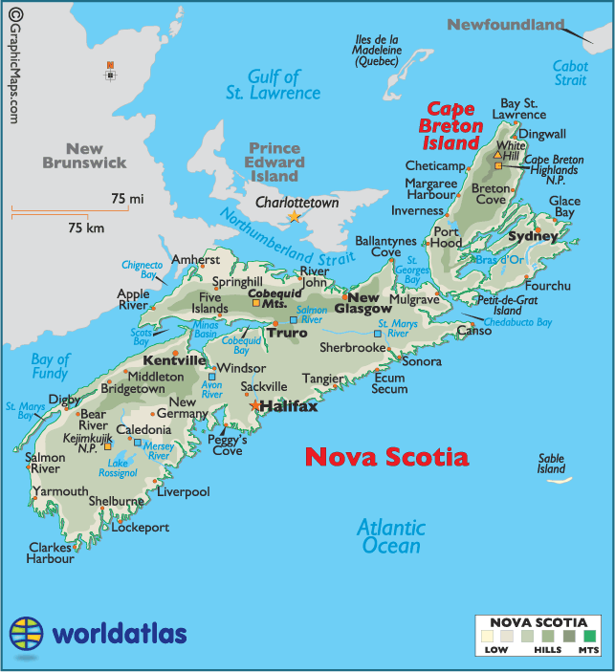

Slide 28
Why is this important in Nova Scotia?
70 % of residents live in coastal areas.
7,579 kilometers of coastline.
Oceans related industry and activities account for approximately 15.5% of the annual provincial GDP (approximately 5 billion dollars!!) and employ over 30,000 individuals.
Home to major universities and research centers, Nova Scotia has the highest concentration of PhD’s in ocean related disciplines in the world!

Slide 29
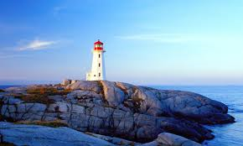

Slide 30
Why do YOU want to learn about oceans?
Write a reflection telling me why you want to learn about oceans.
You can tell me about a favourite memory involving the ocean
Maybe there is a career you are interested in?
Are you interested in freaky creatures that live 10,000 meters under the sea?
Maybe you love dolphins and whales!
Maybe you needed an extra science credit… (If this is the case tell me something you would like to learn, or something cool you learned today!)
This reflection should be between ½ – 1 page in length (single spaced).
This will be passed in tomorrow ☺

