Slide 1
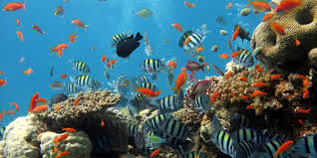
Dichotomous Keys

Slide 2
Dichotomous Keys
A dichotomous key is a tool that allows the user to determine the identity of items in the natural world based on the items characteristics
"Dichotomous" means
“divided into two parts” Greek origin
dichotomous keys always give two distinct choices in each step, often they are opposites
Black/white; wings/no wings

Slide 3
How to use a Dichotomous Key?
Here are creatures we don’t know!
Lets choose one
Notes:
3

Slide 4
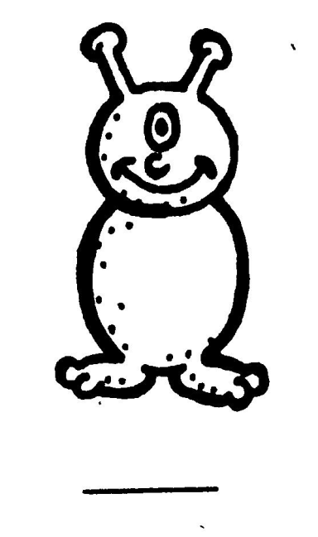
How to use a Dichotomous Key?
Choose only one creature at a time.
Notes:
4

Slide 5
How to use a Dichotomous Key?
Read steps 1a and 1b
Decide which statement is true
1b is true

Slide 6
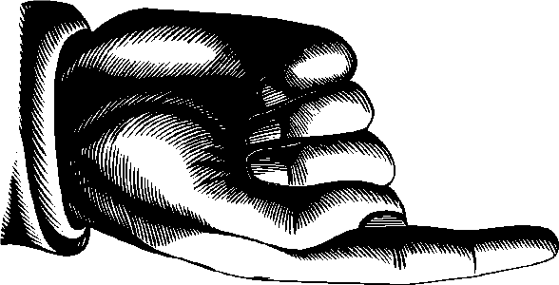
How to use a Dichotomous Key?
Then follow the directions after that step.
Go to step 5!

Slide 7
How to use a Dichotomous Key?
At choice 5, you make another dichotomous choice
5a is true
Go to step 6!

Slide 8
How to use a Dichotomous Key?
Keep going until you come to a step
that gives you the creature’s name.
6 a. The creature has one antennae Go to Step 7.
C

Slide 9
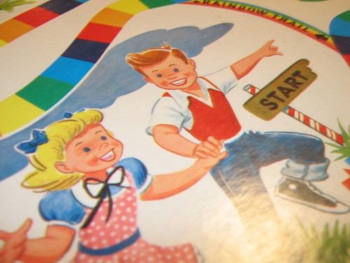
How to use a Dichotomous Key?
Choose a new creature and start at step 1a and 1b again. Continue until you find the creature’s name.
C
Where do you start Again?

Slide 10
Then, find the names of all the creatures
Complete the Norn Dichotomous Key
Notes:
10

Slide 11
What is a Cladogram?
A cladogram is a diagram which shows relationships among organisms.
A cladogram uses lines that branch off in different directions ending at a clade, a groups of organisms with a last common ancestor.

Slide 12
What is a Cladogram?
There are many shapes of cladograms but they all have lines that branch off from other lines.
The lines can be traced back to where they branch off.
These branching off points represent a hypothetical ancestor which is inferred to exhibit the traits shared among the terminal taxa above it.

Slide 13
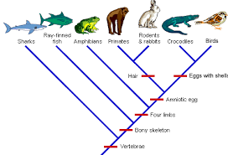

Slide 14
Go to the following site:
http://ccl.northwestern.edu/dtttl2009/LS_426_-_The_Design_of_Technological_Tools_for_Thinking_and_Learning/Past_Projects/Entries/2008/3/11_Here_is_a_project_title_files/TreeInteractive-02.swf
Watch the video on how to build a cladogram.
Then… Build your own cladogram ☺

Slide 15
Dichotomous Keys
Complete the shark dichotomous key assignment.

