Slide 1
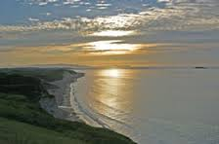
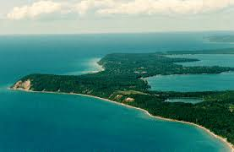
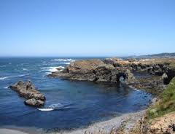
Coastal Zones

Slide 2
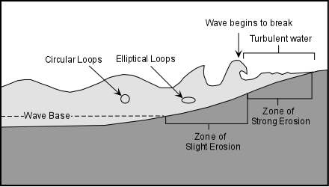
What is a Coastal Zone?
A coastal zone is the interface between the land and water.
These zones are important because a majority of the world's population inhabit such zones.
Coastal zones are continually
changing because of the dynamic
interaction between the oceans
and the land.

Slide 3
Subsystems of the Coastal Zone
The coastal zone is commonly considered to be composed of 3 subsystems:
Marine sub-system
Coast sub-system
Terrestrial sub-system
Each sub-system has its own characteristics, resources and problems.

Slide 4
Marine Sub-System
The marine sub-system consists of the oceanic component of a coastal zone.
Characteristics:
Water depth, salinity, and temperature
Wave and tide ranges
Water currents
Diversity of marine habitats
Resources:
Exploitation of fisheries, oil and gas, tourism and recreation,
Uses for navigation, transportation and waste discharge

Slide 5
Coast Sub-System
The Coast sub-system is a relatively narrow and dynamic transition zone between the marine and terrestrial sub-systems.
It includes the littoral zone (between low and high tide marks), and the supralittoral zone (salt water spray zone).
Characteristics:
Coastal profile (sandy beach, pebble beach, rocky shore)
Tidal regime, shore line topography, wind and wave regime
Resources:
Sand and gravel extraction
Exploitation for tourism and recreation, and forest resources
Uses for human settlement, port development, aquaculture, and land reclamation.

Slide 6
Terrestrial Sub-System
The Terrestrial sub-system consists of land where human or other activity can affect the marine environment.
Characteristics
Topography
Soil types
Surface water resources
Aquifer structure and groundwater resources
Resources:
Use of terrestrial and freshwater resources
Agriculture and aquaculture
Industry
Human Settlement

Slide 7
Coastline vs. Shoreline
Coast: Area of contact between land and sea—Extend inland until meets a different geographical setting
Coastline follows the general line of the coast(sometimes in the case of small inlets or bays the coastline is measured as running directly across, joining the coastline on the opposite side.)
Coastline is not measured as precisely as shoreline.
Shoreline: Precise boundary where water meets adjacent dry land.
The shoreline is the perimeter of the land along the water’s edge, measured to the closest exactness as possible. As a result shoreline is generally longer for a particular location.

Slide 8
Canada’s Coastline
Globally, Canada has the longest coastline of any country. The coastline includes the mainland coast and also the coasts of offshore islands.
The total length of Canada’s coastline is 243 042 km.

Slide 9
Complete the following…
Exploring Canada’s Coastlines
Complete questions 1 - 6
Types of Coastlines
Using the website provided fill in the chart

