Slide 1
Coastal Zones: Erosion

Slide 2
Coastline Vs. Shoreline

Slide 3
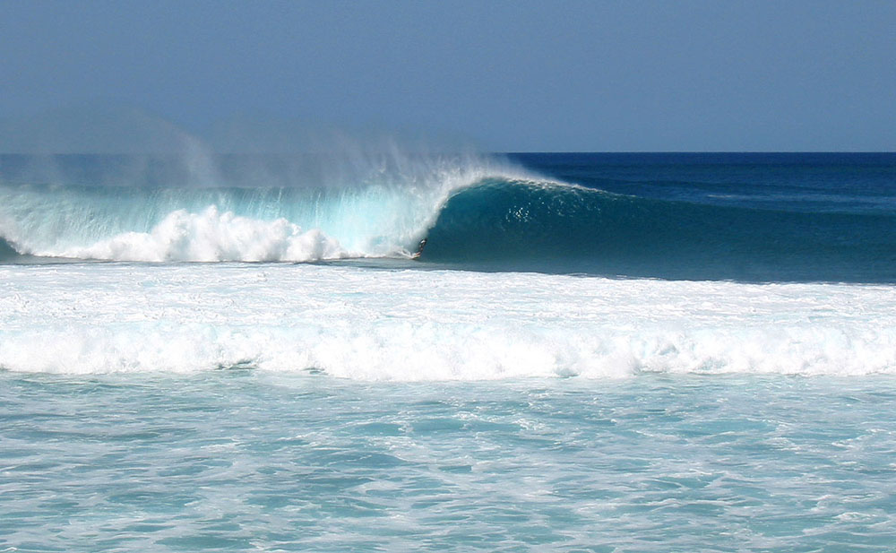
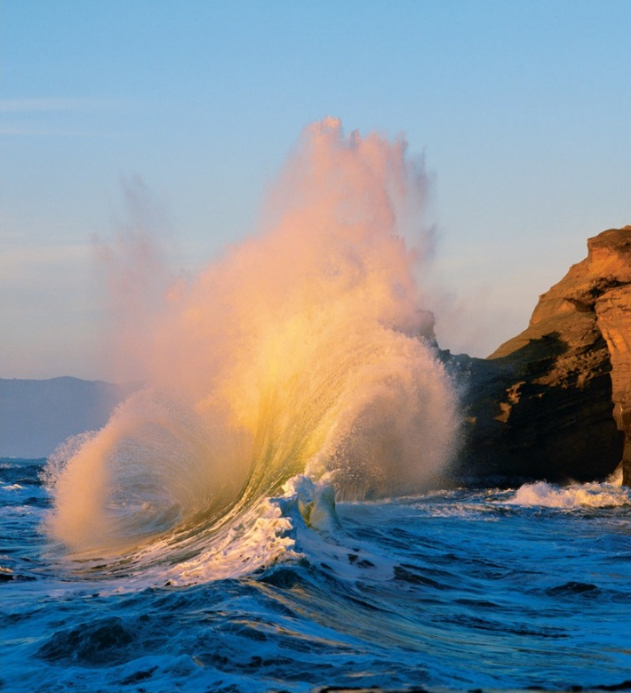
Shaping of Shorelines
Waves: transport energy by motion—ultimate source of wave energy is the sun
Longshore current: Current that parallels shoreline developed by waves coming in at an angle to shore.

Slide 4
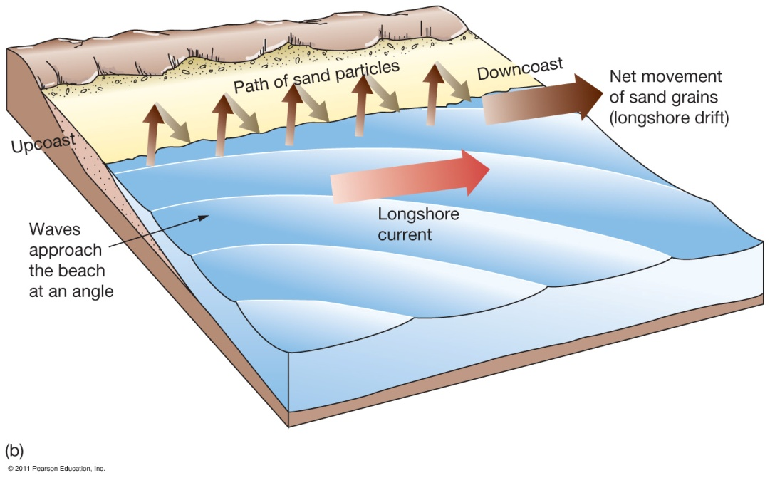
Longshore Currents
Parallel motion of water along shoreline
Caused by wave refraction(bending)
Causes zigzag motion of water in surf zone

Slide 6
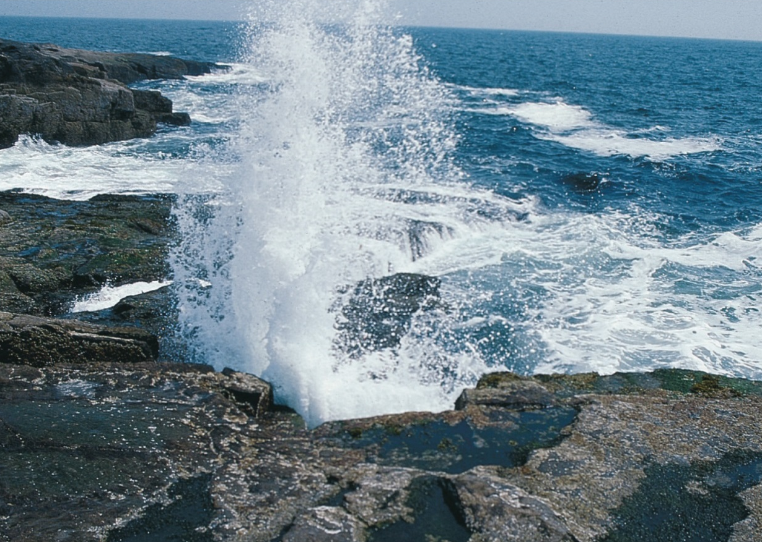
Coastal Erosion
Waves are dominant mechanism in coastal erosion—Water forced into cracks in rock at high pressures
Coastal Erosion is wearing away of land and the removal of beach or dune sediments by wave action, tidal currents, wave currents, drainage or high winds

Slide 7
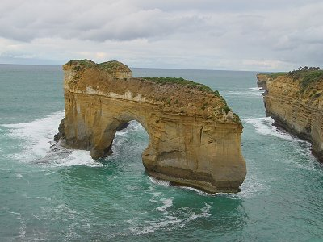
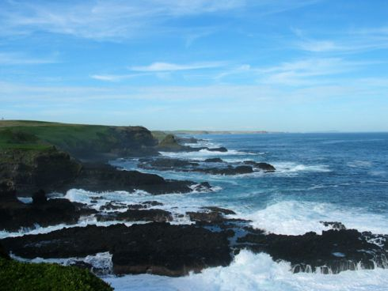
Coastal Erosion
Wave energy is focused on prominent points that jut out into deep water
attack the sides of points and form sea caves, sea arches, and sea stacks by undercutting them
Sea stack with sea arch in it

Slide 9
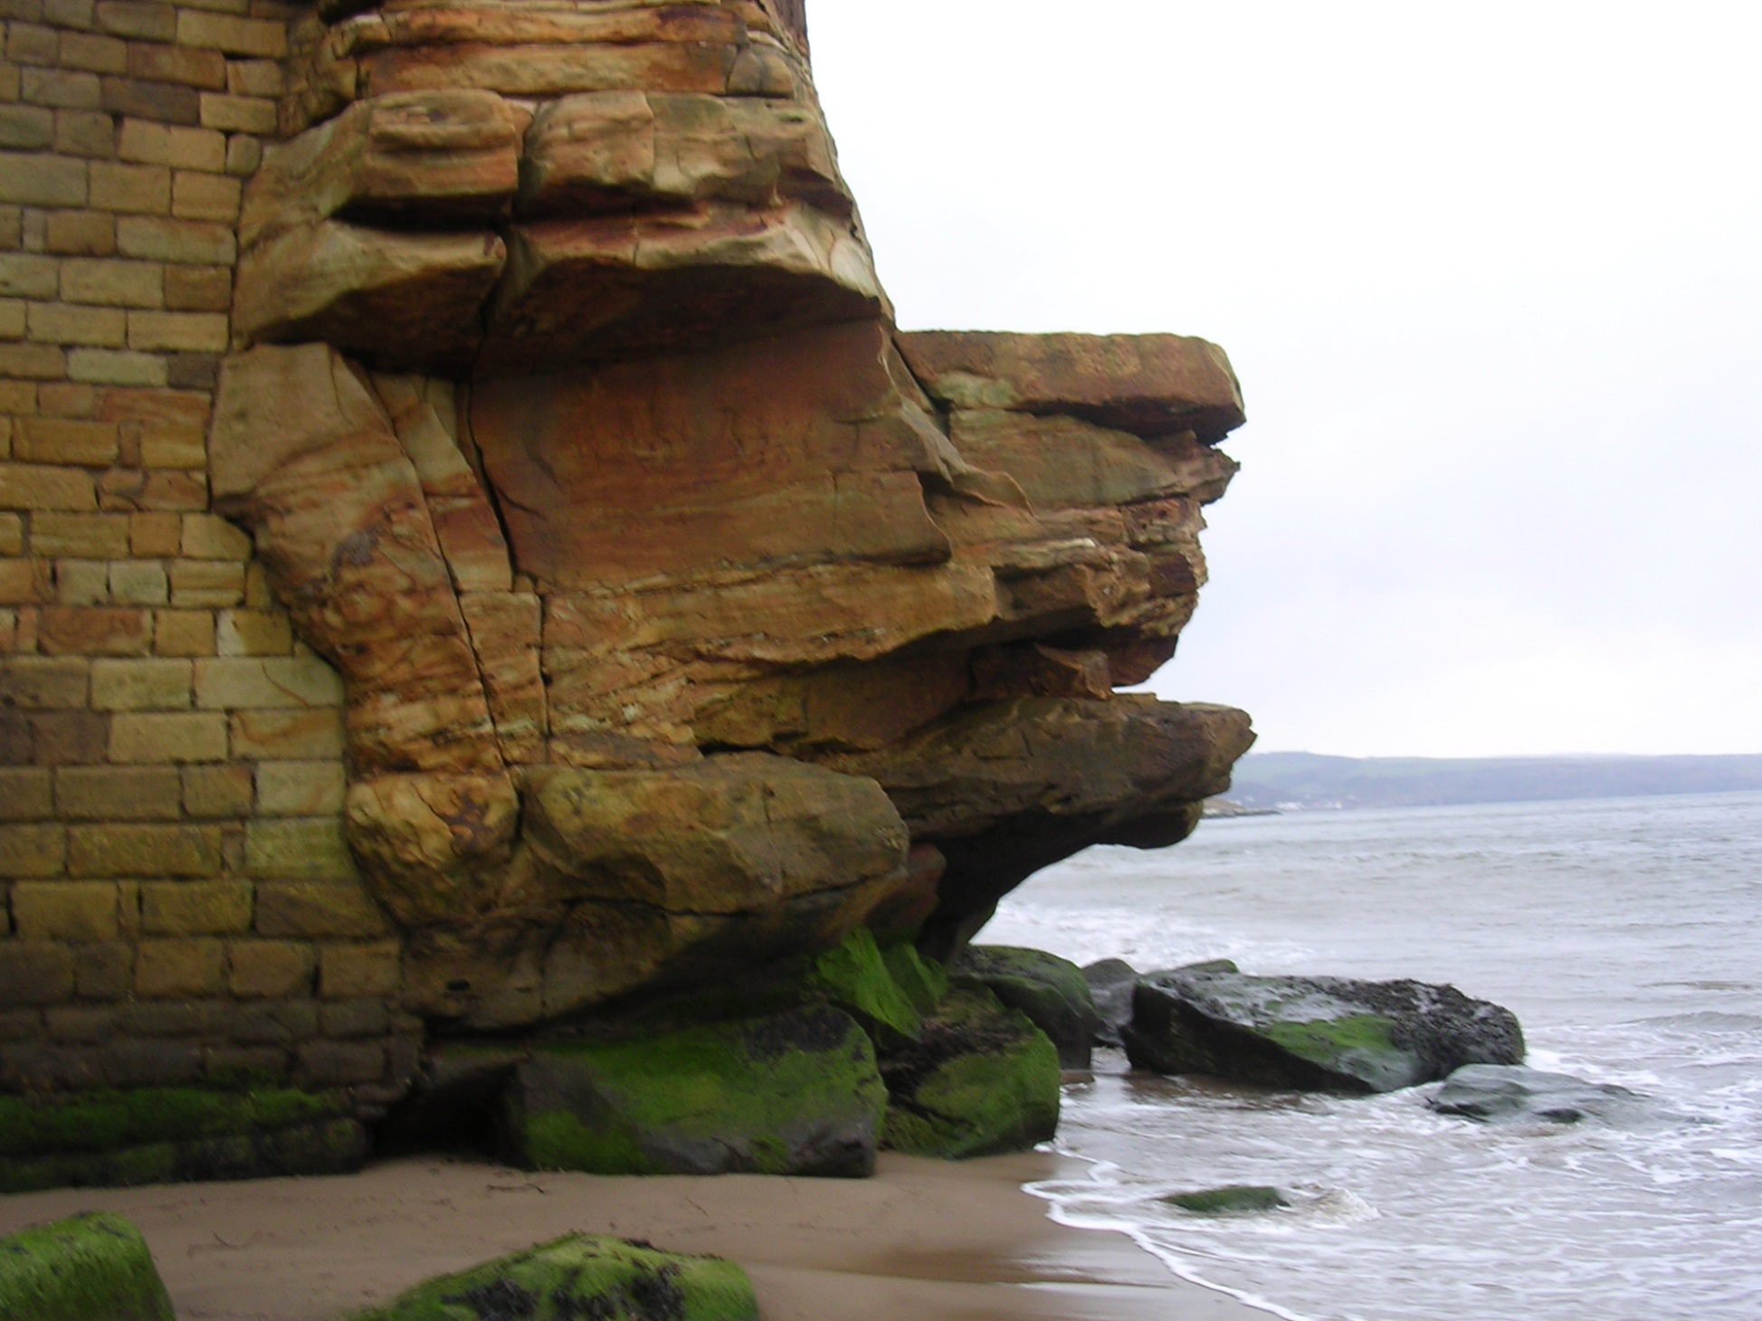

Slide 10
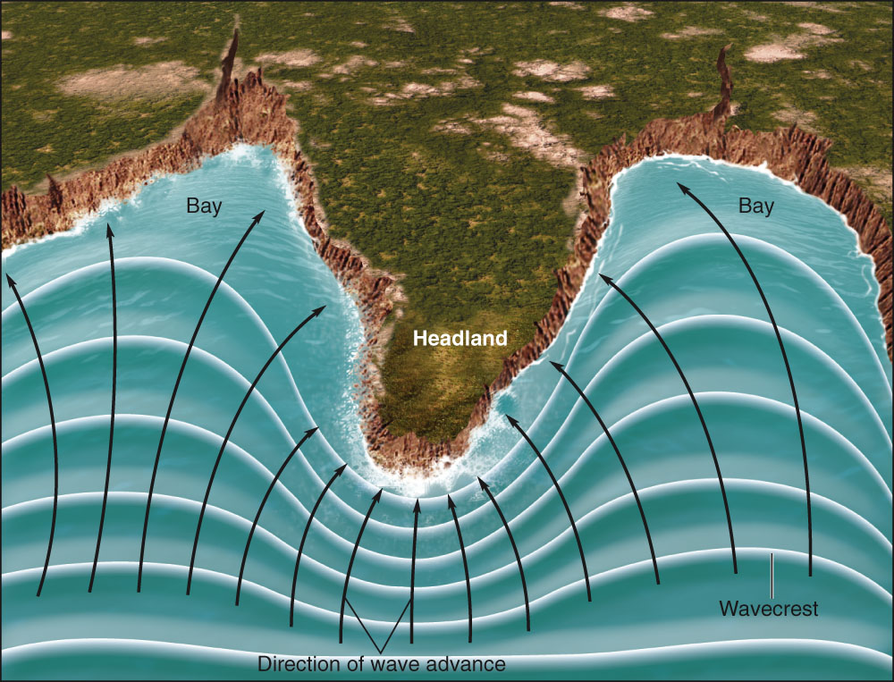
Shorelines Can Be Straightened by Erosion (Wave Energy)
Marine erosion is most rapid on high-energy coasts, areas battered by large waves. (erosionional shore)
Low-energy coasts are infrequently attacked by large waves. (deposional shore)

Slide 12
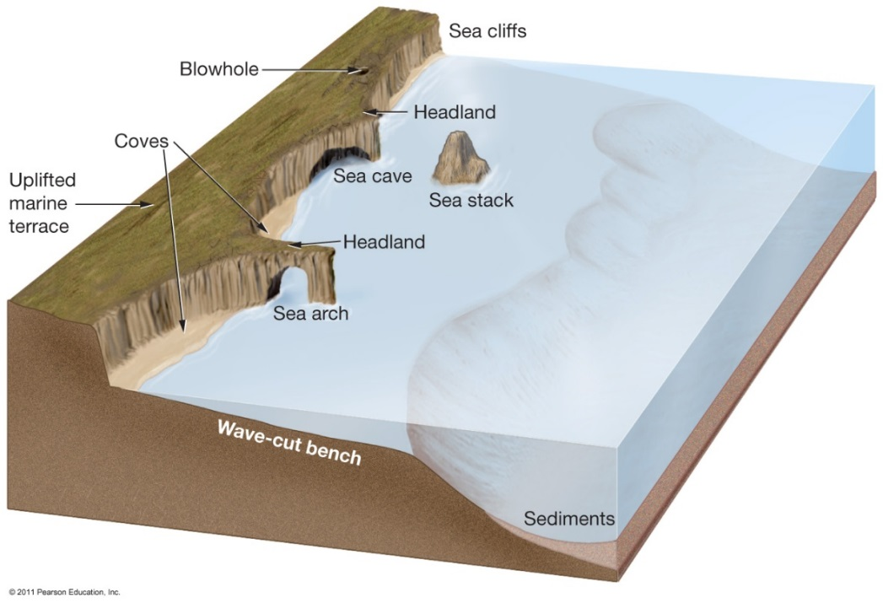
Erosional Shores-Features
Protruding bits of land called headlands absorb much wave energy.
Wave cut cliffs and sea caves are other features carved out by wave activity.

Slide 13
Erosional Shores
Sea arches form where sea caves in headlands erode all the way through.
Sea stacks form when the tops of sea arches erode away completely.
Bedrock uplift generates a marine terrace.

Slide 15
The Coast: Deposition

Slide 16
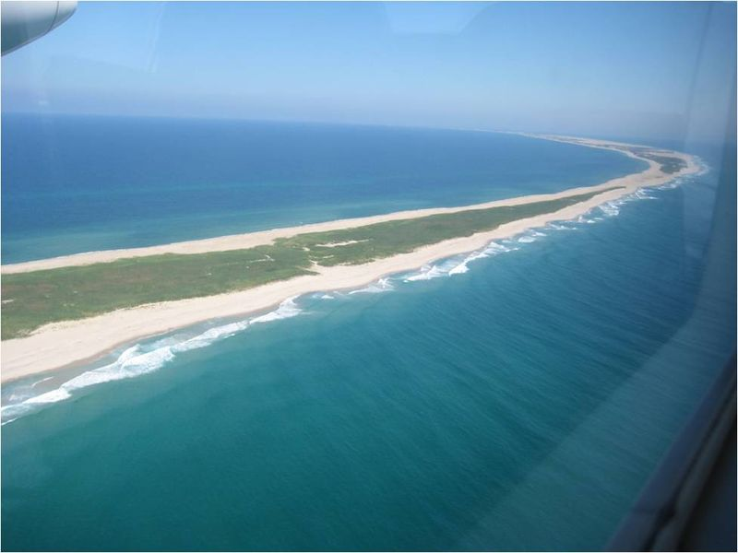
Depositional Shoreline Features
Common along East and coast of the North America
Coastal deposition is the laying
down of material on the coast by
the sea.

Slide 17
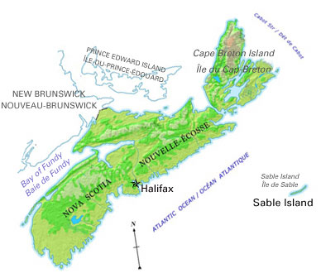

Slide 19
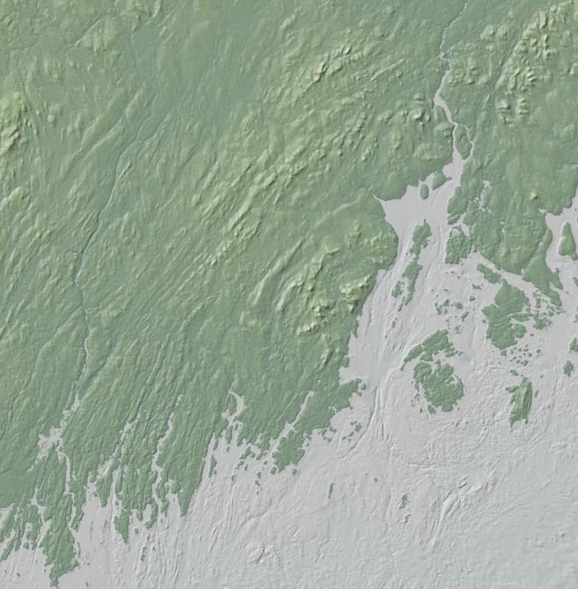
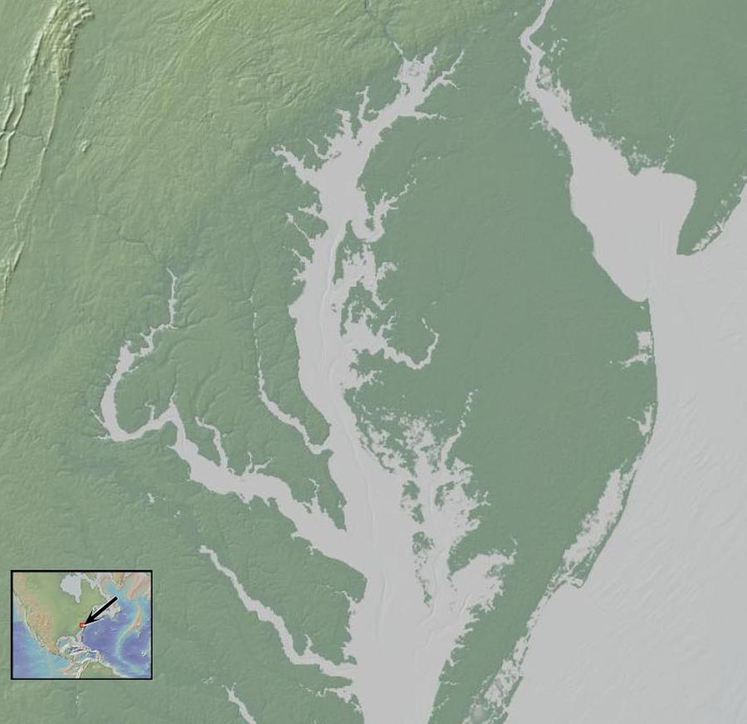
Types of coasts
Primary coast: Shaped by non-marine processes (glaciations, streams, etc.)—Usually a landscape drowned by rising sea level

Slide 20
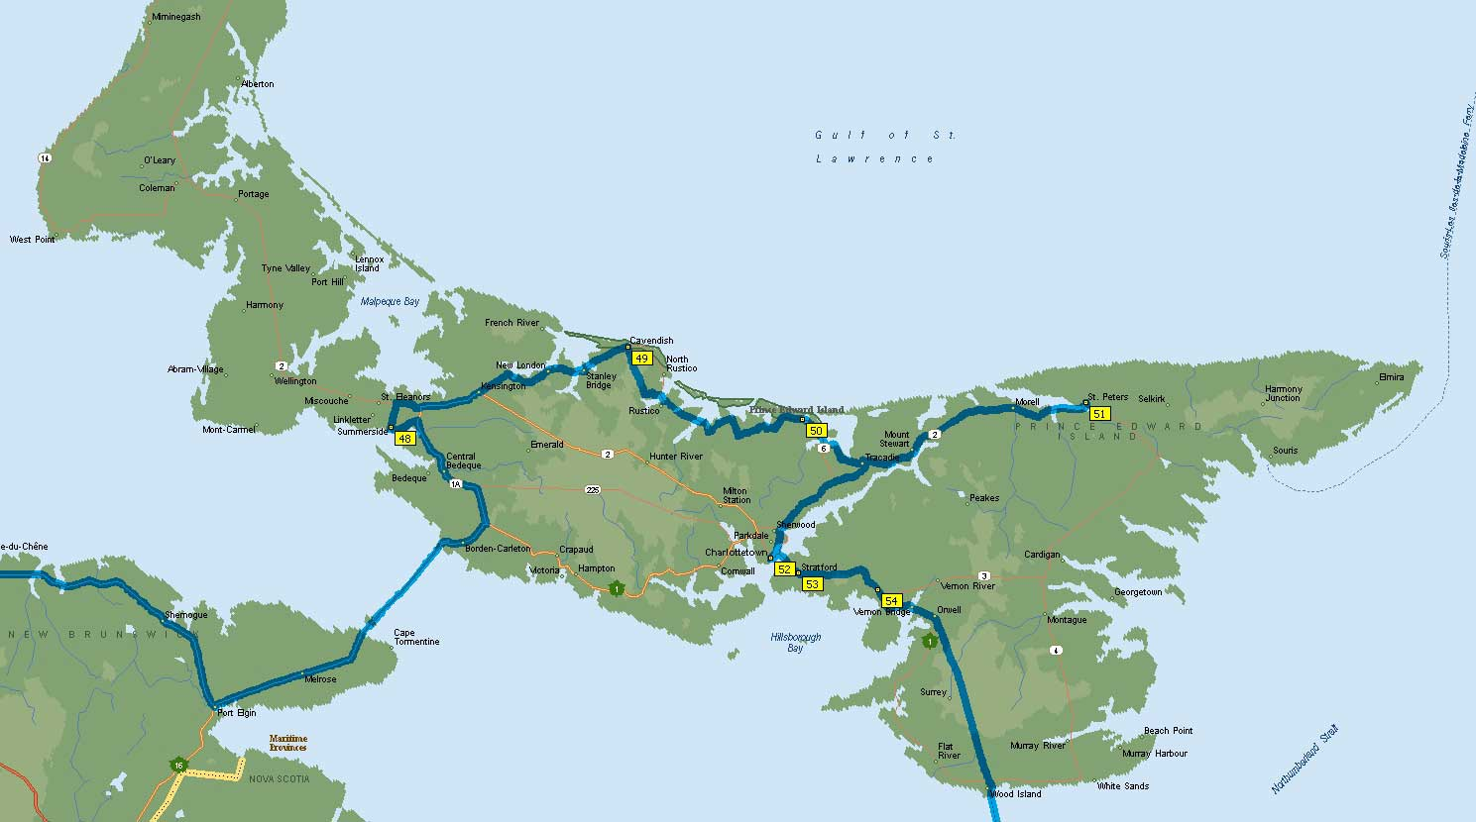
Types of coasts
Secondary coast: Shaped by coastal erosion and deposition
Primary coasts often have secondary coastal features

Slide 21
