Slide 1
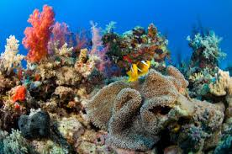
Marine Biomes

Slide 2
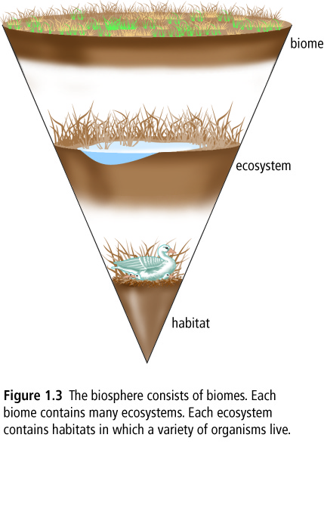
Biomes
A biome is a major, geographically extensive ecosystem, structurally characterized by its dominant life forms.
Most of the oceans are considered part of a single biome, although areas with particularly unusual or unique physical characteristics or inhabitants may be considered as separate ecosystems within the biomes.

Slide 3
World Oceans

Slide 4
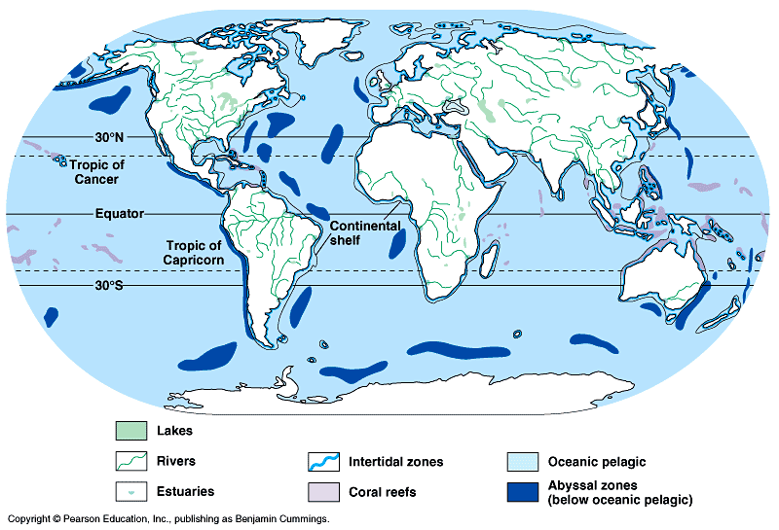

Slide 5
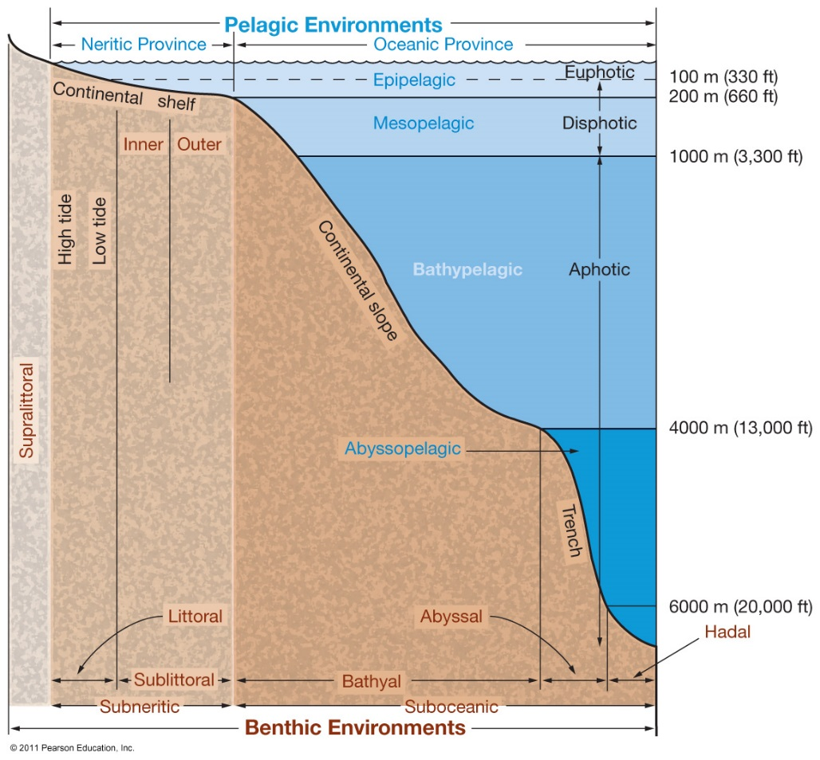
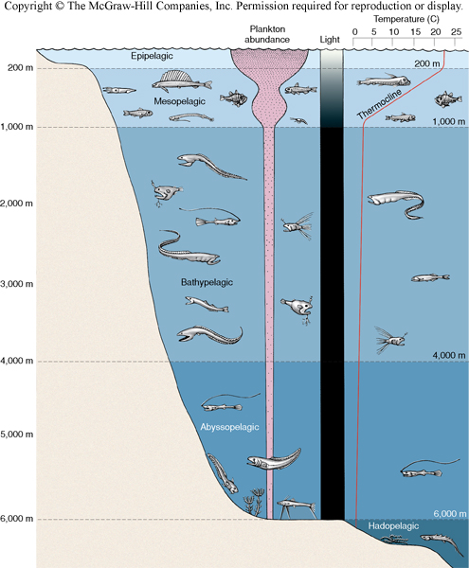

Slide 6
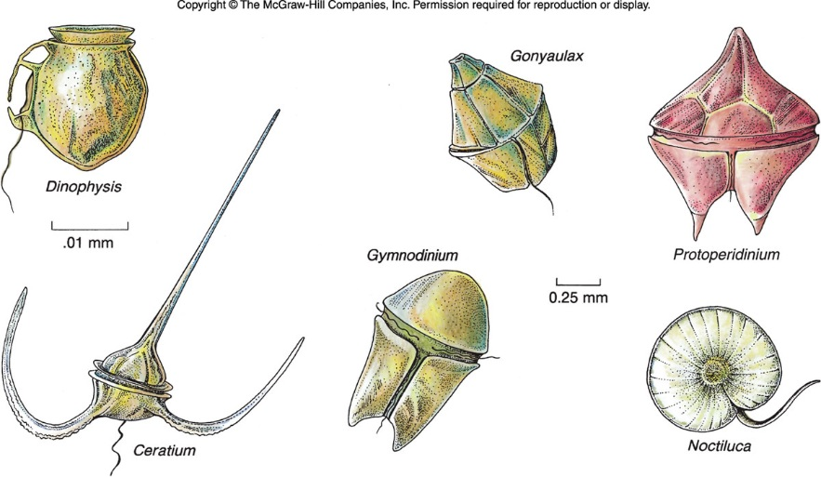
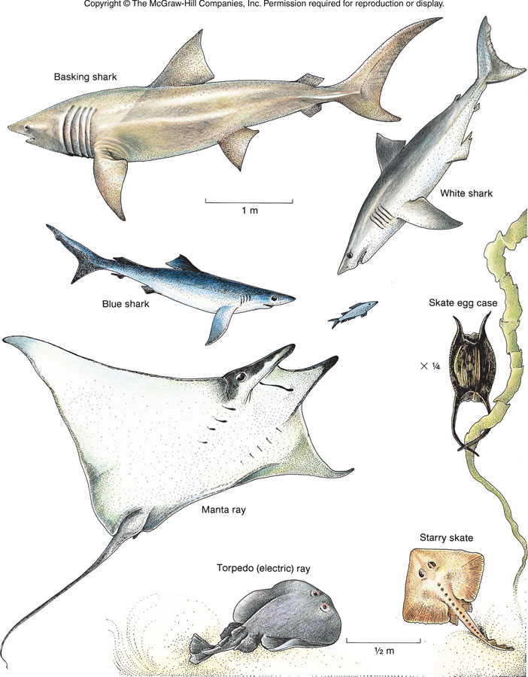
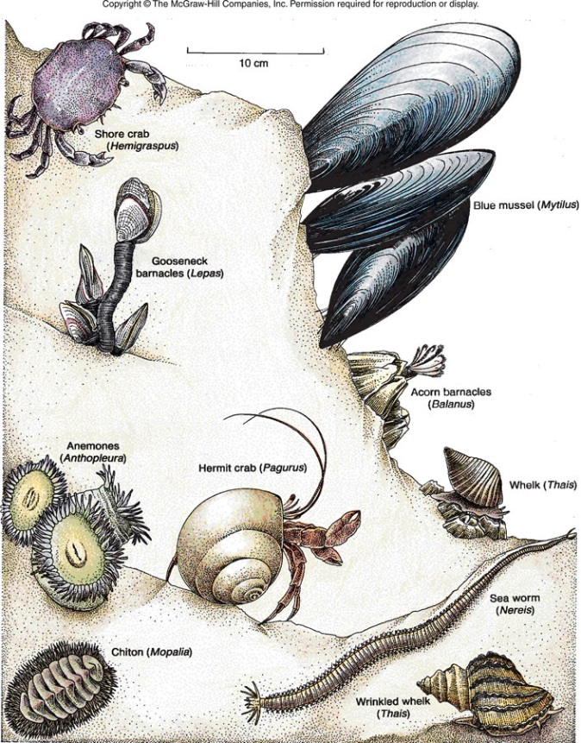
Classification of Marine Organisms
Plankton (floaters) [P]
Nekton (swimmers)[N]
Benthos (bottom dwellers)[B]

Slide 7
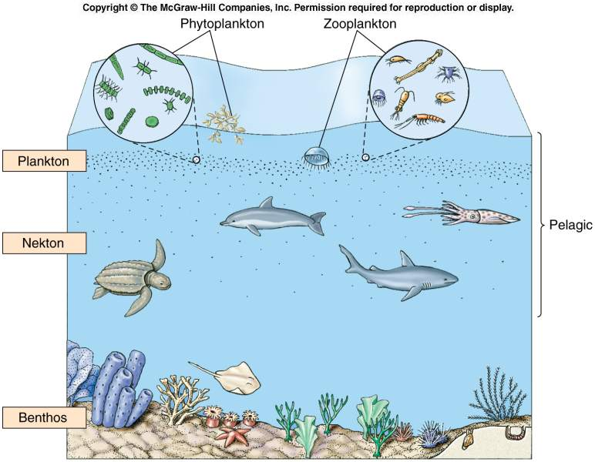

Slide 8
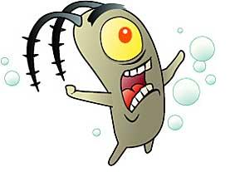
Plankton
Greek for “drifters”
Plankton is all plants or animals that drift with the ocean currents as inhabitant of the open waters of the ocean or sea
limited ability to move and can migrate vertically through the water from day to night.
Very diverse
http://www.ted.com/talks/the_secret_life_of_plankton?utm_source=newsletter_weekly_2012-04-03&utm_campaign=newsletter_weekly&utm_medium=email

Slide 9
Importance of Plankton
Plankton is very important as it occupies the first two or three links in the marine food chains.
Zooplankton are the animal members of the plankton ranging in size from bacteria size to 15 m jellyfish.
Phytoplankton are plant plankton and are the trees of the ocean.
They float near the surface to make the most of the sunlight for photosynthesis.
Their small size slows sinking,
Structure and shape slows sinking rate
Density decrease by storing droplets of oil in the cytoplasm.

Slide 10
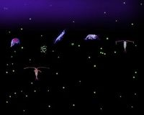
Plankton: Functional Groups
Phytoplankton
-autotrophic algae
-live near the surface…..why?
-diatoms, cyanobacteria, dinoflagellites
Zooplankton
-small crustations or other animals that feed on other plankton
-include eggs and larvae of larger animals
Bacterioplankton
-bacteria re-mineralize and decompose other plankton
AN ENTIRE COMMUNITY OF PLANKTON!

Slide 11
Types of Phytoplankton
There are 3 main types:
Diatoms
Dinoflagellates
Coccolithophores

Slide 13
Diatom
Are the most dominant and productive phytoplankton
Used in silver polish, toothpaste, and for filtering beers, wines, and juices
There may be up to 100,000 different species of diatoms.
Each species requires certain ecological conditions in order to survive.
Chemical | Physical
Nutrients pH Salinity | Temperature Light

Slide 15
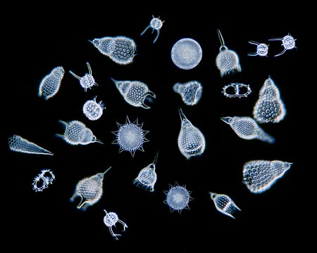

Slide 16
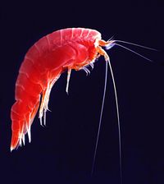
How much Plankton is there? And where is it?
Varies horizontally, vertically, seasonally
Light
-“All plankton ecosystems are driven by the input of solar energy”
-Geographic regions and seasons where light is abundant
-Surface Waters
Nutrients
-ocean circulation and stratification
-nutrients tend to be in deeper waters
Highest in Spring & Fall

Slide 17
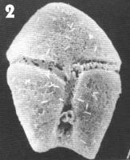
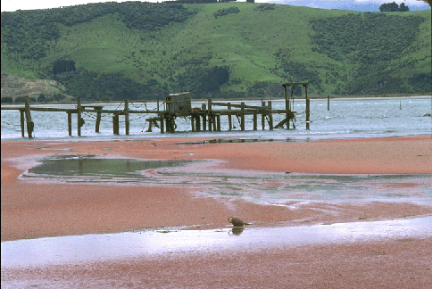
Dinoflagellates
Some Dinoflagellates cause “red tide” – they bloom so extensively that the water looks red
Some release a neurotoxin that is stored in certain shellfish and causes Paralytic Shellfish Poisoning (PSP) in humans when shellfish are eaten
Red tide

Slide 18
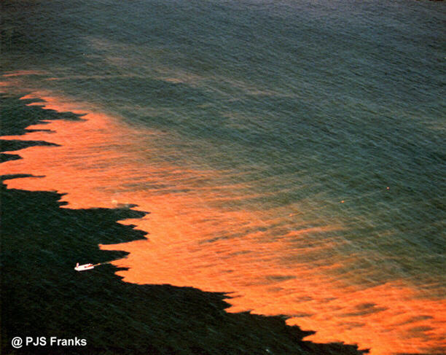
Red Tides
An algae “bloom” of dinoflagellites

Slide 19
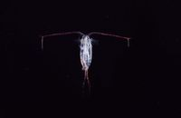
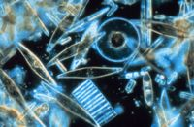
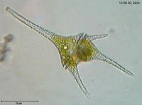
A Copepod: the largest animal biomass on earth
Brings carbon to the deep sea
Diatoms: unicellular, eukaryotic algae. Cell wall made of silica, two symmetrical sides with a split between them
A Dinoflagellite

Slide 20
Benthic
Organisms resides primarily in or on the bottom of the ocean and don't swim or drift for extended periods of time.
They burrow, crawl, walk (motile) or are permanently affixed to the ocean bottom or each other.
Demersal organisms: flounder swimming and rest on the bottom
Epifauna: live all of the time on the bottom of the ocean
Infauna: live under or within the bottom of the ocean

Slide 22
Nekton
Cephalopods (squids), fishes, marine mammals, sea turtles and marine birds
Many are carnivores or herbivores without natural predators.
Planktivorous nektons: are animals that feed directly on plankton such as baleen whales and some fish.
Herbivorous nektons are ones that feed on large seaweeds and sea grasses (turtles and manatees).
Carnivorous nekton are the dominant carnivorous animals of the pelagic environment and generally these animals migrate great distances in search of food. Use fins, jets of water, strong flippers, flukes and flippers to swim through the water.

Slide 25
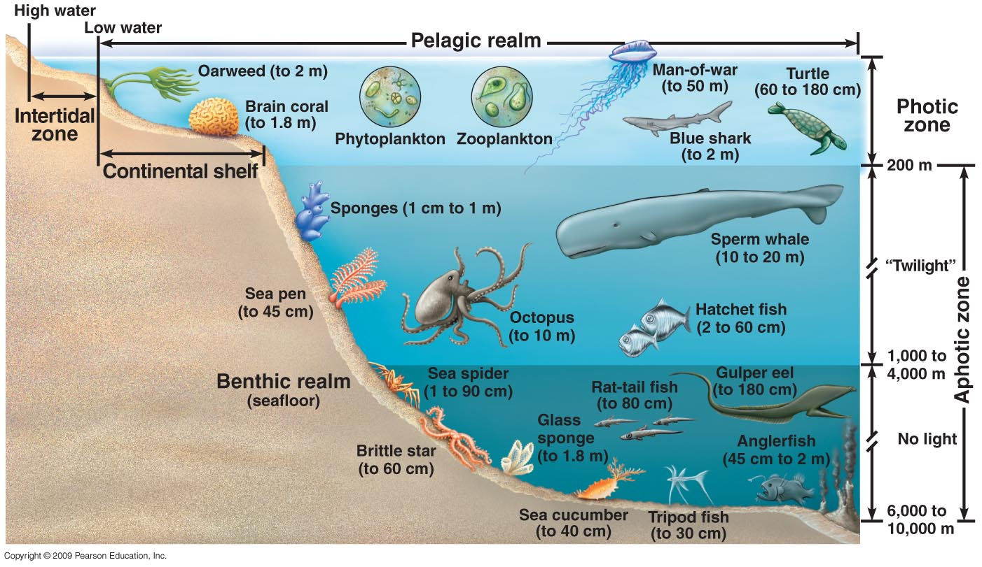

Slide 26
HABs: Harmful Algal Blooms
Harmful algal blooms, sometimes referred to as “red tides,” are mostly caused by single celled algae called phytoplankton (not all are red, and not all red blooms are harmful!)
Harmful algae are a small subset of species that negatively affect human, animal, and ecosystem health and coastal resources through the production of potent chemical toxins (algal toxins) or the build up of excess biomass.

Slide 27
Impacts of HABs
Human Health Impacts:
Effects can range from neurological impairment to gastrointestinal distress to respiratory irritation, in some cases resulting in severe illness and even death.
Animal Health Impacts:
Massive fish kills are most common. Algal toxins have also been associated with deaths of whales, manatees, sea lions, dolphins, sea turtles, birds and invertebrates.
Environmental Impacts:
Degrades ecosystem health by forming large and dense blooms. These blooms alter habitat quality through overgrowth, shading, oxygen depletion, or accumulation on beaches.
Socioeconomic Impacts:
Can be very costly! Just one major HAB event can cost local coastal economies tens of millions of dollars, translating to a much larger nationwide impact.

Slide 28
Algal Explosion!
You will be playing the role of either a fish or an algae.
Algae: You are trying to make it to the other side of the room without being “eaten” (tagged)
Fish: You are trying to “eat” (tag) ONE piece of food.
If an algae gets eaten, they will show their token to the fish.
If the token has an X the algae is toxic. The fish dies and both players become algae in the next round.
If the token does not have an X the algae becomes a fish in the next round.

Slide 29
Algal Explosion Questions
Explain what happen to the fish population that caught algae with X tokens? What happened to the algae?
Describe some long term effects of this (Think about the various impacts; human, animal, environmental, socioeconomic!)
If plankton are so important to the ocean, why can algal blooms be so detrimental?
One of the biggest concerns is the lack of oxygen. Describe how algal blooms cause this and why this is a big issue for fish (fish don’t need oxygen… do they?)

