Slide 1
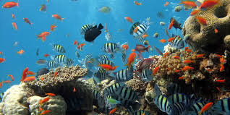
Classification of Life

Slide 2
Classification
Why do we need to classify things?
Why do scientists need a standardized way to classify things?
What do we need to look for when we classify objects?

Slide 3
Why do we need a classification system?
There are over 8.8 million different species known on Earth.
Scientist are still discovering new species.
  thousands of new marine species are discovered every year!
http://marinebio.org/oceans/coral-reefs/

Slide 4
Why Classify?
Developed by scientists to bring order to the great diversity of life forms.
Provides a logical naming system.
Newly discovered organisms may be grouped.
Identify organisms
Represent relationships among organisms.

Slide 5
Classification of Living Things:
Taxonomy: The science that deals with the classification of living things.
Unity: Similar characteristics among organisms which group them together. (how organisms are similar)
Diversity: Different aspects between organisms that place them into different groups. (how organisms are different)

Slide 6
Key Terms continued…
Species: A group of organisms, alike in many ways that can interbreed under natural conditions to produce fertile offspring.
Genus: A group of similar species.
Top Ten New Species!

Slide 7
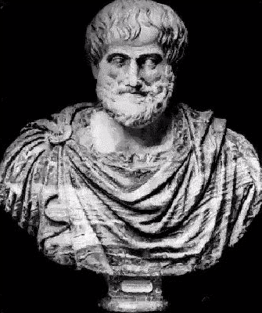
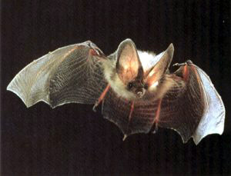
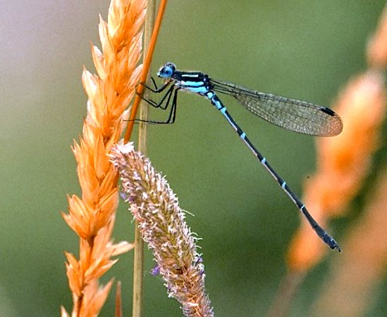
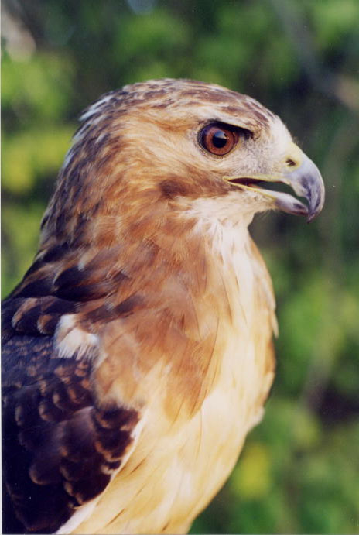
Early Classification Systems
Aristotle, a Greek philosopher (384-322 BC.) observed and grouped over 500 different animals. He grouped them according to where they lived;
Animals...
Land dwellers air dwellers water dwellers
What are some problems with this system?!
  Bats, birds and dragonflies are both ‘air dwellers’, yet they are not related. They are mammals, avians and insects respectively.
Today, we know that hawks, ostriches and penguins are all birds, but Aristotle classified them as land, water and air dwellers.
The invention of the microscope and increased world travel led to the need for a more effective classification system.

Slide 8
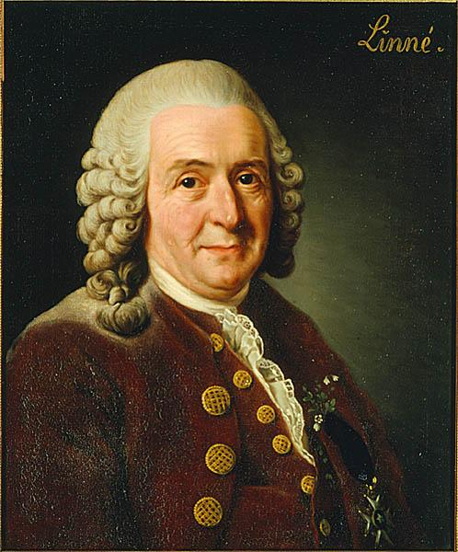
Binomial Nomenclature...a better method of classification
Carolus Linnaeus (1707-1778)
He developed a classification system based only on structural characteristics.
He is the father of modern taxonomy!
Linnaeus recognized that the more features that an organism has in common, the closer their relationship.
Without realizing it, Linnaeus was also grouping organisms according to their evolutionary history or phylogeny.
*** Linnaeus incorrectly viewed species as unchanging.

Slide 9
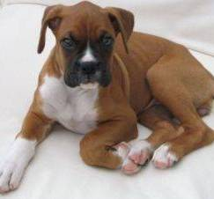
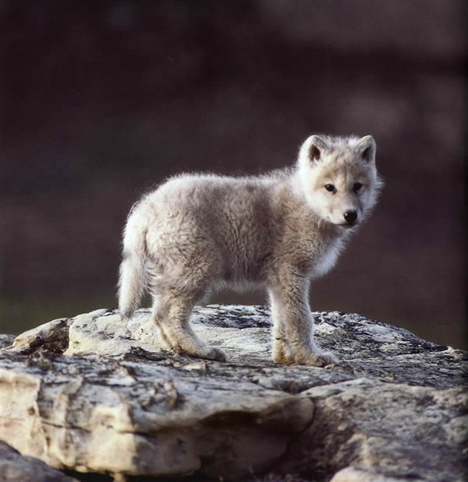
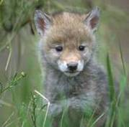
...Binomial Nomenclature
Linnaeus used a two name system for assigning names to organisms.
This is known as binomial nomenclature.
  Two word Latin name. Latin is a dead language (unchanging)
  The first name is the genus (a noun)
  Second name is the species (an adjective) within the genus.
  Genus and species are given together to constitute the species name of an organism. Genus may be indicated with first initial, but only if it is understood.
Examples:
  Canis familiaris (dog)
  C. lupus (wolf)
  C latrans (coyote)
Note that this system shows a connection between dogs, wolves, and coyotes.
Genus is capitalized. Species is lower case.
https://www.youtube.com/watch?v=F38BmgPcZ_I

Slide 10
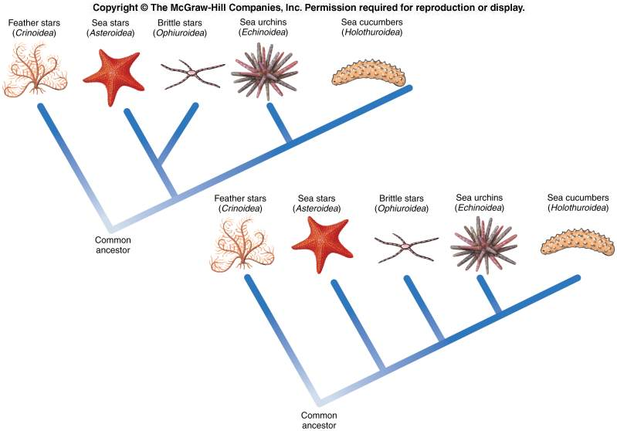
Classification
Is
Tricky…

Slide 11
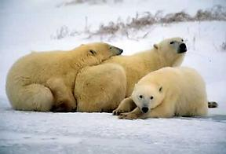
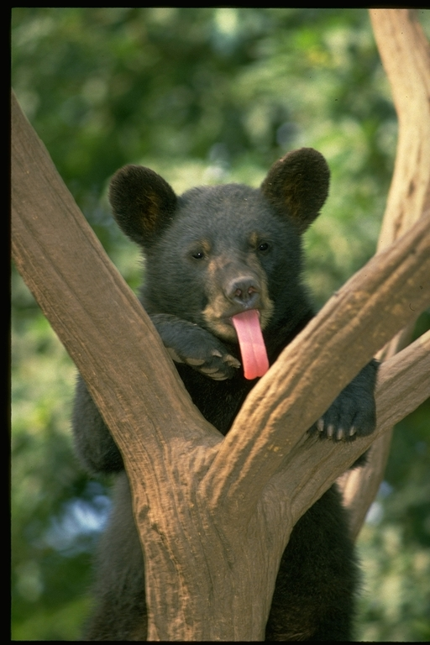
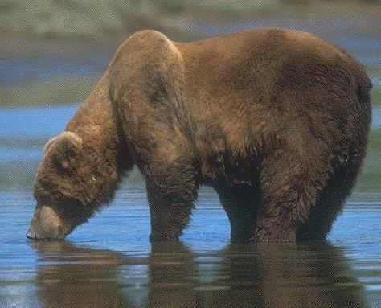
Advantage 1: Binomial Nomenclature indicates similarities between organisms.
Example:
Genus: Ursus, meaning bear
U. maritimus
U. americanus
U. horribilis

Slide 12
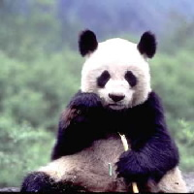
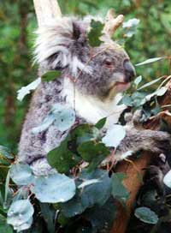
Ailuropoda melanoleuca Phascolarctus cinereus
Fooled you…
not bears at all…

Slide 13





Some organisms were named a long time ago. Since then more information has been gained and now we realize they were not named correctly.
Ex: Seahorse

Slide 14
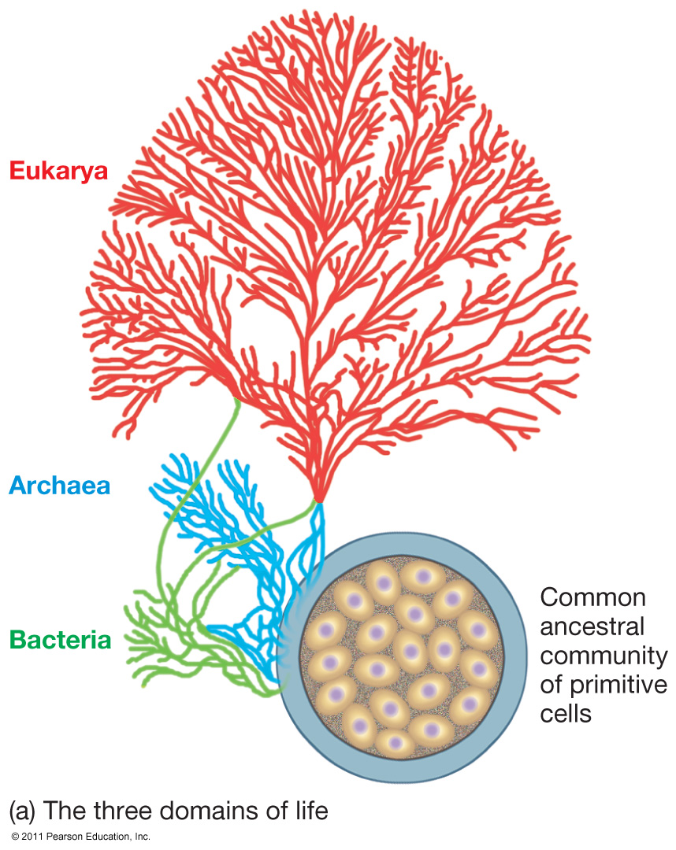
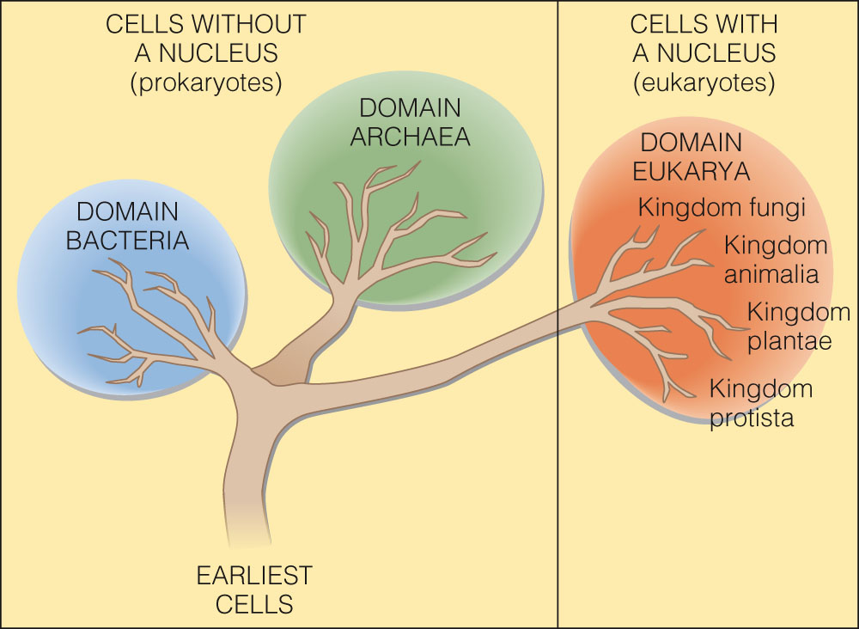
Classification of Life
Three domains
  Archaea
  Bacteria
  Eukarya

Slide 15
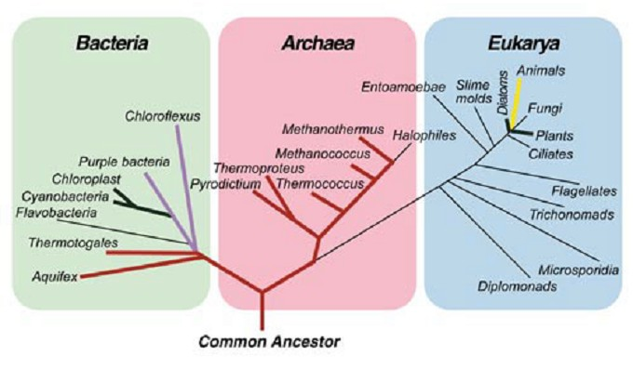
Three Kingdom Classification System

Slide 16
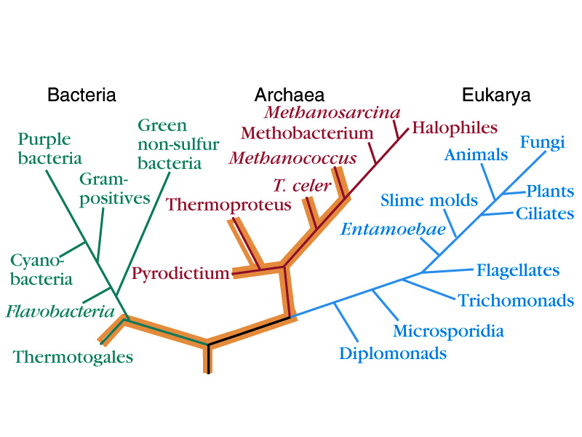

Slide 17
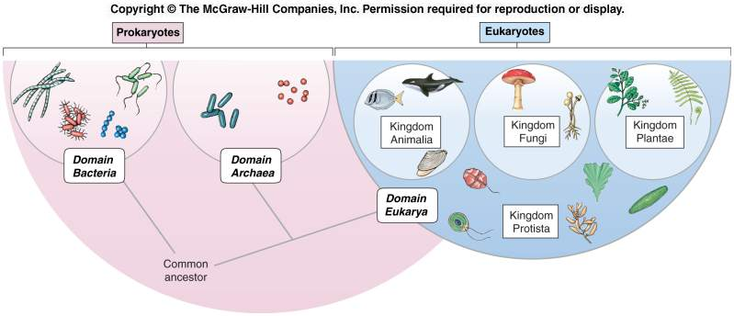

Slide 18
Bacteria and Archaea
The Bacteria and Archaea contain single-celled organisms without nuclei or organelles; they are called prokaryotes.

Slide 19
Eukarya
The fungi, protists, animals, and plants contain organisms with cells having nuclei and organelles; they are called eukaryotes.

Slide 20
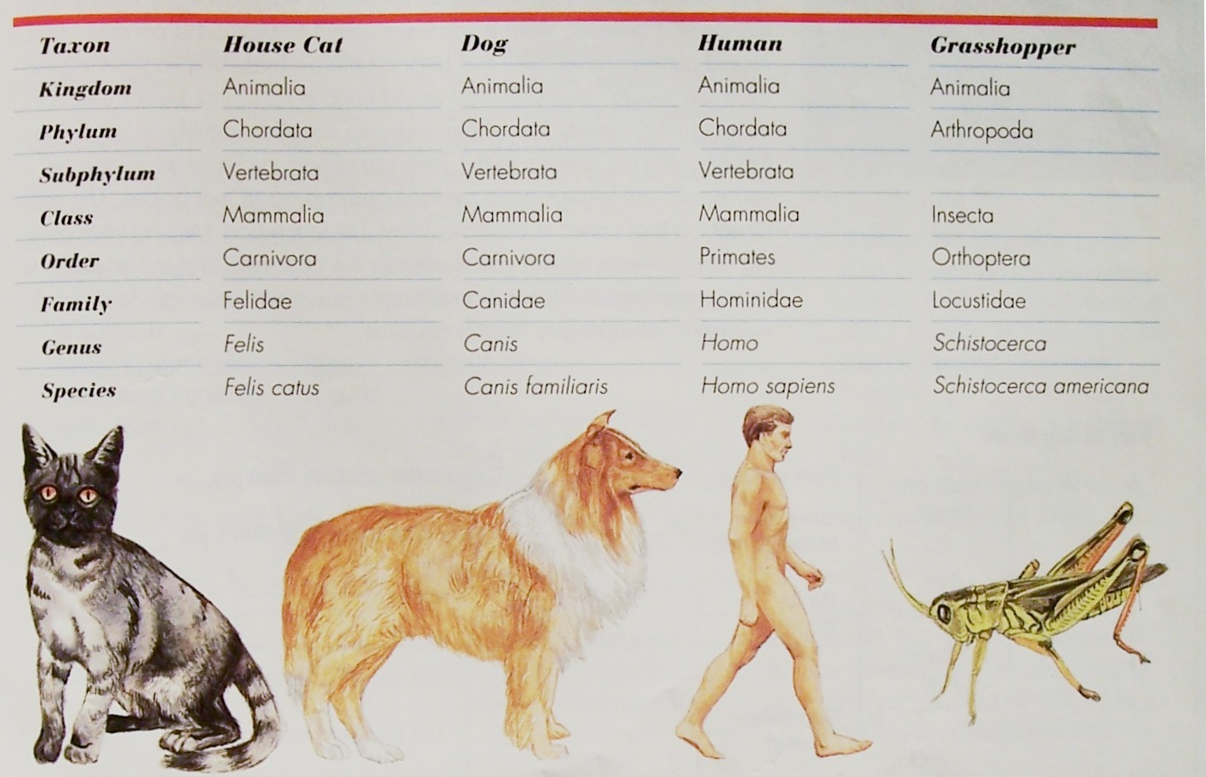
Classification of Sample Animals

Slide 21
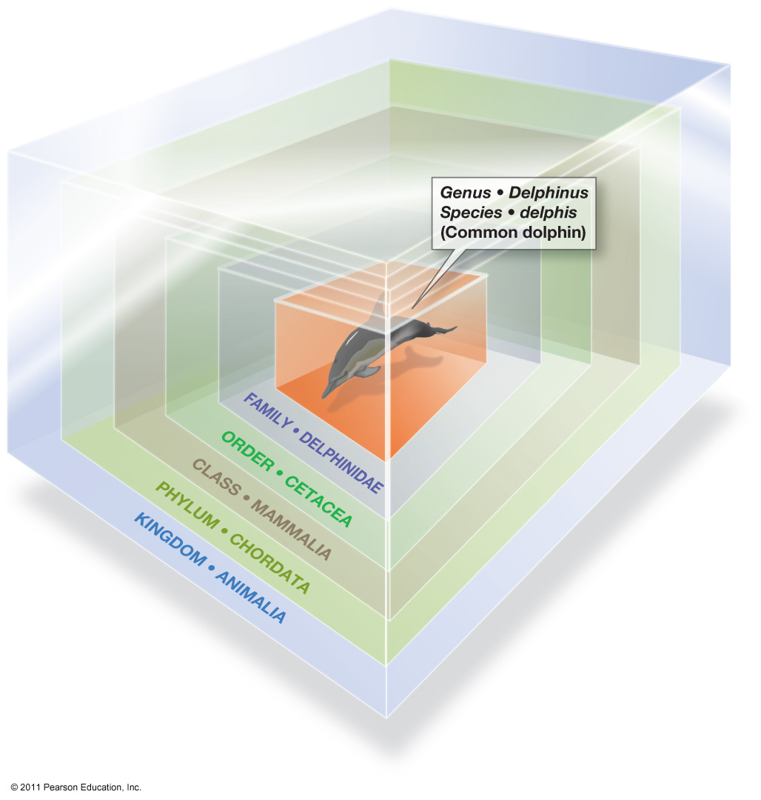
The Seven Taxa
Scientist place organisms into different taxa; the more taxa the organisms have in common the more closely related they are!
  Kingdom
  Phylum
  Class
  Order
  Family
  Genus
  Species
    Fundamental unit
    Population of genetically similar,
    interbreeding individuals

Slide 22
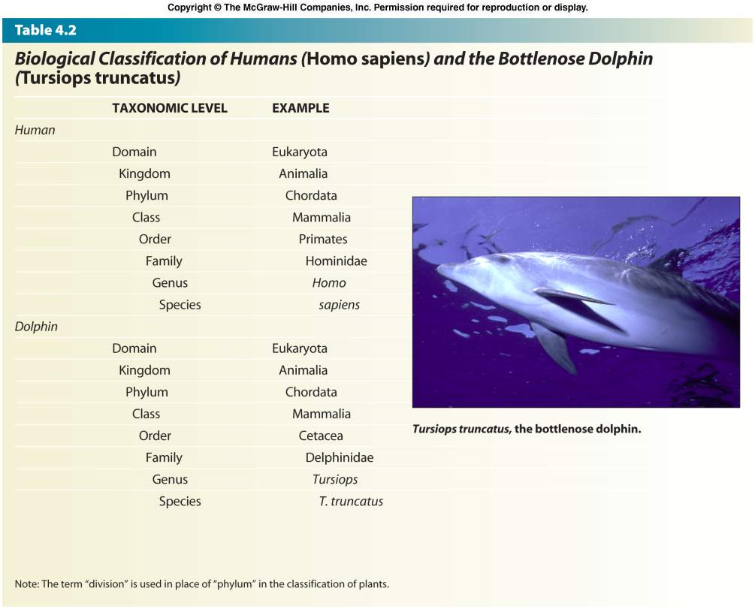

Slide 23
Classification Examples
Organism | Tulip | Amoeba | Giant Sea Kelp
Kingdom | Plantae | Protista | Protoctista
Phylum | Magnoliophyta | Protozoa | Phaeophyta
Class | Lilliopsida | Rhizopoda | Phaeophyceae
Order | Liliales | Amoebida | Laminariales
Family | Lilliaceae | Amoebidae | Lessoniaceae
Genus | Tulipa | Amoeba | Macrocystis
Species | primulina | proteus | pyrifera

Slide 24
Classification Assignment
Classifying Whales
  Activity 9.1.1 (pages 332-333 Biology 11 Text Book)
Classification Questions (Worksheet)

Slide 25
Using a Classification Key
The Key
(a) Baleen plates (b) Teeth | Go to 2 Go to 4
2. (a) Dorsal fin (b) No dorsal fin | Go to 3 Bowhead whale (Balaena mysticetus)
3. (a) Long pectoral fin (b) Short pectoral fin | Humpback whale (Megaptera novaeangline) Blue whale (Balaenoptera musculus)
4. (a) No dorsal fin (b) Large dorsal fin | Go to 5 Killer whale (Orincus orca)
5. (a) Small nose (b) Large projection from nose | Go to 6 Narwhal (Mondon monoceros)
6. (a) Mouth on ventral surface (underside) of head (b) Mouth at front of head | Sperm whale (Physeter macrocephalus) Beluga (Delphinapterus leucas)
1. What are the 4 characteristics used to classify whales?
2. Why might Biologists use a key?
3. Provide an example of when a biologist might use a key to classify whales.
4. Make a list of other characteristics that could be used to classify whales.

Slide 26
Dichotomous Keys
A dichotomous key is a tool that allows the user to determine the identity of items in the natural world based on the items characteristics
"Dichotomous" means
        “divided into two parts” Greek origin
  dichotomous keys always give two distinct choices in each step, often they are opposites
    Black/white; wings/no wings

Slide 27
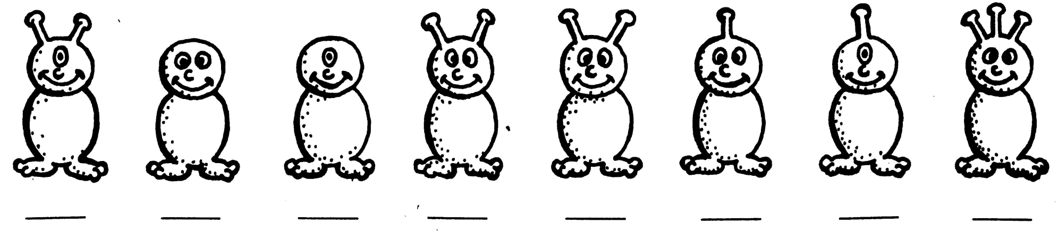
How to use a Dichotomous Key?
Here are creatures we don’t know!
Lets choose one
Notes:
27

Slide 28


How to use a Dichotomous Key?
Choose only one creature at a time.
Notes:
28

Slide 29



How to use a Dichotomous Key?
Read steps 1a and 1b
Decide which statement is true
1b is true

Slide 30

How to use a Dichotomous Key?
Then follow the directions after that step.
Go to step 5!

Slide 31
How to use a Dichotomous Key?
At choice 5, you make another dichotomous choice
5a is true
Go to step 6!

Slide 32


How to use a Dichotomous Key?
Keep going until you come to a step
that gives you the creature’s name.
6 a. The creature has one antennae Go to Step 7.
C

Slide 33



How to use a Dichotomous Key?
Choose a new creature and start at step 1a and 1b again. Continue until you find the creature’s name.
C
Where do you start Again?

Slide 34
Then, find the names of all the creatures
Notes:
34

Slide 35
Five Kingdoms of Organisms
Monera
  Simplest organisms, single-celled
  Cyanobacteria(make their own food), heterotrophic bacteria, archaea
Protista
  Single- and multicelled with nucleus
  Algae, protozoa
Fungi
  Mold, lichen

Slide 36
Five Kingdoms of Organisms
Plantae
  Multicelled photosynthetic plants
  Surf grass, eelgrass, mangrove, marsh grasses
Animalia
  Multicelled animals
  Range from simple sponges(invertebrates) to complex vertebrates

Slide 37
