Slide 1
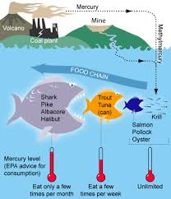
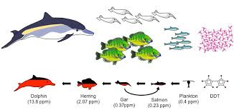
Bioaccumulation and Biomagnification

Slide 2
Bioaccumulation and Biomagnification
Bioaccumulation is a process in which materials, especially toxins, are ingested by an organism at a rate greater than they are eliminated.
Biomagnification is the increase in the concentration of a toxin as it moves from one trophic level to the next.

Slide 3
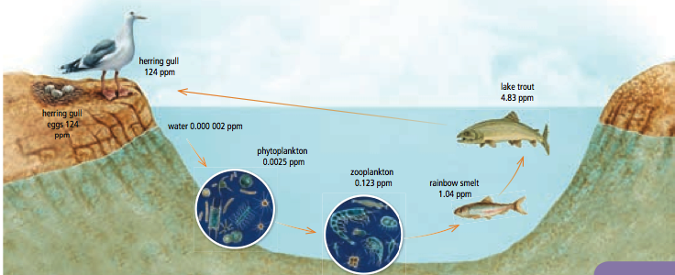
Biomagnification

Slide 4
Persistent Organic Pollutants (POP’s)
POP’s are a group of toxic chemicals sharing 4 common properties:
Highly toxic
Persistent in the environment
Travel long distances globally
Bioaccumulation in humans and wildlife

Slide 5
The Dirty Dozen

Slide 6
How does this affect us?
Greatest health problems at top
DDT → is an agricultural insecticide that was once used in North America
PCB → was previously used in industries.

Slide 7
The Ocean: Toxic Soup
The ultimate destination for most persistent anthropogenic substances → THE OCEAN
Substances with long residence times can
cause serious harm to biota
(all living things in the ocean!!!)
Substances can interact:
Plastics are known to adsorb hydrophobic pollutants,
increasing toxicity.

Slide 8
Biomagnification occurs when contaminants that don’t easily degrade increase with each link of a food chain.
In seawater, these persistent molecules stick to small particles and phytoplankton. Small fish eat the phytoplankton, but the contaminants can’t be broken down and are absorbed, intact, by the fish. When small fish are eaten by larger predators, the process repeats again and again, up the food chain.
Each subsequent predator receives a higher dose than the previous one. Animals at the top of the food chain, such as dolphins, receive the most concentrated dose of these contaminants with every meal.

Slide 9
Biomagnification Webquest
Go to the following website:
http://oceanexplorer.noaa.gov/edu/learning/player/lesson13/l13la1.html
Complete the activity and answer questions a – f.

Slide 10
Biomagnification Mystery
Go to the following Web site:
http://web.uvic.ca/~leckers/webquesteasy.html
Read through the Introduction and the Task.
Select one of the Biomagnification “Mysteries” and complete the questions associated with it.

