Slide 1
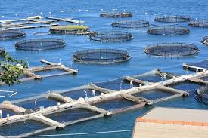
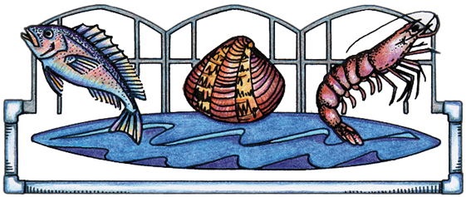
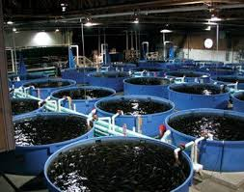
What is Aquaculture?

Slide 2
Photograph by HBOI

Slide 3
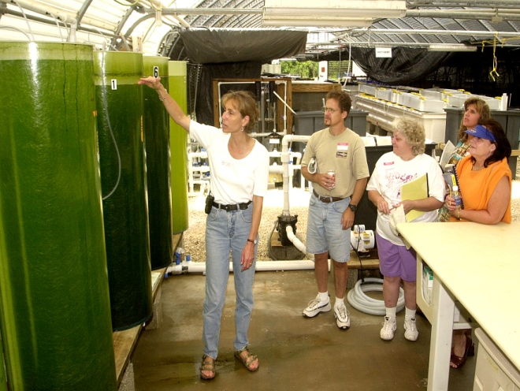
Mariculture
Photograph by HBOI
The husbandry marine organisms
(the care, cultivating and breeding of crops and animals)

Slide 4
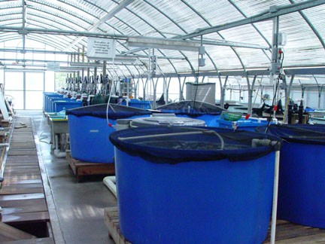
Aquaponics
Photograph by HBOI
The husbandry of animals and plants together

Slide 5
Aquaculture is Agriculture
The husbandry of freshwater and marine organisms is no different than their terrestrial counterparts.
Engineering, nutrition, health management, system and personnel management, marketing and business planning are comparable.

Slide 6
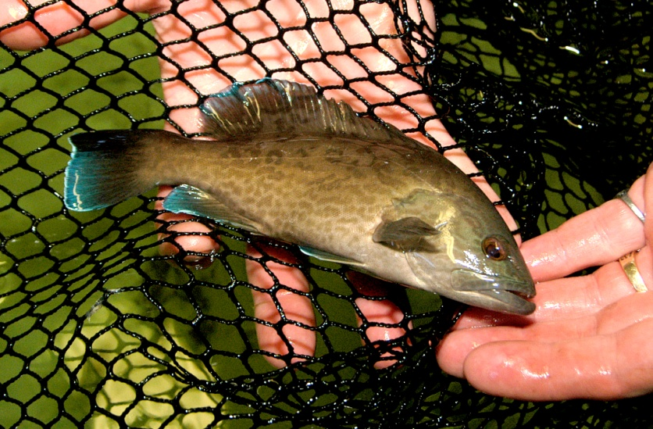
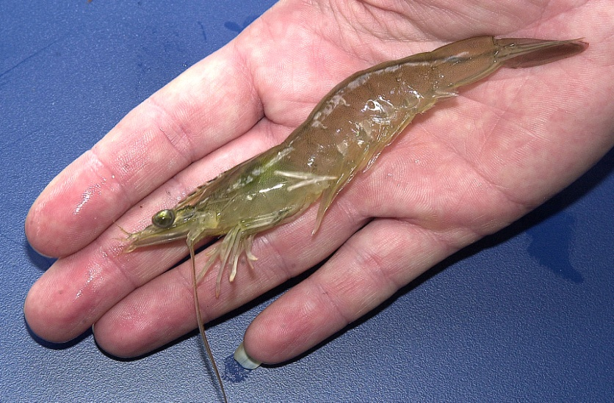
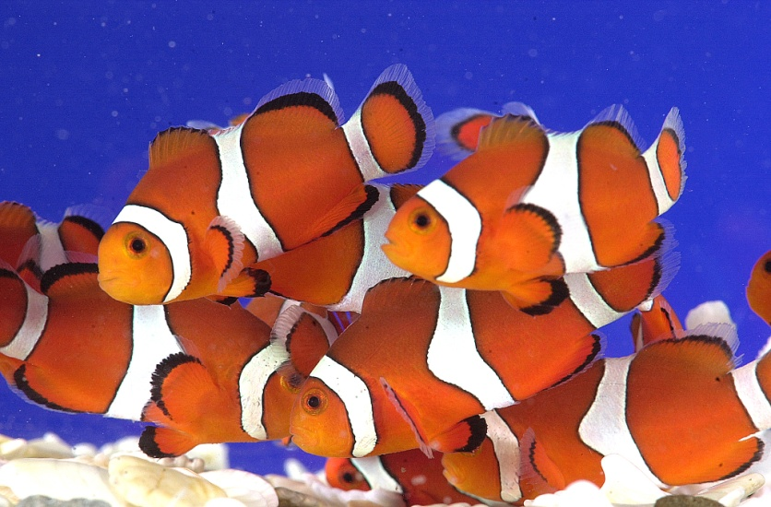
Photograph by HBOI
Photograph by HBOI
Fisheries stock enhancement
Bait production
Photograph by HBOI
Photograph by HBOI
Ornamentals
Biomedical

Slide 7
How many of you eat seafood?
About 40% of the seafood we eat is from aquaculture farms
Aquaculture production in North America is valued at $1.5 billion

Slide 8
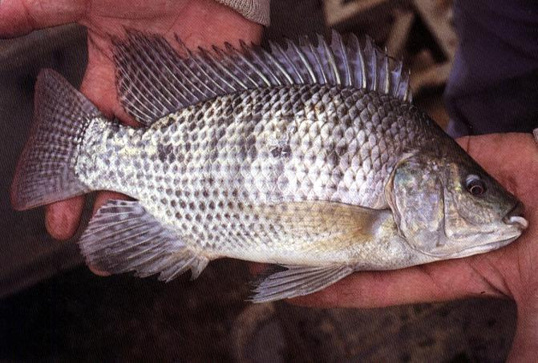
Commercially Cultured Species
Catfish
Tilapia
Trout
Salmon
Striped Bass
Oysters
Clams
Shrimp
Photograph by HBOI

Slide 9
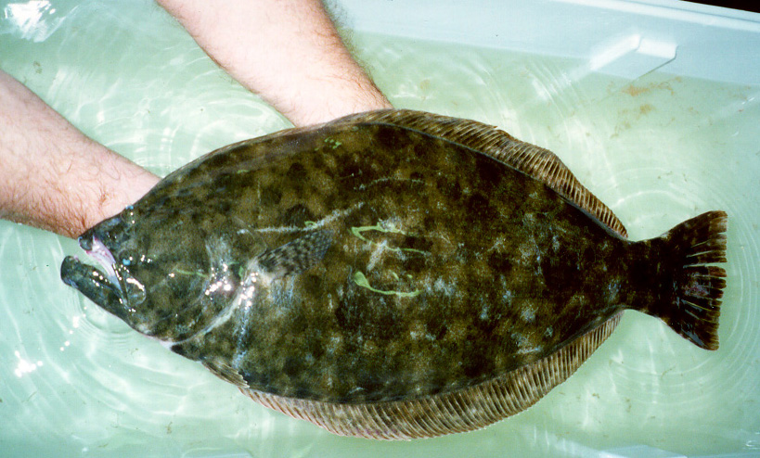
Research and Development Species
Snapper
Cobia
Flounder
Pompano
Sturgeon
Tuna
Conch
Lobster
Photograph by HBOI

Slide 10
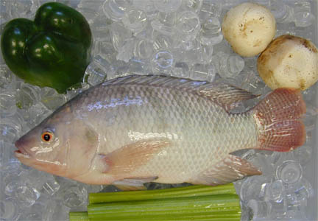
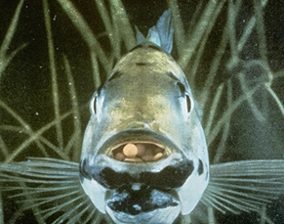
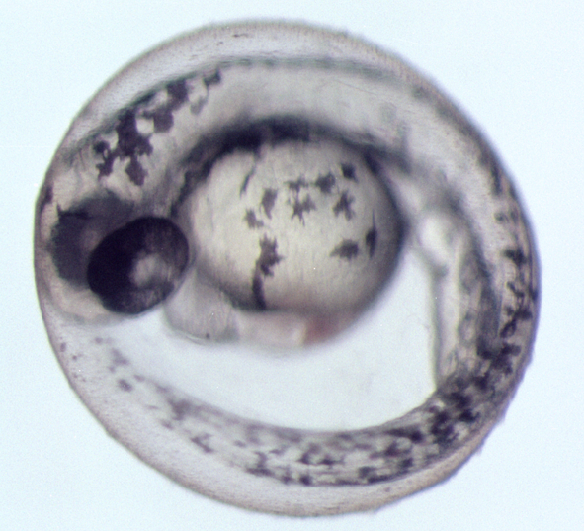
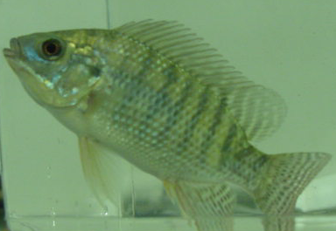
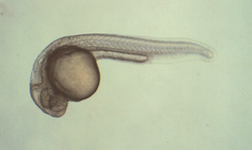
Phases of Aquaculture
Broodstock
Management
Harvest & Market
Hatchery
Production
Grow-out
Nursery
Production

Slide 11
Aquaculture Systems
Open
Netpens, cages, longlines, bottom culture
Semi-closed
Ponds, raceways, tanks
Closed
raceways, tanks

Slide 12
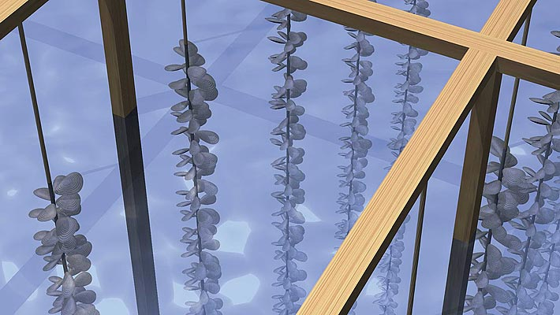
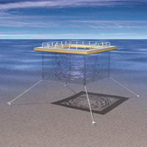
Aquaculture systems: Open
Organisms are reared in natural systems
No diversion or pumping of water
Floating netpens, floating racks, longlines, on-bottom culture

Slide 13
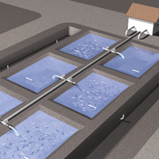
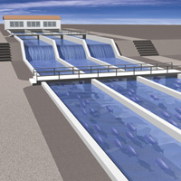
Aquaculture systems: Semiclosed
Organisms are reared in manmade impoundments
Water is diverted from natural flows or pumped
Examples are ponds and raceways

Slide 14
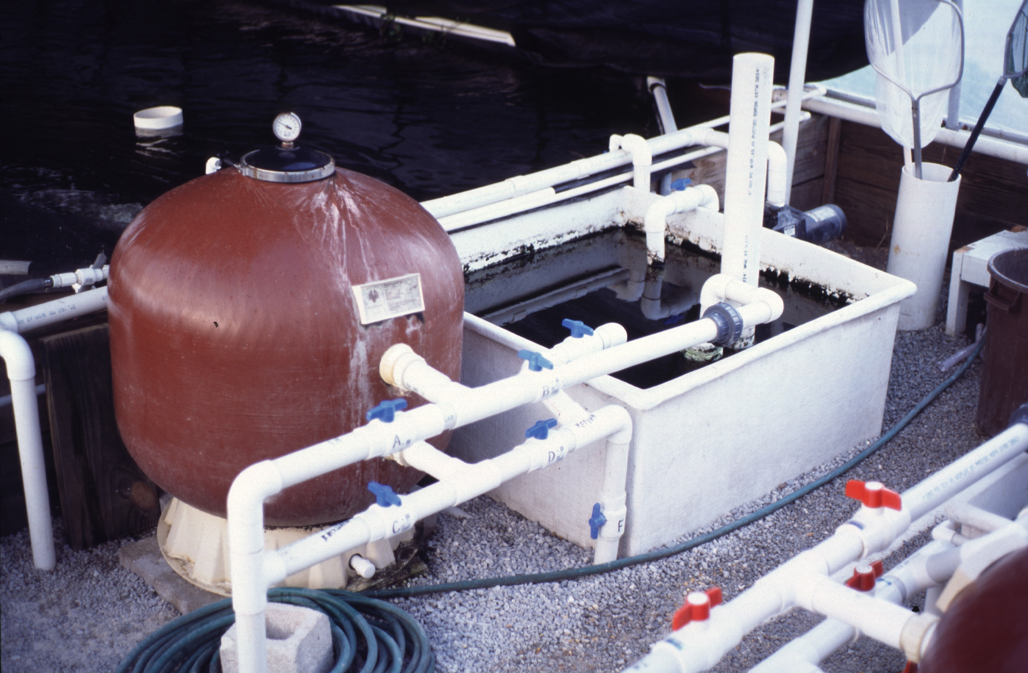
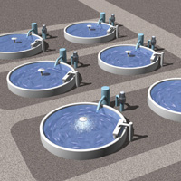
Aquaculture systems: Closed
Water is reused - little or no effluent
Sophisticated water filtration and treatment
Recirculating aquaculture systems, aquariums
Photograph by HBOI

Slide 15
Water Systems
Flow-through: one time use of water
Recirculation: reuse of water

Slide 16
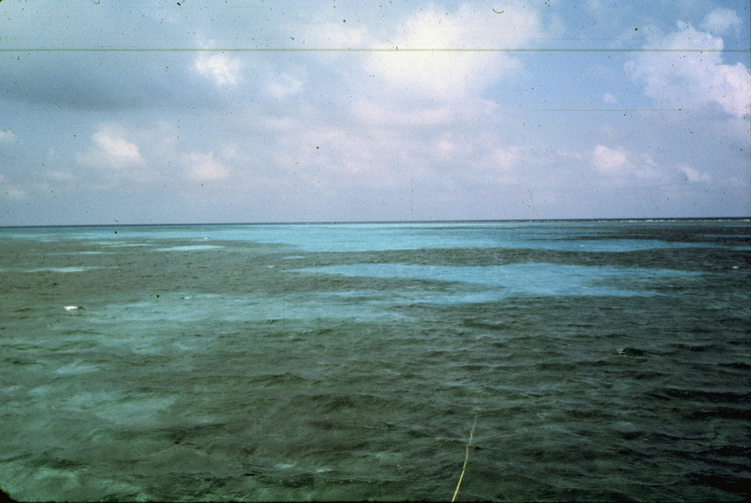
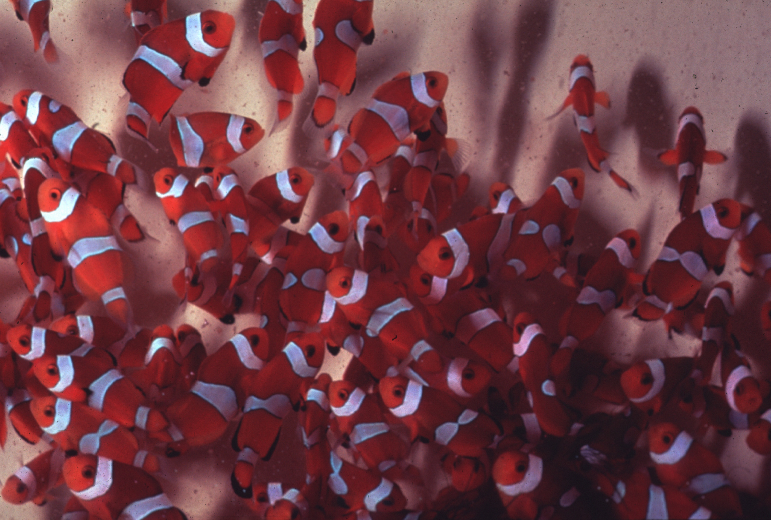
Aquaculture systems: Flow-through
Pretreatment
Water
Source
Effluent
Rearing
Tank
Photographs by HBOI

Slide 17
Flow-through aquaculture systems
Advantages
Lower cost
Simplicity
Provides ambient food
Requires lower skill level
Disadvantages
No environmental control
Source of contaminants, pollutants
Greater regulatory constraints

Slide 18
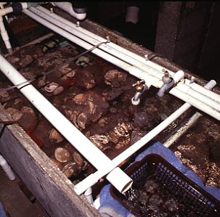
Aquaculture systems: Recirculating
Water
Source
Post treatment
Effluent
Pretreatment
Water treatment
Biofiltration
Disinfection
Rearing
Tank

Slide 19
Recirculating aquaculture systems
Advantages
Environmental control
Free of outside contaminants
Fewer regulatory constraints
Disadvantages
Higher costs
Higher skill level
Complex system, potential problems
Must provide all feed
Buildup of toxins & pathogens

Slide 20
Methods of Cultivation Extensive vs. Intensive
Extensive =
Utilize natural productivity
Low density
No or supplemental feeds
Low water exchange
Intensive =
Maximize production
Limited space
High density
Complete diet
High water exchange

