Slide 1
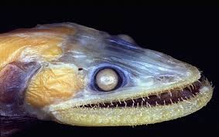
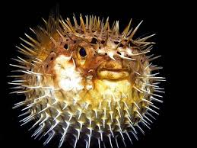
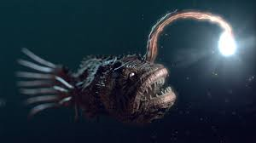
Adaptations to
Marine Life

Slide 2
What does an organism need to survive?
Oh Fish!!

Slide 3
Biodiversity
Biological diversity, or biodiversity, refers to the variety of species and ecosystems on Earth and the ecological processes that they are a part of.
The three components of biodiversity include ecosystem diversity, species diversity and genetic diversity.
High levels of biodiversity increase an ecosystem’s resilience and resistance to natural and human influenced disturbances.
Biodiversity also provides countless ways for life to adapt to changing environmental conditions.

Slide 4
Adaptations of Marine Organisms
Adaptation is an evolutionary process whereby an organism becomes increasingly well suited to living in a particular habitat.
It is not a quick process! Natural Selection over many generations results in helpful traits becoming more common in a population.
Adaptation is also a common term to describe these helpful or adaptive traits.
  In other words, an adaptation is a feature of an organism that enables it to live in a particular habitat.

Slide 5
Types of Adaptations
Marine organisms have adapted to the great diversity of habitats and distinctive environmental conditions in the marine environment.
Adaptations are many and varied but they are generally grouped into 3 main categories:
  Structural
  Physiological
  Behavioural

Slide 6
Structural Adaptations
Structural adaptations are the physical features of the organism.
These include things you can see, like its shape or body covering, as well as its internal organisation.
Example: Bivalves are filter feeders, they have adapted specialized siphon structures that filter the organisms from the surrounding water.

Slide 7
Physiological Adaptations
Physiological adaptations relate to how the organism’s metabolism works.
These adaptations enable the organism to regulate their bodily functions, such as breathing and temperature, and perform special functions like excreting chemicals as a defence mechanism.
Example: Whales migrate over large distances and may spend time in a combination of arctic, tropical and temperate waters.
  To cope with these temperature changes, they are endothermic or ‘warm blooded’, meaning they are able to maintain a constant body temperature that is not dependent on the surrounding water.

Slide 8
Behavioural Adaptations
Behavioural adaptations are learned or inherited behaviours that help organisms to survive.
Example: Bryozoans are tiny animals that band together to aid in finding food and to survive predation.

Slide 9
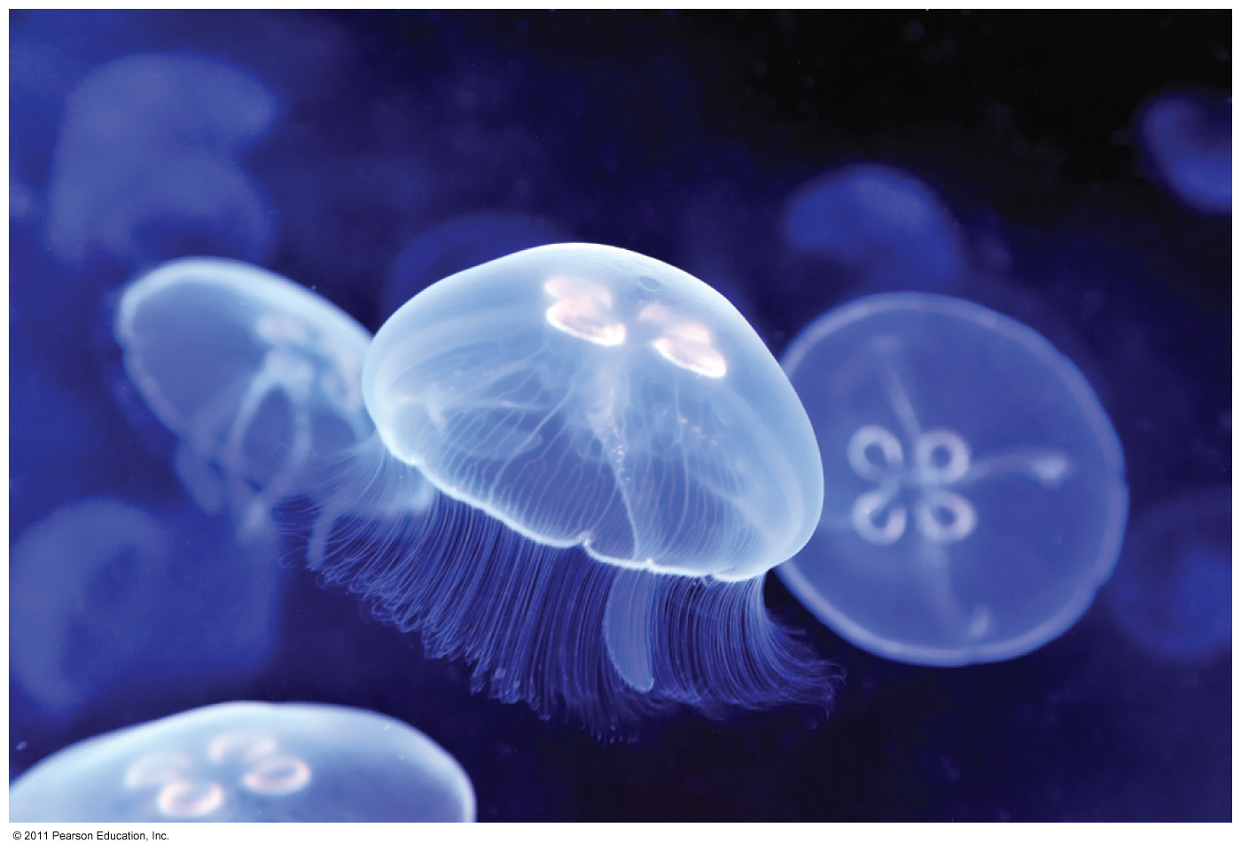
Water’s Transparency
Many marine organisms see well.
Some marine organisms are nearly transparent.
  Elude predators
  Stalk prey

Slide 10
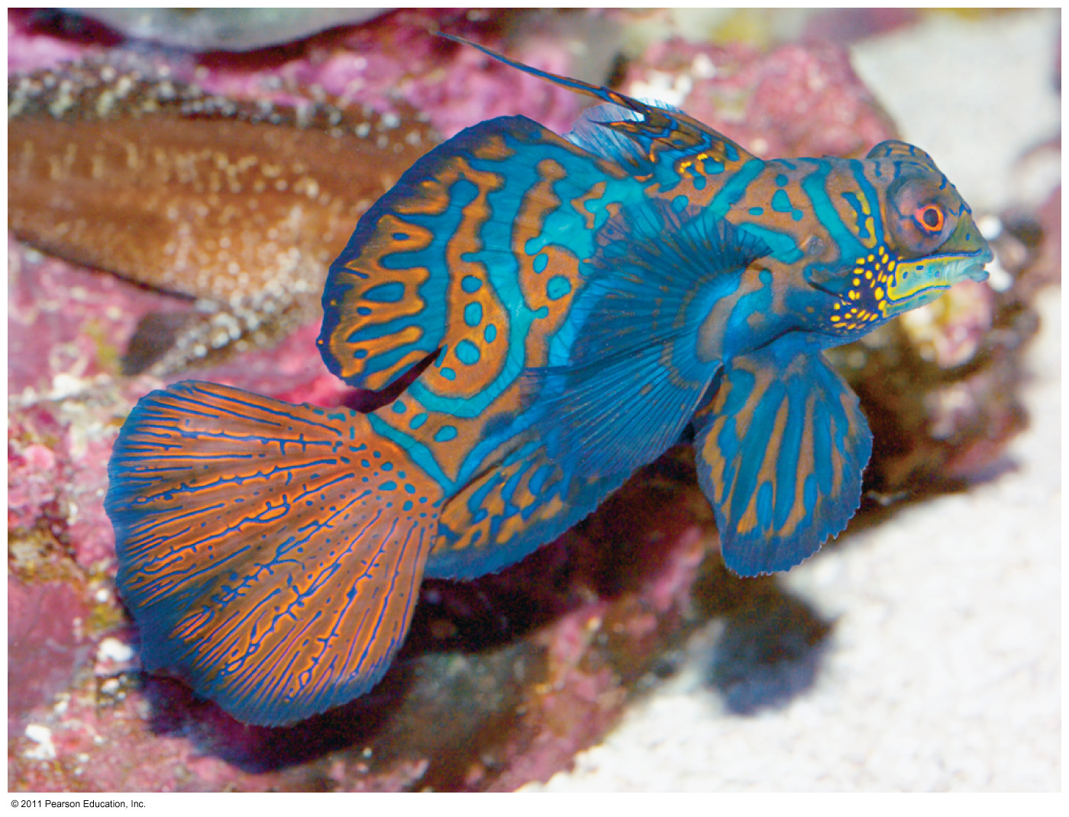
Adaptations to Marine Environment
Camouflage through colour patterns
Countershading – dark on top, light on bottom
Disruptive colouration – large bold patterns, contrasting colours make animal blend into background

Slide 11
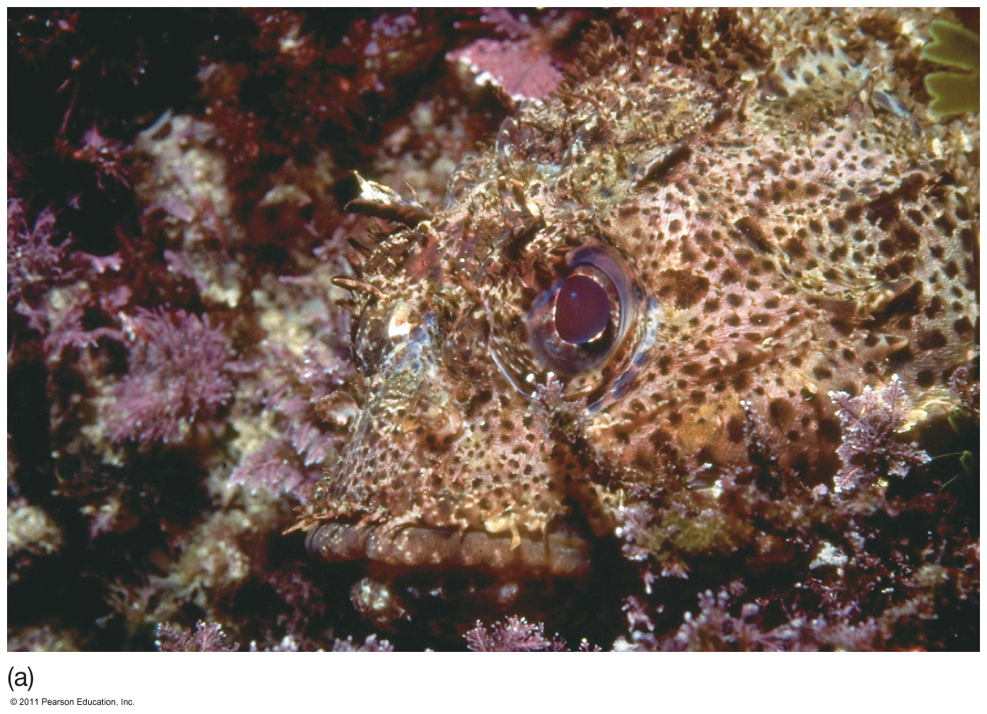
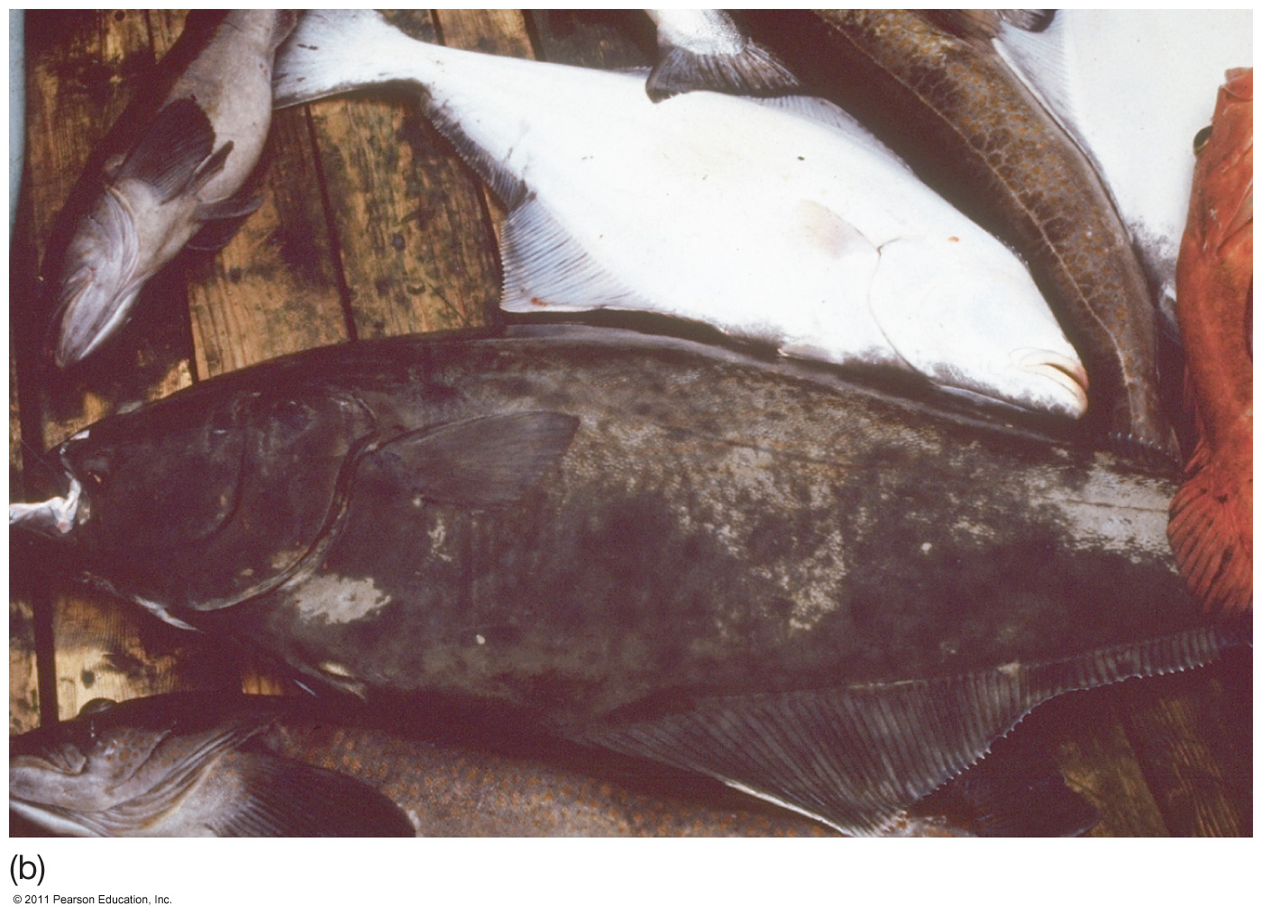
Camouflage and Countershading

Slide 12
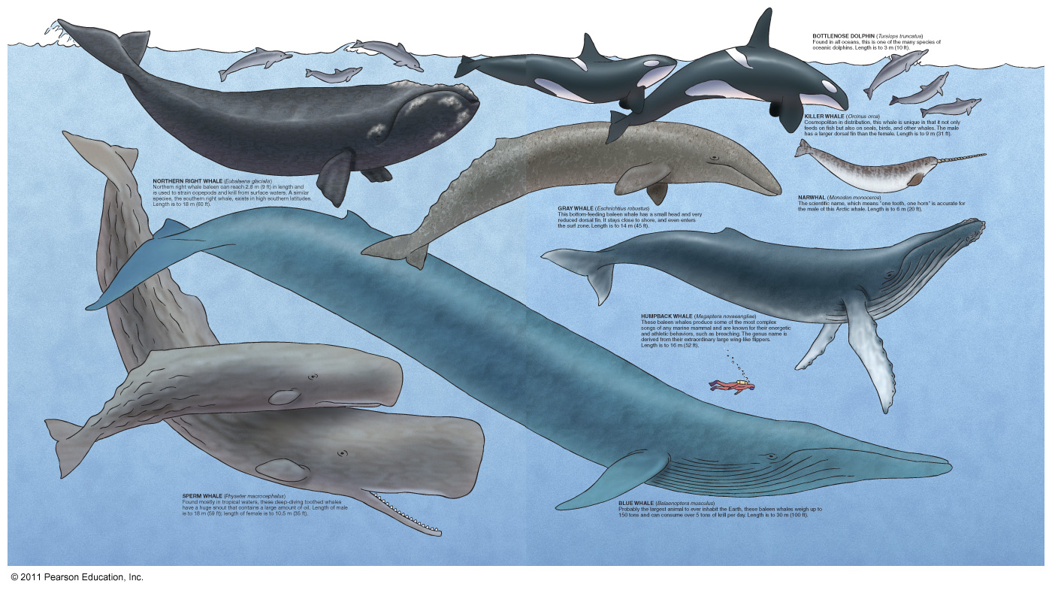
Water Pressure
Many marine organisms – no inner air pockets
Collapsible rib cage (e.g., sperm whale)

Slide 13
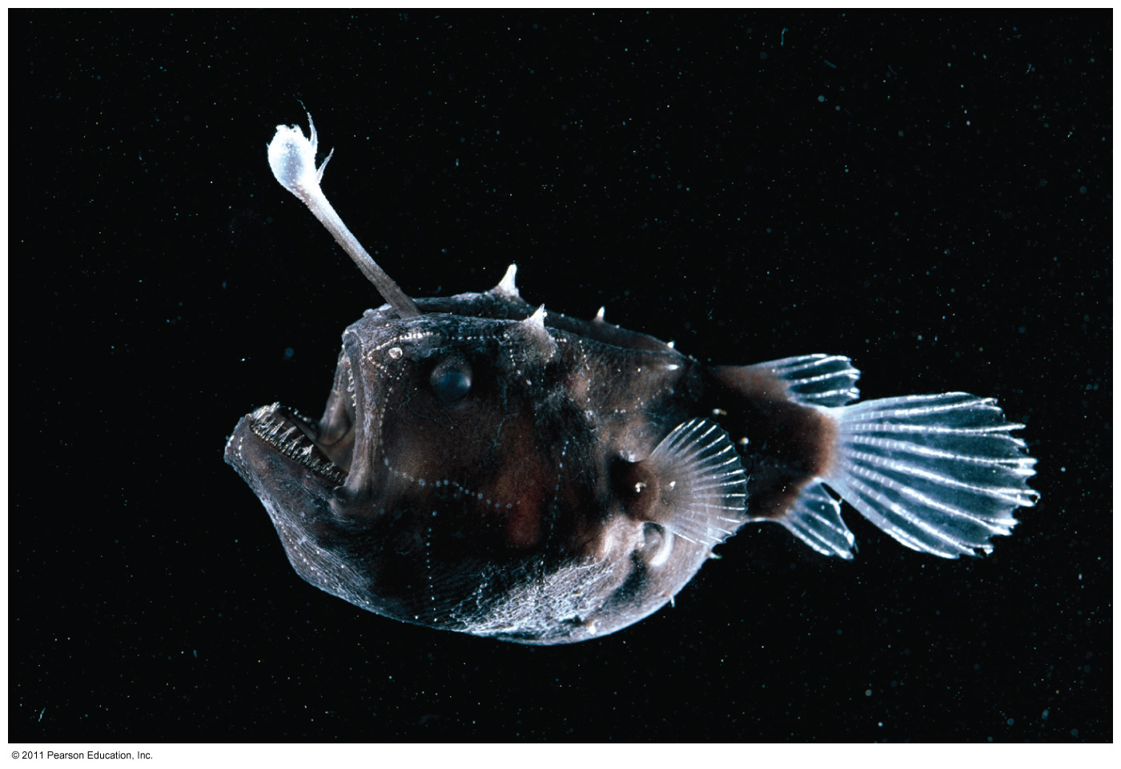
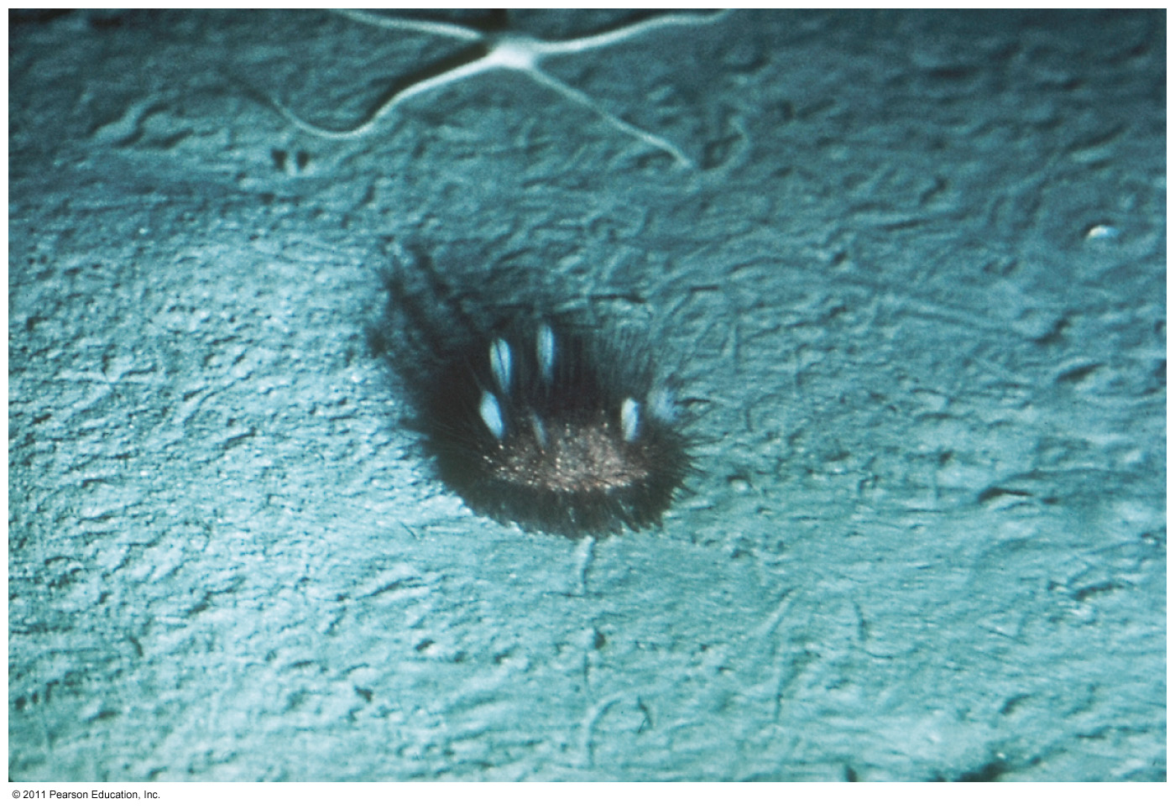
Organisms of the Deep

Slide 15
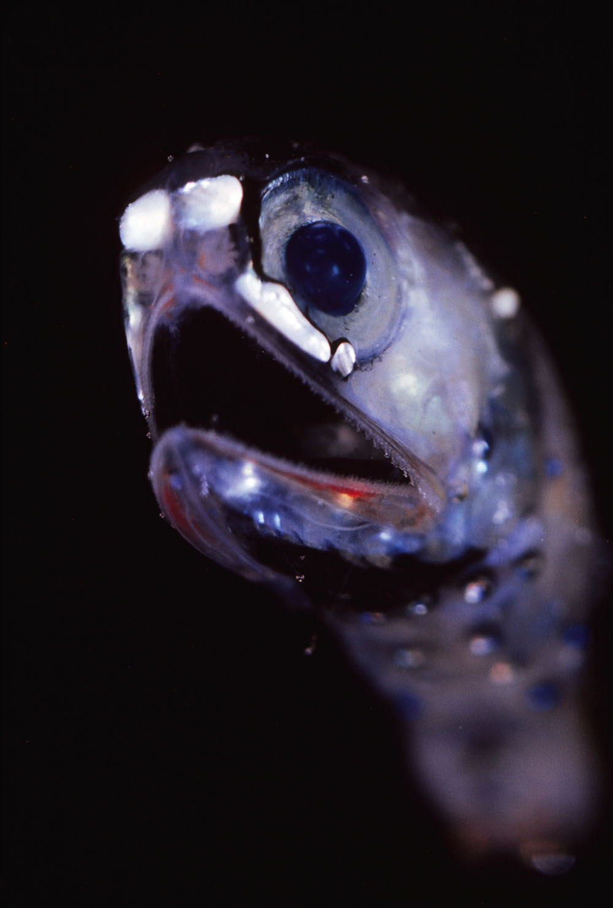
Notes:
Figure 16.15 A bioluminescent mesopelagic lanternfish. Large light-producing organs on the body mask the fish’s shadow and may identify it to potential mates. This fish is 8 centimeters (3.5 inches) long.

Slide 16
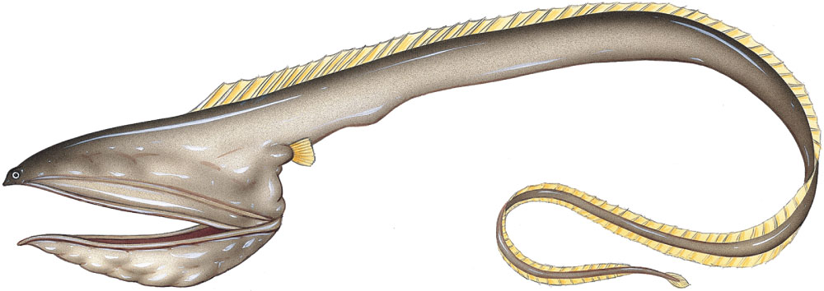
Notes:
Figure 16.16 The deep-sea gulper eel (genus Eurypharynx), a bathypelagic species with a worldwide distribution beneath tropical waters. Its length is about 60 centimeters (24 inches). (From J. C. Briggs, Marine Zoogeography. © 1974 McGraw-Hill, Inc. Reprinted with permission of the McGraw-Hill Companies, Inc.)

Slide 17
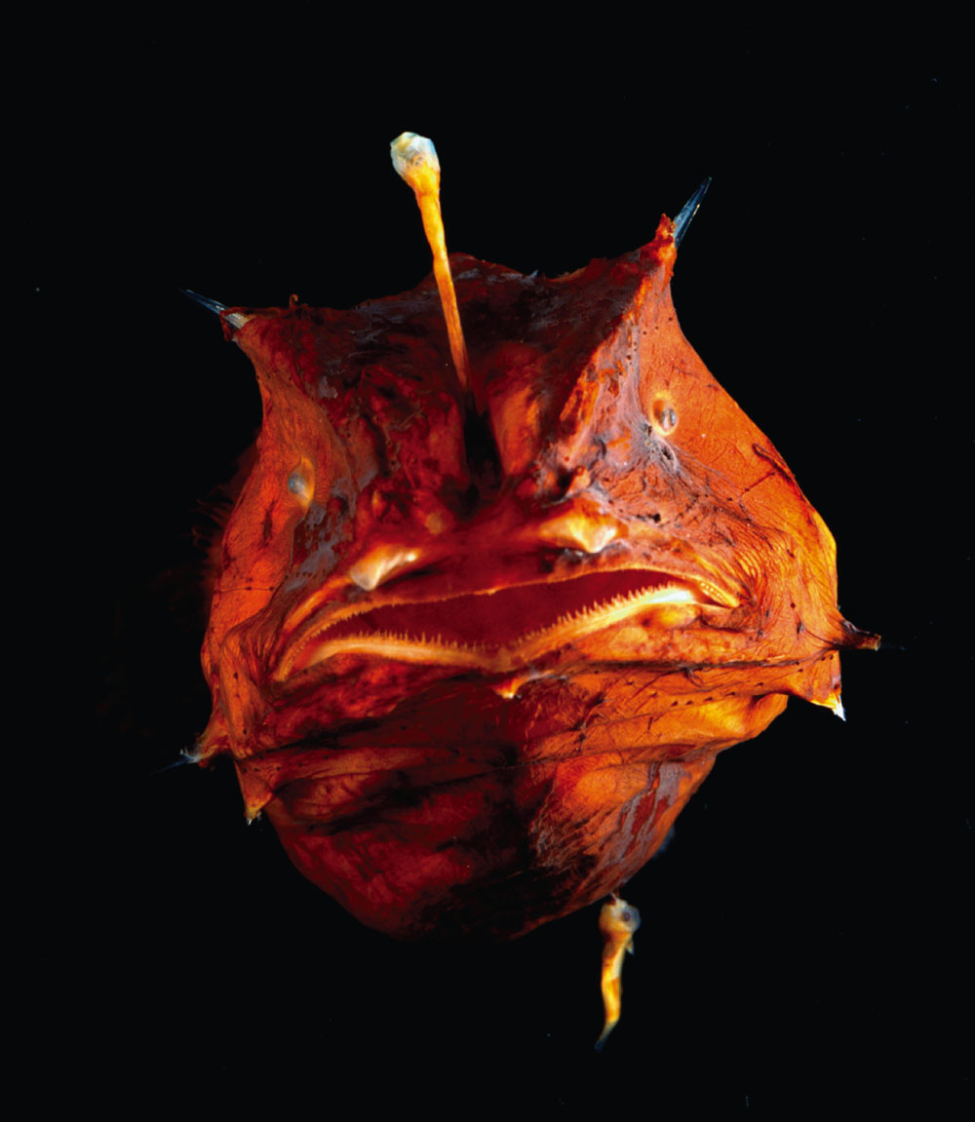
Notes:
Figure 16.17 Some species of deep-sea anglerfishes have bioluminescent lures. This fish is about 10 centimeters (4 inches) long.

Slide 18
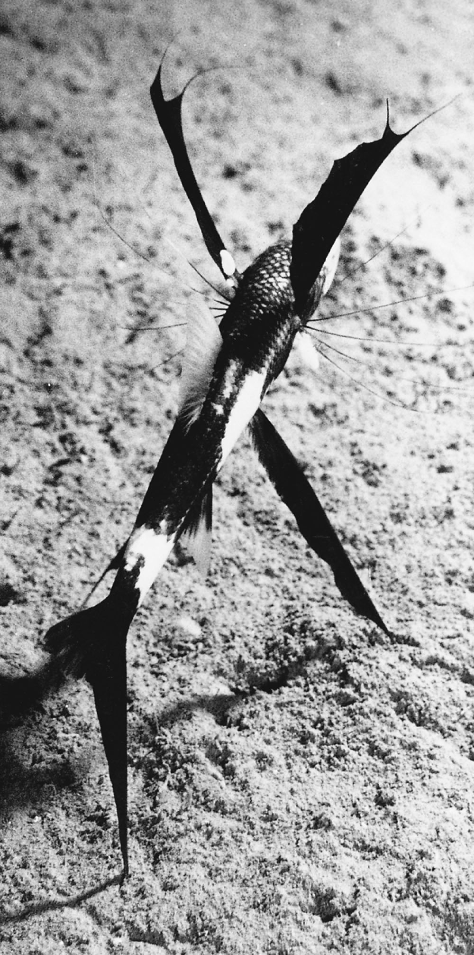
Notes:
Figure 16.18 A blind tripod fish, an abyssal benthic species. The long, curved projections on the fish’s fins and gills are thought to aid in sensing the distant vibrations of prospective prey.

Slide 19
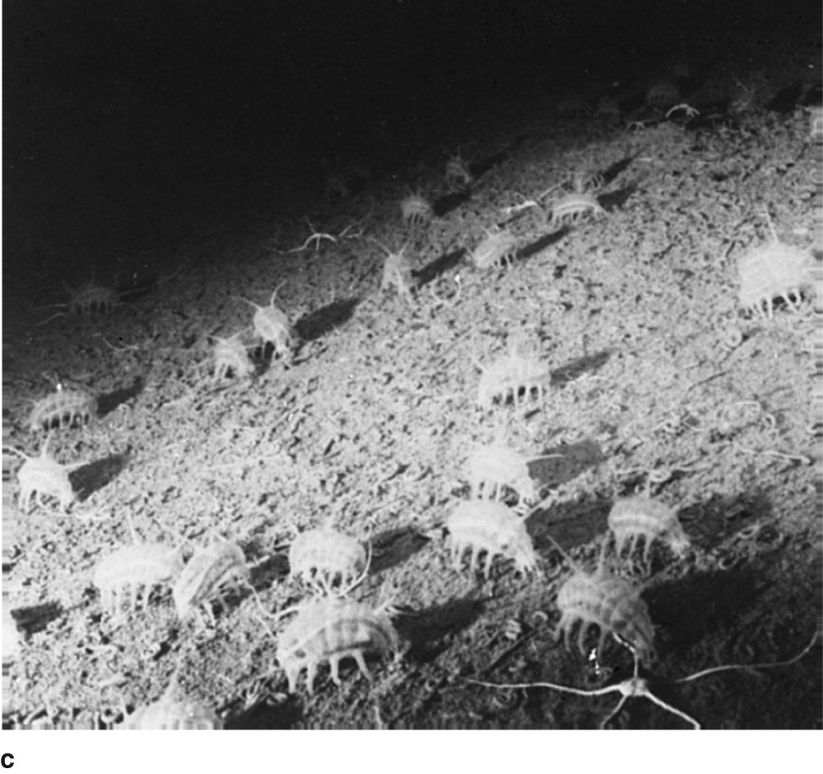
Notes:
Figure 16.19 Abyssal benthic animals. (From J. C. Briggs, Marine Zoogeography. © 1974 McGraw-Hill, Inc. Reprinted with permission of the McGraw-Hill Companies, Inc.)

Slide 20
Fashion a Fish
You are going to create a new species of marine organism!
Task:
You will creating a picture of your new organism (you MUST colour it!)
Your organism must have at least one adaptation (structural, physiological or behavioural).
Once you have completed the picture answer the questions.

Slide 21
Fashion a Fish
Write a complete paragraph explaining the attributes of the fish you have designed. You must identify and describe the adaptation and explain the significance of the adaptation in the fish’s survival.
Do you believe your fish would survive in the “real world”, or ocean? Explain why or why not.
Describe the advantages to the fish’s adaptations. Are there any disadvantages or negative effects of the adaptation?
Explain why biodiversity is important for ecosystem survival.
Explain how biodiversity is affected by adaptations within a species and why adaptations are important to animal survival.
Name two fish adaptations in each of the following categories: mouth, shape, coloration, and reproduction. Describe the advantages of each of these adaptations to the survival of the fish in their habitats.

